Slide 1
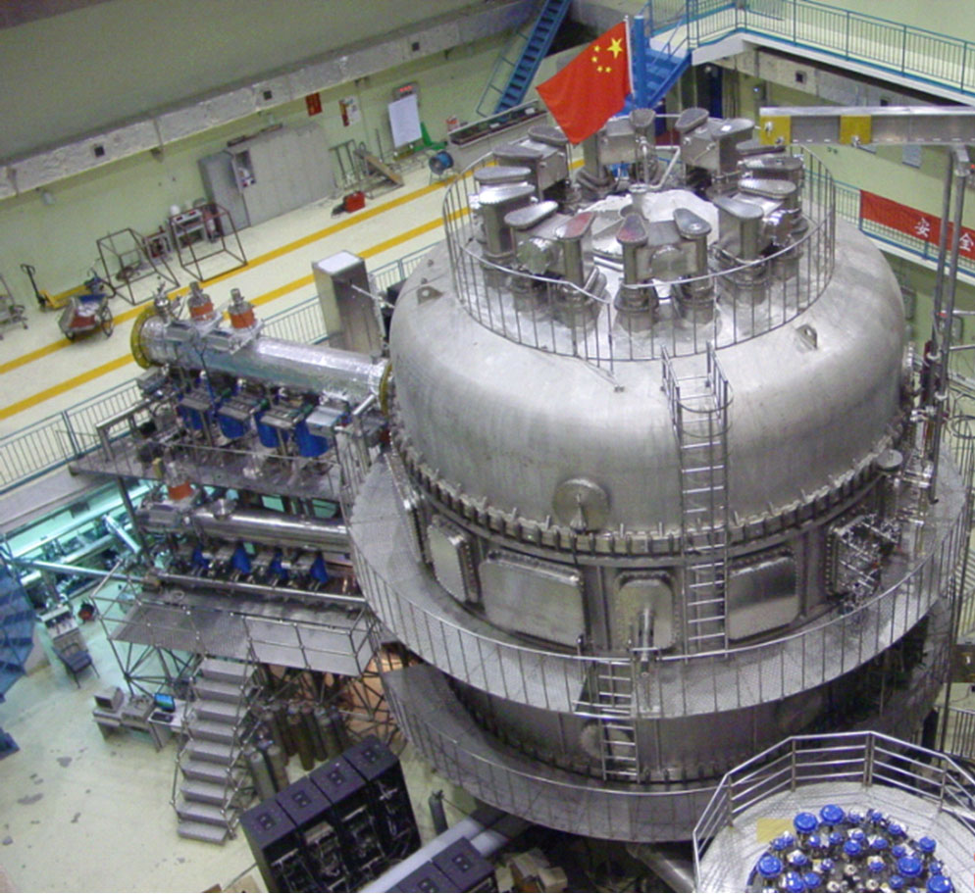
Evidence of Zonal-Flow-Driven Limit-Cycle Oscillations during the L-H Transition and at H-mode Pedestal in EAST
Guosheng Xu¹, H.Q. Wang¹, S.C. Liu¹, L.M. Shao¹, B.N. Wan¹, H.Y. Guo¹, P.H. Diamond², G.R. Tynan², M. Xu², N. Yan^{1,3}, V. Naulin³, A.H. Nielsen³, H.L. Zhao⁴, T. Lan⁴, N. Fedorczak², P. Manz², R. Chen¹, W. Zhang¹, L. Wang¹, B. Cao¹
¹Institute of Plasma Physics, Chinese Academy of Sciences, Hefei, China
²UCSD, 9500 Gilman Drive, La Jolla, California 92093, USA
³Association EURATOM DTU, Risø Campus, Roskilde, Denmark
⁴Department of Modern Physics, USTC, Hefei, China
E-mail: gsxu@ipp.ac.cn

Slide 2
Outline
Introduction
New diagnostics for transition on EAST
Evidence of LCO during L-I-H transition
Small-amplitude LCO prior to transition
Observation of LCO at H-mode pedestal
Summary

Slide 3
Outline
Introduction
New diagnostics for transition on EAST
Evidence of LCO during L-I-H transition
Small-amplitude LCO prior to transition
Observation of LCO at H-mode pedestal
Summary

Slide 4
Physics behind the L-H transition
New information on the L-H transition has been obtained in the EAST superconducting tokamak by applying newly-developed two gas-puff-imaging (GPI) systems and two reciprocating Langmuir probe systems near the transition power threshold.
<V_{E×B}>′
Turbulence
Kinetic Energy
Zonal flows
Kinetic energy transfer is controlled by the E×B shear due to tilting of turbulent eddies.
E×B flow is the leading-order guiding center flow.
Equilibrium flow: balanced by ion diamagnetic term in the radial force balance
Slow timescale: of ms (local transport time)
lock in the transition
Predator:
m,n = 0,0
E_{r}×B flow
Zonal flow: turbulence driven
Fast timescale: tens of μs (decorrelation time)
mediate the transition

Slide 5
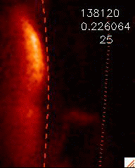
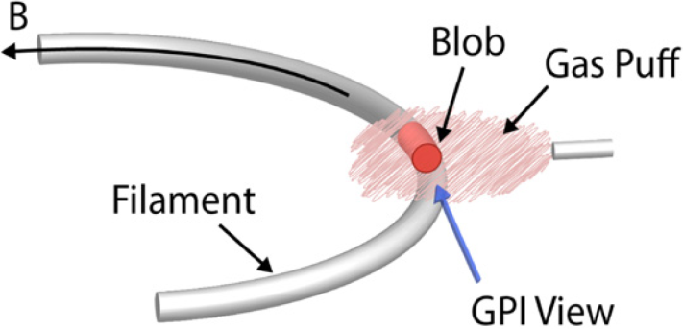
Different flow diagnostics at plasma edge
GPI or BES: 2D imaging, time-delay estimation (TDE)
Doppler reflectometry: Doppler shift of incident wave
Charge-exchange spectroscopy: Doppler shift of emission lines
fluid velocity. It contains diamagnetic velocity which is not a real guiding center velocity
E_{r} is estimated from the radial force-balance equation for a single-ion species
Langmuir probe: direct measurement of E_{r} by calculating the radial potential difference between two points.
group velocity of
structure motion

Slide 6
Outline
Introduction
New diagnostics for transition on EAST
Evidence of LCO during L-I-H transition
Small-amplitude LCO prior to transition
Observation of LCO at H-mode pedestal
Summary

Slide 7
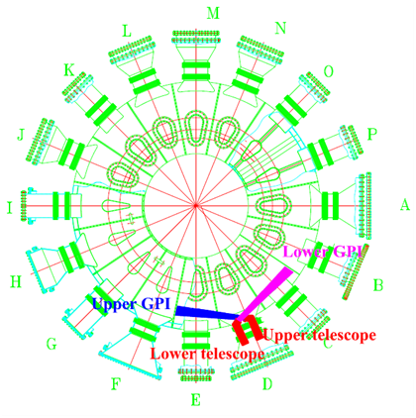
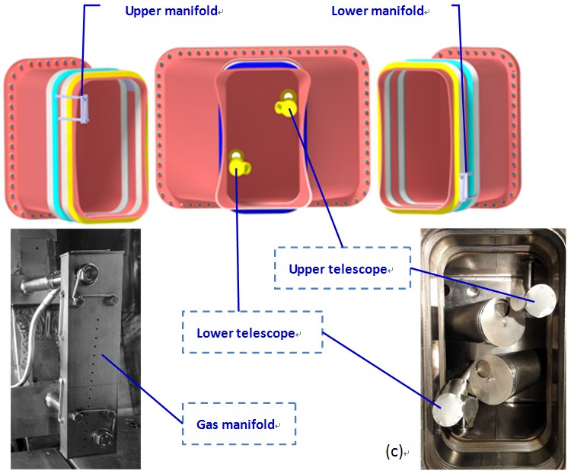
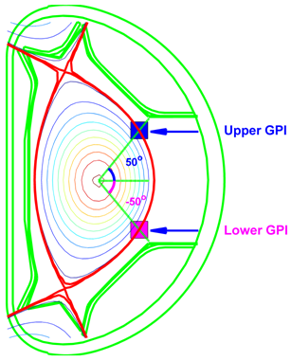
New gas-puff-imaging systems on EAST
Two GPI systems separated toroidally by 67° and poloidally by ~100°, up-down symmetrical about the midplane.
HeI line emission at 587.6 nm, 13×13 cm square area
400 kHz frame rate, 64×64 pixels with 12-bit dynamic range.

Slide 8
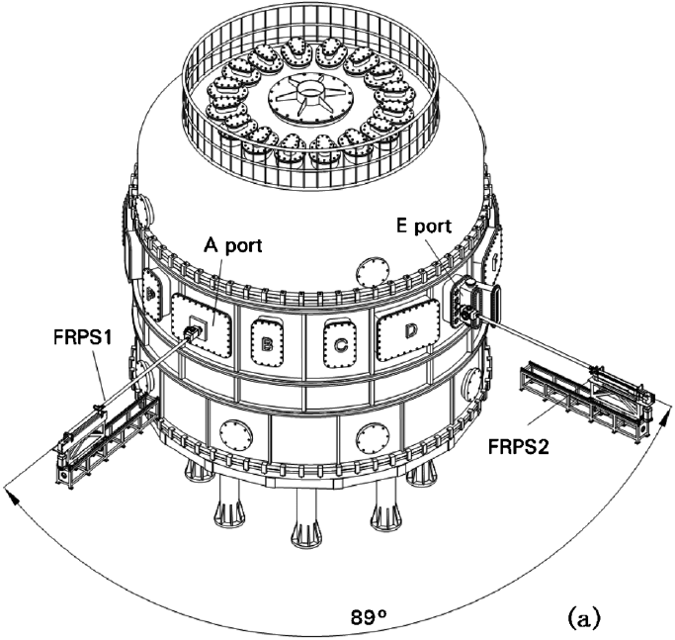
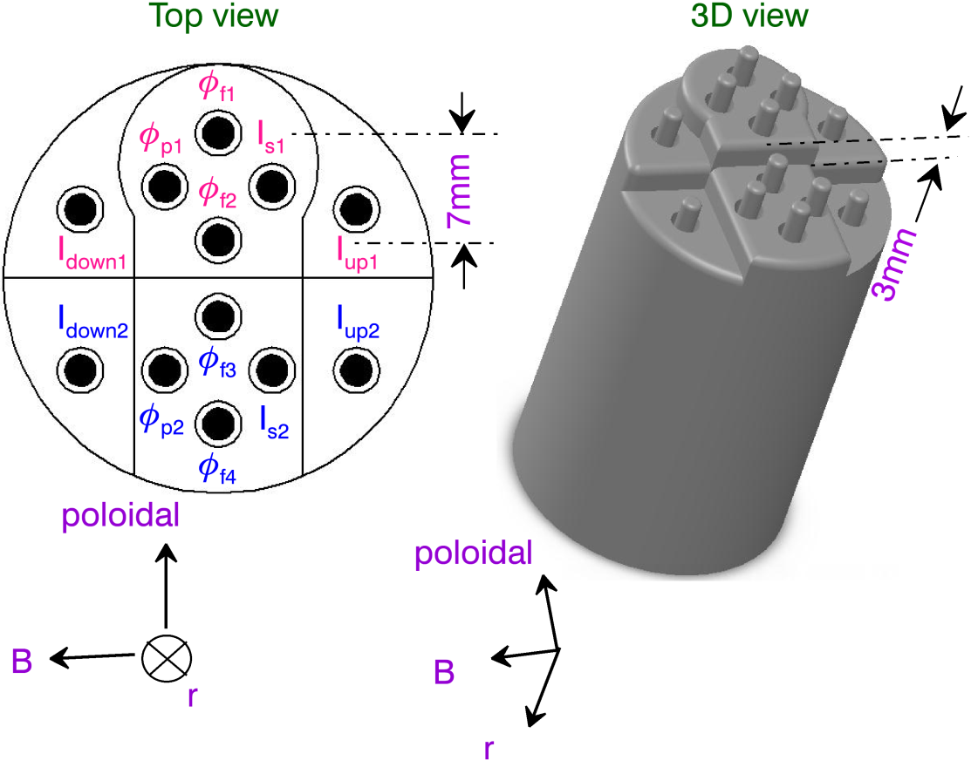
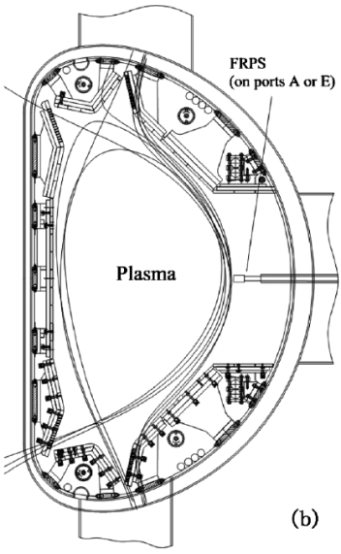
Reciprocating probe systems on EAST
Two reciprocating Langmuir probes, separated toroidally by 89°, inserted through horizontal ports at the outer midplane.
A specifically designed multi-tip probe array provides measurements of n_{e}, T_{e}, p_{e}, φ_{p}, Γ, and v|| at two radial positions spaced by 3 mm.

Slide 9
Outline
Introduction
New diagnostics for transition on EAST
Evidence of LCO during L-I-H transition
Small-amplitude LCO prior to transition
Observation of LCO at H-mode pedestal
Summary

Slide 10
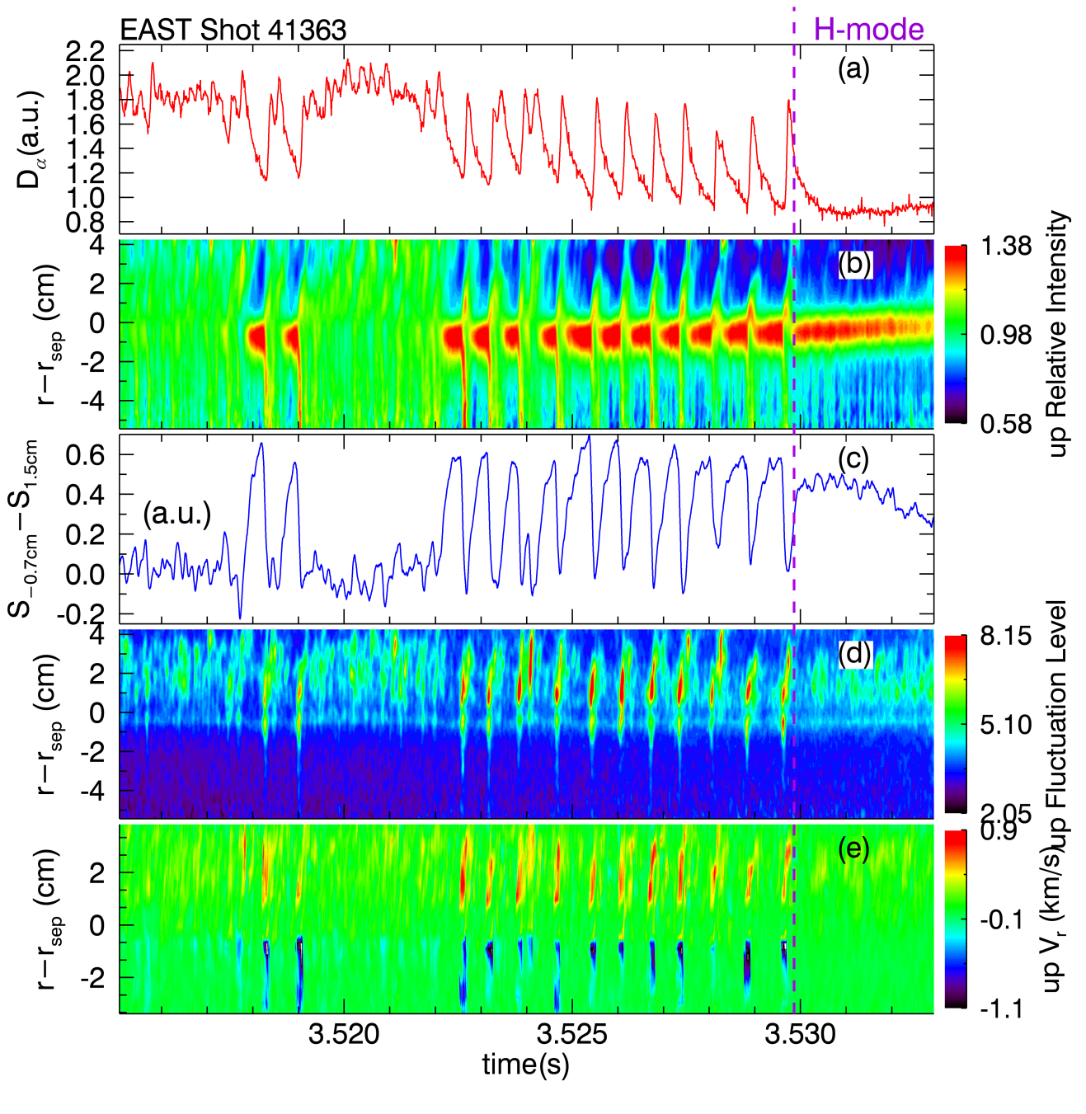
GPI measurement of dithering L-H transition
The decay phase in Dα (typically of 500 μs ~ timescale of SOL parallel loss τ|| = L||/M||C_{s}) is apparently much longer than the growth phase (~100 μs).
During quiet periods, the radial transport is blocked due to suppressed turbulent level.
Quiet period is terminated by a sudden outburst of turbulence.
Enhance radial transport and flatten the GPI emission profile.
The outburst originates from the vicinity of the separatrix with clear wave fronts propagating outward into the far SOL and inward deeply into the plasma.

Slide 11
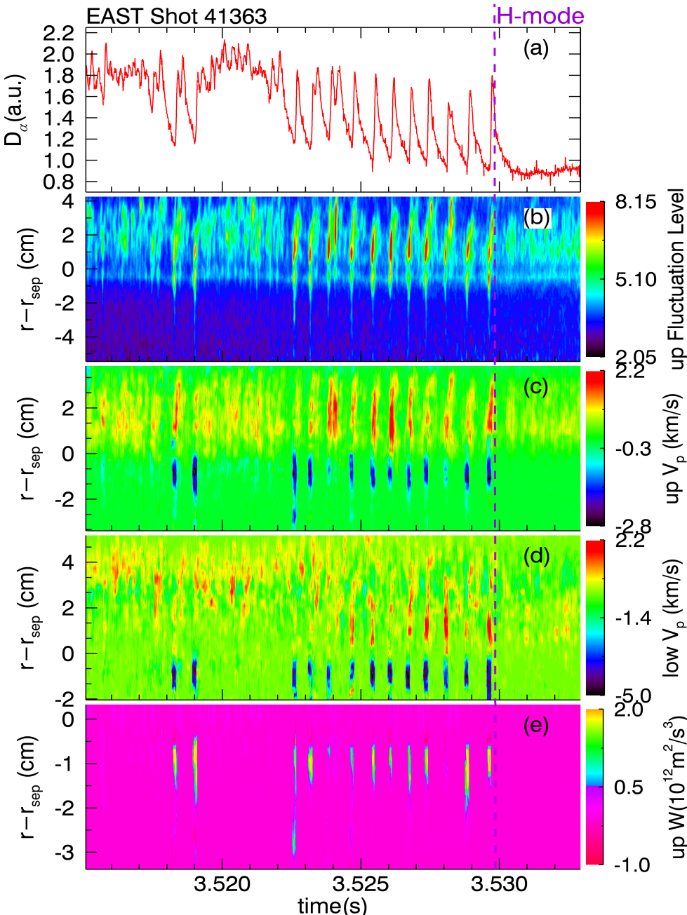
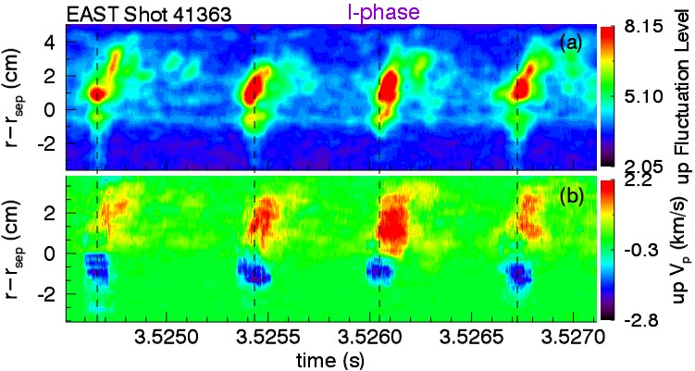
Zonal flows are driven by turbulent outbursts
Zoom in ⇒
The Reynolds work clearly demonstrates energy transfer from turbulence to zonal flows during the turbulent outbursts.
Turbulence is suppressed as its kinetic energy has been released and its driving force - the local pressure gradient - has been weakened.
Subsequently, zonal flows die away as their energy supply - the turbulence - has declined.

Slide 12
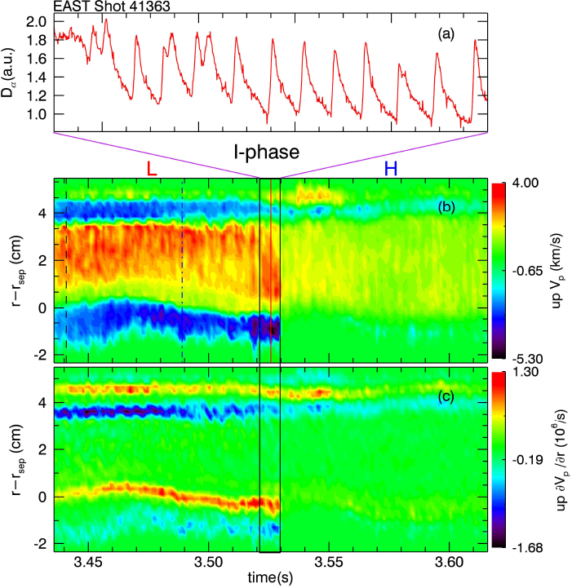
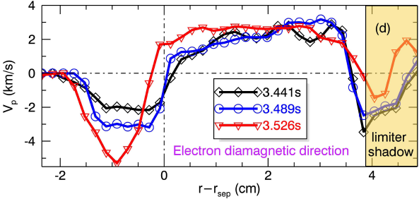
Equilibrium flow shear locks in the transition
The flow and flow shear increase slowly over tens of ms as approaching the L-H transition.
Finally terminates the I-phase and locks in the transition.
Equilibrium E×B flow: balanced by ion diamagnetic term in the radial force balance equation.
Electron diamagnetic direction

Slide 13
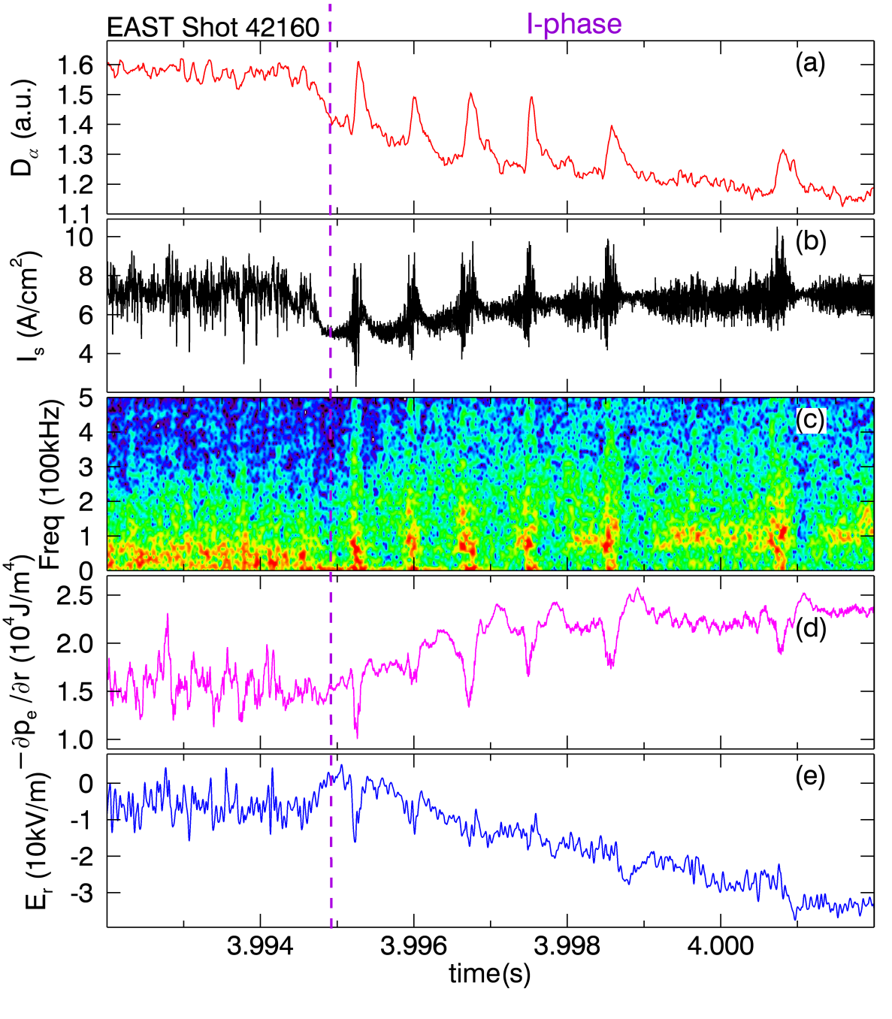
Probe measurements of LCO near separatrix
During I-phase, equilibrium E×B flow builds up due to an accumulation of ∇p at plasma edge, indicating that the confinement is progressively improved.
∇p is periodically weakened by the turbulent outbursts, but recovers quickly.
The duration of quiet period extends progressively with increasing equilibrium flow.
Fluctuation levels reach minimum just following the turbulent outburst, then recover slowly during quiet period before next outburst.
Small-amplitude dithering cycles frequently appears prior to the I-phase.

Slide 14
Transition direction is controlled by equili-flow
At marginal heating power, sometimes I-phase transitions back to L-mode as the equilibrium E×B flow is reduced instead of enhanced.
L-mode I-phase L-mode
Measured by Langmuir probe near separatrix

Slide 15
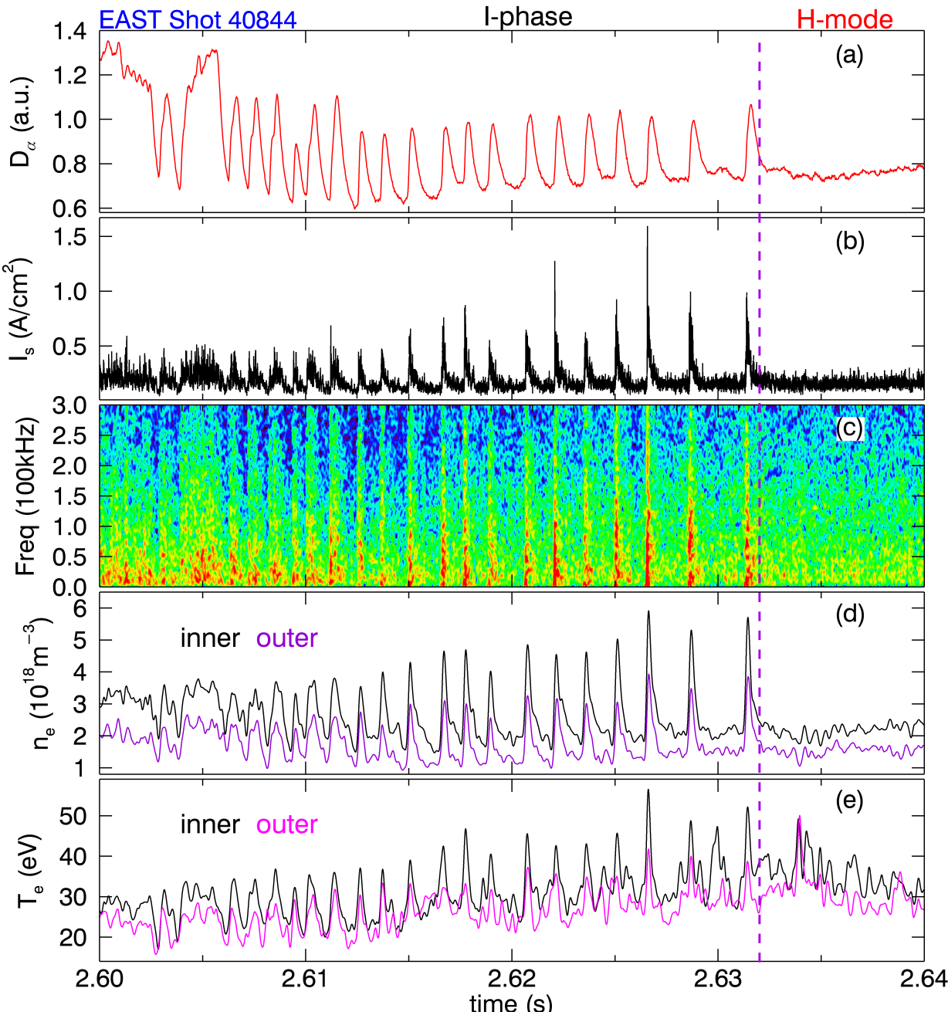
Probe measurements of LCO transition in SOL
Probe measurements generally confirm the GPI observations.
During I-phase, the turbulent outbursts periodically expel particles and heat into the SOL, generating positive pulses in n_{e} and T_{e}, behaving like ELMs.
The pulse amplitude appears to be smaller at a radial position away from the separatrix, suggesting that the perturbations originate from the separatrix.

Slide 16
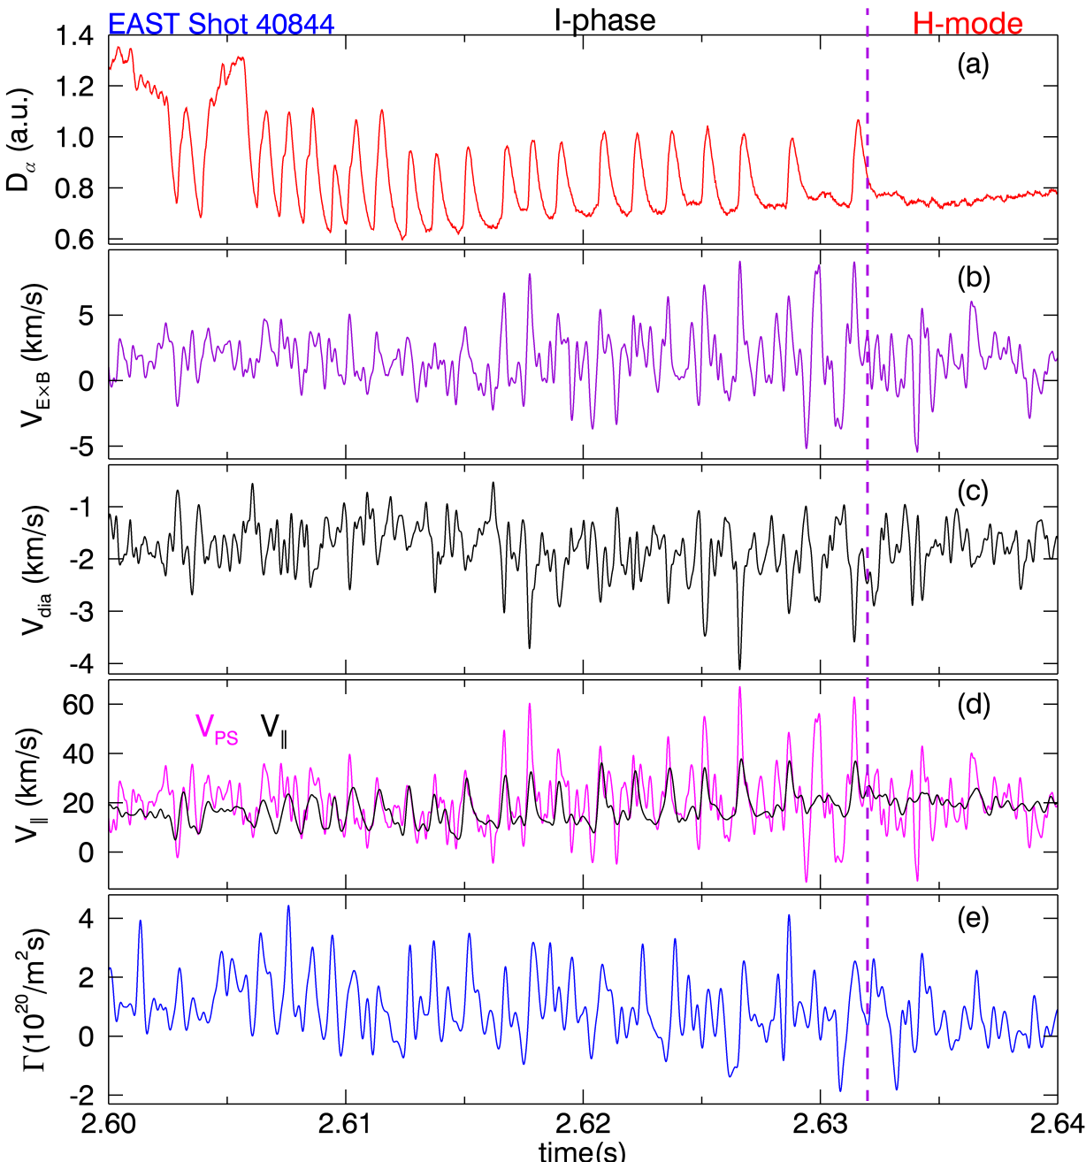
Probe measurements of LCO transition in SOL
In the SOL, significant E×B flow and ion diamagnetic flow in the ion diamagnetic direction and parallel flow in the cocurrent direction are driven by the turbulent outbursts.
The parallel velocity measured by the Mach probe is found to be consistent with the Pfirsch-Schlüter flow very well, which may suggest that the parallel flow at the outer midplane is dominated by the Pfirsch-Schlüter flow.

Slide 17
Outline
Introduction
New diagnostics for transition on EAST
Evidence of LCO during L-I-H transition
Small-amplitude LCO prior to transition
Observation of LCO at H-mode pedestal
Summary

Slide 18
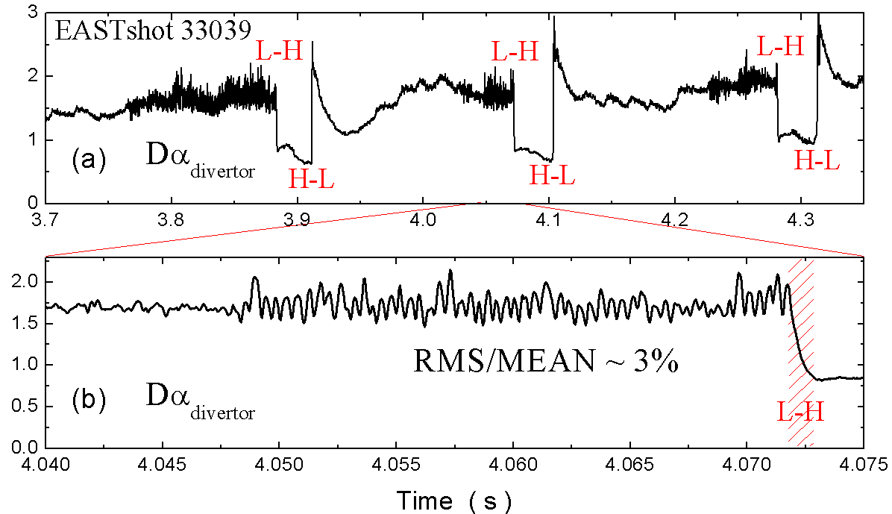
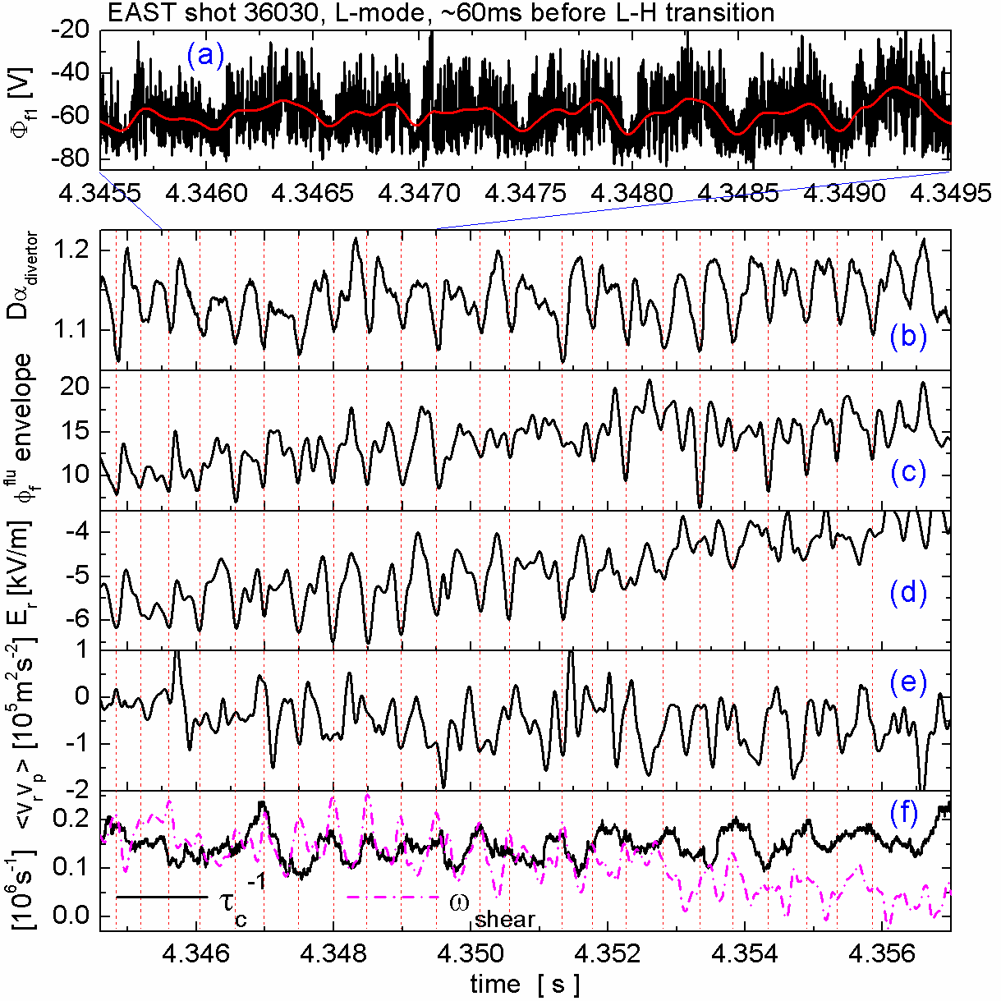
Small-amplitude LCO prior to L-H transition
Near the power threshold, small-amplitude dithering, characterized by quasi-periodic oscillations at a frequency of < 4 kHz, much lower than the f_{GAM}, frequently appears hundreds of milliseconds before sharp L-H transition or the I-phase, behaving like a transition precursor.
Probe measurements at ~1 cm inside separatrix show clear LCO behavior.
Fluctuations are periodically suppressed when the local E_{r} shearing rate transiently exceeds the turbulence decorrelation rate.
G.S. Xu et al., PRL 107 (2011) 125001

Slide 19
Outline
Introduction
New diagnostics for transition on EAST
Evidence of LCO during L-I-H transition
Small-amplitude LCO prior to transition
Observation of LCO at H-mode pedestal
Summary

Slide 20
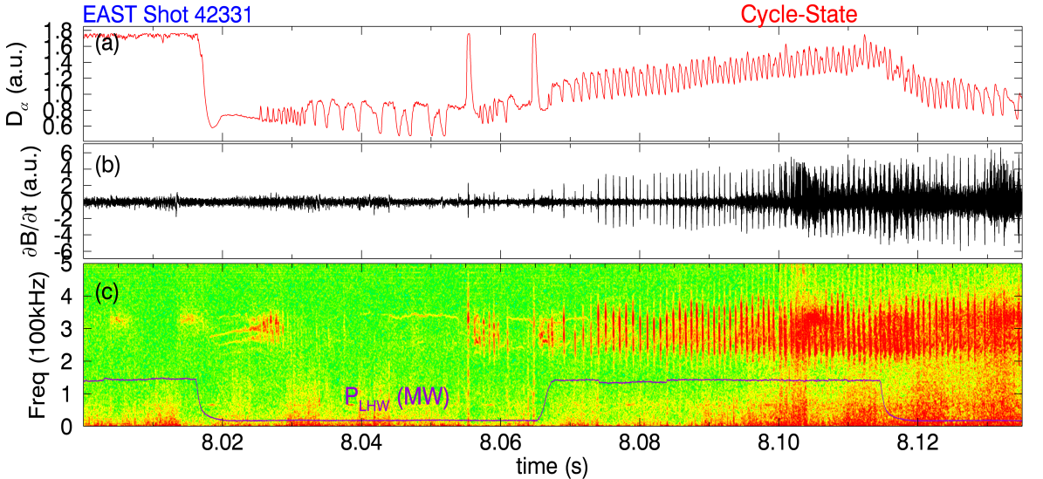
Observation of a LCO state at H-mode pedestal
An oscillation appears shortly after the L-H transitions and also in the inter-ELM phase.
Probe measurements at ~1cm inside separatrix show zonal-flow modulation of a high-frequency-broadband turbulence in the steep-gradient region of H-mode pedestal.
This modulation leads to intermittent transport events across the edge transport barrier, and therefore a modulation in the recycling neutrals near the divertor targets.
EX/P4-06 FEC 2012 H.Q. Wang, G.S. Xu

Slide 21
Outline
Introduction
New diagnostics for transition on EAST
Evidence of LCO during L-I-H transition
Small-amplitude LCO prior to transition
Observation of LCO at H-mode pedestal
Summary

Slide 22
Summary
New information on the L-H transition has been obtained in EAST by applying newly-developed two gas-puff-imaging (GPI) systems and two reciprocating Langmuir probe systems near the transition power threshold. The results strongly support the following physical picture of the L-H transition:
Energy transfer from turbulence to zonal flows is through the Reynolds work which is controlled by the 0,0 E×B shear:
L-H transition is a result of the combined effect of equilibrium flow shear and zonal flow shear. Near transition power threshold, the evolution of equilibrium flow shear is sufficient slow so that a zonal-flow-driven LCO appears.
During I-phase, turbulence is suppressed periodically, thus allowing the equilibrium flow shear to increase slowly and finally lock in the transition.
Small-amplitude LCO frequently appears hundreds of milliseconds before sharp L-H transition or the I-phase, behaving like a transition precursor.
In EAST, the zonal-flow-driven LCO is seen not only preceding the L-H transition, but also in the steep-gradient region of H-mode pedestal, however it interacts with a turbulence of higher frequency.

Slide 23
Thank you very much for your attention!

