Slide 1

Be tile power handling and main wall protection (FTP/2-1Rb)
I Nunes^{1,2}, V Riccardo³, P J Lomas³, P de Vries⁴, G Arnoux³, G Matthews³, K-D Zastrow³, S. Devaux³, T Farley⁵, M Firdaouss⁶, C Reux⁷ and the JET EFDA contributors
Imaging Challenges for the ITER Plasma Facing Components Protection (ITR/2-2Ra)
J-M. Travere¹, M-H. Aumeunier^{1,3}, M. Joanny¹, T. Loarer¹, M. Firdaouss¹, E. gauthier¹, V. Martin¹, V. Moncada¹, L. Marot², D. Chabaud³, E. Humbert³, J-J. Fermé⁴, C. Thellier⁴
Dr Jean-Marcel Travere
CEA/IRFM

Slide 2
OUTLINE
  Introduction
  Design of Be title and experimental validation at JET
  Imaging challenges of the ITER PFCs protection
  Conclusion

Slide 3
INTRODUCTION
  Be and W Plasma Facing Components (PFCs) are a key issue for the next generation of fusion devices
  PFCs will be exposed to :
      Heavy heat load deposits between 5 MW/m² up to 20 MW/m² peak
      Long discharges (hundreds of seconds for ITER)
  Two R&D tasks directly related to these conditions :
      Design of metallic PFCs and metallic tokamak operation
      Efficient metallic PFCs monitoring during plasma discharge
Notes:
Attention : Be titles sont inertielles (pas ITER relevant d’un point de vue composant) mais c’est ITER relevant d’un point de vue operation machine

Slide 4
Be Tile design
Goal : Design of Be tile with good power handling for JET ITER Like Wall experiment
Overall tile shape
Tile assembly :
    Castellations : to reduce thermal stress (hence cracking)
  Blocks and slices dimension : defined by acceptable eddy currents
Shadowing of exposed edges :
  Toroidal facing surfaces:
  Central block allowed exposed wetted height < 40 μm : shadowing not necessary
  Other blocks : shadowed by tile shaping
40μm
~ 0.35mm
See poster for shadowing of toroidally facing edges
Notes:
Rappel Projet JET ITER like WALL : passer des config limiter et divertor Carbone => limiteurs en Be et Divertor en W en modifiant le moins possible la géométrie initiale du JET
Cependant des adaptions ont du être faites compte tenu du changement de materiau (Be)
Optimisation analytique du profil général de la tuile puis travail de détail sur thermal stress, eddy currents et ombrage au niveau des blocks et dans chaque block des castellations
Because of the castellation => shadowing !
Sur les cotes, angles d’incidences plus grands => ombrage nécessaire des castellations les unes par rapport aux autres
Au centre pas nécessaire
Le tout est monté sur un carrier (support) monté par un articulated arm (conséquence sur le design)
Dimensions approx => 30 cm x 10 cm
Important ! : optimisation de l’ombrage

Slide 5
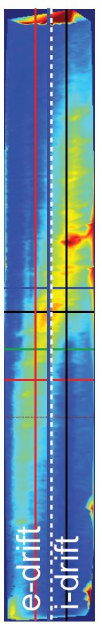
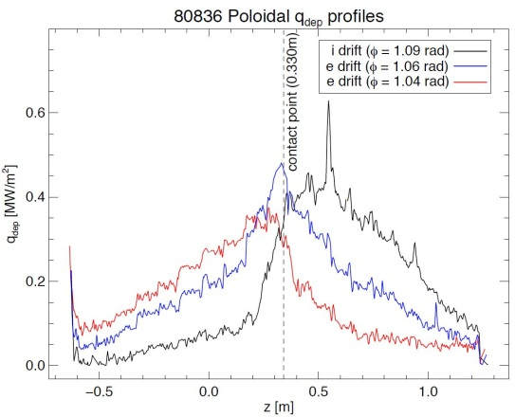
operation of JET ITER like wall (1/2)
Poloidal profiles show similar peak power density on both the i-drift and e-drift side in line with the design
IR image of Be tile of the inner wall
and power deposit on Be tile
| PAGE 5
24th IAEA Fusion Energy Conference 8-13 October 2012 – San Diego - USA

Slide 6
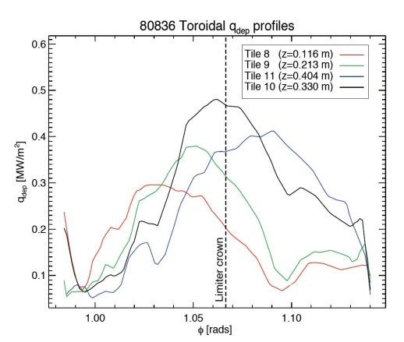
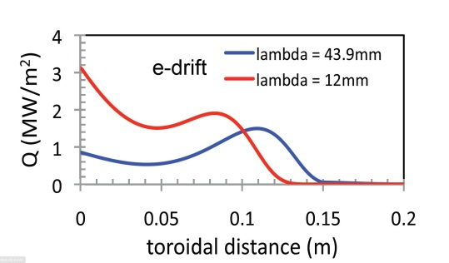
operation of JET ITER like wall (2/2)
Possible contributors being investigated:
  Toroidal misalignment of the limiters
  Uncertainty on true temperature measurements
For Calculations using λ_{q} in the far SOL, expected power density at the apex is a factor 2 larger than measured. If near SOL included discrepancy becomes larger. No peak power density at the wings is observed in the measurements
Systematic difference between expected and measured power density observed for both outer and inner limiters
| PAGE 6
24th IAEA Fusion Energy Conference 8-13 October 2012 – San Diego - USA
Notes:
Manque une slide plus générale qui montre l’interieur du jet avec ILW et où se trouvent les tuiles Be.
Pour opération . Système IR pour monitorer (vue KL7 interne)
Légende : 1 grph horiz toro 2 grp verti polo.
Question : Poloidal profiles show similar peak power density on both the i-drift and e-drift side in line with design. Ça aurait pu être différent ?
Comparaison entre théorie (graphique du bas avec 2 Lq différents : un dépot au centre et un sur le bord coté electronique (e-drift)
Avec graphique exp; (le premier en haut) constat = profil assez différent et max très différent
IMPORTANT : expliciter Possible contributors being investigated
Observations vraies aussi pour l’OUTER limiter

Slide 7
ITER like wall active protection
  WAll Load Limiter System (WALLS) which monitors topology and location of plasma boundary. Models power deposition and the thermal diffusion on individual plasma facing components
  Plant Enable Window System (PEWS 2) which predicts the surface temperature in the NBI shine through regions. Co-ordinates switch off/on of PINIs when temperature reaches the limit
OUTER
INNER
  Vessel Temperature Map (VTM) which receives data from 5 near-IR cameras looking at regions of interest (ROIs) and issues alarms responded by the Real Time Protection System that co-ordinates the responses of the various systems
ROI
24th IAEA Fusion Energy Conference 8-13 October 2012 – San Diego - USA
Notes:
1 et 2 : anciens systèmes JET
3 nouveau système avec utilisation IR pour sécurité
PEWS 2 = coupe ou allume les NBI en fonction des alarmes de façon à maintenir une pui

Slide 8
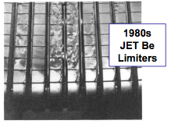
OPERATION NEAR LIMITs
Local damage has been observed due to off-normal events and prolonged heated limiter tests (high elongation limiter plasmas at low q₉₅ with P_{IN}=5MW for 7.5s)
Temperature on the protected limiter <800ºC
Temperatures on the damaged limiter (oblique view) <920ºC
Melting not associated with edges like in the 1989 Be limiters
24th IAEA Fusion Energy Conference 8-13 October 2012 – San Diego - USA
| PAGE 8

Slide 9
Be title design highlights
Limiters showed very good power handling
Shadowing of the edges very successful in avoiding melting during high power operation (no melting of the edges observed so far)
Measurements of temperature rise for both inner and outer limiters show systematic lower values than predicted
Hot spots due to neutral beam have been successfully detected and protective action taken.
24th IAEA Fusion Energy Conference 8-13 October 2012 – San Diego - USA
| PAGE 9

Slide 10


Surface temperature measurement in Reflective environment
  Contribution of reflected light in the direct IR signal on low emissivity metallic PFCs (ε ∼ 0.1 - 0.3 for Be/W) ?
  To address this point, we have adapted a commercial ray tracing Monte Carlo software which is realistic (physic-based model) and uses native CATIA CAD files
24th IAEA Fusion Energy Conference 8-13 October 2012 – San Diego - USA
| PAGE 10

Slide 11
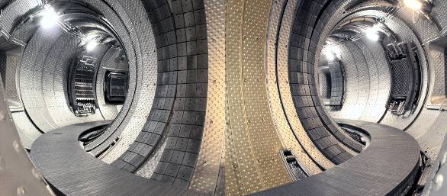

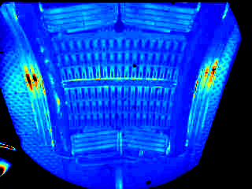

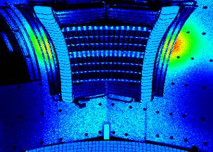

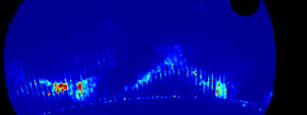

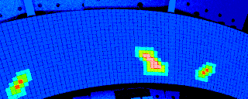

Proof of concept at Tore supra
Reflections must be assessed to understand IR signal
and get realistic
IR surface temperature measurements
EXPERIMENTAL images
SIMULATED images
Reflected features on Tore Supra LHCD launcher coming from hot spots (carboneous deposits) located on the Limiter
See poster for other simulations studies applied to JET & ITER
. Reflections
Hot Spots ?
1
1
2
2
24th IAEA Fusion Energy Conference 8-13 October 2012 – San Diego - USA

Slide 12
Towards ITER IR PFCS monitoring system
  Foreseen Vis/IR wide angle viewing system (WAVS) : 18 IR ( & 18 visible) cameras covering 80 % of the ITER vacuum vessel
  Monitoring of complex thermal scenes with many different objects in the field of view : equivalent to JET IR wide angle viewing system x 18
  System will generate about 7 Gb/s of data during plasma operation : 2 orders of magnitude compared to current Tore Supra IR system
  Operating such a imaging system and analyzing IR ITER WAVS movies only “by hand” may be difficult (impossible ?)
Automation will be needed to monitor
80 % of vacuum vessel
during ITER plasma discharge
24th IAEA Fusion Energy Conference 8-13 October 2012 – San Diego - USA

Slide 13

PROPOSED IR pfcs monitoring SYSTEM
  To take in account these new ITER constraints, in addition to a PFCs real-time protection based on operational limits thresholds, a vision-based intelligent monitoring system has been designed able to :
    detect and recognize thermal/transient events during plasma discharge
    store them “on the fly” (annotation in ITER database)
    produce a summary at the end of a discharge
  It is a part of a multi-sensor and modular data analysis CEA/IRFM software platform (PInUP)
Proof of concept on TS during 2010 plasma campaign in parallel to the TS protection system
PINUP in live
24th IAEA Fusion Energy Conference 8-13 October 2012 – San Diego - USA

Slide 14
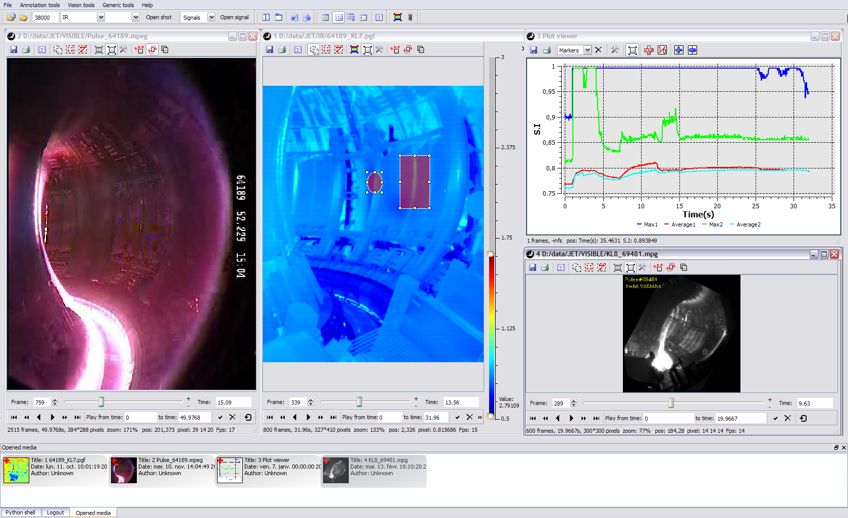
Adaptation to the JET ITER like wall experiment
PInUP adapted & installed for in-between pulses analysis as part of the Protection of Iter like Wall (PIW) project
PInUP is very poweful for image analysis
and easy to adapt
to different tokamak environments
24th IAEA Fusion Energy Conference 8-13 October 2012 – San Diego - USA

Slide 15
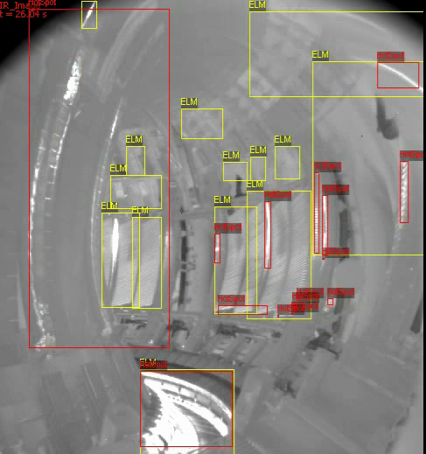
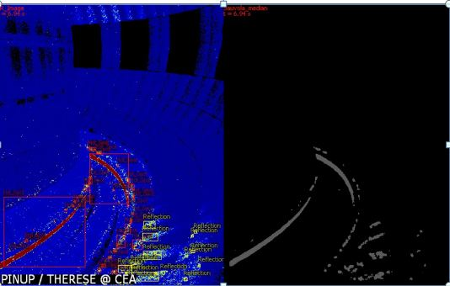
PFCs Vision based monitoring on JET & ITER
PFCS vision based monitoring system can
model different IR thermal & transient events
in wide angle views
ITER Vis/IR wide-angle IR view
JET wide-angle IR view
JET real discharge
  Red : hot regions tracking
  Yellow : ELMs
ITER simulated discharge using SPEOS
  Red : hot regions tracking
  Yellow : reflection detection
24th IAEA Fusion Energy Conference 8-13 October 2012 – San Diego - USA

Slide 16
summary
Be tile design for the ITER Like Wall Experiment is successful with efficient shadowing and good power handling
Active wall protections are efficient in most cases
Full predictive photonic simulation has been validated on Tore Supra and tested on JET and ITER reference plasma scenario
A new IR PFCs vision-based monitoring system, able to detect and identify transient & thermal events has been validated on Tore Supra
It is a part of CEA PInUP platform which has been successfully adapted & installed at JET as a part of the JET PIW project
IR PFCs vision-based monitoring system has been also tested on experimental IR WAVS movies & simulated IR WAVS movies
24th IAEA Fusion Energy Conference 8-13 October 2012 – San Diego - USA

Slide 17
DSM
IRFM
SIPP
More details on posters Thursday October 11, 2012
Poster Room (8:30 – 12:30)
FTP/2-1Rb
Be tile power handling and main wall protection
and
THANK YOU
FOR
YOUR ATTENTION
ITR/2-2Ra
Imaging Challenges for the ITER Plasma Facing Components Protection
Commissariat à l’énergie atomique et aux énergies alternatives
Centre de Cadarache | 13108 Saint Paul Lez Durance Cedex
T. +33 (0)4 42 25 46 59 | F. +33 (0)4 42 25 64 21
  Etablissement public à caractère industriel et commercial | RCS Paris B 775 685 019

Slide 18
SPARE

Slide 19
IR WIDE ANGLE VIEW simulation
Reflections must be assessed to get realistic
IR surface temperature measurements
JET (11 MW power injected plasma) :
  Remarkable features in the divertor area well-reproduced with the simulation
  On hot targets (divertor tiles) ~ 10 % error on T surf
  On cold targets (wall components) ~ 40 % error on T surf
ITER (High performance reference plasma) :
  20% error at strike point on W divertor and up to 400% error on Be wall (see poster for more details)
24th IAEA Fusion Energy Conference 8-13 October 2012 – San Diego - USA

Slide 20
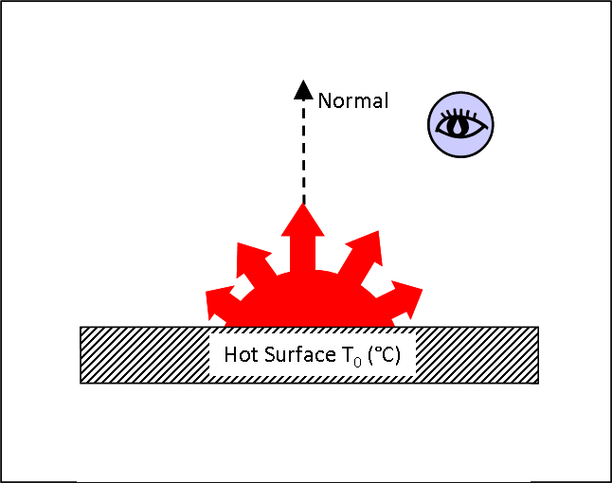
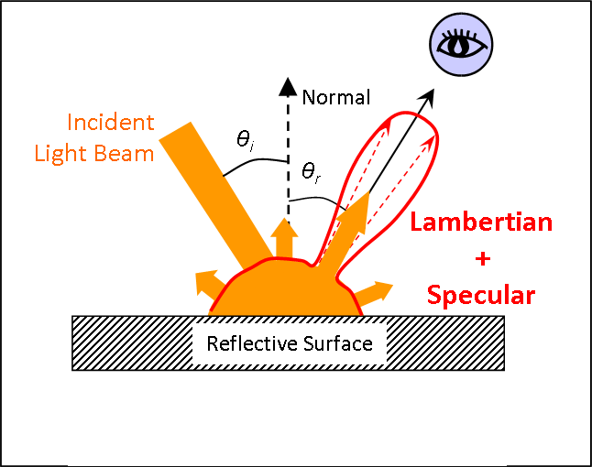
UNDERSTANDING of IR signal in
  Unlike actively cooled carboneous PFCs, measuring an absolute surface temperature on metallic PFCs is challenging because of the contribution of reflected light in the direct IR signal and the not well known low emissivity (ε ∼ 1 for carbon and 0.1 - 0.3 for Be/W)
  To assess this point, we have used and adapted a industrial (OPTIS) ray tracing Monte Carlo software (SPEOS) able to :
    Propagate the light through complex 3D geometry from CATIA native files
    Accurately model the photon-surface interaction (physic-based model)
  Radiative properties
  Optical properties
  Emissivity depends on the observation angle
  Modeled as Lambertian for carbon and as cosinus N power for metal
Bidirectional Reflectivity Distribution Function (BRDF)

Slide 21
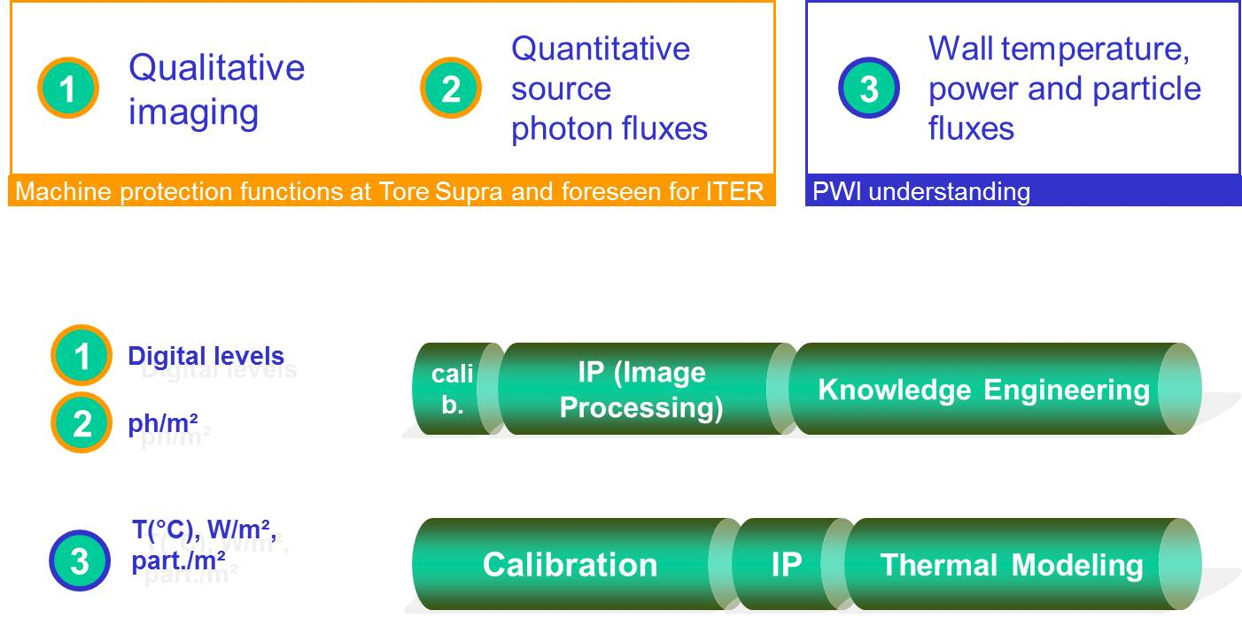
Towards ITER PFCS monitorING
  Steady state ITER simulated scenario : the temperature of the first wall remains constant at 175°C whereas the temperature of the divertor target increases up to 1600°C :
      Overestimation of the surface temperature from 20% for the strike point location to 400% for the first wall, if the reflected flux is not taken into account
  Thanks to this observation ITER has defined three performance levels for IR measurements and associated R&D efforts :
24th IAEA Fusion Energy Conference 8-13 October 2012 – San Diego - USA

Slide 22
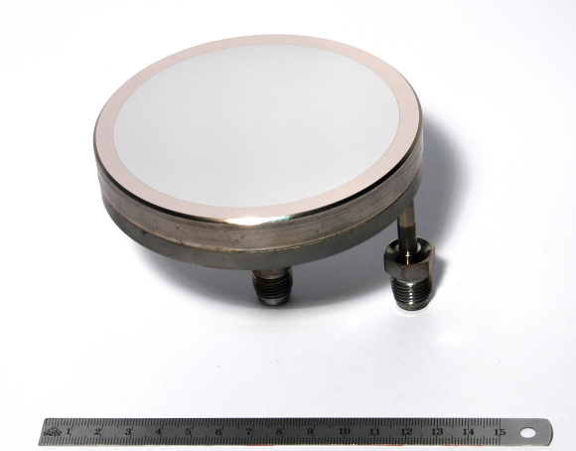
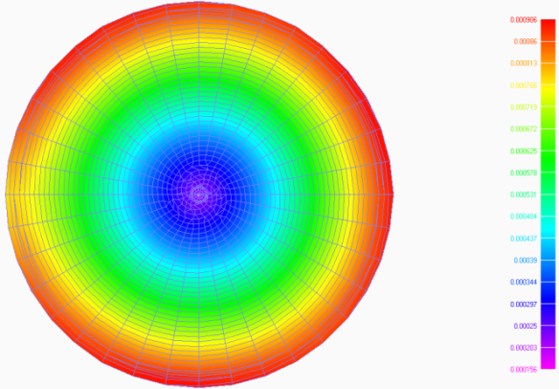
ITER first mirror proTOtype
As the performance of the PFCs protection is directly linked to the image quality, feasibility, performances and prototyping of the first actively cooled optical components facing the plasma have been addressed. Due to ITER harsh environment, only metallic first mirrors (FMs) are candidates.
Full scale actively cooled metallic mirrors of 109 mm in diameter have been successfully designed and manufactured with blanks of stainless steel and TZM (Mo-based alloy) with Nickel interlayer, and reflective coatings of rhodium and molybdenum of 3 to 5 mm thick.
Waterproof ness tests of the integrated cooling system have been conducted with success at 60 bars/25°C and 40 bars/200°C environmental conditions respectively
Thermo-mechanical behavior has been investigated for different ITER FMs designs and geometries (100 mm and 200 mm), to evaluate the FMs heating and optical surface deformation during ITER operation.
It is shown that the use of more conductive materials than stainless steel for the blank, such as CuCrZr and TZM, and an optimized active integrated cooling system can limit efficiently the FMs heating and reduce their optical surface deformation under plasma radiation flux and neutron load.
Prototype of ITER first mirror under waterproofness test
NASTRAN simulation of FM optical surface deformation
24th IAEA Fusion Energy Conference 8-13 October 2012 – San Diego - USA

Slide 23
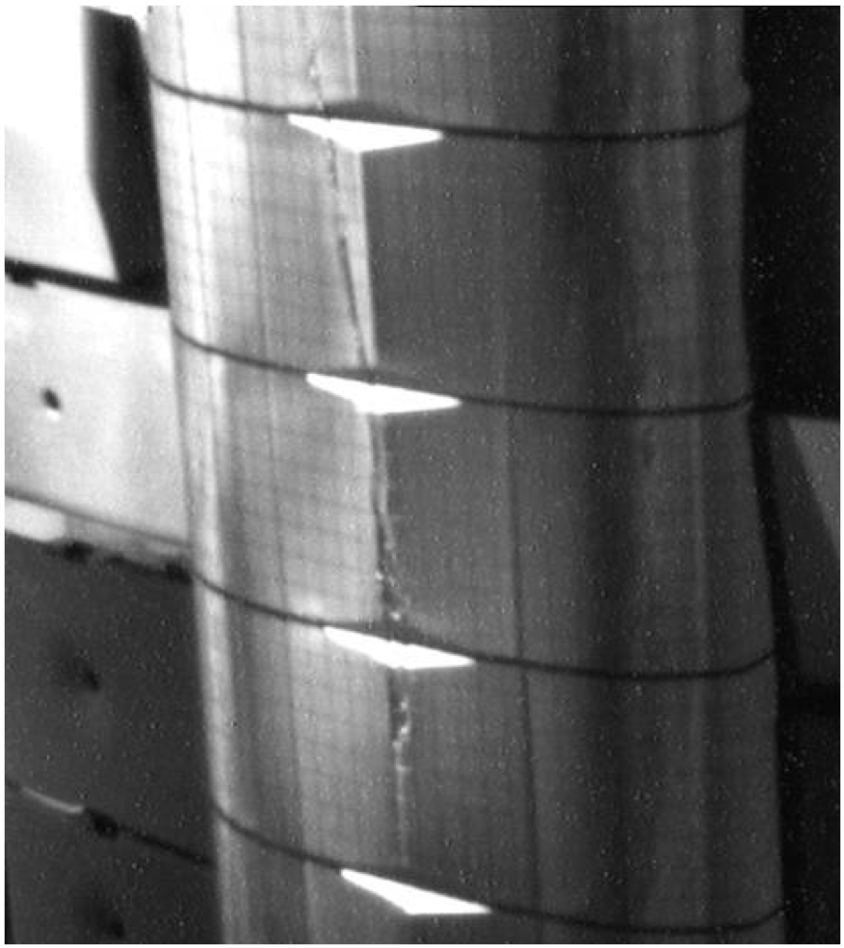
However
Measurements of temperature rise for both inner and outer limiters show systematic lower values than predicted. Being investigated.
Overall, shadowing of the edges very successful in avoiding melting for high power operation
Hot spots due to neutral beam re-ionisation power loads that are hard to predict with sufficient accuracy have been successfully detected and protective action taken.
However :
Damage observed in one pulse at high elongation with additional heating of 5MW for 7s
Monitored temperature < 800ºC. Limiters not monitored must have reached far higher temperatures with one in view of a camera apparently releasing Be in bursts
A posteriori inspection of the inner limiters have shown melting in two limiters
24th IAEA Fusion Energy Conference 8-13 October 2012 – San Diego - USA
Notes:
high elongation = courbure du plasma suit la courbure du limiter
Low q => angles d’incidences importants
Limiter monitoré t < 800 C ok mais un autre pas surveillé a fondu
Be 1989 : différences avec ILW

