Slide 1
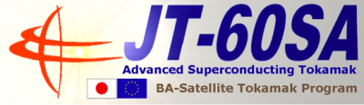
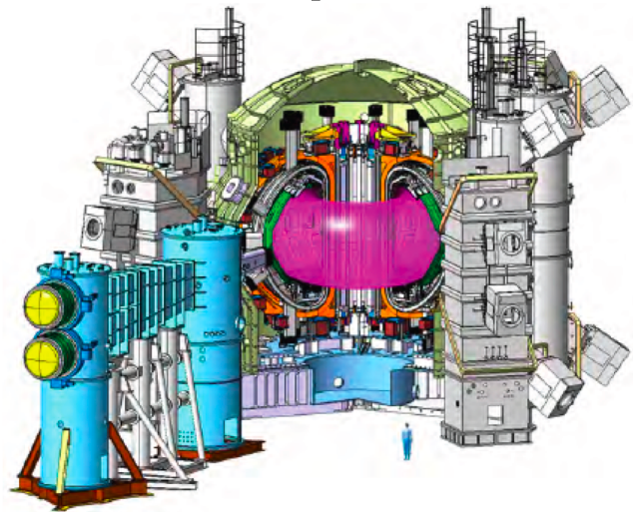
24th IAEA Fusion Energy Conference, San Diego, Oct. 2012
OV4/1
Progress of
the JT-60SA Project
Y. Kamada, P. Barabaschi, S. Ishida,
The JT-60SA Team,
JT-60SA Research Plan Contributors
(392 persons,
15 JA institutes, 23 EU Institutes)
* BA Satellite Tokamak Project team,
*JA Home team (JAEA),
*EU Home team (F4E, CEA , CIEMAT , Consorzio RFX , ENEA , KIT , SCK.CEN/Mol )
*JA Contributors (CRIEPI, Hokkaido Univ ., Keio Univ., Kyoto Institute of Technology , Kyoto Univ .,
Kyushu Univ., Nagoya Univ ., NIFS, Osaka Univ., Shizuoka Univ ., Univ. of Tokyo, Tohoku Univ .,
Tokyo Institute of Technology ., Univ. of Tsukuba )
*EU Contributors (Aalto Univ., CCFE , CEA , CIEMAT , CNRS/ Univ. de Marseille, Consorzio RFX ,
CRPP /Lausanne , EFDA-CSU , ENEA , ENEA-CREATE , ERM , FOM , F4E, FZ /Jülich , IFP-CNR ,
IPP /Garching, JET-EFDA , KIT , National Technical University of Athen , Univ. of York)

Slide 2
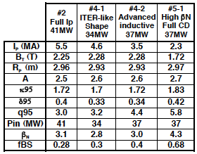
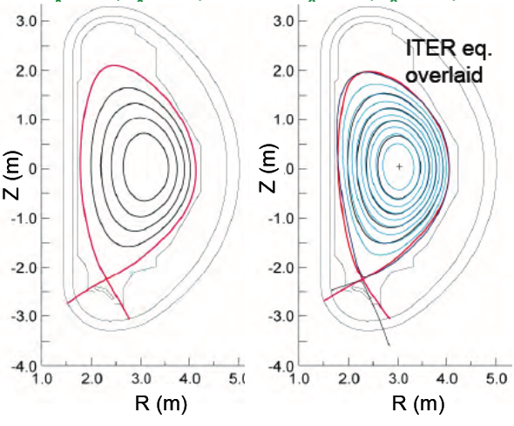
JT-60SA: Highly Shaped Large Superconducting Tokamak
representative scenarios
JT-60SA: highly shaped (S=q₉₅I_{p}/(aB_{t}) ~7, A~2.5) large superconducting tokamak confining deuterium plasmas (Ip-max=5.5 MA) lasting for a duration (typically 100s) longer than the timescales characterizing the key plasma processes such as current diffusion time, with high heating power 41MW.
Contribute to ‘Success of ITER’ , ‘Decision of DEMO design’ ＆Foster next generation leading scientists.
6
5.5MA
4.6MA
5
DEMO reactors
JT-60SA Target
4
β_{N}
3
FB ideal MHD limit
ITER
Steady-state
2
JT-60U
Existing Tokamaks
ITER
1
Inductive
0
0
20
40
60
80
100
400
3000
Sustainment Time (s)

Slide 3
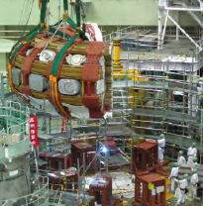
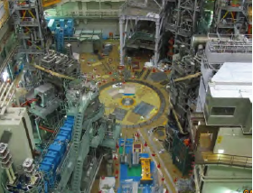
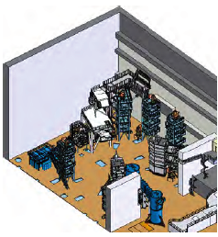
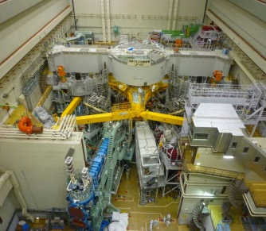
Tokamak assembly starts in Dec. 2012, First plasma in Mar. 2019
By 2012 Sep., 18 Procurement Arrangements (PAs) have been concluded
(JA: 10PAs, EU: 8PAs) = 75% of the total cost of BA Satellite Tokamak Program.
Year
2007
2008
2009
2010
2011
2012
2013
2014
2015
2016
2017
2018
2019
2020
Construction
Experiment
Preparation
Disassembly
Assembly
Operation
Commissioning
Integrated
Commissioning
JT-60U Torus Disassembly completed => JT-60SA Assembly from Dec. 2012
2012 Dec.
2010 Mar.
2012 Oct.
Cryostat Base
from EU
The first experience of disassembling a radio-activated large fusion device in Japan.
Careful treatment of the activated materials and safety work are being recorded as an important knowledge base for Fusion Development.

Slide 4
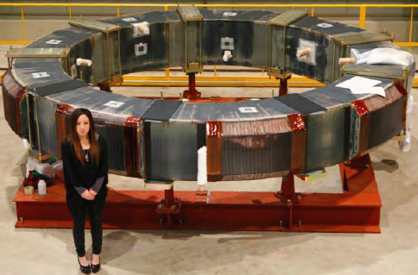
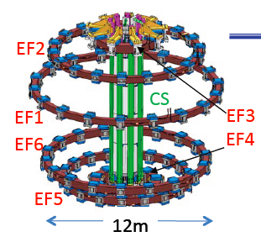
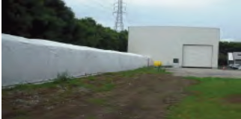
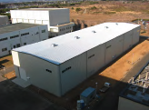
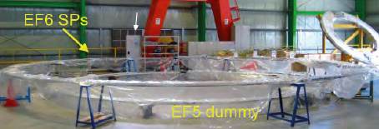
Manufacture of EF coils & CS: JAEA
4.4 m
Conductor Manufacture building (Naka)
Conductors :under
mass production (Naka)
EF (NbTi) : 55%
CS (Nb3Sn): 25%
completed
EF4 coil completed
manufacturing error (in-plane ellipticity) of the current center
= 0.6mm (x 10 better than requirement)
Coil Manufacture building (Naka)
Manufacture of EF5 & EF6 started
CS (5.1K, 8.9T) conductor test,
The critical current I_{c} by 4,000 cycle excitation (JAEA/NIFS)
=> Confirmed ‘no degradation’
EF5&6 manufacture started in JAEA Naka
12 m

Slide 5
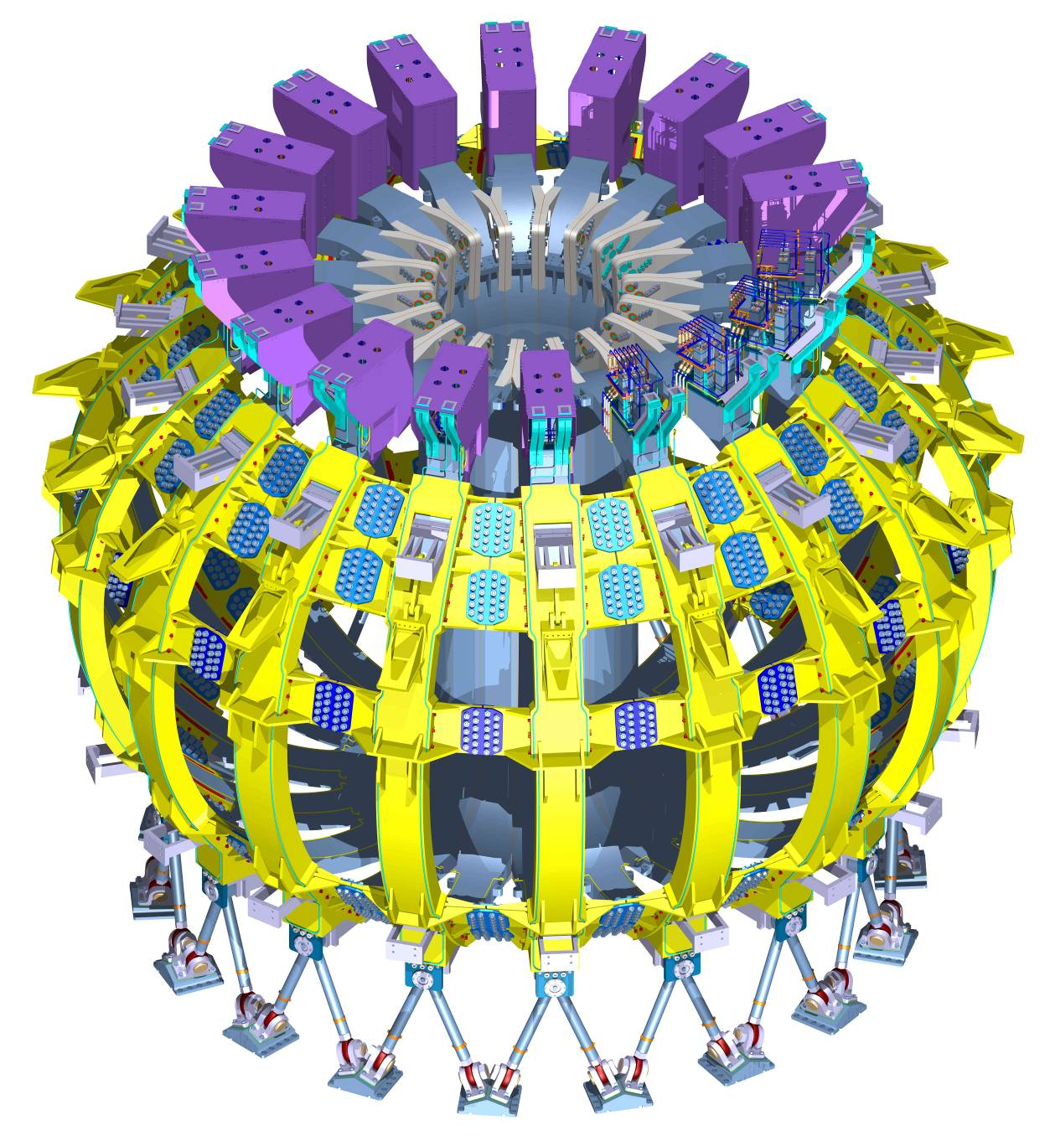
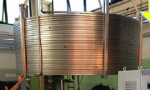
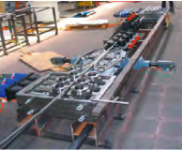
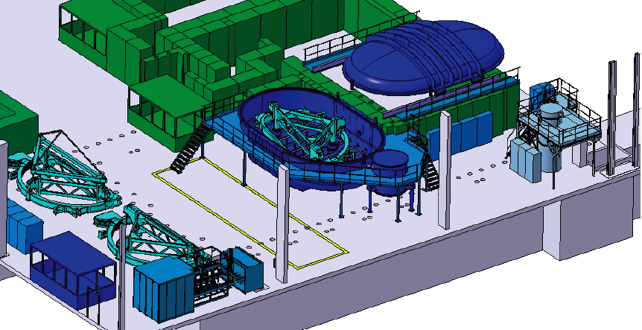
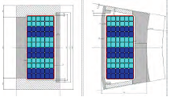

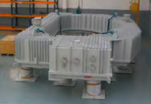
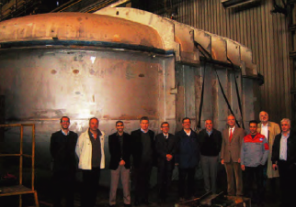
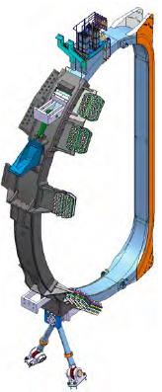
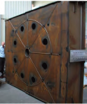
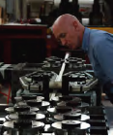
TF coil & test :F4E, ENEA,CEA,SCK CEN
TF Conductor (F4E)
under mass production.
TF Coils (ENEA, CEA)
Manufacture started:
The first winding packs
~ early 2013.
TF coil test (at nominal current): Facility preparation started(CEA Saclay) .
Cryostat (SCK CEN) ) completed & delivered to Saclay.
18 (+1 spare)
ENEA
6 double
pancakes
NbTi
(25.7kA,5.65T, 4.9K)
Conductor Samples &
Joints were tested successfully at SULTAN
CEA

Slide 6
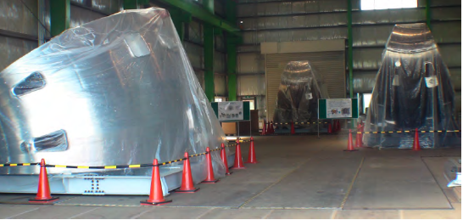
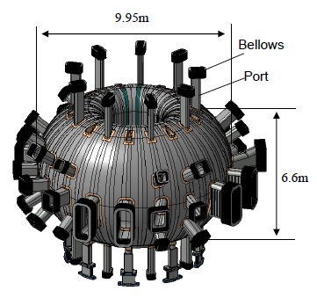
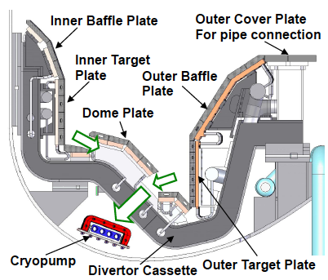
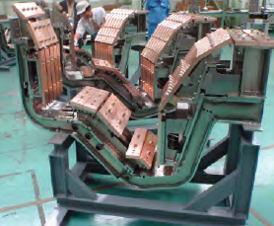
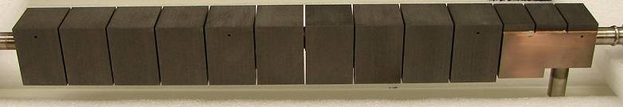
Vacuum Vessel and Divertor : JAEA
Vacuum Vessel
120deg. (40deg. X 3) completed
Welding procedure established
=>tolerances well within requirement +-5mm
2nd
FY2012=> another 120deg.
1st.
3rd
double wall, SS316L low cobalt (<0.05%)
Divertor
41 MWx100s =>15 MW/m² : W-shaped + vertical target with V-corner at the outer target
& divertor pumping speed can be changed by 10 steps between 0 - 100 m³/s
Divertor cassettes: with fully water-cooled plasma facing components & remote handlable
Manufacture of brazed CFC monoblock targets on going. .
The first three divertor cassettes:
accuracy of ±1 mm
A. Sakasai, FTP/P7-20

Slide 7
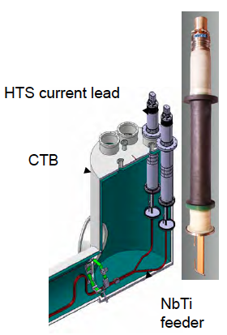
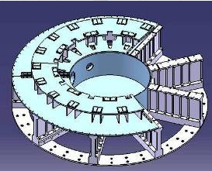
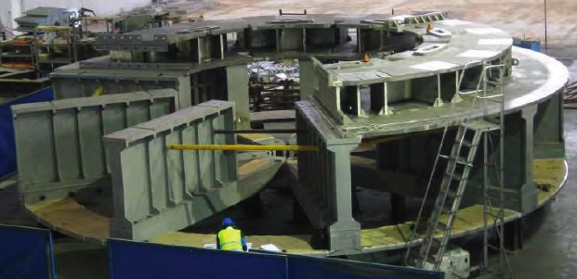
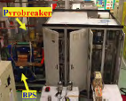
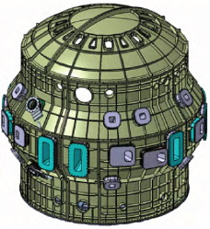
Cryostat :CIEMAT
High Temperature Superconducting Current Leads :KIT
Cryostat Base manufacture
almost finished
=> Delivery to Naka in the 1st week Jan.
26 current leads based on W7-X
Material purchasing is progressing
Power Supplies :
CNR-RFX, ENEA, CEA
Quench Protection Circuit (CNR-RFX)
Prototypes completed
Switching Network Units (ENEA)
Contract signed in Sep. 2012
Superconducting Magnet PS (CEA & ENEA)
contracts expected by Mar. 2013
The RWM control coil PS (CNR-RFX)
specification is in the final stage
13.4mφ ,250t
Cryostat Vessel Body Cylindrical Section: drawings completed,
all the material has been supplied by JAEA
Cryogenic Systems :CEA
Contract of manufacture is expected within 2012
All CEA contributions: A.Becoulet, OV/4-5
P. Bayetti, FTP/P1-29

Slide 8
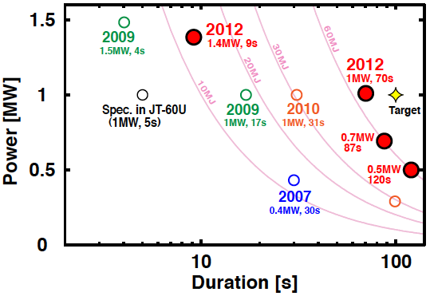
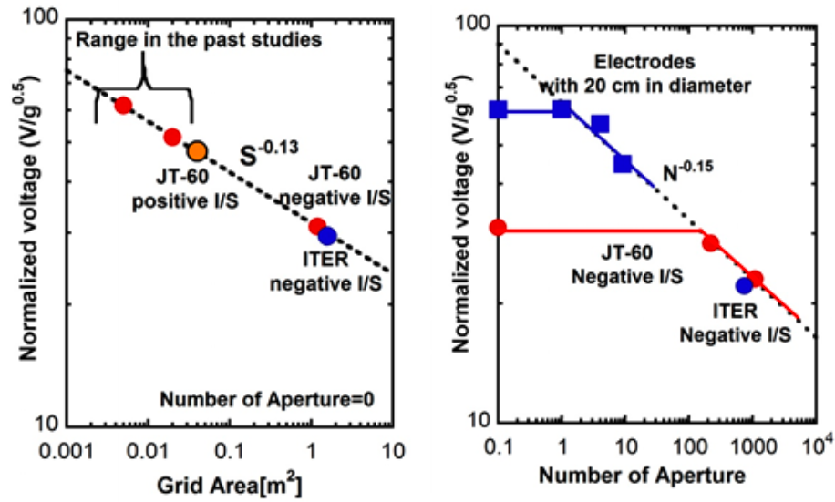
Development of N-NB & ECRF for JT-60SA:JAEA
N-NB System
ECRF System
(500 keV & 3A demonstrated in 2010)
High power long pulse gyrotron (110GHz)
1 MW x 70 s & 1.4 MW x 9 s
achieved with newly installed 60.3 mmφ transmission line & improved mode convertor.
2011-: Using test stand, we found
V: vacuum insulation voltage
V/G^{0.5} ~ S^{-0.13} & N^{-0.15}
( the first scaling of the multi-aperture grid)
V ( insulation voltage) (kV)
G( grid length(mm))^{0.5}
S: grid area (m²)
N: number of the apertures
The first dual-frequency gyrotron
(110 & 138GHz) was successfully manufactured, oscillation confirmed.
→200kV & 100s without breakdown was demonstrated with 70mm single gap.
→ 500kV extraction is expected in JT-60SA’s 3-stage-acceleration (also contributes to ITER)
Mock-up test of a novel linear-motion antenna showed preferable characteristics.
M.Hanada, FTP/P1-18
A. Isayama, FTP/P1-16

Slide 9
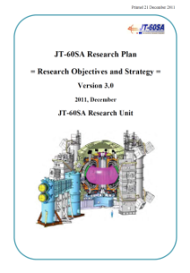
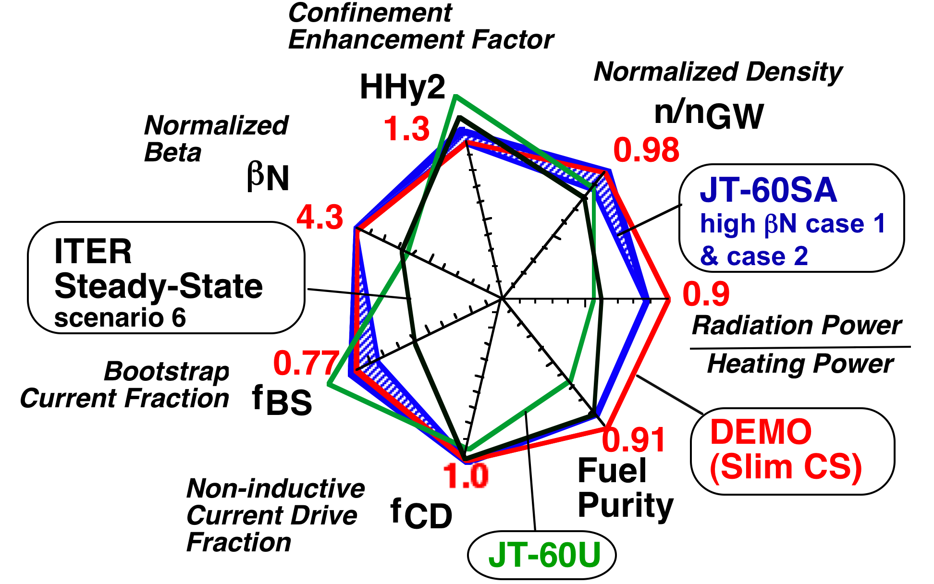
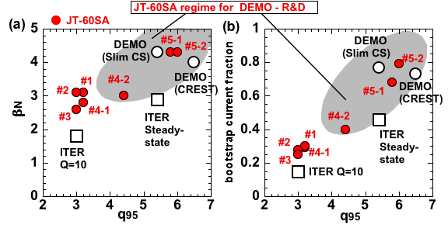
JT-60SA: Research Goal
With the ITER- and DEMO-relevant plasma parameters and the DEMO-equivalent plasma shapes, JT-60SA contributes to all the main issues of ITER and DEMO.
=> ‘simultaneous & steady-state sustainment of the key performances for DEMO’.
DEMO reference: ‘ economically attractive ( =compact) steady-state’
but we treat ‘the DEMO regime’ as a spectrum.
JT-60SA should decide the practically acceptable DEMO parameters,
and develop & demonstrate a practical set of DEMO plasma controls.
JT-60SA Research Plan Ver. 3.0 has been completed in Dec. 2011 with 332 co-authors (JA 145 + EU 182 + Project Team 5, from 38 institutes)

Slide 10
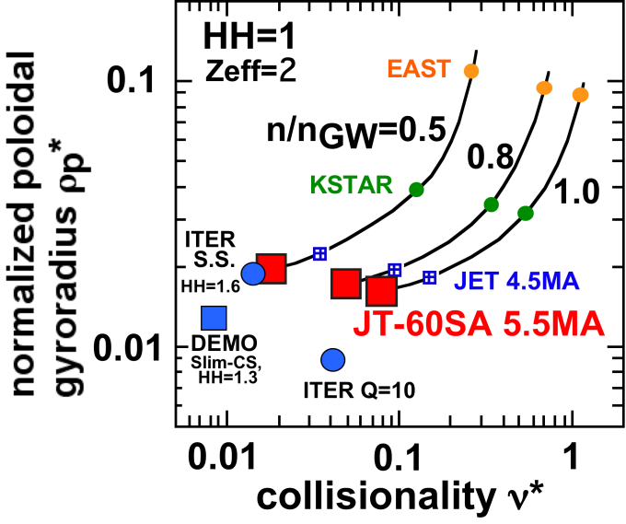
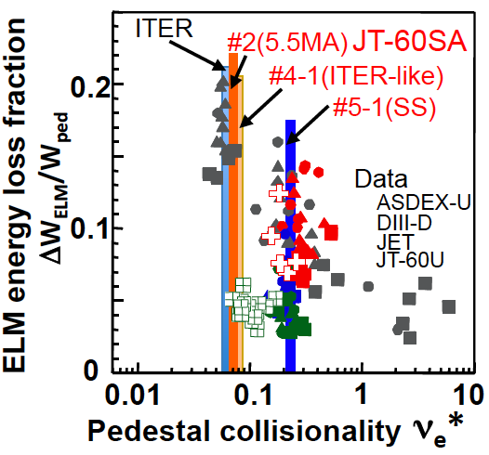
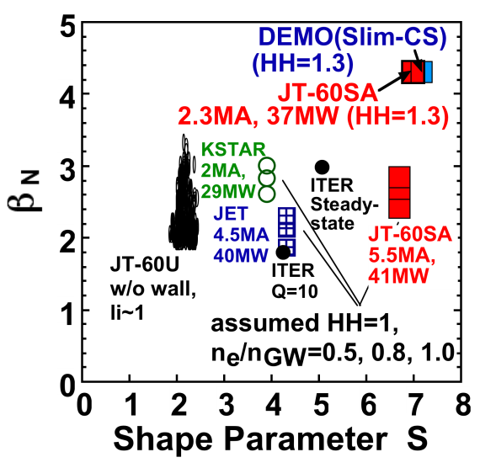
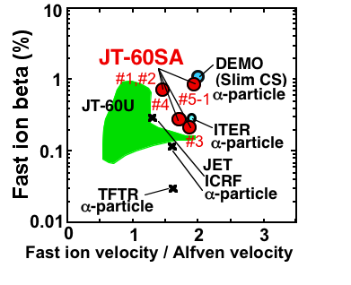
JT-60SA allows study on self regulating plasma control
with ITER & DEMO-relevant non-dimensional parameters
Collisionality,
Gyroradius,
Pedestal
Collisionality
Mutual Interaction
Beta,
Plasma shape,
First ion beta,
Fast ion speed,

Slide 11
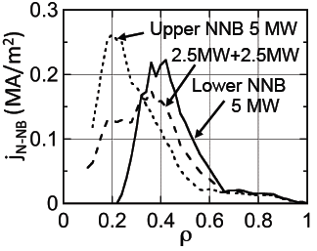
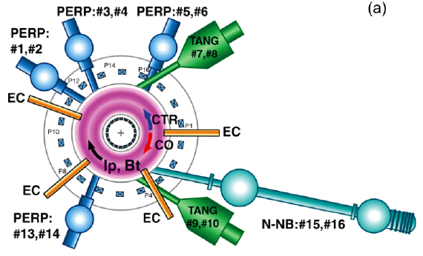
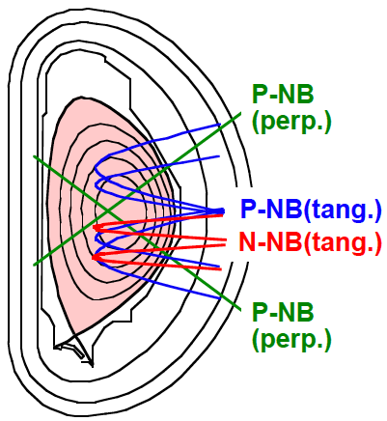
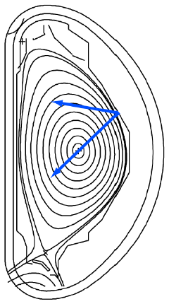
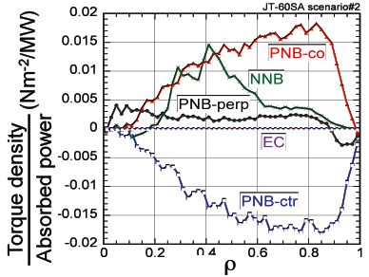
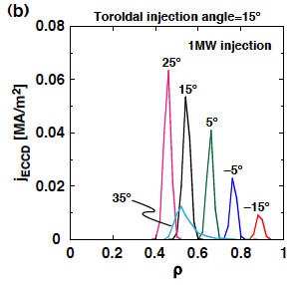
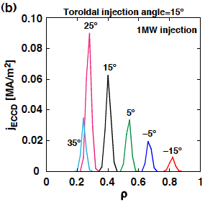
41MW×100s high power heating with variety
Variety of heating/current-drive/momentum-input combinations
NB: 34MW×100s
N-NB driven current
Positive-ion-source NB (85keV), 12units × 2MW=24MW,
CO:2u, CTR:2u, Perp:8u
Negative-ion-source NB,
500keV, 10MW, Off-axis
EC
NNB
Torque input
EC driven current
ECRF: 7MW×100s
110GHz+138GHz,
9 Gyrotrons,
4 Launchers
with movable mirror
>5kHz modulation
110GHz,1.7T
138GHz2.3T
j_{ECCD}(MA/m²)
A. Isayama, FTP/P1-16

Slide 12
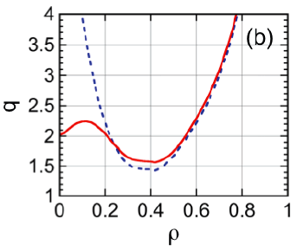

Profile controllability for high-β_{N} & high-bootstrap plasmas
1.5D transport code TOPICS (with the CDBM transport model) + F3D-OFMC
➔ Self consistent simulation for Scenario 5-1( I_{p}=2.3MA with ITB)
M. Honda, TH/P2-14
By changing from the upper N-NB to the lower N-NB
=> qmin increases above 1.5.
By changing combinations of tangential
P-NBs (co, counter, and balanced) with N-NB, the toroidal rotation profile is changed significantly. ⬄ RWM-stabilizing rotation
upper N-NB
co-P-NB + N-NB
co-P-NB + ctr-P-NB
+ N-NB
lower N-NB
Toroidal rotation velocity
(10⁵ m/s)
ctr-P-NB + N-NB
0.3% of V_{Alfven}
ρ
S. Ide, FTP/P7-22

Slide 13



ITER- & DEMO- relevant heating condition
& sufficiently long sustainment
JT-60SA allows
* dominant electron heating,
(+ scan of electron heating fraction )
* high power with low central fueling
* high power with low external torque
(+ scan)
For all the representative scenarios:
τ_{flat-top}(100s) > 3 x current diffusion time τ_{R}
Advanced inductive scenario (#4-2):
q(r) reaches steady-state before t=50s with q(0)>1.
ITER Q=10
ITER S.S.
7
6
5
Scenario 4-２
Bootstrap fraction=0.4
q
4
3
2
1
0
0
0.5
1
0
ρ
Modelling studies by METIS:
G. Giruzzi, TH/P2-03

Slide 14




MHD stability control
Stabilizing Wall
Fast Plasma Position Control coil
RMP
Error Field Correction (EFC) coil)
(=>RMP, 18 coils 30 kAT, ~9 G~4x10⁻⁴B_{T}
RWM Control coil: 18 coils. on the plasma side.
RWM control
+ ECCD (NTM), rotation control
β_{N} = 4.1 (C_{β} =0.8) with effects of conductor sheath, noise (2G), and latency (150 μs).

Slide 15



Fuel & Impurity Particle Control for ITER & DEMO
Compatibility of the radiative divertor with impurity seeding and sufficiently high fuel purity in the core plasma should be demonstrated.
SOL/divertor simulation code suite SONIC
Divertor heat flux can be managed by controlling Ar gas puffing.
Detailed simulation by IMPMC illustrates dynamics of impurity:
Origin (puff and back-flow) and distribution of Ar illustrated.
The separatrix density necessary to maintain the peak heat flux onto the outer divertor target <~10MW/m²
q_{heat} (MWm²)
Δ_{sep} (m)
Acceptable for #5-1:
I_{p}=2.3MA, 85% n_{GW} ,
separatrix density
~ 1.6x10¹⁹m⁻³
-2
2
0.75 pa m³/s
Ar puff
Z (m)
-2.4
n_{Ar}/n_{i}
back-flow
%
10
8
IMPMC
6
-2.8
4
2
2
2.5
3
R (m)
S. Ide, FTP/P7-22

Slide 16
Summary
The JT-60SA device has been designed as a highly shaped large superconducting tokamak with variety of plasma control capabilities in order to satisfy the central research needs for ITER and DEMO.
  Manufacture of tokamak components is in progress on schedule
  by JA & the EU.
  JT-60 torus disassembly has been completed, and JT-60SA assembly will start in Dec.2012.
  JT-60SA Research Plan Ver. 3.0 was documented by >300 JA & EU researchers.
In the ITER- and DEMO-relevant plasma parameter regimes, heating conditions, pulse duration, etc., JT-60SA quantifies the operation limits, plasma responses and operational margins in terms of MHD stability, plasma transport, high energy particle behaviors, pedestal structures, SOL & divertor characteristics, and Fusion Engineering.
The project provides ‘simultaneous & steady-state sustainment of the key performances required for DEMO’ with integrated control scenario development.

