Slide 1
Effects of ECH on Toroidal Rotation：
KSTAR Experiments, Intrinsic Torque Modeling and Gyrokinetic Stability Analyses
^{a,b}Y.J.Shi, ^{b}W.H.Ko , ªJ.M.Kwon, ^{a,c}P.H.Diamond, ^{b}S.G.Lee, ªS. H.Koh, ^{d}L.Wang, ªS. Yi, ^{e}K. Ida, ^{b}L. Terzolo, ^{b}S.W. Yoon, ^{b}K.D. Lee, ^{b}J.H. Lee, ^{b}Y.U. Nam, ^{b}Y.S. Bae, ^{b}Y.K.Oh, ^{b}J.G.Kwak, ^{f}M.Bitter, ^{f}K.W.Hill, ^{g}O.D.Gurcan , ^{h}T.S.Hahm
ªWCI Center for Fusion Theory, NFRI, Daejeon, Korea
^{b}National Fusion Research Institute, Daejeon, Korea
^{C} CMTFO and CASS, University of California, San Diego, USA
^{d}Huazhong University of Science and Technology, Wuhan, China
^{e}National Institute of Fusion Sciences, Toki, Japan
^{f}Princeton Plasma Physics Laboratory, Princeton, NJ, USA
^{g}Laboratoire de Physique des Plasmas, Ecole Polytechnique, CNRS, Palaiseau Cedex, France
^{h}Seoul National University, Seoul, Korea
24th IAEA Fusion Energy Conference
8-13 October 2012, San Diego, USA

Slide 2
Outline
Motivation
II. Rotation diagnostics on KSTAR
III. Experimental results: Effects of ECH on toroidal rotation on KSTAR
IV. Analyses and Interpretation of the effect of on-axis ECH for H-mode plasma : ITG ↔TEM transition
V. Summary and future plans

Slide 3
Motivation
Torodial rotation physics is relevant to the L→H transition,
ITB formation and RWM stabilization. NBI torque is not practical
for ITER, and future devices.
Spontaneous rotation phenomena found in all plasmas. Related
phenomena include rotation reversals and some transport
bifurcations.
Physical mechanism of intrinsic torque generation involves broken
symmetry in turbulence ⇒‘residual’ stress ⇒ intrinsic torque
density
Residual stress related mode properties ⇒ possible flip upon
ITG ↔ TEM
Related phenomena:
OH reversal (see Rice, this session) ⇔ ECH induced counter torque

Slide 4
Outline
Motivation and Introduction
II. Rotation diagnostics on KSTAR
III. Experimental results: Effects of ECH on toroidal rotation on KSTAR
IV. Analyses and Interpretation of the effect of on-axis ECH for H-mode plasma : ITG ↔TEM transition
V. Summary and future plans

Slide 5
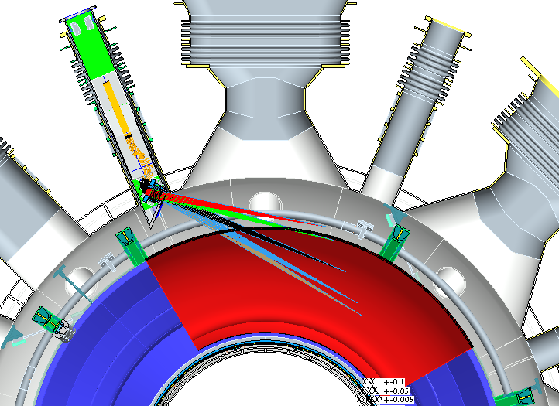
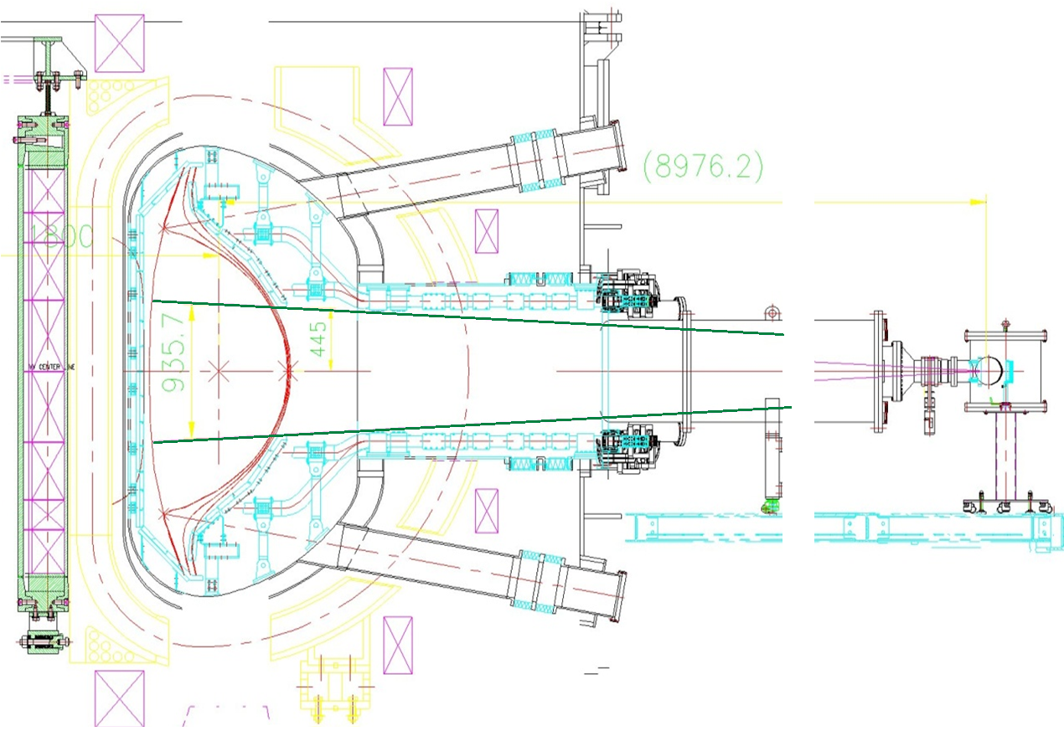
B_{T}=2 T, I_{p}~0.6 MA, N_{e}:2~4e19 m⁻³
co-P_{NBI}~1.3 MW (90keV)
P_{ECH}~0.35 MW@110GHz, 0.7 MW@170GHz
Experimental parameters:
Rotation diagnostics on KSTAR
XICS
CES
Advantage:
high time resolution (10ms) for all kinds of plasma
Measurement limit :
- 47 cm < z < 47 cm , r/a for circular / shaped plasmas is ~ 0.95 / 0.5
Advantage:
covers whole plasma(R=1.8 ~ 2.3m) and especially pedestal region
(ΔR_{edge} = 5mm, Δt=10 msec)
Measurement limit : need modulated NBI

Slide 6
Outline
Motivation
II. Experimental setup on KSTAR
III. Experimental results: Effects of ECH on toroidal rotation on KSTAR
IV. Analyses and Interpretation the effect of on-axis ECH for H-mode plasma : ITG ↔TEM transition
V. Summary and future plans

Slide 7
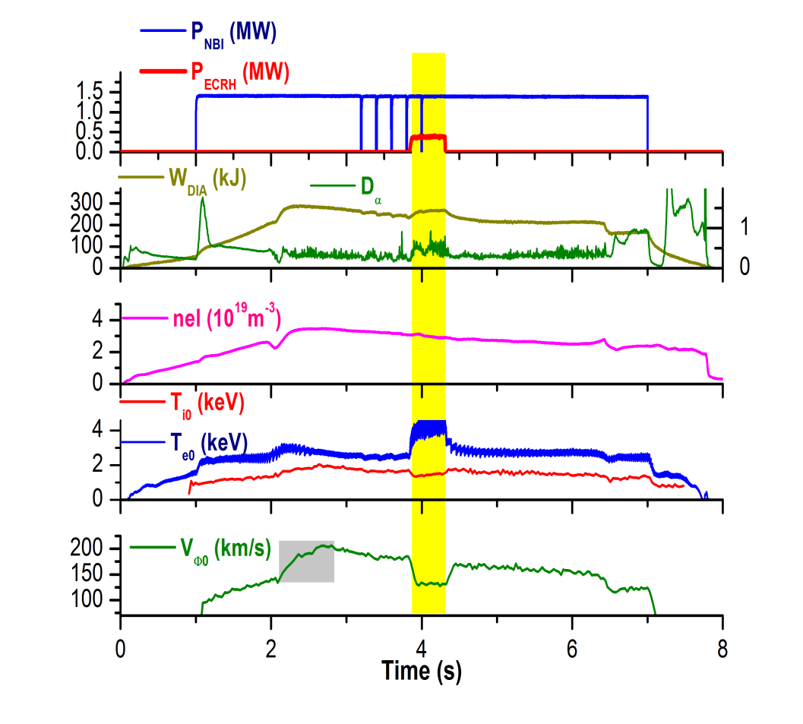
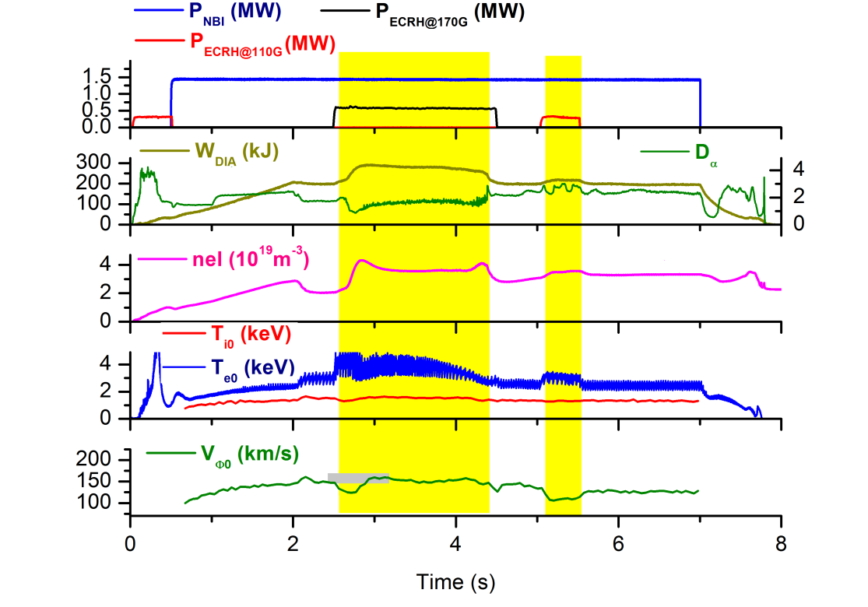
General phenomena: ECH effects on toroidal rotation
P_{NBI}
P_{ECH}
W_{DIA}
D_{α}
ne
T_{e0}
T_{i0}
V_{φ0}
ECH injected during flat top of H-mode
ECH during L → H and L-mode
ECH causes a counter-current rotation increment, both in L-mode and H-mode plasma. (Ida ‘02, Yoshida ‘09, Solomon ‘11, McDermott ‘11)
Increment in core toroidal rotation due to L→H is larger without ECH
7

Slide 8
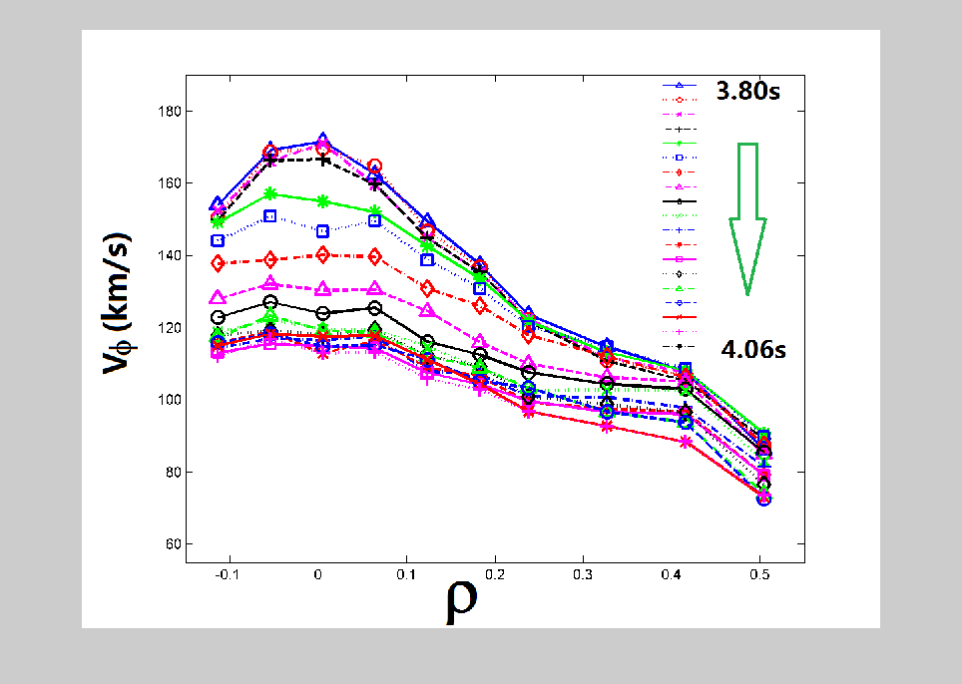
On-axis ECH for H-mode plasma
pivot
pedestal
Response of rotation of center plasma to ECH is faster than that of outer plasma
Rotation velocity
NBI
NBI+ECH
Ion temperature
Toroidal rotation profile flattened by ECH with pivot point ρ~0.7, which is inside of pedestal ρ~0.85.
Core toroidal rotation (both XICS and CES) dramatically decreases during ECH phase –ΔV_{φ}(0) /V_{φ}(0) ~ 30%
Pedestal rotation does not change.
Electron temperature
8

Slide 9
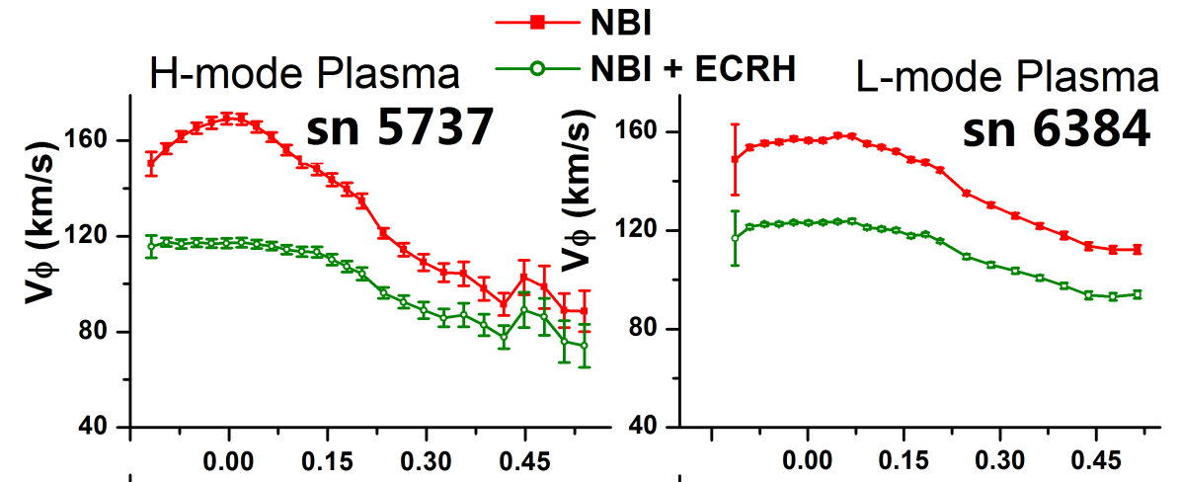
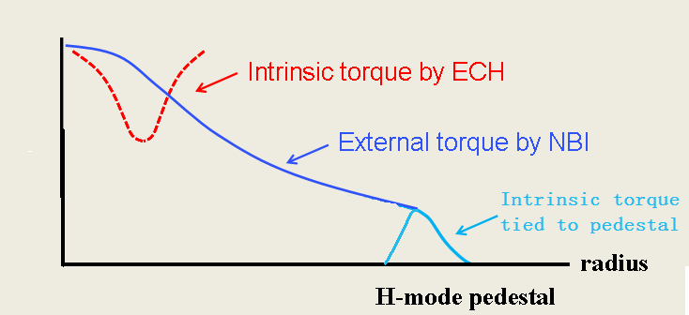
Comparison of ECH effects on rotation profile (H-mode, L-mode)
ECH in H-mode | ECH in L-mode
Core rotation decreases | Rotation decreases over broad region
Counter- intrinsic current torque from ECH Co-current torque from pedestal | Counter- intrinsic current torque from ECH
Rotation scenario for ECH+NBI H-mode plasmas on KSTAR
Interplay of three torques
External torque by NBI
Intrinsic torque tied to steep H-mode pedestal
Core intrinsic torque (due to ECH)
9

Slide 10
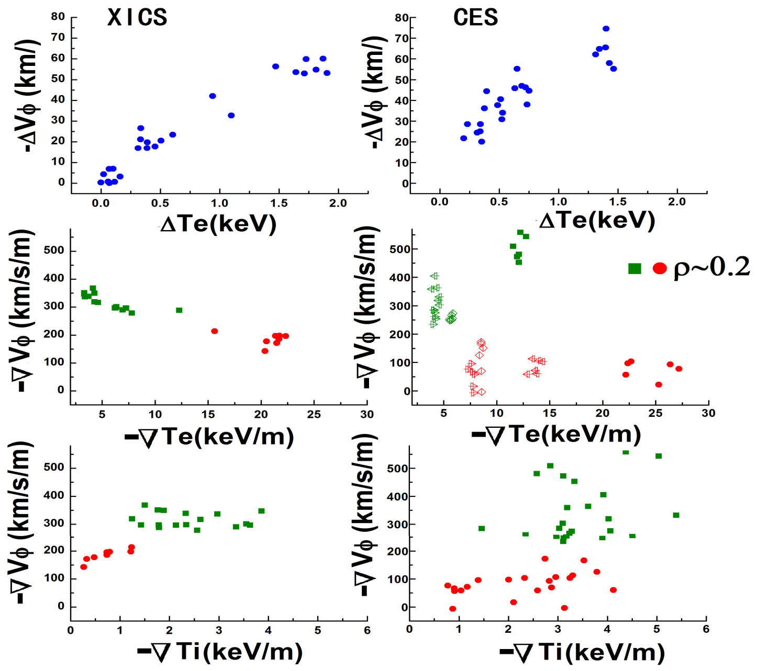
Studies of Macro and Local Correlations
Macro-scaling
⎯Linear relation
–ΔV_{φ} ~ Δ T_{e}
akin Rice scaling
Local scaling
–Δ(∇V_{φ} )~ Δ(∇T_{e})
⇒ ∇V_{φ} flattening tracks ∇T_{e} steepening
(see also McDermott‘11)
XICS : focused on the deep core (ρ~0.2) and for ECH duration
CES : several positions (ρ=0.2~0.54) and several points in time
10

Slide 11
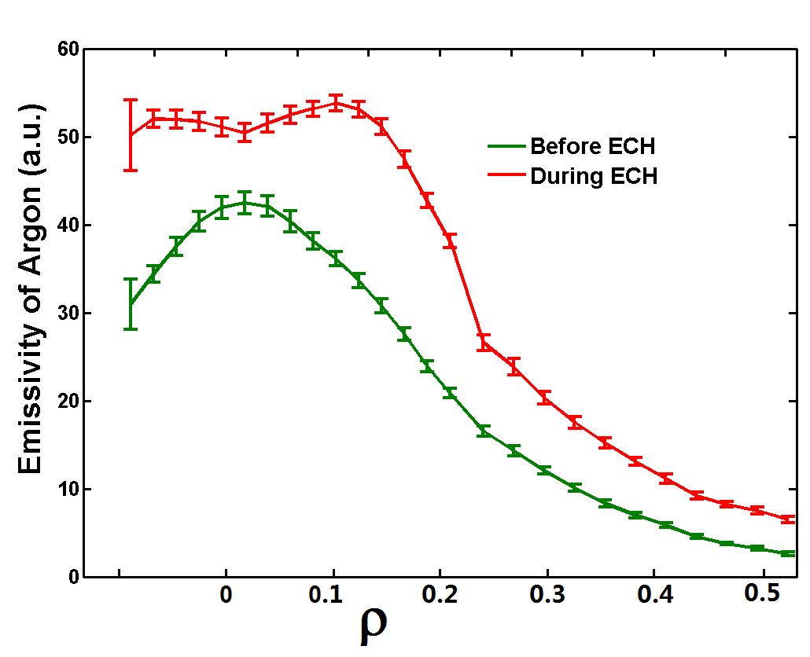
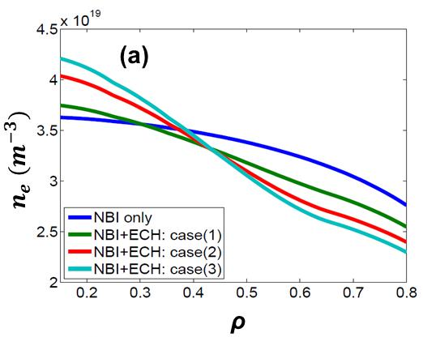
Density Profile(?!)
Density profile is critical to microstability physics.
Momentum and particle transport strongly coupled.
Density profile was not available in 2011 campaign.
There is indirect evidence of density peaking by ECH (Ar emissivity signal)
Using line averaged density info as a constraint, we synthesize a range of possible density profiles, for use in analysis. We explore this range.
Least conservative peaking case
Most conservative
peaking case
11

Slide 12
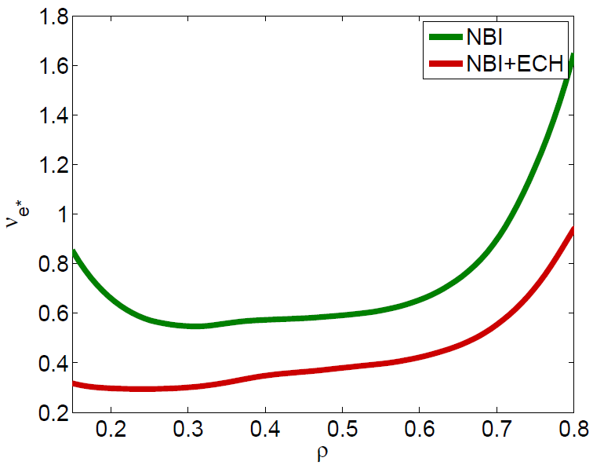
Collisionality Change due to ECH
Collisionality ν_{e*} drops by 2 or more with ECH
TEM excitation definitely possible in NBI+ECH phase
But… collisions are still non-negligible
12

Slide 13
Summary of Data Analysis
∇T_{e} steepens, ∇T_{i} drops
-Δ(∇V_{φ}) correlates with Δ(∇T_{e}), as V_{φ} flattens.
Indirect evidence of density peaking
ν_{e*} drops by 2 or more; ν_{e*}<1,unambiguously
Working hypothesis:
ECH-driven core counter-torque acts to flatten KSTAR core rotation profiles
ECH induces a change in turbulence population from ITG to TEM
ITG →TEM change induces τ_{intrinsic} shift co → counter N.B. ~ ∇T_{e} , ∇n (W.Wang ‘11)
To test hypothesis ⎯ Mechanism of counter torque?
⎯ evidence for population change?
Diamond ‘08, Camenen ‘11, Rice ‘11, McDermott ‘11
13

Slide 14
Outline
Motivation and Introduction
II. Rotation diagnostics on KSTAR
III. Experimental results: Effects of ECH on toroidal rotation on KSTAR
IV. Analyses and Interpretation of the effect of on-axis ECH for H-mode plasma : ITG ↔TEM transition
V. Summary and future plans

Slide 15
ECH ⇒ TEM driven counter-torque
Critical questions:
1)Rarely asked ⎯
What is the relevant symmetry breaking mechanism operative in the core of KSTAR?
Conventional wisdom → ExB shearing. Is this relevant? (contrast to ETB case)
Hypothesis: consider intensity gradient mechanism!
2)Frequently asked ⎯
Does a transition in the turbulence population actually occur?
in lieu of nonlinear simulations with flux-driven ions, electrons and profile evolution, explore linear stability i.e. compare ‘before’ (NBI) vs ‘after’ (NBI+ECH)
key issue: density peaking, and particle transport in general,
→ momentum and particle transport are strongly coupled.
∇n peaking favors ITG→TEM transition
density peaking counter to quasi-linear understanding of convection velocity,
i.e. ITG → TEM often favors outward convection (i.e. “pumpout”) (Garbet’ 05)
15

Slide 16
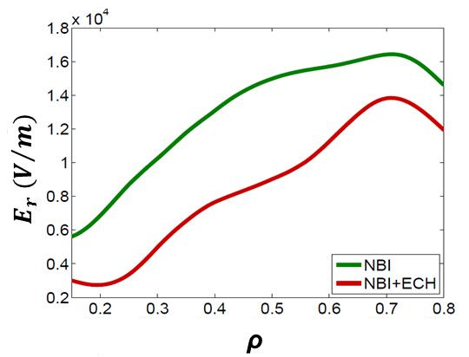
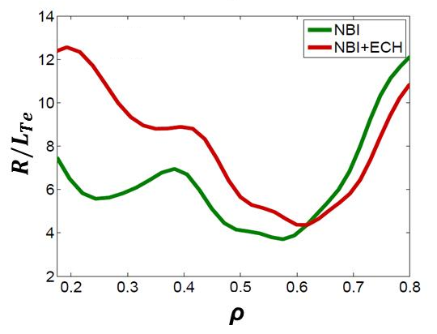
Symmetry Breaking by Fluctuation Intensity Gradient
With ECH
Velocity drops with ECH, ⟨V_{E}⟩’ ~const.,
contrast to L→H, where ⟨V_{E}⟩’ ↑
Turbulence intensity gradient effects strengthen, as central ∇T_{e} increases, L_{Te} drops
⇒ likely TEM intensity gradient increases with ECH
fluctuation intensity
radius
Symmetry breaking induced by radial gradient of
turbulence intensity (Gurcan, et al., PoP’10)
16

Slide 17
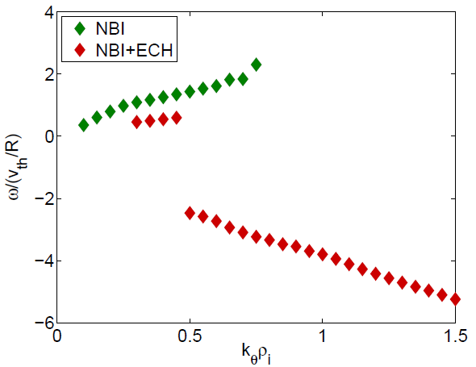
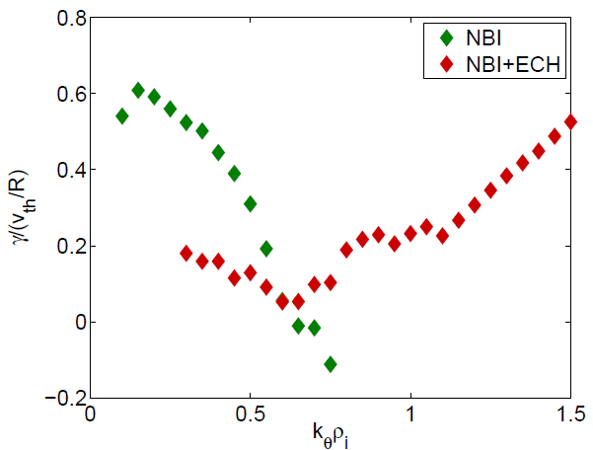
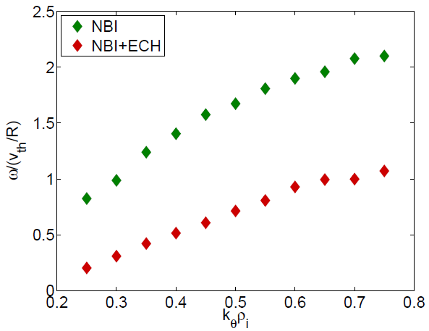
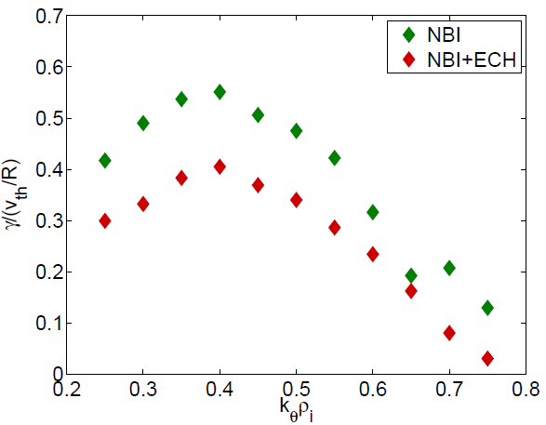
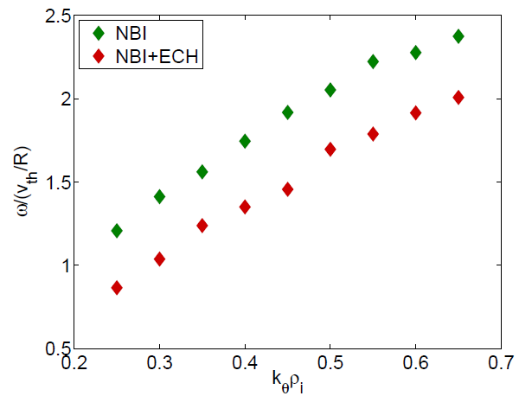
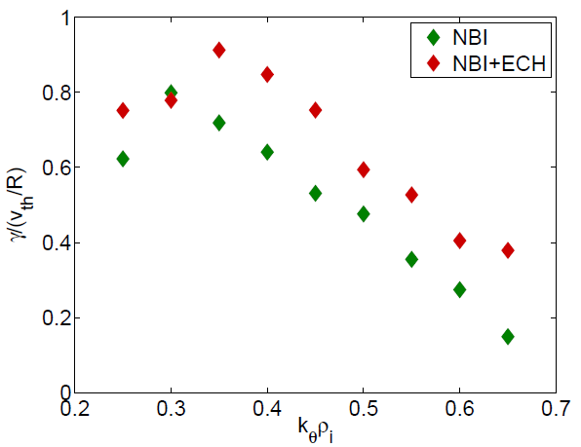
Linear Stability Study using GS2 Gyrokinetic Code
Comparison of micro-instability ‘before’ (NBI only) vs
‘after’ (NBI+ECH)
Collisions, ExB shearing, toroidal rotation are included
Consider most conservative n_{e}(r)
ITG → TEM transition occurs only in deep core
ITG remains as dominant instability, albeit with reduced frequency and growth rate
 | Mode Frequency | Linear Growth Rate
ρ=0.18
ρ=0.3
ρ=0.5
ITG +
TEM -
$$ρ=0.18, 0.3, 0.5$$
Region of ‘Mode flip’quite limited!
17

Slide 18
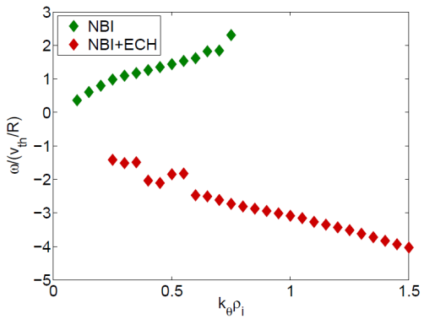
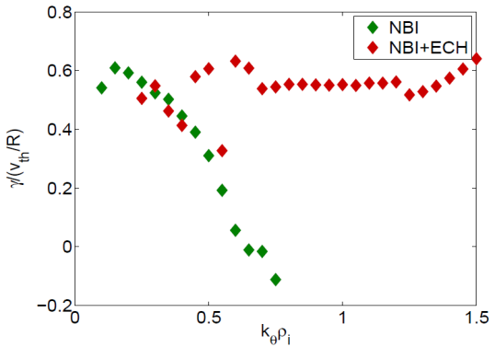
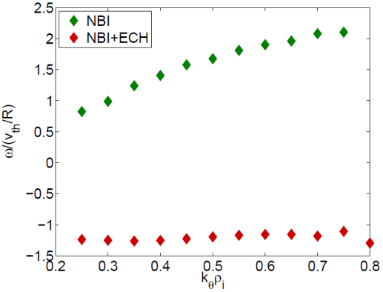
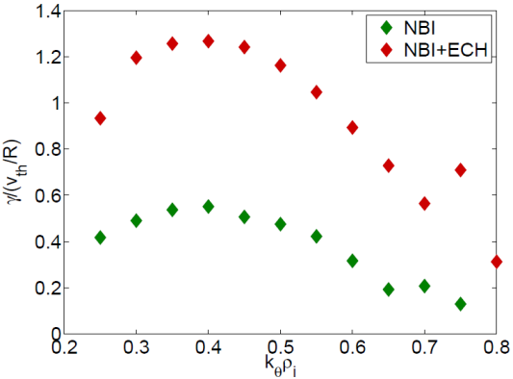
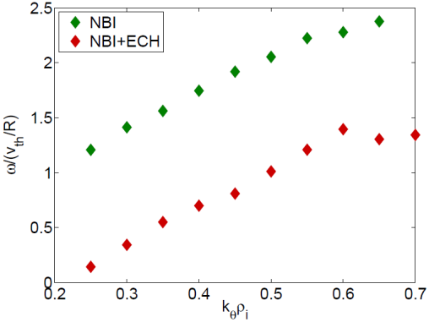
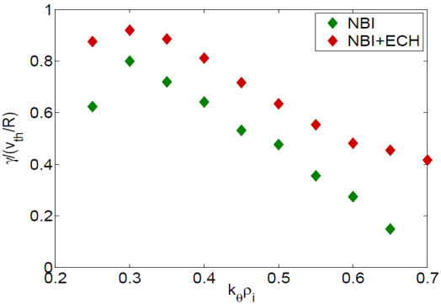
Linear Stability Study for Least Conservative Peaking Case
Comparison of micro-instability ‘before’ (NBI only) vs
‘after’ (NBI+ECH)
Collisions, ExB shearing, toroidal rotation are included
Consider least conservative n_{e}(r)
ITG → TEM transition occurs over broad region
 | Mode Frequency | Linear Growth Rate
ρ=0.18
ρ=0.3
ρ=0.5
ITG +
TEM -
ITG +
TEM -
$$ρ=0.18, 0.3, 0.5$$
Extent of ‘Mode flip’ broader and unambiguous.
18

Slide 19
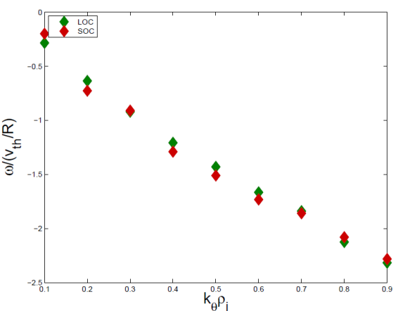
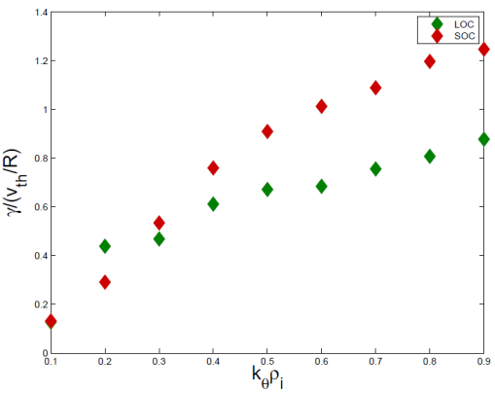
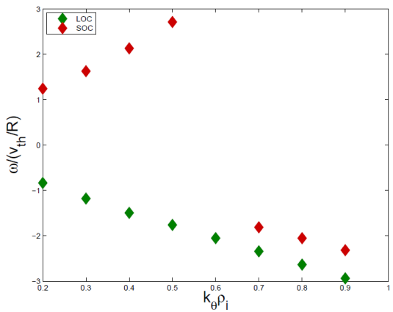
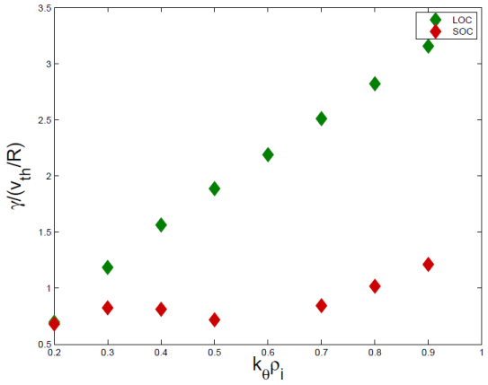
Related analysis: OH reversals in Alcator C-Mod
(Thanks to John Rice, Chi Gao and colleagues!)
C-mod OH shot: sn 1100317028
Comparison of micro-stability ‘before’ (LOC) vs
‘after’ (SOC) reversal
Collisions, ExB shearing, toroidal rotation are included, density profile provide
TEM→ITG transition occurs at ε=0.25 near q~1.8
In contrast to conservative choice for ECH case, TEM→ITG transition is unambiguous
‘Mode flip’ idea is viable in this case
ε=r/R0 | Mode frequency | Linear growth rate
ε=0.20
ε=0.25
ITG +
TEM -
‘Mode flip’ is clear.
19

Slide 20
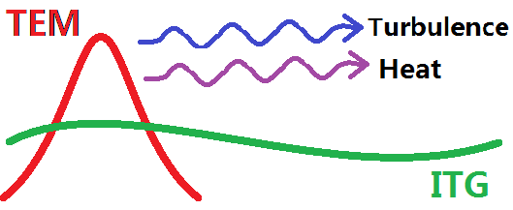
Digest of the analysis
macroscopics (Δ(∇Vφ) ~-Δ(∇Te)), R/ L_{Te} increase, density peaking, etc, all suggest TEM-driven counter-intrinsic torque induced by ECH.
Linear stability analysis, indicates that region of mode flip transition is very sensitive to density peaking.
Comments:
density peaking is critical ⇒ reinforces strong coupling of momentum and particle transport.
Likely that core turbulence in a ‘mixed state‘ of both TEM and ITG Modeling needs to comprehend dynamics of two competing domains.
Turbulence spreading, heat avalanches may extend domain of TEM influence.
20
Notes:
20

Slide 21
Outline
Motivation and Introduction
II. Experimental setup on KSTAR
III. Experimental results: Effects of ECH on toroidal rotation on KSTAR
IV. Analyses and Interpretation for the effect of on-axis ECH for H-mode plasma : ITG ↔TEM transition
V. Summary and future plans

Slide 22
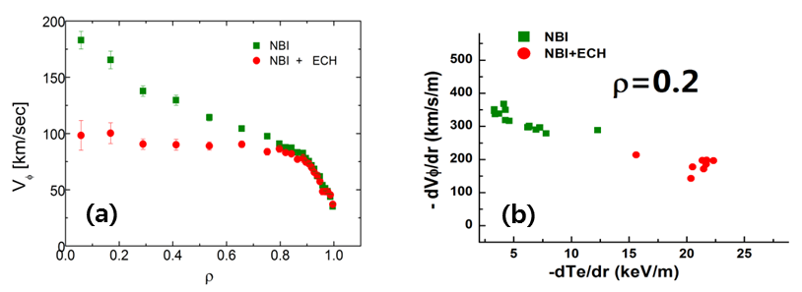
Summary .1
I. For co-NBI heated plasma on KSTAR,
both XICS and CES show
— on-axis ECH (400kW) induced
counter-current torque in core
(-ΔVφ/ Vφ ~30%)
— Δ (∇Vφ) ~- Δ (∇Te) in core
II. Rotation profile in ECH+NBI H-mode is determined by an interplay of 3 players:
co-current NBI torque,
pedestal intrinsic torque (co-current)
core intrinsic torque by ECH
(counter-current).
III. Density profiles for KSTAR not available. The transport of momentum is strongly coupled to the transport of particles. There is some indirect evidence of moderate density profile peaking during ECH. This favors TEM over ITG.
22
Notes:
22

Slide 23
Summary .2
IV. Intrinsic torque is induced by broken symmetry in turbulence. Sign dependence of residual stress depends on mode propagation direction (i.e. sign flips upon ITG ↔ TEM).
V. Measured profiles hint that E×B shear induced symmetry breaking becomes modest and unchanged with ECH, while turbulence intensity gradient effects becomes stronger as ∇Te increases.
ITG +
TEM -
ITG +
ρ=0.3
TEM -
ρ=0.18
VI. Linear gyrokinetic analysis shows that ITG ↔ TEM transition sensitive to density profile, i.e.
VII. Evidence to support ITG ↔ TEM transition contingent on peaking. Likely need to address mixed states and non-local dynamics (i.e. turbulence spreading )!?
Mode frequency for
most conservative n_{e}(r)
Mode frequency for
least conservative n_{e}(r)
→quite limited for most conservative n_{e}(r)
→extends thru broad region for least conservative n_{e}(r)
23
Notes:
23

Slide 24
Future plans
Experimental aspects
I. Coordinated experimental studies of particle transport. Obtain density profile.
II. Scans with higher ECH power, broader range of P_{ECH}/P_{NBI}; transport analysis (including momentum)
III. BES fluctuation studies, coordinated with macroscopics
⎯ intensity profile?
⎯ plasma frame propagation direction? Are flips of frequency centroid observed?
IV. Explore counter-NBI H-mode + ECH → ala’ Solomon, understanding of the interaction of multiple torques. i.e. Does remaining intrinsic counter torque due ECH match result of transport analysis?
V. Comparison with OH reversals
24
Notes:
24

Slide 25
Future plans
Theory and simulation aspects
I. Comprehensive linear stability analysis of experimental profiles, quantitative calculation of Π^{R}
II. Development of residual stress models which comprehend mixed populations and turbulence spreading or propagation, to explore the effect of a spatially bounded ‘mode flip’region.
III. Nonlinear gyrofluid simulations of domains of dynamically competing flux driven ITG and TEM turbulence populations.
TEM
Mixed
ITG
IV. Exploration of alternative scenarios
25
Notes:
25

Slide 26
Thank you
for your attention!

Slide 27
BACK UP
27

Slide 28
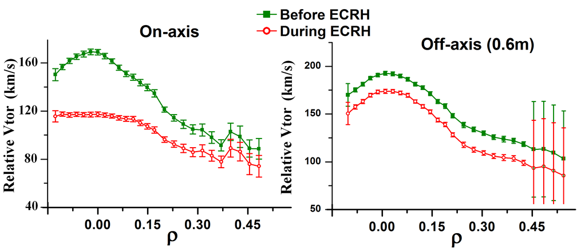
Toroidal Rotation Change by Off-axis ECH
Change of ECH resonance location (other parameters same) ➔ toroidal rotation drops ~ 10%
Off-axis ECH outside of q=1 surface:
reduced heating efficiency ➔ reduced counter torque
unlikely to excite MHD ➔ no NTV, but counter torque persists
28

Slide 29
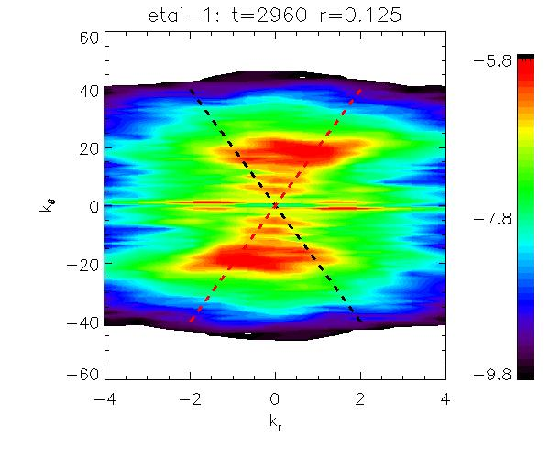
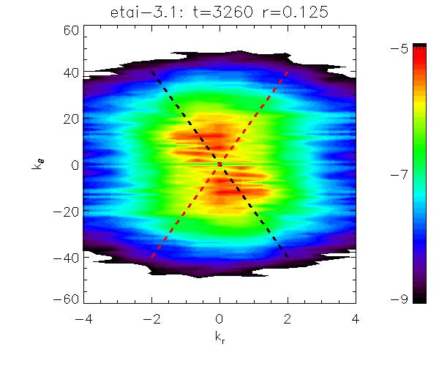
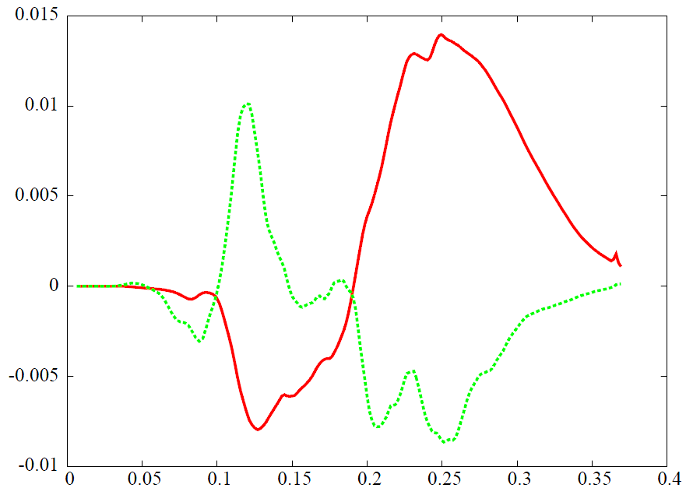
Gyrokinetic Simulation of Intrinsic Torque Reversal at ITG ↔TEM
TEM
ITG
V|| / V_{th}
TEM
k_{θ}
k_{θ}
ITG
k_{r}
k_{r}
r/R₀
Gyrokinetic simulation of ITG and TEM using gKPSP code (global, $δf$)
ITG and TEM show opposite fluctuation symmetry breaking pattern
➔ Sign flip in Reynolds stress
➔ Sign flip in fluctuation $k_{∥}$ spectrum and $E×B$ shearing
➔ Intrinsic torque and rotation reversal at ITG ↔ TEM transition
29

Slide 30
Residual Stress due Intensity Gradient
Direction
co-current for $V_{∗i}$ ↔ i.e. ITG
counter-current for $V_{∗e}$ ↔ i.e. TEM
Dependence, for TEM
$$Π_{rφ}^{R}=\frac{2Ω_{i}}{L_{I}}\frac{\hat{s}}{Rq} \sum_{k}{τ_{c,k}k_{θ}^{3}ρ_{s}^{2}c_{s}^{2}x_{k}^{2}\left|\frac{e{\hat{φ}}_{k}}{T_{e}}\right|(1+2τ+4τ^{2}\frac{L_{n}}{R_{0}} })$$
$L_{I}$ = intensity gradient scale length $\frac{1}{L_{I}} \sim \frac{1}{I}\frac{∂I}{∂r}$
$L_{I} \sim L_{Te}>0$
➔ $Δ\left(\frac{∂〈V_{φ}〉}{∂r}\right) ≅\frac{2Ω_{i}Δ_{s}^{2}}{L_{T_{e}}}\frac{\hat{s}}{Rq} \left(1+2τ+4τ^{2}\frac{L_{n}}{R_{0}}\right)>0$ for standard estimate
$$τ=T_{i}/T_{e}$$
$Δ_{s}$ ~ spectral width

