Slide 1
Study of Toroidal Flow Generation by ICRF
Minority Heating in Alcator C-Mod Plasma
S. Murakami, K. Itoh¹⁾, L.J. Zheng²⁾, J.W. Van Dam²⁾,
P. Bonoli³⁾, J.E. Rice³⁾, C.L. Fiore³⁾, C. Gao³⁾ and A. Fukuyama
Department of Nuclear Engineering, Kyoto Univ., Kyoto 606-8501, Japan
¹⁾ National Institute for Fusion Science, Gifu 509-5292, Japan,
²⁾Institute for Fusion Study, Univ. Texas at Austin, USA
3)Plasma Science and Fusion Center, MIT, Cambridge, MA, USA
This work is supported by Grant-in-Aid for Scientific Research (C) (23561000), (S) (20226017) and (A) (23244113) from JSPS, Japan.

Slide 2
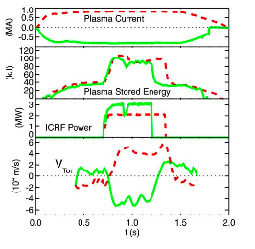
Toroidal Flow related to ICRF Heating
Alcator C-mod
Important role of the plasma flow and its shear in the transport improvement is indicated by experimental observations.
=> H-mode transition, ITB formation, …
Spontaneous toroidal flows with no direct momentum input are observed in many devices.
=> A number of generation mechanisms are proposed to explain these spontaneous flows.
Among them spontaneous flows related to the ICRF heating has been observed in JIPP-TIIU[Ida, NF1991], JET[Eriksson, PPCF1997], Alcator C-Mod[Rice, NF2002, 2005] and etc.
Especially, in the Alcator C-Mod plasma[Rice, NF2005][Fiore, PoP2012], the spontaneous toroidal flow and ITB formation have been investigated intensively in the ICRF heating plasma.
ITB

Slide 3
TF and ITB formation in Alcator C-Mod by ICH
[Fiore, PoP2012]
The r_{res} scan experiment has been performed.
ITB formation can be seen when the resonance location was placed at well off the magnetic axis, near |r/a|~0.5.
A deep well in the toroidal flow velocity appears as ICRF resonance r_{res}/a=-0.54. (ExB shearing rate ~ γ_{ITG})
res

Slide 4
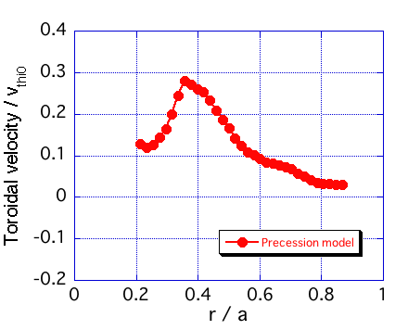
Motivation
We have studied the toroidal flow (TF) generation by the ICRF heating using GNET code, in which the drift kinetic equation is solved in 5D phase-space.
[Murakami, NF2000, NF2006]
In our previous study [Murakami, IAEA FEC 2010]
  A co-directional TF is generated outside of the RF wave power absorption region, which is consistent direction with the experimental results.
  It is found that the toroidal precession motion of trapped energetic tail ions plays an important role in generating the averaged TF.
In this study we investigate the ICRF resonance location dependencies of the TF generation to make clear the role of ICRF heating driven TF in the ITB formation of the Alcator C-Mod plasma.
GNET simulation
Precession model

Slide 5
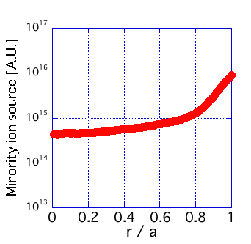
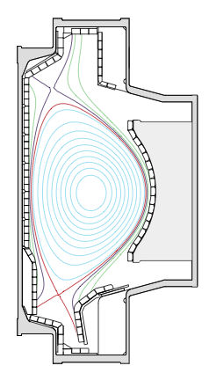
GNET : ICH Simulation Model
GNET (Global NEoclassical Transport simulation code) [S. Murakami, NF2006, NF2000] solves the drift kinetic equation as a (time-dependent) initial value problem in 5D phase space based on the Monte Carlo technique.
C(f) : linear Coulomb Collision Operator
Q_{ICRF} : ICRF heating term: wave-particle interaction model
S_{particle} : particle source
=> by ionization of neutral particle: AURORA
L_{particle} : particle sink (loss)
=> Charge exchange loss
=> Orbit loss (outermost flux surface)
Plasma parameters (fixed);
n_{e0}~8x10¹⁹m⁻³, T_{i0}=T_{e0}~3.2keV
A model ICRF wave field is assumed;
minority ion
source

Slide 6
r_{res} Dependencies of P_{abs} and p_{minority}
We study the resonance location, r_{res} , dependencies of the toroidal flow fixing plasma and RF wave parameters.
P_{abs} shows a clear shift of the RF power absorption region and p_{minority} also shows a clear shift of the energetic minority ion pressure.

Slide 7
r_{res} Dependencies of Velocity Space Distribution
r_{res}/a = -0.55
r_{res}/a= -0.2
r_{res}/a = 0.1
r_{res}/a = 0.5
r/a=0.5
r/a=0.75
Total

Slide 8
Poloidal Angle Dependencies of Distribution (r/a=0.5)
Flux avrg.
θ=0
θ=90
θ=180
r_{res}/a
= -0.55
r_{res}/a
= 0.1
r_{res}/a
= 0.5

Slide 9
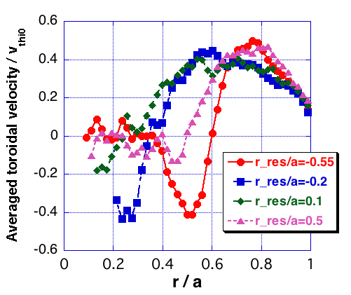
r_{res} Dependencies of Minority Ion Toroidal Flow
Minority ion velocity
We can see large co direction toroidal flows in the outside region of the resonance location, r/a>|r_{res}/a|, in all cases and the TF velocity reaches more than 40% of v_{thio} (V_{tor} ~300km/s with P_{ICRF}~2MW).
Deep wells are observed at the ITB region in the r_{res}/a=0.5 and -0.55 cases.

Slide 10
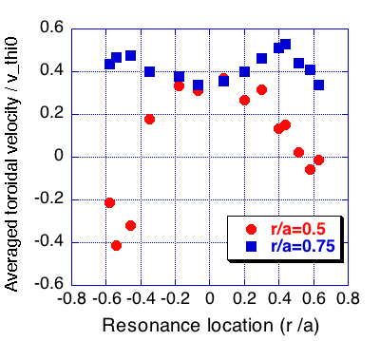
Velocity Shear of Minority Ion near r/a=0.5
GNET
[Fiore, PoP2012]
We can see that the toroidal flow shear near r/a =0.5 is enhanced when the resonance location shifted to |r_{res}/a| >0.5.
The simulation results shows similar tendency with the experimental ones[Rice, NF2002].

Slide 11
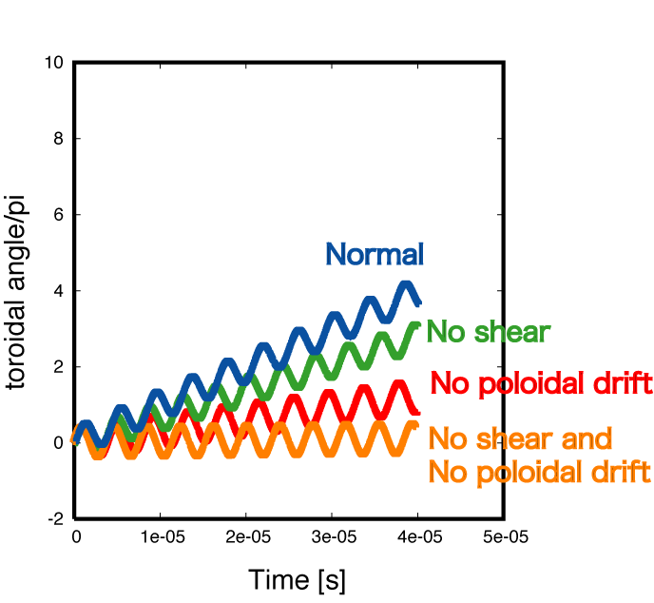
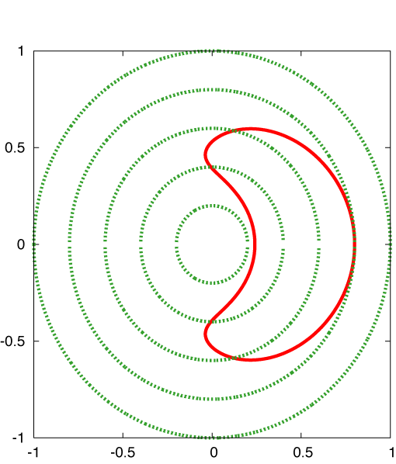
Toroidal Precession Motion of Trapped Ions
[R.B. White, ''The Theory of Toroidally Confined Plasmas”, 2001]
E=200keV
θ_{p}=75 degrees
Poloidal
drift
Toroidal
drift
Finite banana size
+ magnetic shear
Poloidal
drift effect
Smaller V_{θ}
Longer
time
Larger V_{θ}
Shorter
time

Slide 12
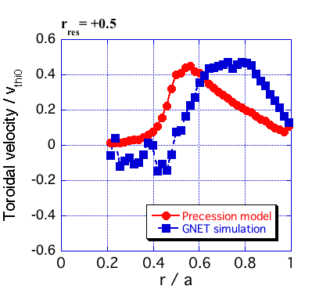
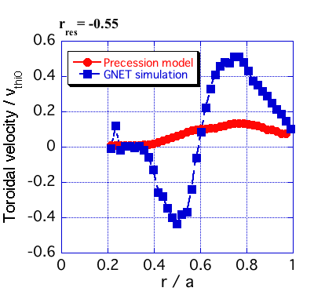
Evaluation of Toroidal Flow using Precession Model
Assume a simple tokamak
GNET dist.+Theory
[Murakami,
IAEA FEC2010]
r_{res}/a = 0.5
r_{res}/a = -0.55
Finite banana size
+ magnetic shear
Poloidal
drift

Slide 13
Radial Profile of Bulk Plasma TF (Toroidal Flow)
Simulation
Radial diffusion eq. of V_{t}
with the torque by minority ion
In order to study the radial profile of the bulk plasma TF driven by the minority ions we solve the radial diffusion equation
(D=1.0m²/s and ν=1.2x10²s⁻¹ are assumed).
We obtain good agreements of the radial profile of TF between the simulation and experimental results.

Slide 14
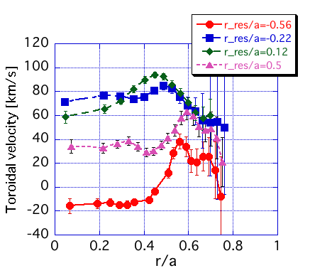
Radial Profile of Bulk Plasma TF (Toroidal Flow)
Simulation
Exp.
In order to study the radial profile of the bulk plasma TF driven by the minority ions we solve the radial diffusion equation
(D=1.0m²/s and ν=1.2x10²s⁻¹ are assumed).
We obtain good agreements of the radial profile of TF between the simulation and experimental results.

Slide 15
Conclusions
We have studied the toroidal flow (TF) generation by the ICRF minority heating in the Alcator C-Mod plasma applying GNET code.
We have found that a co-directional minority ion TF is generated in the outside region of the resonance location and that the TF velocity reaches more than 40% of v_{thio} (V_{tor} ~300km/s with P_{ICRF}~2MW).
When we shift the resonance location to the out side of |r/a|~0.5 the TF just inside of the resonance location reduces to 0 or changes to opposite direction, and the TF shear is enhanced.
Estimated TF by precession model agrees well with simulated one in the r_{res}/a~0.5 case but not in the cases r_{res}/a<0.1.
=> Large banana width effect?
A simple time development eq. of bulk plasma TF is solved including the torque by the minority ion and relatively good agreements are obtained with the experimental ones.
=> This suggests a role of the ICRF driven TF on the experimentally
observed sheared flow near ITB region.

Slide 16
Finite Banana Size effect on TF
r_{res}/a = -0.55
ρ=0.5, θ=0
ρ=0.75, θ=0
The orbits of the energetic minority ion are investigated to make clear the finite banana size effect on the TF.
We found that the energetic ion has a large orbit size in the r_{res}/a=+0.55 case and that those ions enhance the shear between r/a=0.5 and 0.8.

Slide 17
Conservation of Canonical Toroidal Momentum

