Slide 1

Multi-field two-fluid and gyro-fluid simulations of Edge-Localized-Modes
T. Y. Xia^{1,2}, X. Q. Xu², Z. X. Liu¹, S. C. Liu¹, B. Gui^{1,2}, W. Meyer², G. Q. Li¹ and J. G. Li¹
¹Institute of Plasma Physics, Chinese Academy of Sciences, Hefei, China.
²Lawrence Livermore National Laboratory, Livermore, CA 94550, USA
X.Q.Xu¹, P.W.Xi^{1,2}, A.Dimits¹, I.Joseph¹, M.V.Umansky¹, T.Y.Xia^{1,3}, B.Gui^{1,3}, S.S.Kim⁴,
G.Y.Park⁴, T.Rhee⁴, H.Jhang⁴, P.H.Diamond^{4,5}, B.Dudson⁶, P.B.Snyder⁷
¹LLNL,²PKU,³ASIPP,⁴NFRI,⁵UCSD,⁶U.York,⁷GA
24th IAEA Fusion Energy Conference,
8-13 Oct. 2012, San Diego, USA
This work was performed under the auspices of the U.S. DoE by LLNL under Contract DE-AC52-07NA27344 and is supported by the China NSF under Contract No.10721505, the National Magnetic Confinement Fusion Science Program of China under Contracts No. 2011GB107001. LLNL-PRES-587359
Notes:
1

Slide 2
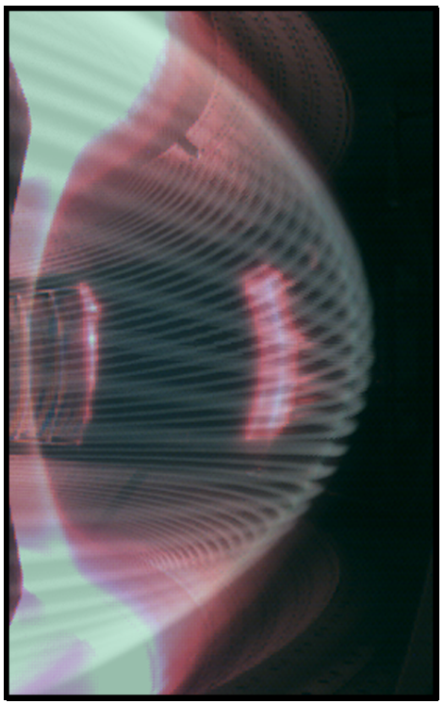
Principal Results
Part one: two-fluid model
Fundamental model: 3-field 2-fluid model is a good enough model for P-B instability and ELM crashes.
Multi-field 2-fluid models are necessary to describe heat transport.
BOUT++ simulations show that bright stripes from visible camera on EAST match ELM filamentary structures.
Part two: gyro-fluid model
First order FLR corrections from “gyro-viscous cancellation” in two-fluid model are necessary to agree with gyro-fluid results for high ion temperature.
Higher ion temperature introduces more FLR stabilizing effects, thus reduces ELM size.

Slide 3
BOUT++ code for modeling tokamak edge ELMs and turbulence*
Framework for writing fluid / plasma simulations in complex tokamak geometry
  Proximity of open+closed flux surface
  Presence of X-point
Written in C++, started from BOUT code, jointly developed by LLNL, Univ. York, other U.S. and international partners
Well benchmarked with ELITE, GATO and other codes
3-field model
Linear Growth Rate (γ/ω_{A})
Toroidal mode number n
X.Q. Xu, B.D. Dudson, P.B. Snyder, M.V. Umansky,
H.R.Wilson and T. Casper, Nucl. Fusion 51 (2011) 103040
* X.Q. Xu and R.H. Cohen, Contrib. Plasma Phys. 38, 158 (1998)
Umansky, Xu, Dudson, et al., , Comp. Phys. Comm. V. 180 , 887-903 (2008).
Dudson, Umansky, Xu et al., Comp. Phys. Comm. V.180 (2009) 1467.

Slide 4
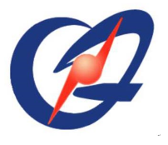


TH/5-2Ra
Multi-field two-fluid Peeling-Ballooning modes simulation with BOUT++
T. Y. Xia^{1,2}, X. Q. Xu², Z. X. Liu¹, S. C. Liu¹, B. Gui^{1,2}, W. Meyer², G. Q. Li¹ and J. G. Li¹
¹Institute of Plasma Physics, Chinese Academy of Sciences, Hefei, China.
²Lawrence Livermore National Laboratory, Livermore, CA 94550, USA
24th IAEA Fusion Energy Conference,
8-13 Oct. 2012,San Diego, USA
This work was performed under the auspices of the U.S. DoE by LLNL under Contract DE-AC52-07NA27344 and is supported by the China NSF under Contract No.10721505, the National Magnetic Confinement Fusion Science Program of China under Contracts No. 2011GB107001. LLNL-PROC-583395.
Notes:
4

Slide 5
Multi-field two-fluid model in BOUT++
Three-field (ϖ, P, A||): peeling-ballooning model.
Four-field (ϖ, P, A||, V||): include sound waves.
Five-field (ϖ, n_{i}, T_{i}, T_{e}, A||): parallel thermal conductivities
Six-field (ϖ, n_{i}, T_{i}, T_{e}, A||, V||): combine all the models together, based on Braginskii equations, the density, momentum and energy of ions and electrons are described in drift ordering[1].
[1]X. Q. Xu et al., Commun. Comput. Phys. 4, 949 (2008).

Slide 6
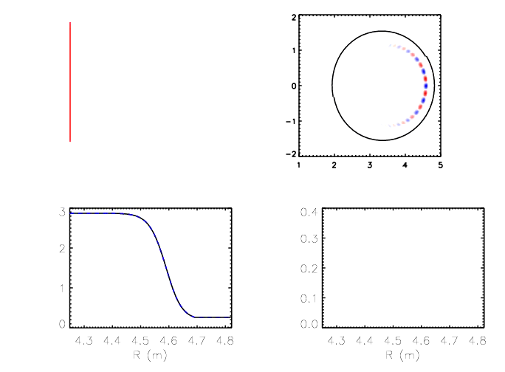
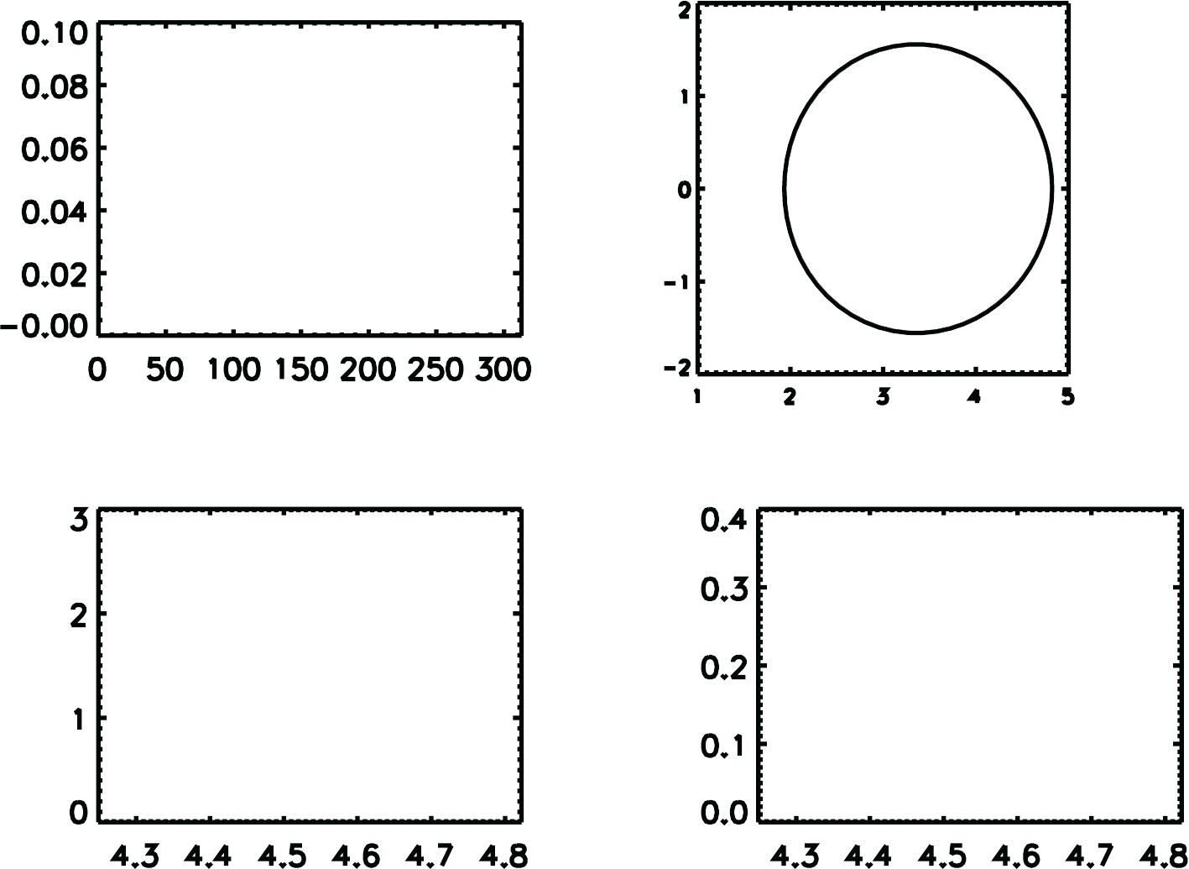


ELM crash in BOUT++ simulations
Pressure Perturbation $\tilde{P}$
ELM size
Vertical Z(m)
Normalized Time (τ_{A})
Major radius R (m)
Electron Temperature
perturbation $\tilde{T}e$ (keV)
Density n_{i} (10¹⁹ m⁻³)
Major radius R (m)
Major radius R (m)

Slide 7

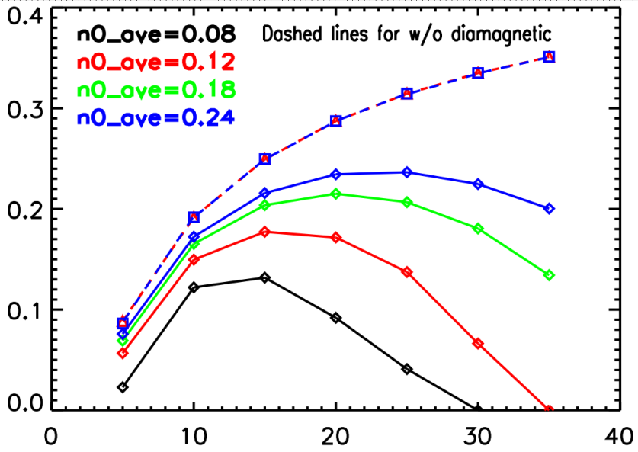






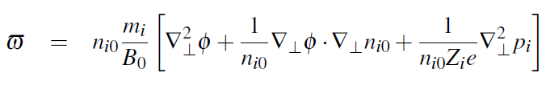
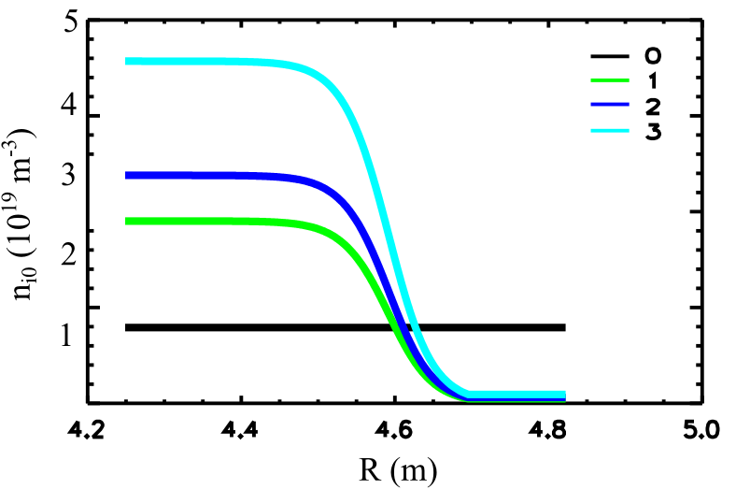
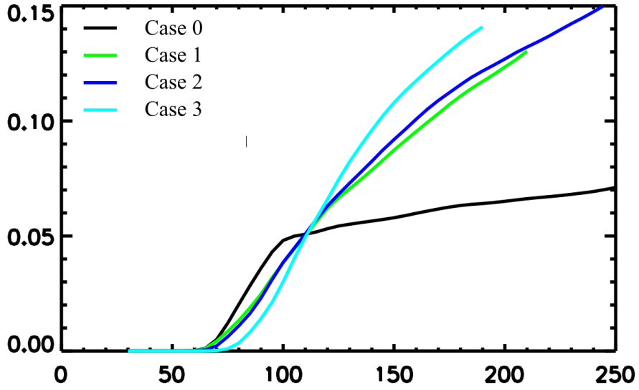
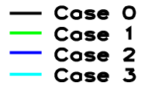
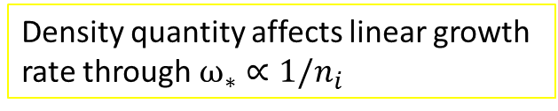
Five-field model: low density leads to larger stabilizing effects by diamagnetic drifts, and density gradient drives larger ELM size
3-field:
5-field
Density quantity affects linear growth rate through $ω_{∗}∝1/n_{i}$
growth rate (γ/ω_{A})
With fixed pressure profile, ion density gradient leads to larger ELM size.
Toroidal mode number n
15
10
5
0
Ion density (10¹⁹ m⁻³)
ELM size (%)
ELM size
Major radius R (m)
Normalized Time (τ_{A})

Slide 8
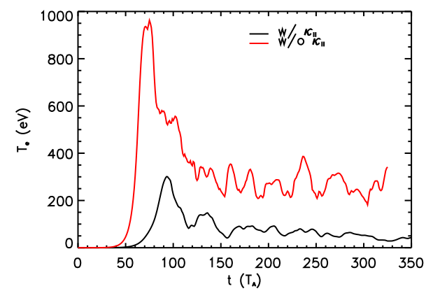



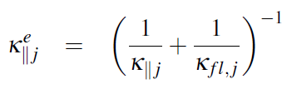
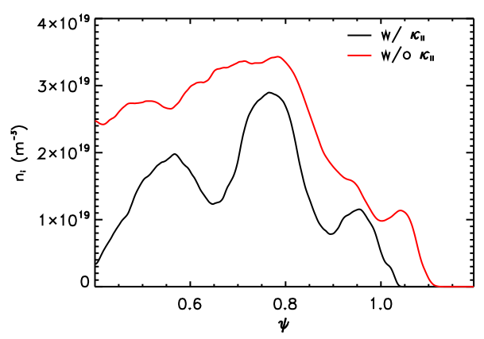
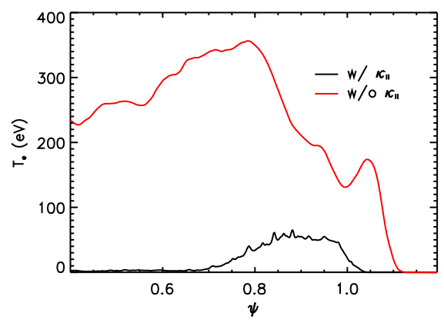
Thermal conductivities suppress the energy transport at inner boundary
Thermal conductivities with flux limited expressions suppress the increase of ELM size:
Electron temperature (eV)
Flux limited expression:
Electron temperature is most sensitive to κ||.
Normalized Time (τ_{A})
Ion density (m⁻³)
Electron temperature (eV)
Normalized flux ψ (radial direction)
Normalized flux ψ (radial direction)

Slide 9
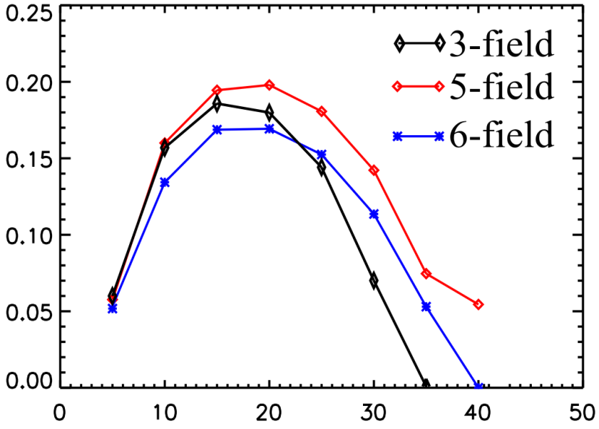
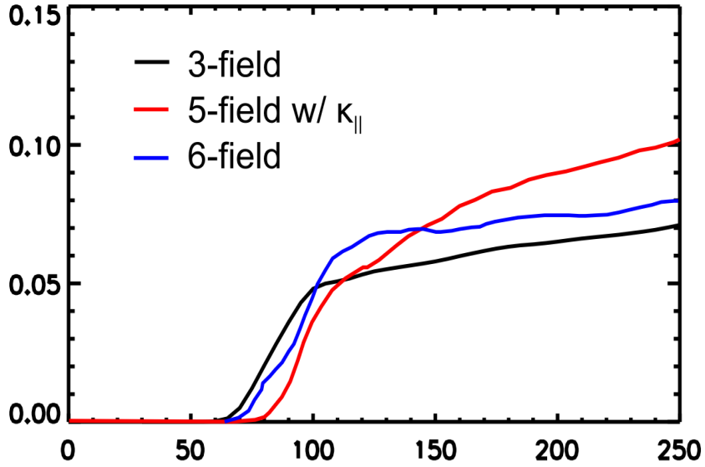
3-field 2-fluid model is good enough to simulate P-B stability and ELM crashes, additional physics from multi-field contributes less than 25% corrections
Fundamental physics in ELMs:
  Peeling-Ballooning instability
  Ion diamagnetic stabilization
    → kinetic effect
  Resistivity and hyper-resistivity
    → reconnection
Growth rate (γ/ω_{A})
Additional physics:
  Ion acoustic waves
  Thermal conductivities
  Hall effect
  Compressibility
  Electron-ion friction
Toroidal mode number n
15
10
5
0
ELM size (%)
ELM size
change the linear growth rate less than 25%
Power depositions on PFCs.
Turbulence and transport
Normalized Time (τ_{A})

Slide 10
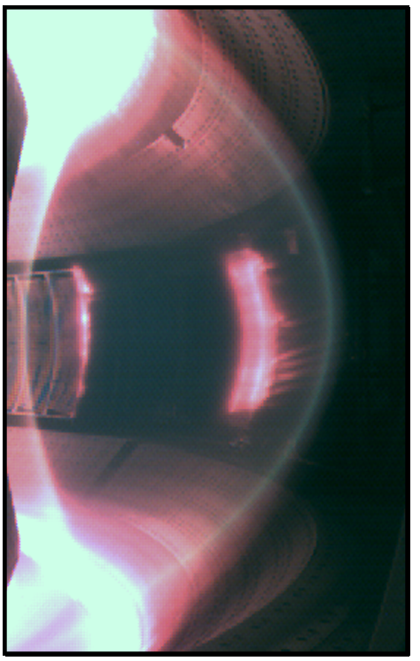
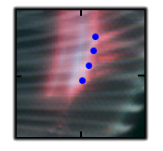
BOUT++ simulations show that the stripes from visible camera match ELM filamentary structures
EAST#41019@3034ms
Visible camera shows bright ELM structure$
BOUT++ simulation shows that the ELM stripe are filamentary structures*
Z (m)
0
-0.5
2 2.25
Major radius
R (m)
Pitch match!
Mode number match!
$Taken by J. H. Yang
*Figure by W.H. Meyer

Slide 11
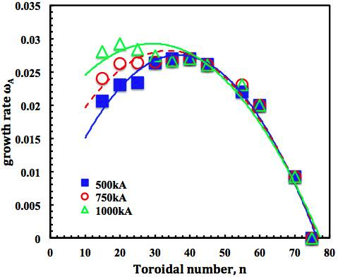
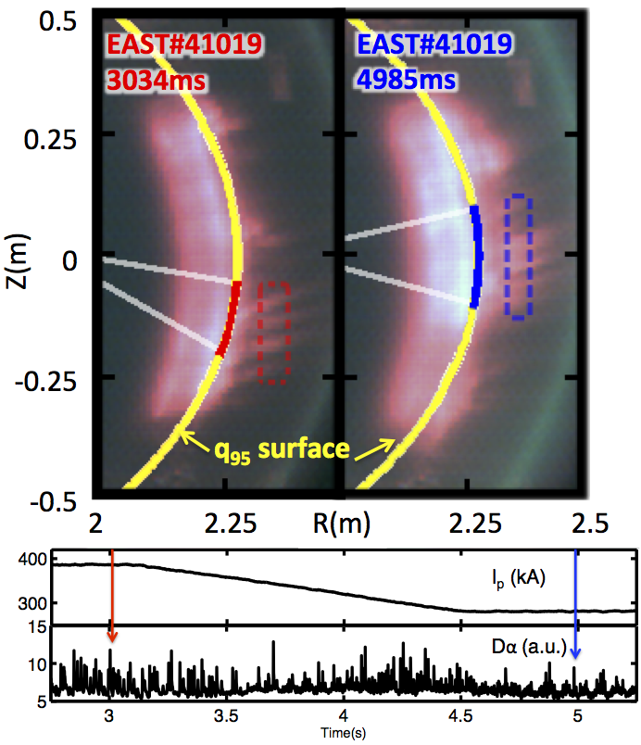
EAST experiments verified BOUT++ predictions
that low-n modes become dominant at high I_{p}
Linear Growth Rate (γ/ω_{A})
Toroidal mode number n
BOUT++:
Higher current has lower n mode
Experiment:
400kA→n=25
300kA→n=30
Qualitatively consist
Z.X. Liu et al, Phys. Plasmas 19 102502 (2012).
Z.X. Liu et al, EX/p7-11, “Study of ELMy H-mode plasmas and BOUT++ simulation on EAST”

Slide 12





Theory and Gyro-fluid Simulations of Edge-Localized-Modes
TH/5-2Rb
X.Q.Xu¹, P.W.Xi^{1,2}, A.Dimits¹, I.Joseph¹, M.V.Umansky¹, T.Y.Xia^{1,3}, B.Gui^{1,3}, S.S.Kim⁴, G.Y.Park⁴, T.Rhee⁴, H.Jhang⁴, P.H.Diamond^{4,5}, B.Dudson⁶, P.B.Snyder⁷ (¹LLNL,²PKU,³ASIPP,⁴NFRI,⁵UCSD,⁶U.York,⁷GA)
24th IAEA Fusion Energy Conference,
8-13 Oct. 2012,San Diego, USA
This work was performed under the auspices of the U.S. DoE by LLNL under Contract DE-AC52-07NA27344 and is supported by the China NSF under Contract No.10721505, the National Magnetic Confinement Fusion Science Program of China under Contracts No. 2011GB107001. LLNL-PRES-587357.
Notes:
12

Slide 13
An isothermal electromagnetic 3-field gyro-fluid model
We derived an isothermal electromagnetic 3-field gyro-fluid model with vorticity formulation generalized from Snyder-Hammett gyro-fluid model [1] for edge plasmas.
Utilizing the Padé approximation for the modified Bessel functions, this set of gyro-fluid equations is implemented in the BOUT++ framework with full ion FLR effects,
In long-wavelength limit, this set of gyro-fluid equations is reduced to previous 3-field two-fluid model with additional gyro-viscous terms resulting from the incomplete “gyro-viscous cancellation” in two-fluid model given by Xu et al [2].
Higher ion temperature introduces more FLR stabilizing effects, thus reduces ELM size.
[1] P. B. Snyder and G. W. Hammett, Phys. Plasmas 8, 3199 (2001).
[2] X. Q. Xu, R. H. Cohen, T. D. Rognlien, et.al., Phys. Plasma 7, 1951 (2000).

Slide 14
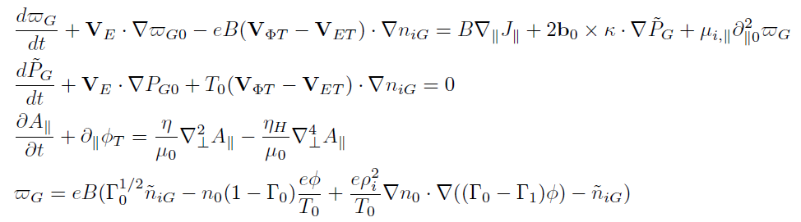

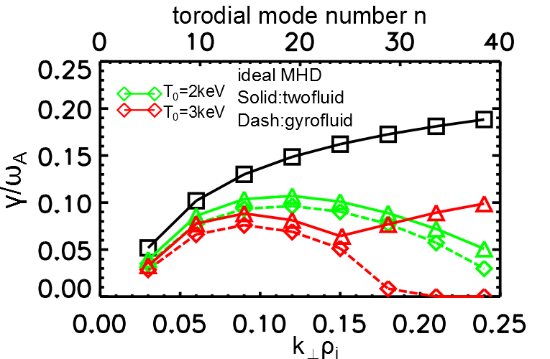

In the presence of large density gradient, gyro-fluid and two-fluid model show qualitative difference when k$⊥$ρ_{i} is large
Consider the large density gradient at H-mode pedestal:
Two-fluid model: no stabilizing on high-n modes,
Gyro-fluid model: strong FLR stabilizing on high-n modes.
Growth rate (γ/ω_{A})
Simple ion diamagnetic effect in two-fluid model is not sufficient to represent FLR stabilizing if density gradient is large!
Normalized wavenumber (k_{θ}ρ_{i})

Slide 15
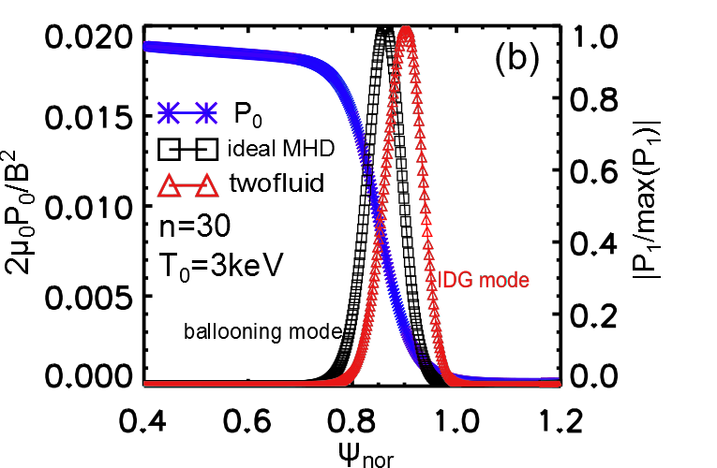
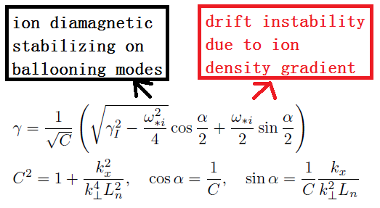
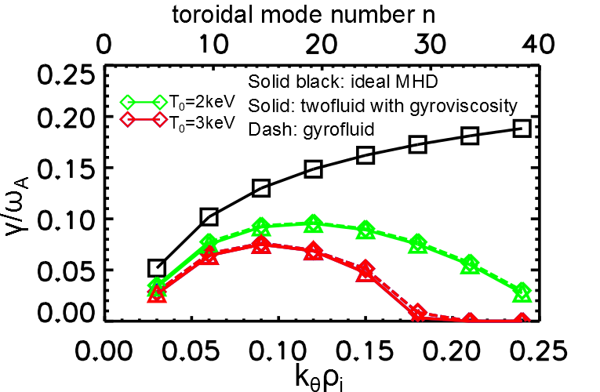
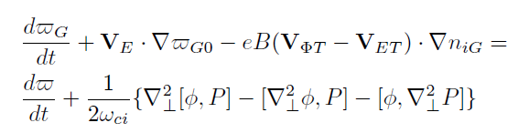
Gyroviscous terms are necessary to stabilize
Ion-Density-Gradient modes, which appear in two-fluid model
Two-fluid dispersion relation:
Normalized flux ψ (radial direction)
At long wavelength limit, gyro-fluid goes back to two-fluid but with additional gyroviscous terms
Normalized wavenumber (k_{θ}ρ_{i})

Slide 16

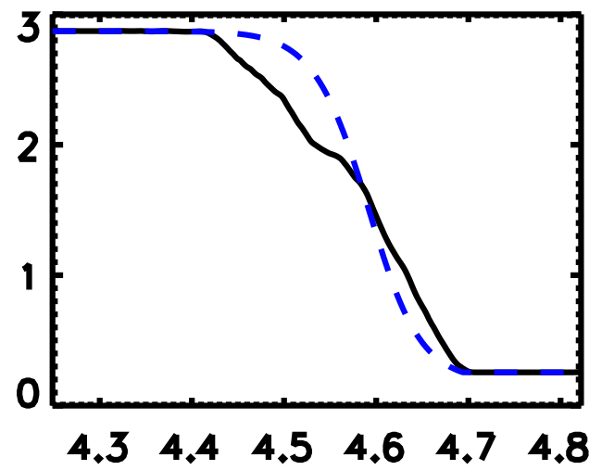
Higher ion temperature introduces more FLR stabilizing effects, thus reduces ELM size
Hyper-resistivity is necessary to ELM crash, but ELM size is weakly sensitive to hyper-resistivity;
With fixed pressure profile, high ion temperature introduce stronger FLR effect and thus leads to smaller ELM size
Definition of ELM size:
R_{in}
R_{out}
ELM size %
Pressure (10⁴ Pa)
Major radius R (m)
Ion temperature (keV)

Slide 17
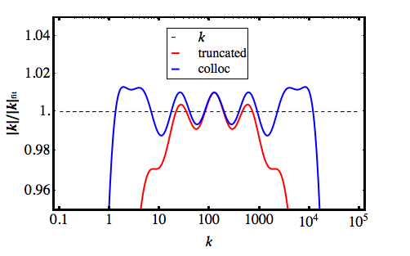
Accurate non-Fourier methods for Landau-fluid operators
Tokamak edge:
kinetic effects important -> need Landau-fluid (LF) operators
Large spatial inhomogeneities & complicated boundary
  need non-Fourier implementation
  Useful accurate approximation:
The new method has favorable Fourier-like computational scaling
Ratio of fit to analytical operator vs. wavenumber
The error is less than 1.5%.

Slide 18
Principal Results
Part one: two-fluid model
Fundamental model: 3-field 2-fluid model is a good enough model for P-B instability and ELM crashes.
Multi-field 2-fluid models are necessary to describe heat transport.
BOUT++ simulations show that bright stripes from visible camera on EAST match ELM filamentary structures.
Part two: gyro-fluid model
First order FLR corrections from “gyro-viscous cancellation” in two-fluid model are necessary to agree with gyro-fluid results for high ion temperature.
Higher ion temperature introduces more FLR stabilizing effects, thus reduces ELM size.

Slide 19
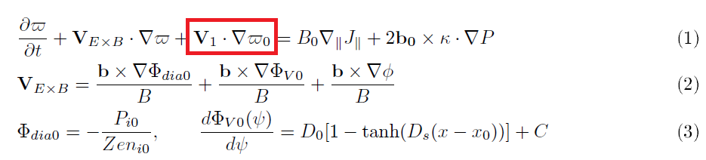
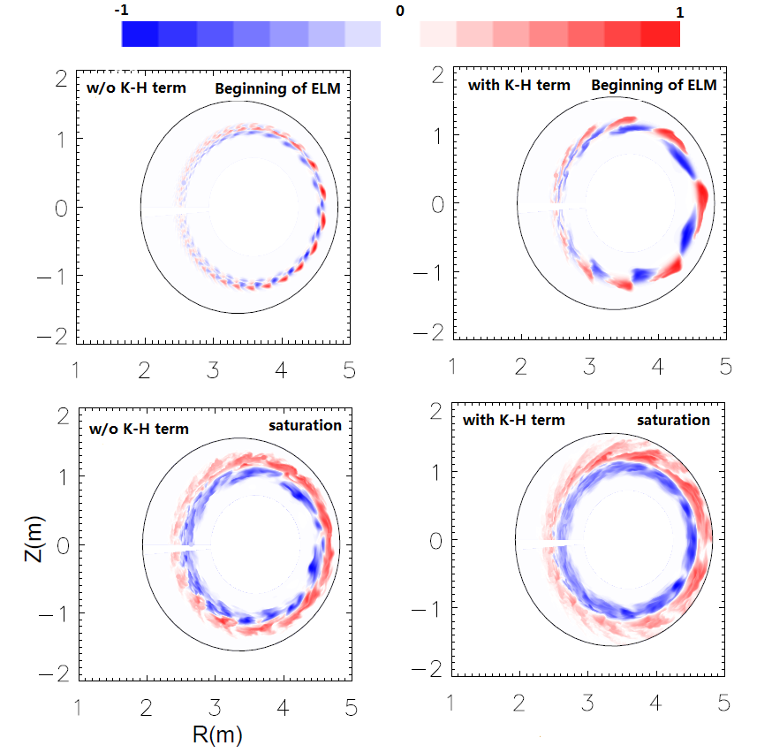
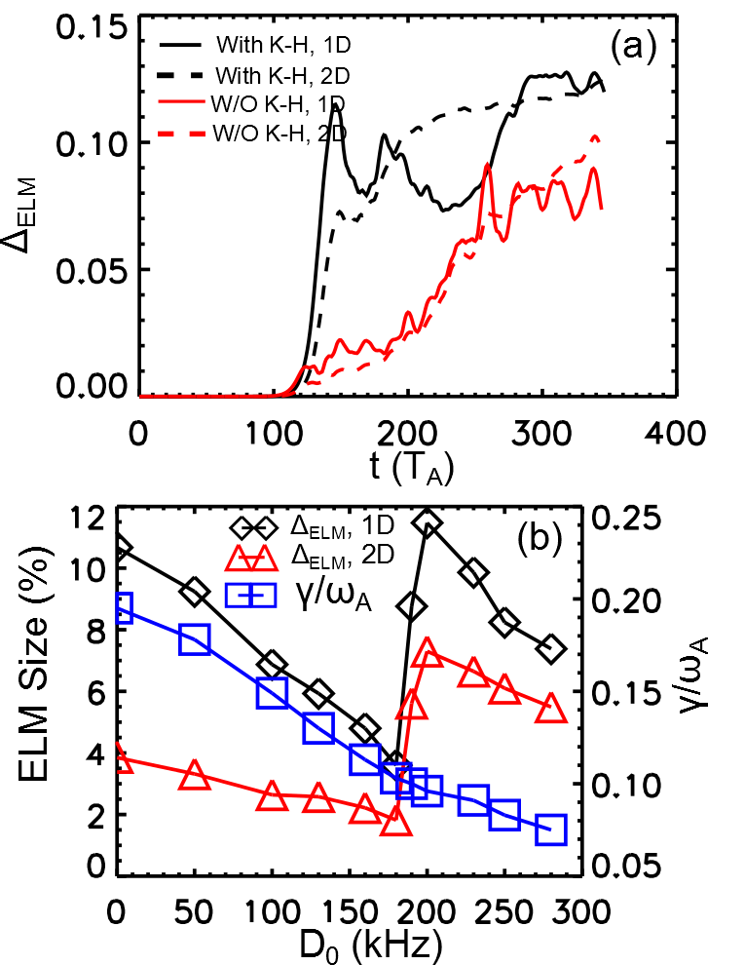
Equilibrium EXB shear flow can stabilize high-n ballooning modes and reduce ELM size, but introduces Kelvin-Helmholtz instability and leads to larger ELM when flow shear is too large.
P. W. Xi, X. Q. Xu, X. G. Wang, and T. Y. Xia, Phys. Plasmas 19, 092503 (2012)

Slide 20
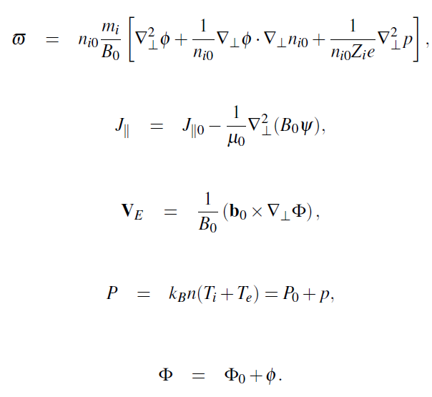
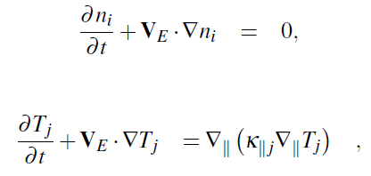
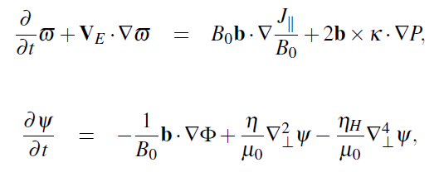
Theoretical Equations for n_{i}, T_{i}, T_{e}, ϖ and ψ
Cross term
(density gradient length scale)
We will neglect the thermal conductivities first.
S=(μ₀RV_{A})/η=10⁸

Slide 21
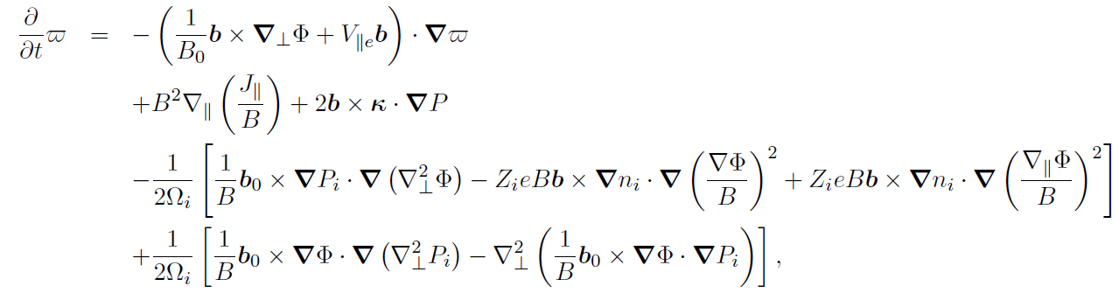
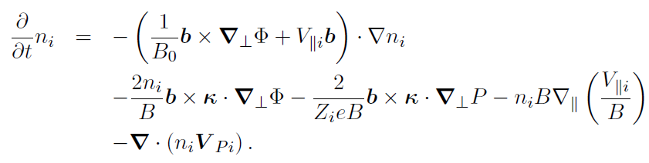


Theoretical Equations for 6-field 2-fluid model
Compressible terms
Vorticity:
Parallel velocity terms
Electron Hall
Thermal force
Gyro-viscosity
Density:
Ohm’s Law:
The parallel ion equation:

Slide 22
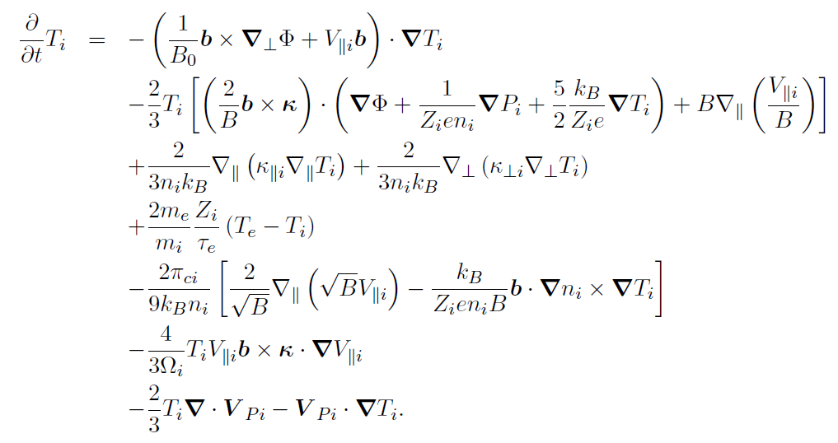
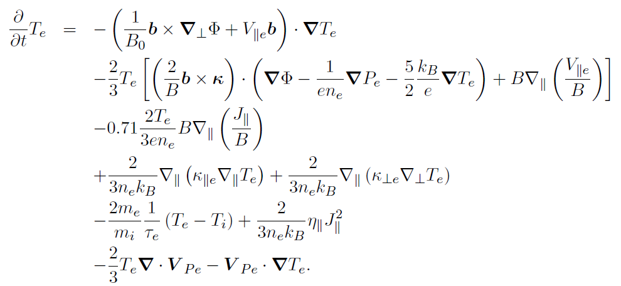
Theoretical Equations for 6-field 2-fluid model (cont.)
Compressible terms
Parallel velocity terms
Electron Hall
Thermal force
Gyro-viscosity
Energy exchange
Energy flux

Slide 23
The new method has Fourier-like computational scaling
Implementation is as a sum of results of Helmholtz solves
For small number of grid cells, direct matrix multiplication is as efficient as Fourier

