Slide 1
Non-Axisymmetric Equilibrium Reconstruction for Stellarators, Reversed Field Pinches and Tokamaks
J.D. Hanson¹, S.A. Lazerson², D.T. Anderson³, M. Cianciosa¹, P. Franz⁴, D.A. Gates², J.H. Harris⁵, S.P. Hirshman⁵, K. Ida⁶, S.F. Knowlton¹, L.L. Lao⁷, E.A. Lazarus⁵, L. Marrelli⁴, D. A. Maurer¹, N. Pablant², S. Sakakibara⁶, J.C. Schmitt², A.C. Sontag⁵, B.A. Stevenson¹, Y. Suzuki⁶, D. Terranova⁴
¹Auburn University, Auburn, AL, USA
²Princeton Plasma Physics Laboratory, Princeton, NJ, USA
³University of Wisconsin, Madison, WI, USA
⁴Consorzio RFX, EURATOM-ENEA Association, Padova, Italy
⁵Oak Ridge National Laboratory, Oak Ridge, TN, USA
⁶National Institute for Fusion Science, Toki, Gifu, Japan
⁷General Atomics, San Diego, CA, USA

Slide 2
Outline
Introduction
Non-axisymmetric (3D) Equilibrium Reconstruction
  Basic Principles
  3D Equilibrium - VMEC
  3D Equilibrium Reconstruction – V3FIT and STELLOPT
Applications of 3D Reconstruction
  Stellarators
    CTH with V3FIT
    HSX with V3FIT
    LHD with STELLOPT
  Reversed Field Pinch
    RFX-mod with V3FIT
  Tokamaks
    DIII-D with both STELLOPT and V3FIT
Conclusions

Slide 3
3D equilibria can now be reconstructed from experimental data for any device with flux surfaces
CTH
DIII-D
HSX
RFX-mod
LHD

Slide 4
3D equilibrium reconstruction based on well established principles
Find the MHD equilibrium that is most consistent with the experimental data
  Signals S, modeled and observed, with variance σ²
  Reconstruction parameters p, and data d
Minimize by changing model parameters
MHD Equilibrium – VMEC
V3FIT and STELLOPT codes

Slide 5
Proven VMEC MHD equilibrium code at the heart of 3D reconstruction codes
Variational Moments Equilibrium Code (VMEC)
  Assumes closed nested flux surfaces: Islands and chaotic regions ignored
  Variational principle – minimizes radial forces on flux surfaces
  Both free-boundary and fixed-boundary equilibria
Fast, robust, widely used throughout the world.
  S. P. Hirshman and J. C. Whitson, Physics of Fluids 26, 3553 (1983)
Flexible and extensible mechanism for specifying VMEC profiles
  Pressure profile
  Either toroidal current profile or iota profile
  Total toroidal (or poloidal) flux enclosed within outermost flux surface
  Free boundary: also needs external coil currents
  Fixed boundary: also needs outermost flux surface shape

Slide 6
Experimental diagnostic set embedded in reconstruction model
From model MHD equilibrium, reconstruction code computes predicted signal from experimental diagnostic
Often need additional quantities (n_{e}, T_{e}, …) to compute modeled signal
Assume quantities are constant on a flux surface – specify radial profile
Diagnostic | Additional Radial Profiles | Model Computation
Magnetic | None | 3D Biot-Savart integral
Soft X-Ray | SXR emissivity ε_{SXR} | Line integral – viewing chord
Interferometry | Electron density n_{e} | Line integral – beam path
Thomson Scattering | Electron density n_{e} Electron temperature T_{e} | Point measurement
Motional Stark Effect | None | Projected B orientation

Slide 7
V3FIT and STELLOPT: similarities and differences
Both codes currently use VMEC as the equilibrium solver
Both codes utilize magnetic diagnostics, soft x-rays, Thomson scattering, and geometrical information for limiter location
Both codes numerically minimize , using a finite difference approximation to the Jacobian matrix
V3FIT and STELLOPT differ
  Details of minimization algorithm
  Methods of including of auxiliary profiles into MHD equilibrium model
  Tightness of coupling between VMEC minimization and reconstruction minimization

Slide 8
3D reconstructions enable interpretation of disruption suppression physics in CTH hybrid plasmas
Compact Toroidal Hybrid (CTH) at Auburn University
  torsatron coils with ohmic heating
  R = 0.75 m, a = 0.2 m,
  B₀ < 0.7 T, I_{oh} < 70 kA
Ohmic current significantly modifies vacuum transform
Studies of disruption suppression using external transform in progress
CTH Shot Runner – Automated reconstructions from experimental database
  Reconstructions at 48 time slices within a shot, ~ 4 minutes wall-clock time.
  Next slide – Movie
    Two reconstruction parameters: total toroidal flux and current profile shape parameter
    25 signals: limiter and 24 partial Rogowski coils

Slide 9
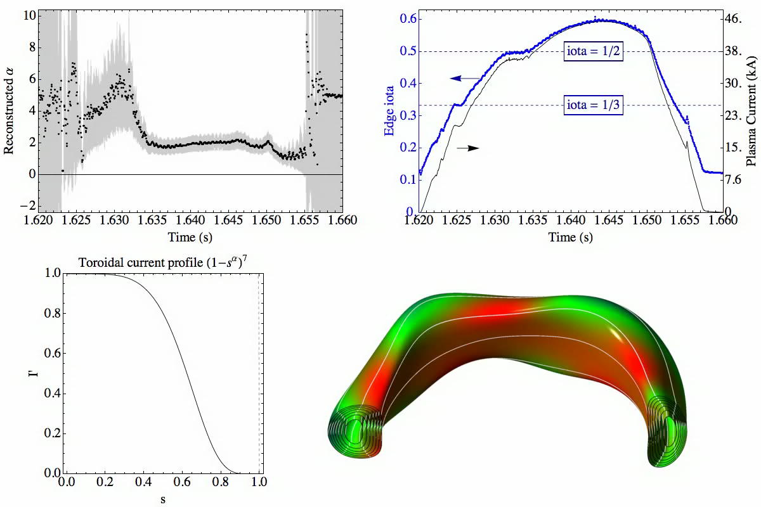

Slide 10
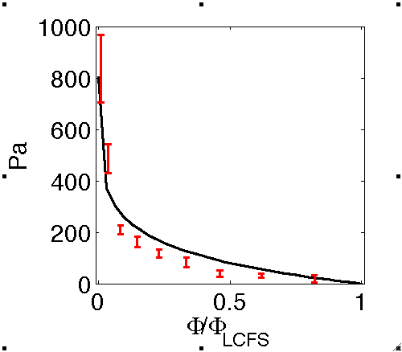
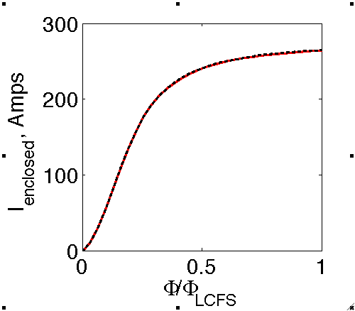
3D reconstructions allow accurate modeling of neoclassical bootstrap current effects on HSX
Helically Symmetric eXperiment (HSX) Stellarator at the University of Wisconsin
  Quasi-helically symmetric
  R = 1.2 m, a = 0.12 m, B₀ ~ 1.0 T
V3FIT reconstructions to study bootstrap current
  Magnetic diagnostics – used for reconstruction
  Poloidal array, radial and poloidal components
Reconstructed pressure and toroidal current profiles agree with measurements and calculations
  Thomson scattering (T_{e} and n_{e}) and Doppler spectroscopy (T_{i})
  Neoclassical bootstrap current with momentum conservation and E_{r} effects (PENTA)
Red – from Thomson and Doppler spectroscopy
Black – reconstruction
Red – neoclassical bootstrap current calculation
Black dashed – reconstruction

Slide 11
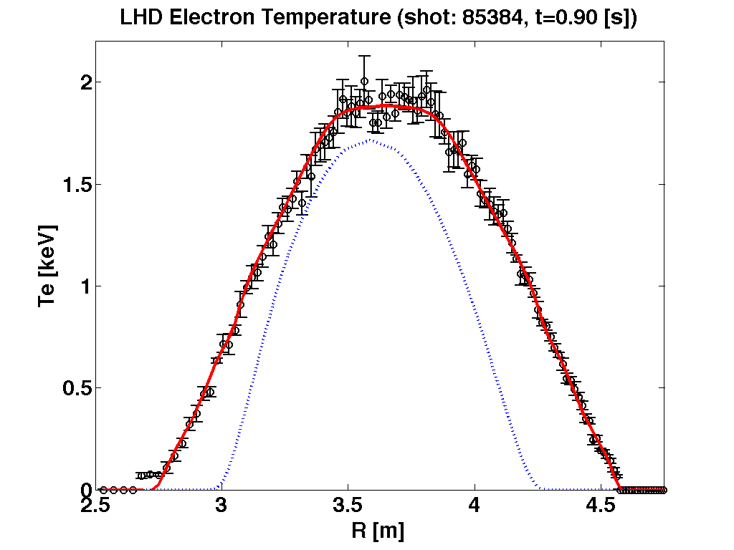
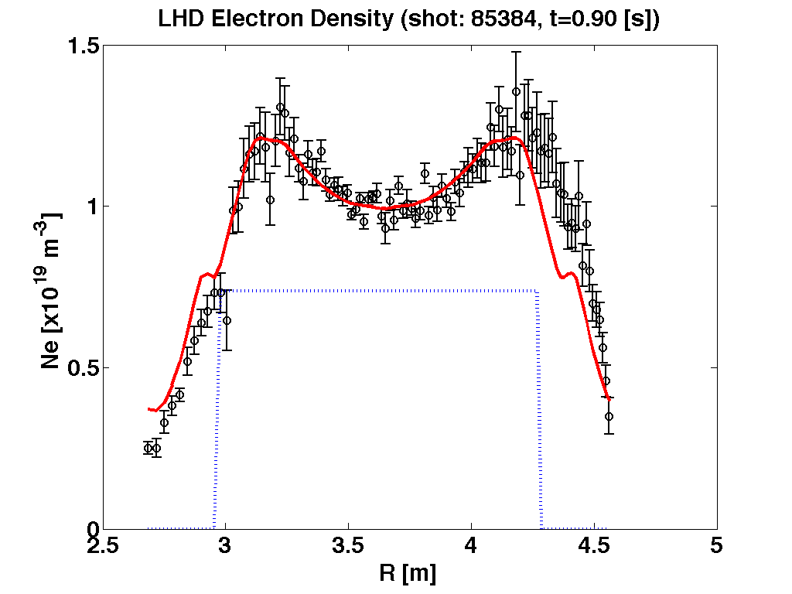
3D reconstructions with Thomson data give accurate plasma size
Large Helical Device (LHD) at the National Institute for Fusion Science, Japan
  R = 3.7 m a = 0.6 m B < 2.8 T
Initial Profile
Initial Profile
  Total toroidal flux is one reconstruction parameter
  T_{e} and n_{e} are assumed to be constant on a flux surface.

Slide 12
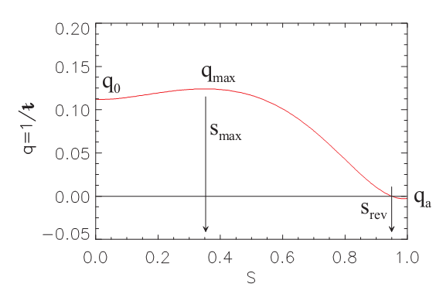
3D reconstructions on RFX-mod reveal details of helical state
RFX-mod at Consorzio RFX in Padova, Italy
  R = 2.0 m, a = 0.46 m, B₀ ~ 0.7 T
RFPs are nominally axisymmetric
Recent observations – spontaneously generated helical states
Axisymmetric or perturbative reconstructions not adequate
3D Reconstructions
  Fixed Boundary VMEC
  Magnetic diagnostics, Thomson scattering positions, Soft x-rays, Interferometer chords
Unambiguous reconstruction to helical state
Reconstruction only finds helical states with non-monotonic q profile

Slide 13
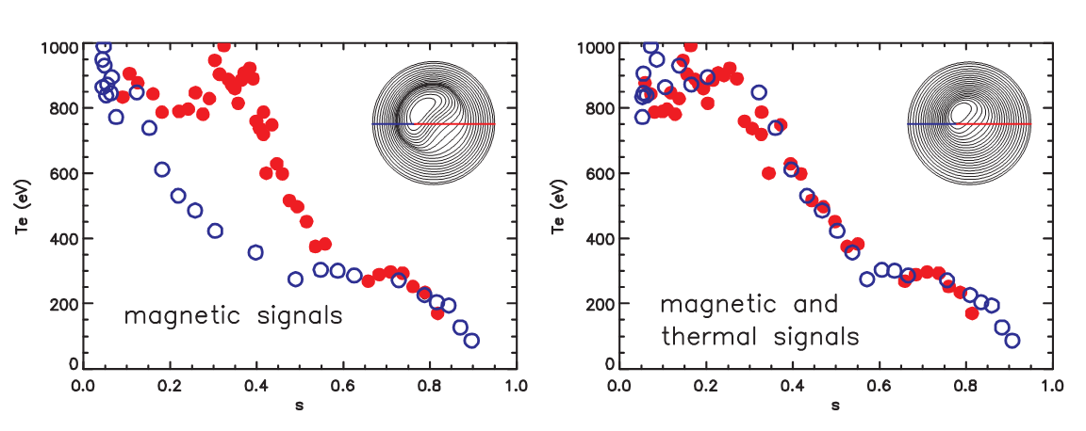
Multiple diagnostics improve reconstruction on RFX-mod
Only magnetic diagnostics
Assume zero pressure
Thomson scattering and magnetic diagnostics
Allow nonzero pressure
Assume T_{e} is constant on a flux surface

Slide 14
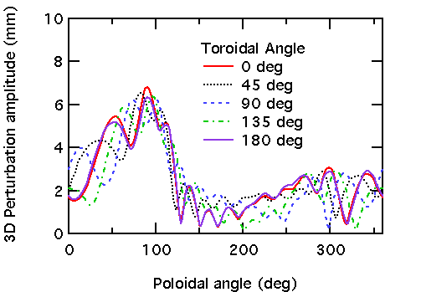
Flux surface boundary motion quantified while applying n=1 fields on DIII-D
DIII-D surface measurement with external n=1 B field
  Observe ~2 cm discrepancy with axisymmetric reconstruction
VMEC free-boundary, using axisymmetric EFIT profiles and applied n=1 external field
  Computed deviation up to 7 mm
3D reconstruction – determine changes to axisymmetric profiles due to n=1 external field

Slide 15
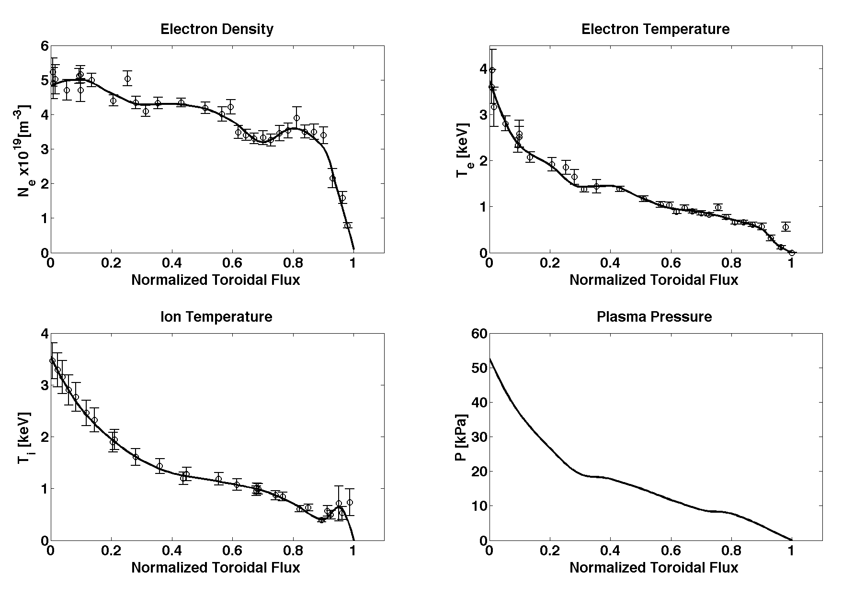
Evidence of RMP penetration in 3D reconstructions observed for n=3 field application on DIII-D
Up-down symmetric shot with n=3 RMP application
  No ELM suppression
  Ne, Te and Ti matched to experiment
  6 [mm] boundary perturbation localized to divertor region
Evidence in reconstruction of RMP penetration
  Flat spots in pressure profile at q=4/3 and q=3 surfaces.
DIII-D shot 142603 reconstructed kinetic profiles. Reconstructed profiles are plotted as a solid line, error bars indicate experimental data points. Electron density and temperature matched to Thomson scattering, ion temperature matched to charge exchange measurements (newly implemented).
Notes:
These are ‘hot off the presses’ reconstructions. Here we’ve parameterized Te, Ne, and Ti as functions of normalized flux, optimized these profiles and used them to construct a P profile which is fed into VMEC. PRES_SCALE was also varied so that we could match magnetic diagnostics. Inclusion of Ti helped to better localize the flat regions. On a sidenote, these flat regions improve the fit to the islands as calculated by SPEC. Speculatively, it appears that RMP suppression of the ELMS did not take place because the plasma did not shield out the resonances. However, I need to take a look at a suppressed shot to see if this is true. What is also interesting is that we’ve yet to truly see a ELM suppression in an up-down symmetric shot.

Slide 16
Conclusions
V3FIT and STELLOPT 3D Equilibrium Reconstruction
  Both codes have been successfully used on multiple experiments
  Reconstruction capabilities maturing (more diagnostics)
  Gaining experience in practical application
3D Equilibrium Reconstruction an Essential Tool for Understanding:
  Intrinsically non-axisymmetric plasmas
  3D shaping effects on nominally axisymmetric plasmas

