Slide 1
Summary for FTP, ITR, and SEE
Stan Milora
Fusion Energy Division
Oak Ridge National Laboratory
USA
24th IAEA Fusion Energy Conference
October, 2012

Slide 2
Outline of presentation
Status of ITER and the Broader Approach
Plasma surface interactions and divertor solutions
Materials and blanket research
Road mapping activities and related future facilities
Very brief concluding remarks

Slide 3
Schedule
ITER Level 0 Reference Schedule
Machine completion and First Plasma November 2020
D-T Operation 2027
Level 0 Reference Schedule within Baseline Boundaries
We are addressing some potential schedule delays (Building, VV, PF Coils etc.) and working with the DAs on resolving them.
IO and DAs as UIT are working hard to maintain this schedule.
IO proposes to install a W-divertor from the beginning (first priority)
IO proposes phased installation of heating :
67MW at non-nuclear phase
full 73 MW at pre-nuclear shutdown)
IO proposes to defer installation of some component and system from the construction to the operation phase (potential items, Heating systems, T-Plant, Hot Cell Tools, ELM/VS coil & PS, and TBM)
IO is investigating the simplified assembly scenario
Notes:
DT 2027
Red part is the criticall path

Slide 4
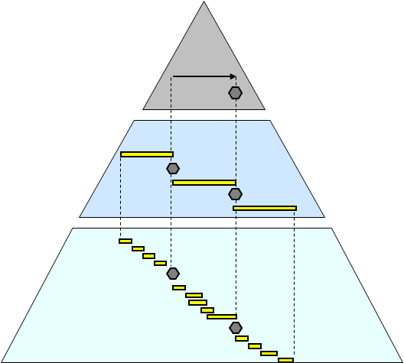
Achievement of Schedule Structure and Management
Completion of DWS
Level 0 Overall Project Schedule (OPS):
~ 50 Activities……………..………………………….
Level 1 Strategic Management Plan (SMP):
~ 3000 Activities ……………………………
Level 2 Detailed Working Schedules (DWS): ~ 150k Activities…………....
(Including IO and DAs)
DWS has been completed on 28th June and reviewed
Milestones are monitored and become controlled.
Notes:
Level 0 is council approved

Slide 5
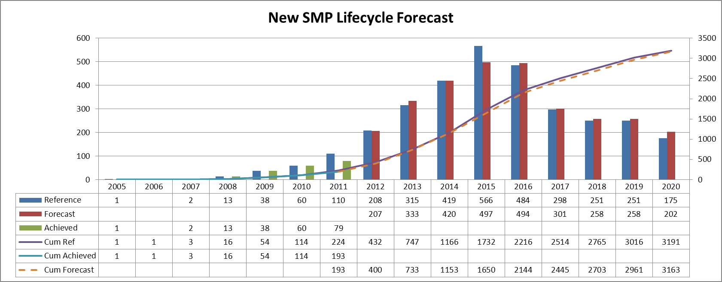
New SMP Lifecycle Forecast
Previous
New
Using the new SMP post 2012
IO and DAs Implementing strong schedule recovery action
Notes:
Have some schedule delat but trying to improve on it.

Slide 6
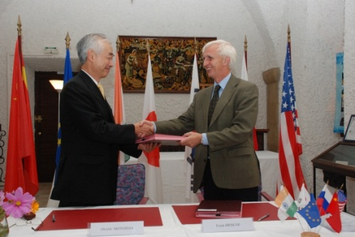
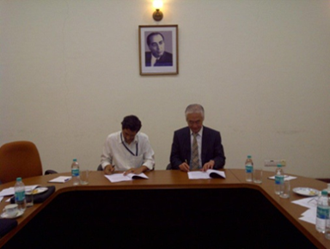
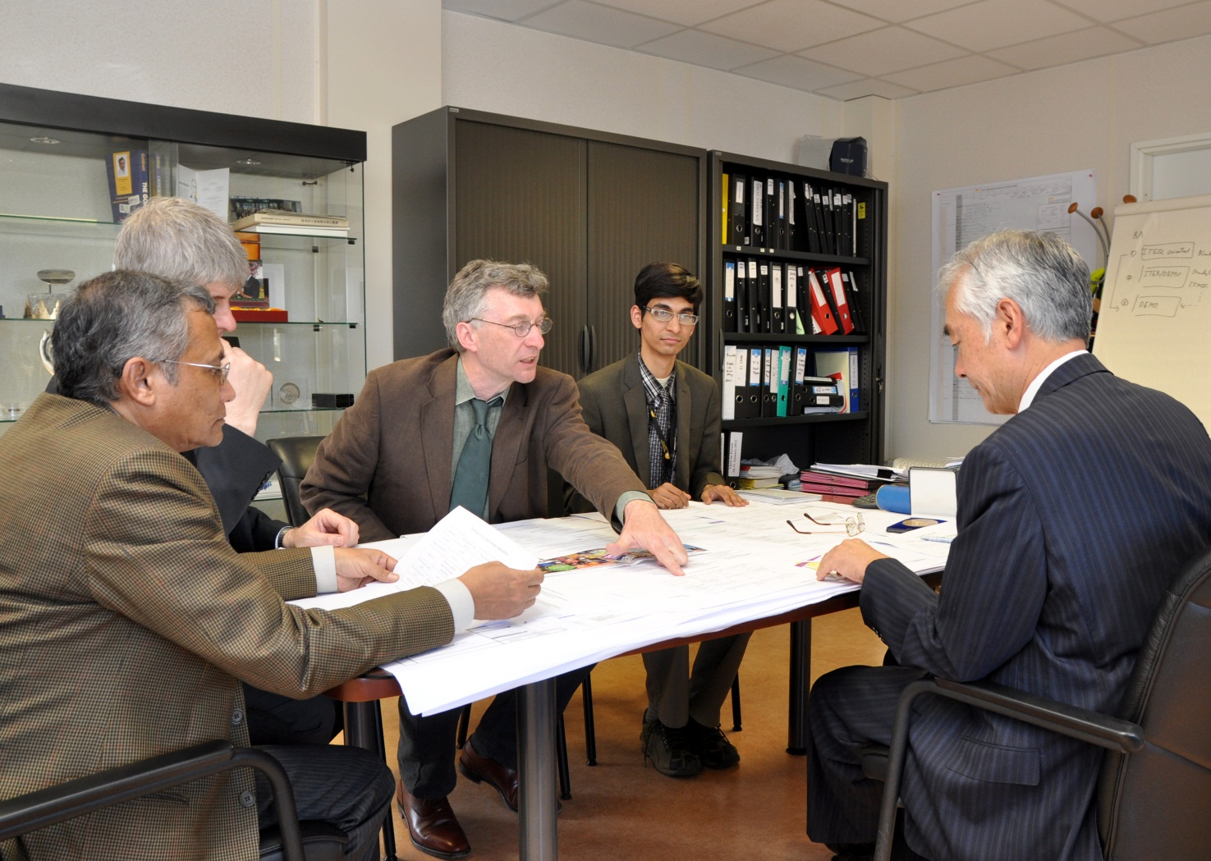
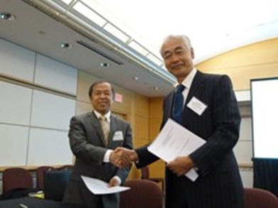
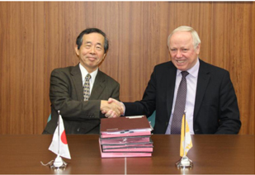
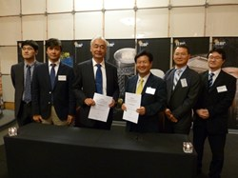
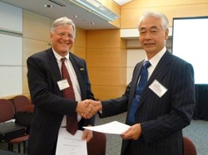
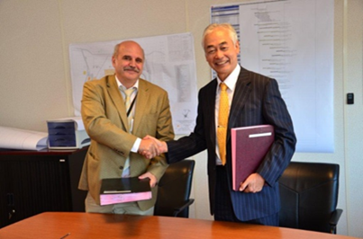
Procurement Arrangements (PA) are important milestones
Total number of signed PA is now 80 out of a total of 137
The achieved value to date is 2338.86109 kIUA out of a total In-Kind project value of 2880.52391 kIUA; 81.2 % of value achieved
EU
IN
CN
JA
KO
US
RF

Slide 7
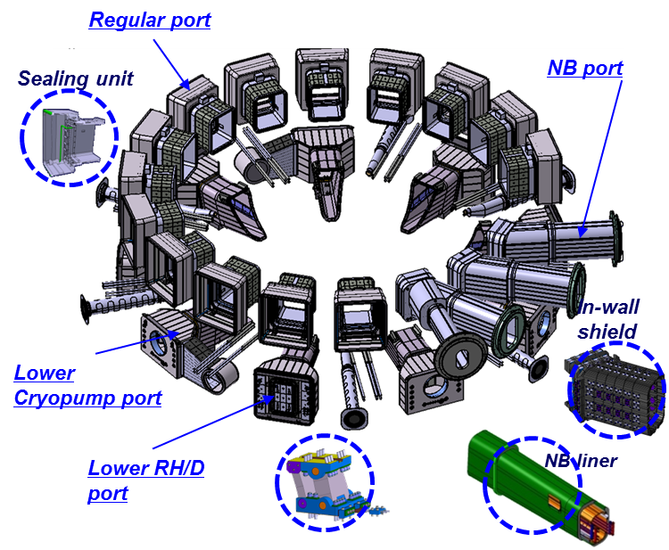
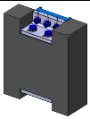
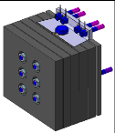
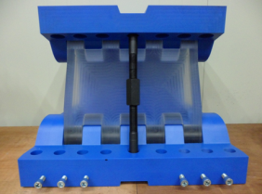
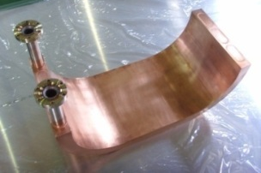
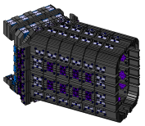
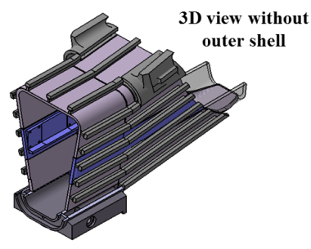
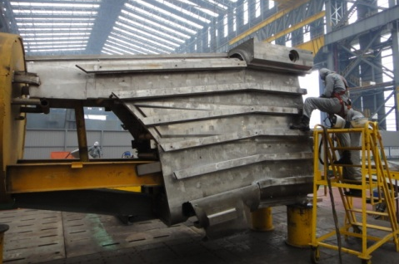
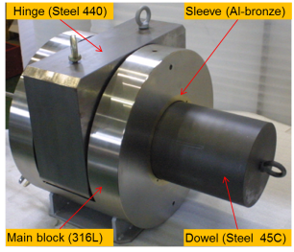
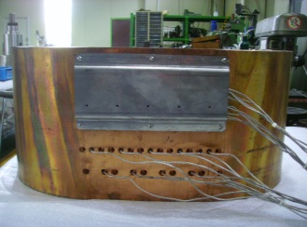
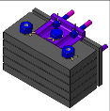
Progress on Manufacturing of the ITER VV Equatorial and Lower Ports in Korea (ITR/P5-01)
J.S. Sa
□ Manufacturing preparation for the main port is in its final stages and will be completed by the end of 2012
Material procurement, fabrication design and fabrication procedure qualifications
Full scale mock-up for lower port stub extension (more than 30 tons) is under fabrication
□Detail designs and fabrication feasibility studies including mock-up fabrication have been performed for the In-wall shield of NB port, VV gravity support and NB duct liner
IWS of NB port | VVGS | NBDL
<ITER VV E/L Ports supplied by KODA>
<Mock-up for VVGS and sleeve>
<Full scale mock-up
for NBDL>
<Fabrication of full scale mock-up for lower PSE – rib welding on the inner shell>
<Detail design>

Slide 8
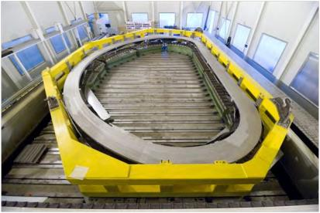
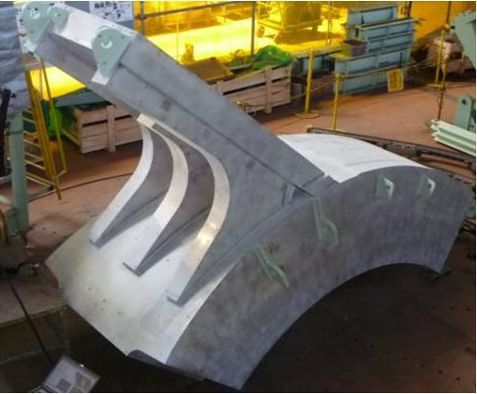
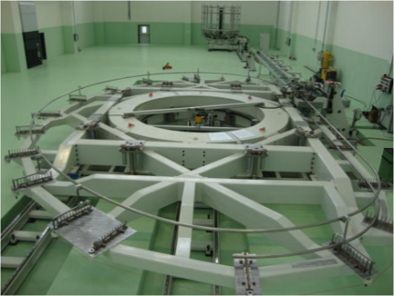
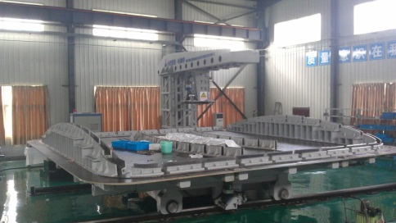
ITER Magnet Systems – from Qualification to Full Scale Construction
H. Nakajima (JAEA) et, al.
The qualifications and constructions of ITER superconducting magnets are going well in collaboration between the ITER organization and 6 Domestic Agencies toward the main goal of first plasma in 2020.
The qualification phase for TF conductors is over and full scale construction of 32% conductors has been completed as shown in the Table.
The trial manufacture of actual size radial plates for TF winding and full size mock-ups of TF coil structure have been completed. EU and JA are ready for full scale construction.
Preparations of the manufacturing facilities for windings of the ITER magnet systems are under way in 4 DAs. The final qualifications with actual size prototypes will start soon.
Radial plate prototype( EU)
TF structure mock-up (JA)
TF winding facility (EU)
CC winding facility (CN)

Slide 9
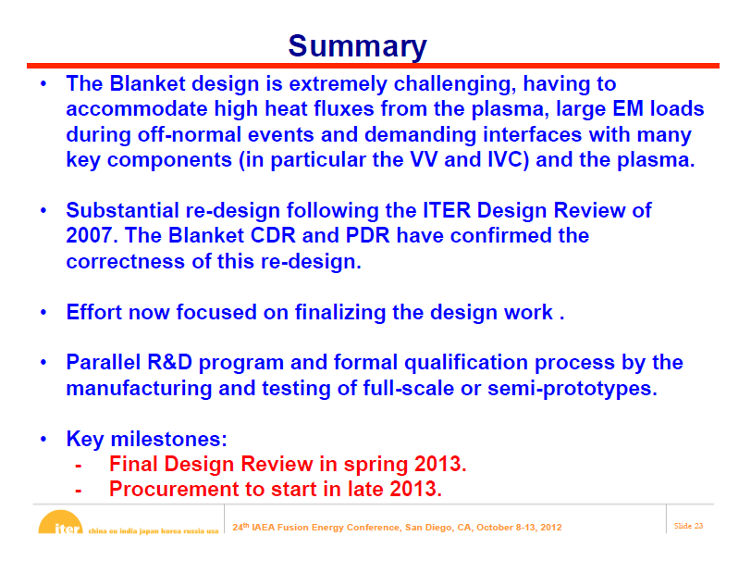
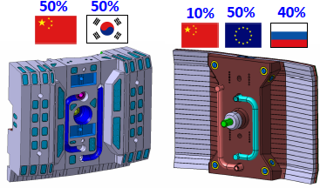
The ITER Blanket System Design Challenge
Raffray ITR 2/6

Slide 10
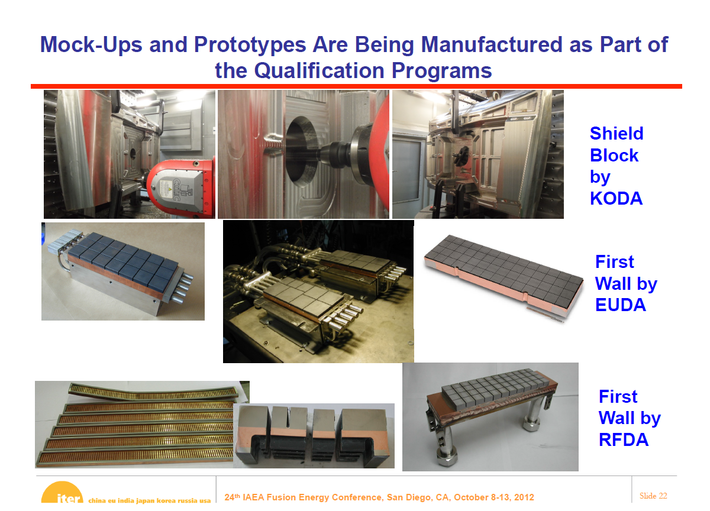

Slide 11
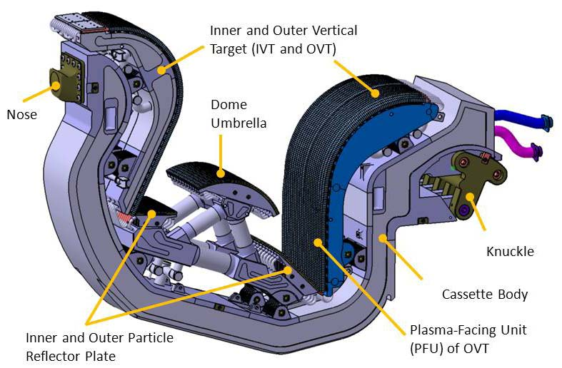
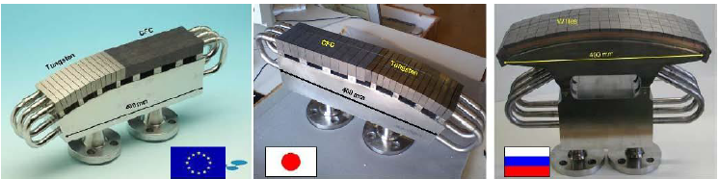
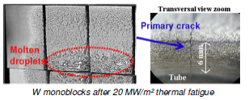

Technology R&D Activities for the ITER full-W Divertor
Lorenzetto ITR/2-3
To decrease costs, the ITER Organization has proposed to reduce by one the number of divertors planned during the ITER lifetime and to begin operations with a full-tungsten (W) variant in place of the original first divertor armoured with carbon fibre composite in the high heat flux regions;
The design of the W divertor is being prepared by the IO;
The fabrication technologies developed by the procuring Domestic Agencies, Europe, Japan and the Russian Federation, are being adapted to the new design requirements;
A decision on which divertor to manufacture for ITER is scheduled to be taken by the end of 2013.
Notes:
Full scale mockups have done 5000 cycles at 10 MW/m2 and 1000 cycles at 15 MW/m2 . Theunit on the right one suffered melting and cracking due the thermal fatigue but survived 300 pulses at 20 MW/M2 and .

Slide 12
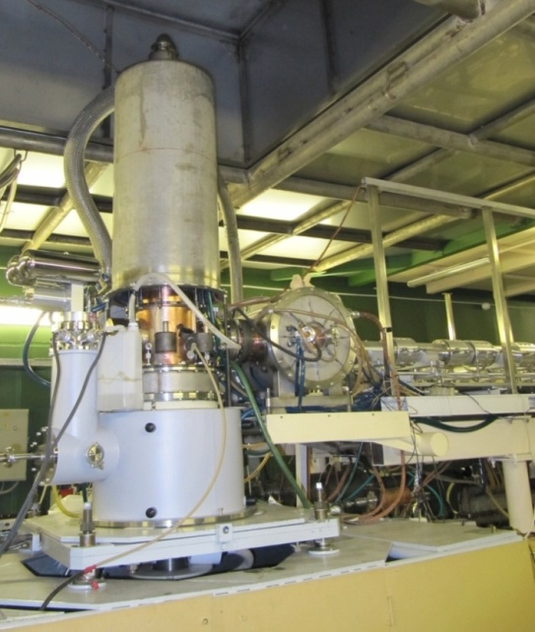
Litvak ITR/1- 4Ra
Achievement of ITER relevant parameters with RF gyrotron
In the last five years four gyrotron prototypes were fabricated and tested.
Gyrotrons V-10, V-11 were tested in 2010 and 2011 respectively with CRYOMAGNETICS LHe –free magnet.
It is important to note that two last gyrotrons (V-10 and V-11) demonstrate very similar output parameters (see Table below).
Gyrotron | Beam voltage kV | Beam current A | Retarding voltage kV | Power * kW | Efficiency % | Pulse duration sec
V-10 V-10 V-11 | 71 71 70 | 34 34 39.5 | 30.5 30 30 | ~750 ~750 ~850 | ~54 ~54 ~53 | 1000 600 ** 1000
V-10 | 70 | 45 | 31.5 | ~960 | ~55 | 400 (serial pulses)
V-11 | 70.5 | 45 | 31.5 | ~960 | ~55 | 1000

Slide 13
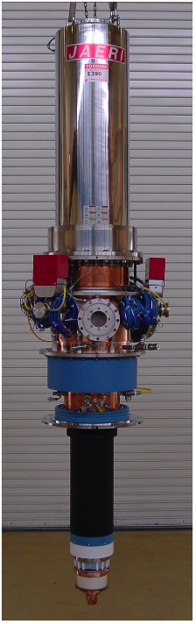
170GHz Gyrotron Development in JAEA
Kajiwara FTP/1-3Rb)
TE31,8 mode gyrotron
• 1MW/800s
• 0.8MW/1hr operation
• Max. efficiency: ~60%
• Total output energy:
>250GJ
• For power increase,
higher mode oscillation has been challenging
TE31,11 mode gyrotron (J7)
(Multi-frequency operation, >1.3MW operation )
• 5kHz power modulation is improved
using novel anode switching
170GHz gyrotron

Slide 14


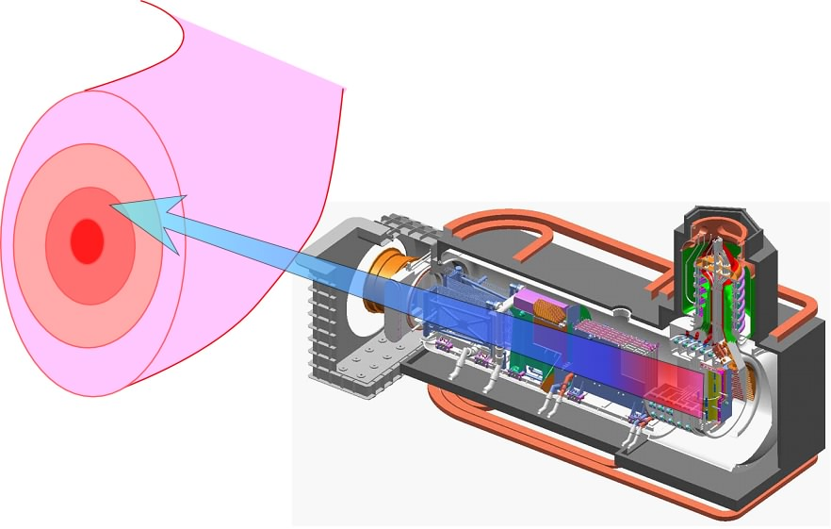
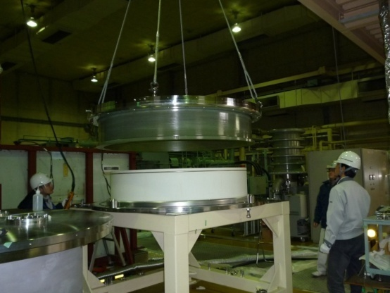
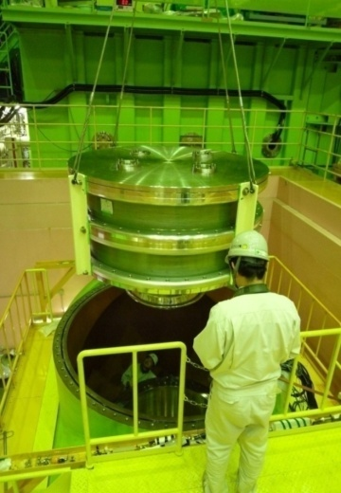
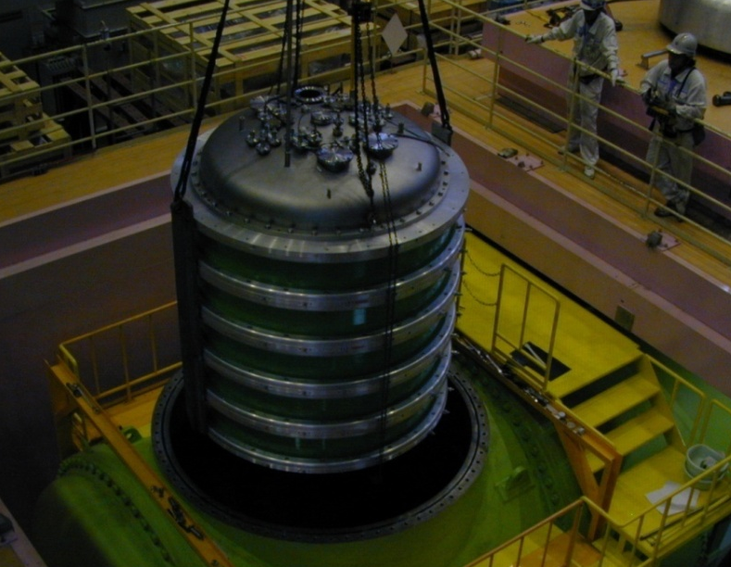
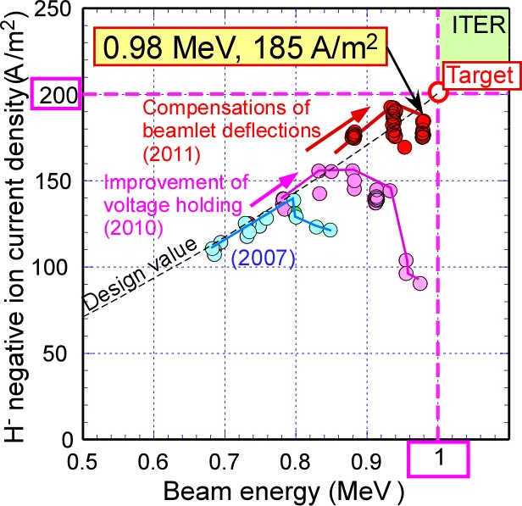
Acceleration of 1 MeV H⁻ Ion Beams
at ITER NB-relevant High Current Density
FTP/1-2
T. INOUE
ITER NB Injector
16.5 MW D⁰ at 1 MeV for 1 hour
Procurement for NB Test Facility is in progress.
HV bushing
ITER accelerator:
1 MeV, 200 A/m² D⁻ ion beam
(total: 40 A from 1280 apertures)
A single stage full-size mockup
achieved 240 kV (120 %) for 2 hours.
A two stage full-size mockup, test interrupted by 3.11.
Status of accelerator R&D
1 MeV accelerator
Next steps
Long pulses (~ 60 s) with:
  low grid heat load
  High reliability
  Beam focusing
  Detail design of ITER accelerator.
Achievement by 2012:
0.98 MeV, 185 A/m² H⁻ ion beam
(total current: 0.46 A from 15 apertures)

Slide 15
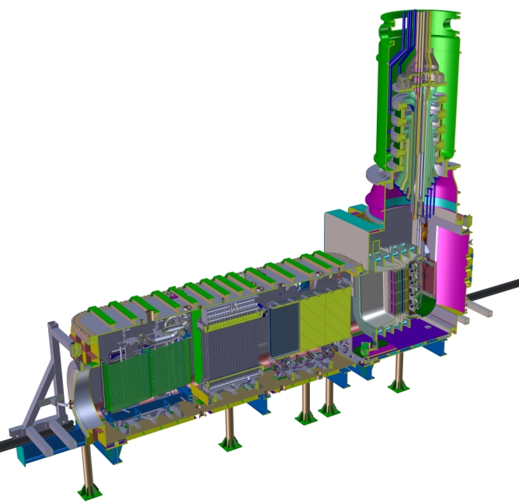
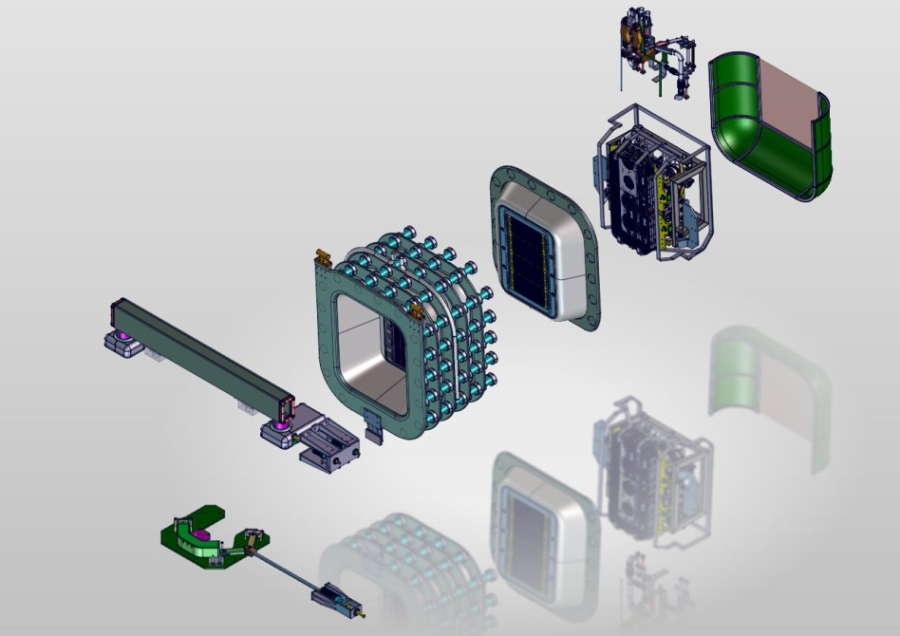
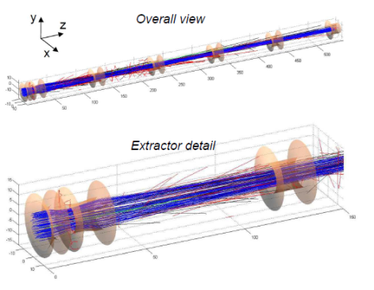
ITR/1-3
Design of the MITICA neutral beam injector: from physics analysis to engineering design
P. Sonato, et al.
Consorzio RFX, Euratom-ENEA association, Padova, Italy
The paper presents the development of the design of MITICA, the prototype heating neutral beam injector for ITER, starting from physic requirements up to the development of the engineering requirements by using a number of original and commercial numerical analysis codes.
An integrated design approach is necessary and involves all the design stages of all the components and plant systems. The progress of the design foresees a continuous cyclic check of the requirement consistency towards a robust design fulfilling all physics needs and constraints and all engineering practices in all the technology fields.
In 2012 the design is converging towards the completion of the main design activities of all the main items and main plant systems of MITICA.
15 m
Beam Source sub-systems
Notes:
MITICA at Padua the fill scale NBI prorotypre is being designed with and integrate package of specalized physics and commercial engineering analysis packages to guaramtee performance is met with acceptable technological risk. The design is converging on a 2012 completion

Slide 16
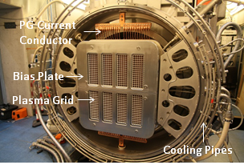
Commissioning and First Results of the ITER-Relevant
Negative Ion Beam Test Facility ELISE ITR/P1-01
The IPP NNBI test facility ELISE:
  important intermediate step of the development of the ITER NBI system
  allows gaining an early experience of the performance and operation of large RF driven sources for negative hydrogen ions
  will give an important input for the commissioning and the design of the SPIDER and MITICA test facilities at Padua and the ITER neutral beam system.
  is now ready to go into operation
  This early start is an important prerequisite for establishing the neutral beam system at ITER in-time for the first plasma pulse.
Extraction system assembly within the HV flange and the plasma grid current conductors.

Slide 17

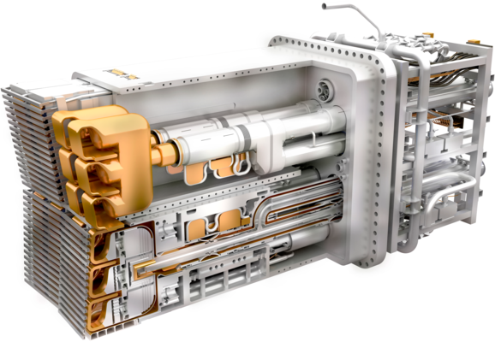
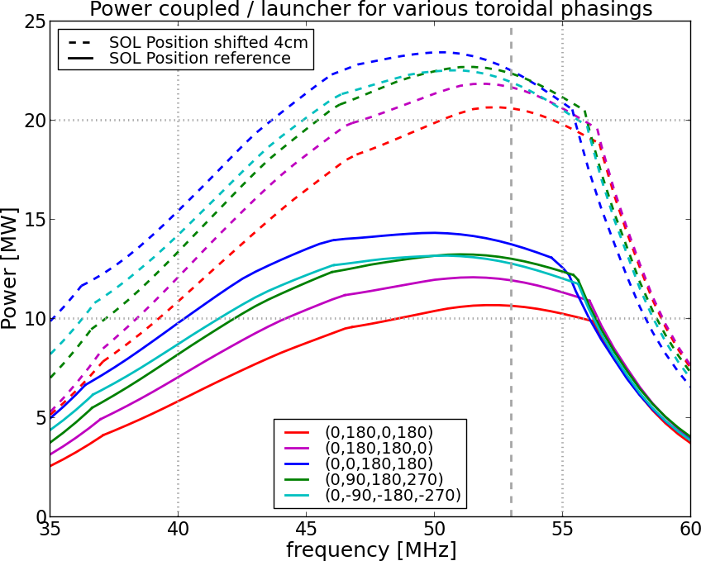










RF Design of the ITER ICRF Launcher
ITER ICRF System : Two Launchers
  20 MW / launcher capped by 45 kV system voltage
    Phase 1 : 20 MW total from 24 MW installed generator power
  Designed on behalf of IO by CYCLE *
    Consortium of EU institutions partially funded by IO through F4E (EU DA)
RF Design completed
  Successful Preliminary Design Review (May 2012)
  Performance depends crucially on SOL :
    TOPICA coupling code : validated on JET-ILA, DIII-D, TS, …
    Worst case SOL profile received from IO assumed
    Expect to be able to move the SOL profile towards the antenna
  RF properties extensively validated on Mock-ups
  RF Sheaths under assessment
Mechanical Design
  Approaching detailed design phase
  Closure of preliminary design issues expected 3/2013
R&D Program outstanding
  Vacuum Ceramic Windows, RF Contacts,
  Faraday Screen Bars, …
ITR/P1-7 : P. Dumortier et al.
ITR/P1-8 : F. Durodié et al.
Power/Launcher for various toroidal phasings
53 MHz
(³He)DT
The project F4E-2009-GRT-026 has been funded with support from Fusion for Energy (F4E). The views and opinions expressed herein do not necessary reflect those of Fusion For Energy or European Commission or ITER Organisation. F4E is not liable for the use which might be made of the information in this publication.
*
Notes:
ON ICRF iimprovements have been made to the design through extensive rf modelling and measuremets on a protoptype . There is growing confidence that the antenna will at least meet its perfomanc e target of 10 MW under the worst case and should deliver 20 or more if the plasma can be moved just 4 cm toward the antenna.

Slide 18
ITER Diagnostics – Technology and Integration Challenges
Johnson ITR/2-1
In the last 2 years, development has entered a new phase, with design responsibility transitioning from the ITER Organization to the DAs.
Significant progress in the integration of the diagnostics into the ports.
  Modular approach for port plug integration using standard interfaces promotes parallel diagnostic front-end designs and planning for remote handling.
  Nuclear dose-rate allocation budget strategy and plan to reassess during design process.
  Compatible diagnostic first wall design
  Standardized modular approach to interspace and port cell support structures.
  Mature plan for qualification testing of integrated port plug in standard test facility.
Conceptual Design Reviews have identified numerous measurement challenges
  Development of radiation-tolerant magnetic sensors
  1st mirror degradation for optical diagnostics
  Strategies to suppress reflected light
  High expected T_{e} poses challenges in interpretation for some techniques.
  ECE radiometer needs to accommodate 2 views and full harmonic spectrum, to assess electron energy distribution
  Vulnerability to damage from stray microwave radiation
Refinement of requirements continues as Procurement Arrangements are signed, providing solid framework for DAs to begin Preliminary Design and R&D phase.

Slide 19


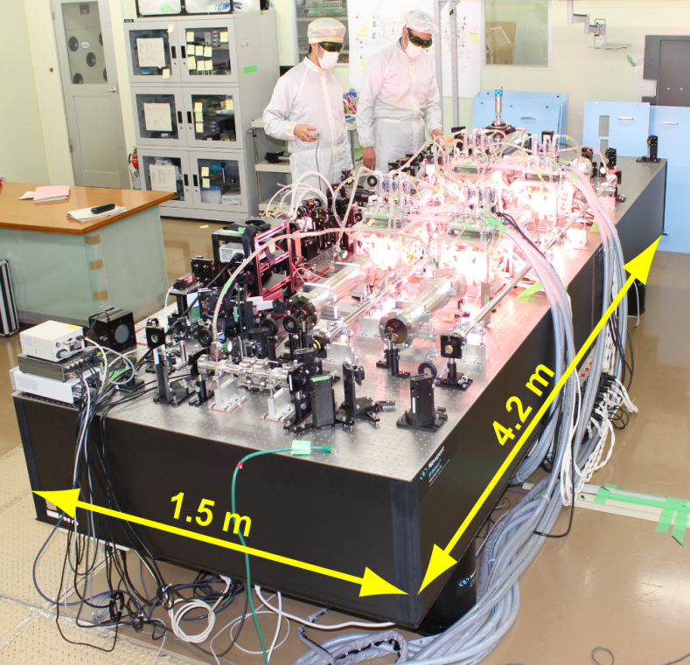
Development of a new laser system for plasma diagnostics with the world's highest performance
ITER edge Thomson scattering system requires a pulsed YAG laser with high output energy of 5 J and high repetition rate of 100 Hz (average power of 500 W)
➔ Development of a new laser system
Output energy of 7.66 J and repetition rate of 100 Hz have been achieved (average power of 766 W, which is twice the previous record)
➔ Required laser performance for ITER has been successfully exceeded
Newly developed YAG laser
Y. KAWANO et al., ITR/P5-35

Slide 20
Technical challenges requiring fusion community engagement (many of these have fusion technology components)
Significant progress in modelling of physics processes underlying ELMs and ELM control
Disruption Mitigation System Conceptual Design
Full revision of predicted heat loads on PFCs in support of First Wall and Tungsten Divertor design
  The final design phase is planned to be completed by the end of 2013
Conceptual design of Plasma Control System moving towards completion
Extensive experimental and modeling R&D continuing in support of development of ITER disruption/ runaway electron mitigation systems

Slide 21
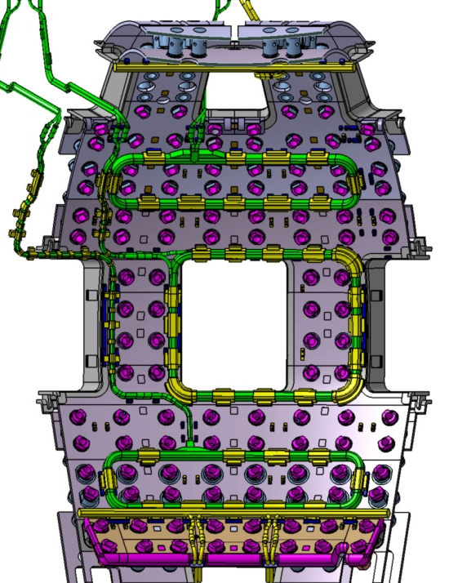
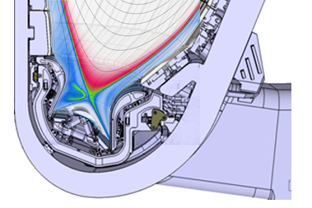
ELM Control in ITER : Schemes
Two systems for ELM control in ITER : ELM Control Coils & Pellet Pacing
  ELM Control Coils → Aimed at suppression of Type I ELMs → ΔW_{ELM} ~ 0
  Pellet injection → Controlled triggering of Type I ELMs → ΔW_{ELM} < ΔW_{ELM}^{controlled}
VS Coil
ELM Control
Coils (90 kAt)
Maruyama - ITR/P5-24
VS Coil
Pellet parameters :
v_{pellet} = 300 – 500 ms⁻¹
V_{pellet} = 17-34 mm³(pacing)/50-90 mm³(core fuelling)
f_{pellet} (per injector) = 4-16 Hz
Notes:
21

Slide 22
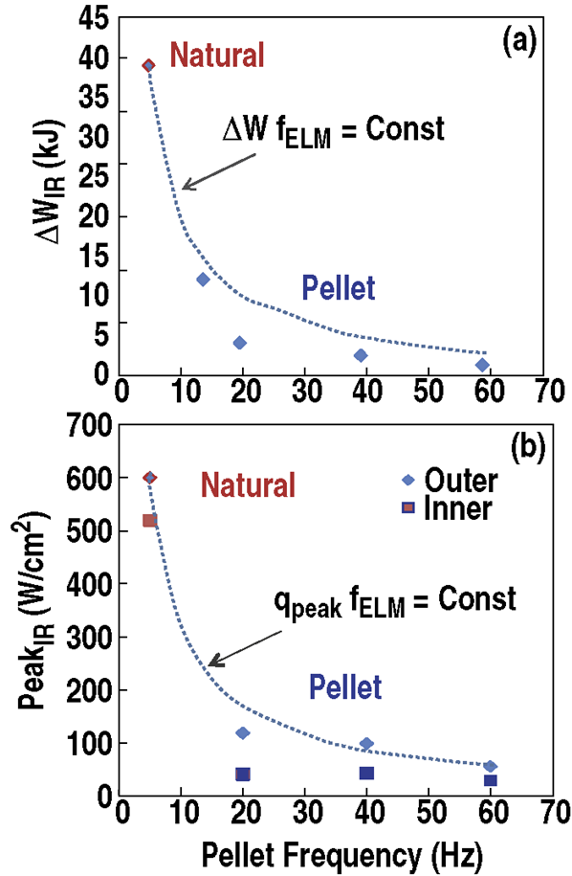
ELM Control in ITER : Summary of Experimental Progress
Major progress on application of both techniques to suppress or control Type I ELMs:
Elimination of Type I ELMs with coils observed in DIII-D, AUG, KSTAR and JET
ELM control by pellets demonstrated in AUG, JET and DIII-D → latest DIII-D experiments have accessed ITER relevant range of ELM control
DIII-D
Baylor
EX/6-02
Notes:
22

Slide 23
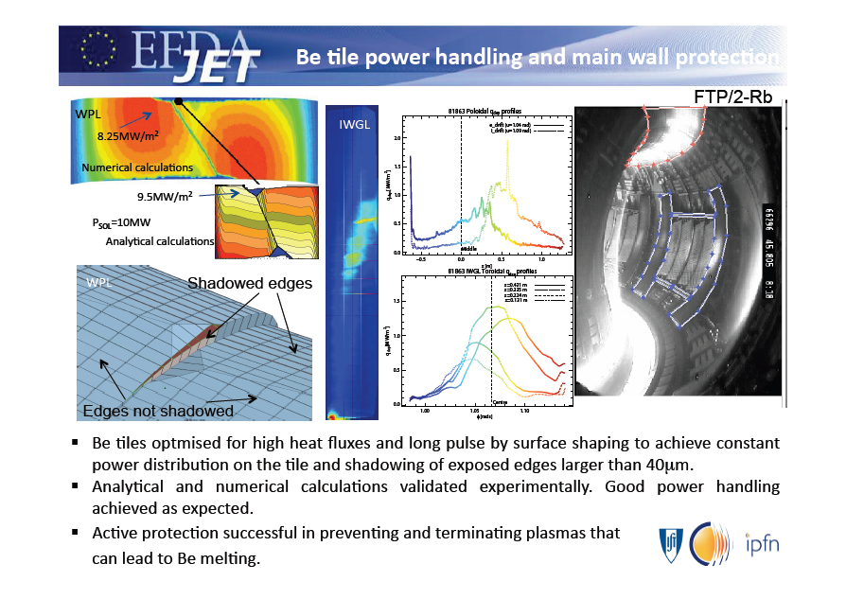

Slide 24
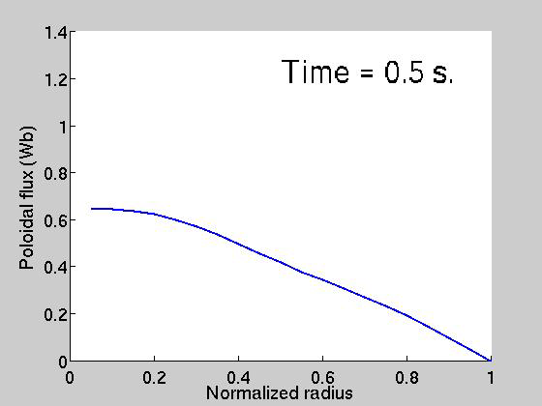

Sustained Regulation of Current Profile and β_{N} Demonstrated in DIII-D Using Model-Based Profile Control Algorithms
CONTROL ACTUATORS
On-axis co-current NBI
Off-axis co-current NBI
Counter-current NBI
Balanced NBI
Off-axis ECCD
Surface loop voltage
#146463 feedback only @ t > 1 s
ψ-profile
movie
******
NEW
******
Ψ(x) + β_{N} control
Shot #146463
CURRENT RAMP-UP
q-profile
movie
β_{N}
I_{p}
m/n=2/1 MHD
#150083 feedback only @ t > 1 s

Slide 25


Slide 26


Slide 27
Plasma surface interactions and divertor solutions

Slide 28

Lore FTP/P1-2

Slide 29






Plasma Characteristics of the End-cell of the GAMMA 10 Tandem Mirror for the Divertor Simulation Experiment
FTP/P1-11
World Largest Tandem Mirror GAMMA 10/PDX
Y. Nakashima, et al., Plasma Research Center, University of Tsukuba
A Large-scale Divertor Simulation Experimental Module (D-module) has been completed this spring.
Plasma
Gas
D-module
V-shaped
target
Heat Flux vs Superimposing ECH Power
Targeted heat-flux level
Total height:
~4.7 m
ITER relevant
Elevating
System
Heat Flux and T_{i //} vs ICRF Power
The heat flux almost linearly increases with the ECH power.
Divertor simulation experi-ments using D-module have been extensively started.
A short ECH pulse of 380 kW into ICRF-heated plasmas attained the highest heat-flux density compar-able to the heat load of ITER divertor plate ( ≥ 10 MW/m² ).
Plasma characterization proved that GAMMA 10 has extraordinary high performance, such as high heat flux, ion temperature and its controllability.

Slide 30




PMTS: new plasma generator to address PMI of materials in fusion environment
Upstream
Downstream
Hot Plasma Channel
Magnetic Field
High Power
RF source
ORNL expertise in RF technologies
10 MW/m²
Test Target
B2-Eirene simulations predict ITER plasma conditions can be reached at the target
Development of novel plasma
production techniques
ORNL’s RF source demonstrated densities of ~4 x 10¹⁹ m⁻³
PMTS will be a cost effective device to carry out a critical R&D program to advance the PMI science and the PFC development on the road to FNSF and DEMO

Slide 31







LiMIT: Lithium-Metal Infused Trenches
LiMIT concept: metal (stainless steel or Moly) tiles with radial trenches containing liquid lithium
The trenches run in the radial (polodial) direction such that they lie primarily perpendicular to the toroidal magnetic field
Li flows in the slots of the metal plate powered by the vertical temperature gradient
NSTX Inner
divertor shelf
Divertor Strikepoint Stripe
Heat flux
B
The vertical temperature gradient generates vertical thermoelectric currents within each trench of LiMIT, which when JxB-“crossed” by the toroidal magnetic field, will create a radial force on the Li driving it along the slot.
This is self-driven flow.
Grad T
F
Li flow
J
Out
In
Cooling channels
The Li flow transfers the heat from the strike point to other portions of the divertor plate
The bulk of the metal plate can be actively cooled for a long-pulsed device or passively
New Li is continuously replenished facing the plasma
Under the plate the Li flows back naturally
Passive Li replenishment
Flow
direction
Flow
direction
M.A. Jaworski, et al. Phys. Rev. Lett. 104, 094503 (2010)
D.N. Ruzic, et al. Nucl. Fusion Lett. 51 (2011) 102002

Slide 32



FTP/P1-13: Super-X Divertor Simulation for HCSB-DEMO
G.Y. Zheng, et al.
Southwestern Institute of Physics, China
EFIT equilibrium HCSB-DEMO (R=7.2m, a=2.1m, I_{p}=14.6MA).
Inner divertor: a snowflake-like configuration near separatrix.
Innovative outer divertor: super-X leg to large R combined with local X-point near target → larger wetted divertor surface area.
Figure 1. Super-X Divertor configuration
Figure 2. The heat load at inner targets
Figure 3. The heat load at outer targets
SOLPS5.0, B2.5-Eirene simulation; SOL n_{e}=3.5×10¹⁹/m³ & P=600MW into divertors.
Inner divertor: peak heat load reduced from 25.3MW/m² to 9.2MW/m².
Outer divertor: peak hat load reduced from to 31.0MW/m² to 10.0MW/m².

Slide 33






Divertor design and physics issues of huge power handling for Demo reactor:
FTP/P7-32 N. Asakura, K. Shimizu, K. Hoshino, et al. JAEA
Enhance P_{rad}^{div} and P_{rad}^{SOL+edge} for “Full detachment” of divertor plasma needed.
SONIC code + Monte Carlo impurity transport applied to DEMO divertor detachment.
Seeding impurity: Ar/Kr preferred to increase P_{rad}^{SOL} ⇒ research issues: restrict impurity to ensure core plasma confinement and low contamination
Long divertor leg: enhance P_{rad}^{div} and helps full detachment ⇒ research issues: optimize He exhaust with reduced ion and neutral fluxes
Cross-field diffusion: strongly increases detachment and energy dissipation ⇒ research Issues: enhance global/local diffusion; modeling/simulation basis for extrapolation to Demo
Power distribution summary
Long leg divertor

Slide 34




FTP/P7-34
Multifarious Physics Analyses of the Core Plasma Properties in a Helical DEMO Reactor FFHR-d1
J. Miyazawa, et al.
National Institute for Fusion Science
Japan
FFHR-d1
R_{c} = 15.6 m
B_{c} = 4.7 T
P_{fusion} ~ 3 GW
3. Neoclassical thermal transport allows sustained burning plasma
lost
(a) β₀ = 0 %
vacuum
confined
Ratio of confined alpha
(b) β₀ ~ 7.5 %
w/o B_{v}
4. Direct loss of alpha particles is tolerable and reaches the divertor behind blanket
(c) β₀ ~ 8.5 %
w/ B_{v}
1. Radial profiles are extended directly from LHD using the gyro-Bohm model
2. Magnetic surfaces at high beta can be maintained by applying B_{v}

Slide 35
Materials and Blankets

Slide 36




FTP/4-5Ra: Opt. production of nanostructured ODS ferritic steels
P. Unifantowicz, J. Fikar, et al., CRPP-EPFL, Switzerland
FTP/4-5Rb: Low activation V alloys for fusion reactors
VM Chernov et al., Bochvar Inst., Moscow, Russia
ODS-FS: Multiple Hot Cross Rolling (HCR) to 65-80% Reduction of Thickness (ROT) & higher purity of substrate powder improve strength and DBTT.
Reference V-4Ti-4Cr @2012:
  Fusion appl. for <100 dpa & 350C – 800C
Optimized V-4Ti-4Cr @2020:
  B600 tests for <150 dpa & 380C – 700C
  Corrosion tests: Li, Na, Pb, Pb-Li
Advanced V-Cr-W-Zr-C-O:
  Further optimization tests in progress
V-4Ti-4Cr
Notes:
ODS steels can go to 15 % strain nno loss of ductility for 2.8 dpa in HFIR
Powder metulargy and Hipping.
Use alloyed powders in milling. Two D rolling hot cross rolling at 800 C to reduce pores. Grain size increases in HCR a bit.
Need to get 60-80% change in thickness.
Ti replaced by ? Thermomechanical treatment IV gives 330 Mpa UTS in
Advanced alloys have 2 X in UTS
Hope to go to 160 dpa with 300 -850 temp window.

Slide 37

Isotope exchange
with H removes 2/3

Slide 38


Slide 39











FTP/P7-17 Research and Development Status of Reduced Activation Ferritic/Martensitic Steels Corresponding to DEMO Design Requirement
H. Tanigawa (JAEA), et.al.
Applicability and technical issues of RAFM steel as the DEMO blanket structural material have to be discussed in view of the DEMO blanket structural soundness in various operation modes.
In the case of water cooled / ceramic breeder blanket of SlimCS design, RAFM hardening and embrittlement is expected just around cooling channels, and the discussion on the structural soundness of the blanket and applicability of RAFM should regard these thin structure.
Estimation of the critical condition* and validation of 14 MeV neutron irradiation effects up to that condition in early stage of DEMO engineering design phase is essential.
* (e.g. ~30dpa/~500appmHe)
Thermal stress
(steady state operation)
Electromagnetic force
(plasma current disruption)
(A part of 2D FEM model)
Equivalent stress (MPa)
Transmutation formed He
(appmHe)
Irradiation dose
(dpa)
0 200 400 600 MPa
Temperature
0mm
(˚C)
300-350
1500
100
25mm
1000
80
350-400
500
60
400-450
50mm
Equivalent stress (MPa)
250
40
450
0 200 400 600 MPa

Slide 40





FTP/4-1Rabc: Kumar, Giancomo, Feng, et al
ITER-TBM Program activities in India, Europe, and China
Goals: “Demonstrate the scientific and technological feasibility of fusion power for peaceful purposes” via testing of nuclear technology in integrated fusion environment.
To deliver the TBM Systems for the first phase of ITER.
Materials and technology R&D in full swing.
Generic TBM Agreement has been approved. ITER Partners’ TBMAs being prepared for signing.
EU HCLL
Indian LLCB
Be
Shield Block
China HCCB
Notes:
A detailed description of the components for the TBMs and auxilairy sysytems and integraation into port and test loops. Extract heat and demonstartion t breeding. Everybody but US is buliding one.
1.6 6 tall x .48 w x .54 thich
HCLL EU HCCB CN LLCB (IN)
Have all done safety analysis
EU
HCLL is breader, multilier coolant and T carrier
Eurofer HIPed first wall. Bend after HIPing cause cracks? More work needed.
CN HCCP. Have develoed ways to make Be pellets and Li orthosilicate pellets. Hipping first wasl.
Indian LLCB with li titanate. Li corrosiion loops. EM pumps loops. Producing Lead lithium. Lititanate pebbles . 3 ton RAFMS melts . Laser welding and Hipping. EM TBM to be finished

Slide 41





Summary of FTP/3-4: “Progress on developing the spherical tokamak for fusion applications” by J. Menard, et al.
100% non-inductive current projected
NSTX Upgrade aims to address understanding gaps to next-step STs
  Confinement, stability vs. collisionality
  Full non-inductive start-up, ramp-up
  Solutions for very high heat flux, such as snowflake divertor, and lithium (future)
Good progress made in overcoming increased EM loads of Upgrade
  Project on schedule & budget, ~50% complete
  Aiming for project completion in summer 2014
ST-FNSF studies quantifying performance and achievable missions vs. device size
  Building on achieved/projected NSTX/NSTX-U performance and design
  Incorporating high triangularity, advanced divertors, TBR ~ 1 option, good maintainability
Friction-stir-welded TF joints
Improved TF cooling-tube soldering
2nd NBI in NSTX-U test cell
High-δ snowflake
TBR~1 for R=1.6m

Slide 42






NRC “Kurchatov Institute”
FTP/4-6: EA Azizov, et al, Development of magnetic Fusion Neutron Source (FNS) and fusion-fission hybrid systems in Russia
Database, analysis, modeling and advanced technologies provide basis to:
Develop a compact FNS based on tokamak from ST to conventional aspect ratios
Expect risks in physics and technology when extending FNS to hybrid systems
Define key efforts of Russian fusion program: ITER, research FNS, hybrid systems
FNS-ST, 0.6m, 5MW
GDT, 15m, 2MW
SC FNS, 1.9m, 20MW
Solid and
molten-salt
blanket options
for hybrid
Ignitor, 1.32m, 95MW

Slide 43
HN Nielson et al: SEE/1-1:
On the Path to MFE DEMO
With ITER under construction, MFE has crossed a threshold to a DEMO programme.
The science and technology issues for DEMO are known. Now we are developing strategies to resolve them:
  Making ITER succeed.
  New fusion nuclear facilities
  What else is needed?
A new IAEA DEMO Programme Workshop series can help all parties define, plan, and coordinate DEMO programme activities.

Slide 44

FTP/3-3: On the Physics Guidelines for a Tokamak DEMO
H. Zohm, et al., MPI fur Plasmaphysik, et al., E.U.

Slide 45
Concluding remarks
Progress on ITER since the last meeting has been impressive. Design is at an advanced stage and production and prototyping of machine components has begun in the DAs.
Our research community has been fully engaged in solving the technical challenges posed by ITER thereby advancing the state of the art in plasma control technologies(magnets, H&CD, fueling, PFCs) and expanding the R&D boundaries to include fusion nuclear technologies(fuel cycle, TBMs).
The momentum must be continued across the board to address the more demanding requirements for DEMO (all of the above plus high temperature radiation resistant materials). In addition to engaging existing facilities and recent and future additions (superconducting tokamaks, W7-X, IFMIF), we will need an increased emphasis on dedicated test facilities for technologies.

Slide 46
What will we have learned from ITER
Reactor scale technology demonstrations
  Superconducting magnets
  IC, EC, NB for heating/current drive (but not yet optimized for efficiency )
  First assessment of tritium breeding and high temperature operation in mockups deploying RAFM steel and various breeding materials and coolants at ~1 MW/m² neutron wall loading (but low fluence and short pulse and difficult to asses TBR)
  Strong core fueling to maintain DT density consistent with production of several hundreds of MW of fusion power (DEMO requires even higher density).
  Divertor with 10 MW/m² steady state heat removal capability operating in semi detached , tightly coupled regime with low net erosion and plasma contamination. (DEMO will operate at higher power density).
  Technologies to mitigate the effects of ELMs and disruptions (pellets OK, reactor relevance of in vessel coils?)
  Torus pumping, exhaust gas cleanup, isotope separation systems of unprecedented scale (but lower throughput in batch processing mode)
  Will have a fairly high inherent availability for research program, but overall duty factor < 10% (plasma control technologies will not have the luxury of generous routine maintenance)

Slide 47
Backup

Slide 48
Backup

Slide 49

ITR/1-1 Eich
Notes:
Strike line moves and leads to overestimate. Gave 5 mm in ITER which I now 1 mm..
Assume the parralel power profile diffuses from the x point to the target. Exponentila diffusion Works great on all machines from IR camera work.
Lambda q = .9 mm for ITER. None are in the detached plasma regime!!
Power spreading parameter S connects the upstream q to downstream
S is 1-2 mm in ITER which drops the heat flux to 6 MW/m2.

Slide 50

Kallenbach

Slide 51


Non-linear Simulation of ELM Energy Deposition
ELM simulations in ITER Q=10 plasma scenario (JOREK code)
Conductive ELMs :
  large magnetic perturbation leads to ergodic edge with homoclinic tangles
  parallel conduction on perturbed magnetic field lines
  broadening of energy deposition scales with magnetic perturbation
Convective ELMs:
  filament formation, energy density losses in parallel direction
  broadening energy deposition due to radial distance travelled relative to parallel transport
Conductive ELM in ITER Q=10 plasma
Notes:
Nonlinear MHD simulation

Slide 52

Modelling of ITER plasma shutdown with runaway mitigation using TSC
I.Bandyopadhyay, A.K. Singh, M. Sugihara and S. C. Jardin
Model of runaway destabilization with a train pellets launched in a plasma with impending disruption, but before thermal collapse
Series of pellets of radii between 5-25mm launched at speed between 500-1000m/s and paced between 50-200Hz can trigger MHD events, which can help deconfine and limit runaway currents to acceptable values
Tradeoff between large pellets with slow pacing and smaller pellets with faster pacing
Experiments should be carried out to confirm proposed runaway mitigation
ITR/P1-12
Notes:
Yes to all. The top curve is I_p and the bottom 'Sydney Opera' curve of I_rway. The periodic fall is due to pellets ejecting the runaways due to excitation of MHD events and the runaway population rises back due to avalanche till the next pellet releases them again.
Regarding thermal collapse, as I explained yesterday, the pellets do not ablate much and shines through in a cold plasma post thermal quench. So we need to launch them prior to the thermal quench, so that they ablate fully by the time they reach mid radius and rapidly cool down the edge.

Slide 53

Development and Testing of Plasma Disruption
Mitigation Systems Applicable for ITER
Disruptions on large tokamaks present challenges to handle the intense heat flux, the large forces from halo currents, and the potential first wall damage from multi-MeV runaway electrons
ORNL is developing the technology to inject sufficient material (Ne, D₂) deeply into plasmas for a rapid shutdown and runaway electron collisional suppression
Massive gas injection via ORNL fast magnetic valves has been used on DIII-D and Alcator C-Mod to successfully mitigate some of the deleterious effects
Injection of large shattered pellets is a new technique developed at ORNL, and experiments on DIII-D resulted in deeper penetration and much higher density with a single pellet containing ~3x10²³ atoms than with massive gas injection of the same
Important capability needed for maintaining successful operation of ITER and future reactors
Illustrations and photos of a pellet shattering on double-impact prototype target (same target design used inside DIII-D vessel)

Slide 54


Slide 55
Going beyond ITER
 | I_{p} (MA) | B (T) | β_{N} | β (%) | P_{fusion} (MW) | P_{elec} (MW_{e}) | Plant Efficiency
ITER Scenario 2 | 15 | 5.3 | 1.8 | 2.4 | 400 | - | -
ITER AT DEMO | 9 | 5.6 | 5 | 3.8 | 1240 | ~ 400 | ~0.3
EU Model D reactor | 14.1 | 5.6 | 4.5 | 5.4 | 2530 | 1518 | 0.6
Optimized current and pressure profiles: flexible plasma heating fueling and current drive tools, edge density control
Higher plasma density (2x10²⁰/m²): efficient core plasma fueling and particle exhaust
Low plasma contamination and low net erosion: high density divertor operation, divertor solution?
Fully developed blanket systems for tritium self sufficiency
Low activation materials
(F82H, Eurofer…), ductile W
Higher magnetic field:
HTS magnets?
Low recirculating power: high efficiency high power density H&CD systems.
High thermal efficiencies: advanced high temperature blanket (DCLL) and divertor, and materials ODS steels, SiC/SiC). High temperature Brayton cycle.
High duty factor: reliability, control/mitigation of transient events, maintainability and RAMI
Notes:
Beta = betaN *I/(aB)

