Slide 1
Multimodal Options for Materials Research to Advance the Basis for Fusion Energy in the ITER Era
Steve Zinkle¹, Anton Möslang², Takeo Muroga³, Hiro Tanigawa⁴
¹Oak Ridge National Laboratory, Oak Ridge, Tennessee, USA
²Karlsruhe Institute for Technology, Eggenstein-Leopoldshafen, Germany
³National Institute for Fusion Science, Toki, Gifu, Japan
⁴Japan Atomic Energy Agency, Aomori, Japan
24th IAEA Fusion Energy Conference
San Diego, California
October 8-13, 2012
Notes:
SDM meeting July 10-11, 2001
1

Slide 2
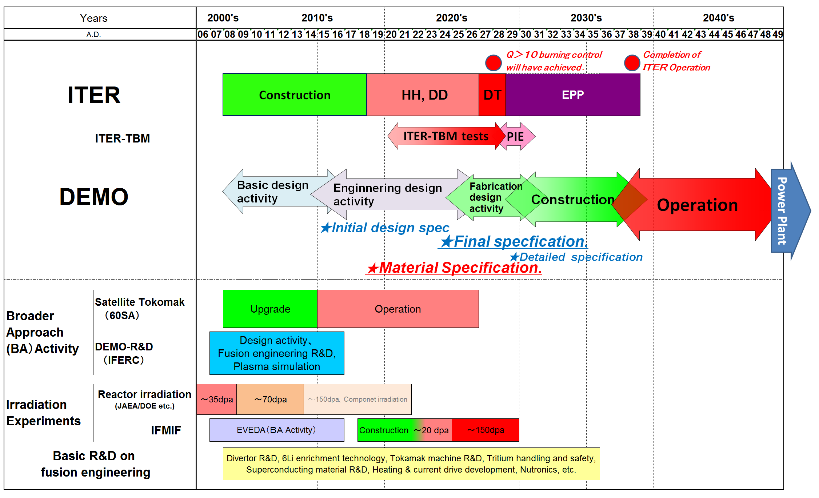
Why Multimodal Research Options?
Although current international fusion energy roadmaps have many common elements, there are also some key differences
  Time schedule, post-ITER facility R&D objectives (FNSF, DEMO, etc.), degree of aggressiveness in DEMO design, scientific discovery vs. engineering confirmation emphasis, etc.
Japan fusion roadmap
ITER Q>10 steady state operation
ITER-TBM Operation
Design activity
~ 2030
~ 2040
~ 2050
~ 2020
★Material specification
★Final Fusion design code
★Draft Fusion design code
2020~2025
IFMIF irradiation
Note: This is the digest version of the technical roadmap studied by Roadmap working group organized under ITER/BA technology advisory committee of Fusion energy forum of Japan (and further modified to include recent ITER schedule changes), and is NOT the roadmap authorized by Japanese government.

Slide 3
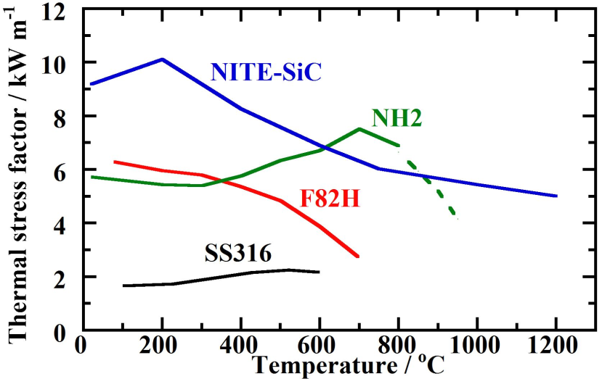
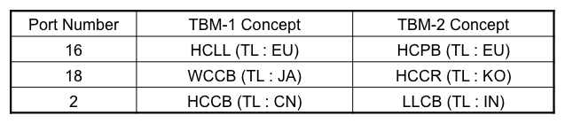
Why Multimodal Research Options? (cont’d)
Every fusion blanket and materials system has shortcomings; there is no utopian solution
  Multiple blanket systems are being explored in an effort to identify at least one viable blanket concept
  E.g., 6 blanket concepts are being proposed for exploration on ITER (not including DCLL concept, etc.)
Brittleness
Reactive
Ferromagnetic
M : Thermal Stress factor
λ： thermal conductivity
σ： tensile strength
ν： Poisson ratio
α： thermal expansion coeff.
Ｅ ： Young’s modulus
(TL = TBM Leader)
HCLL : Helium-cooled Lithium Lead, HCPB : He-cooled Pebble Beds (Ceramic/Beryllium)
WCCB : Water-cooled Ceramic Breeder (+Be), HCCR : Helium Cooled Ceramic Reflector
HCCB : He-cooled Ceramic Breeder (+Be), LLCB : Lithium-Lead Ceramic Breeder (He/LiPb)

Slide 4
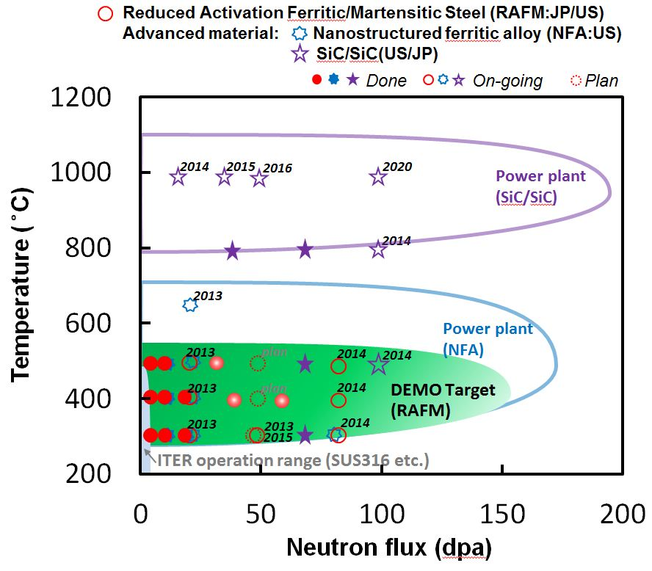
Parameter regimes under investigation in US/JP program on structural materials for fusion

Slide 5
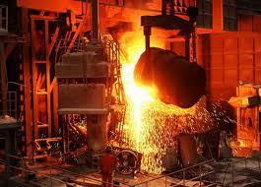
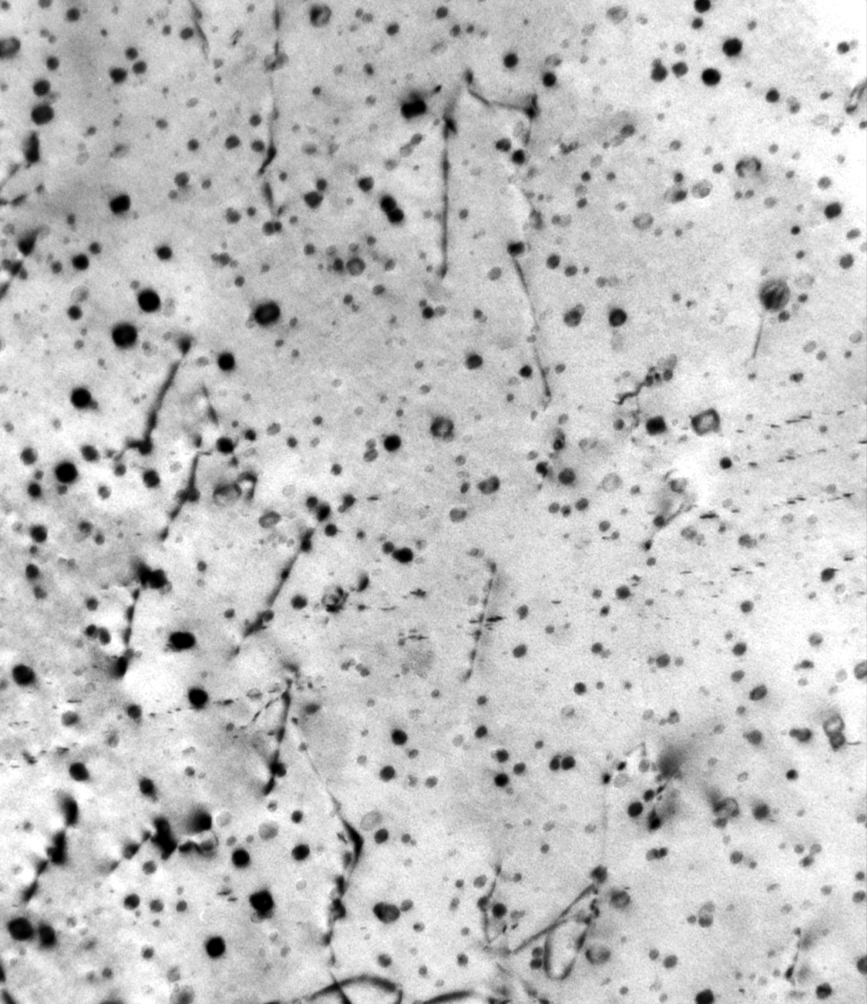
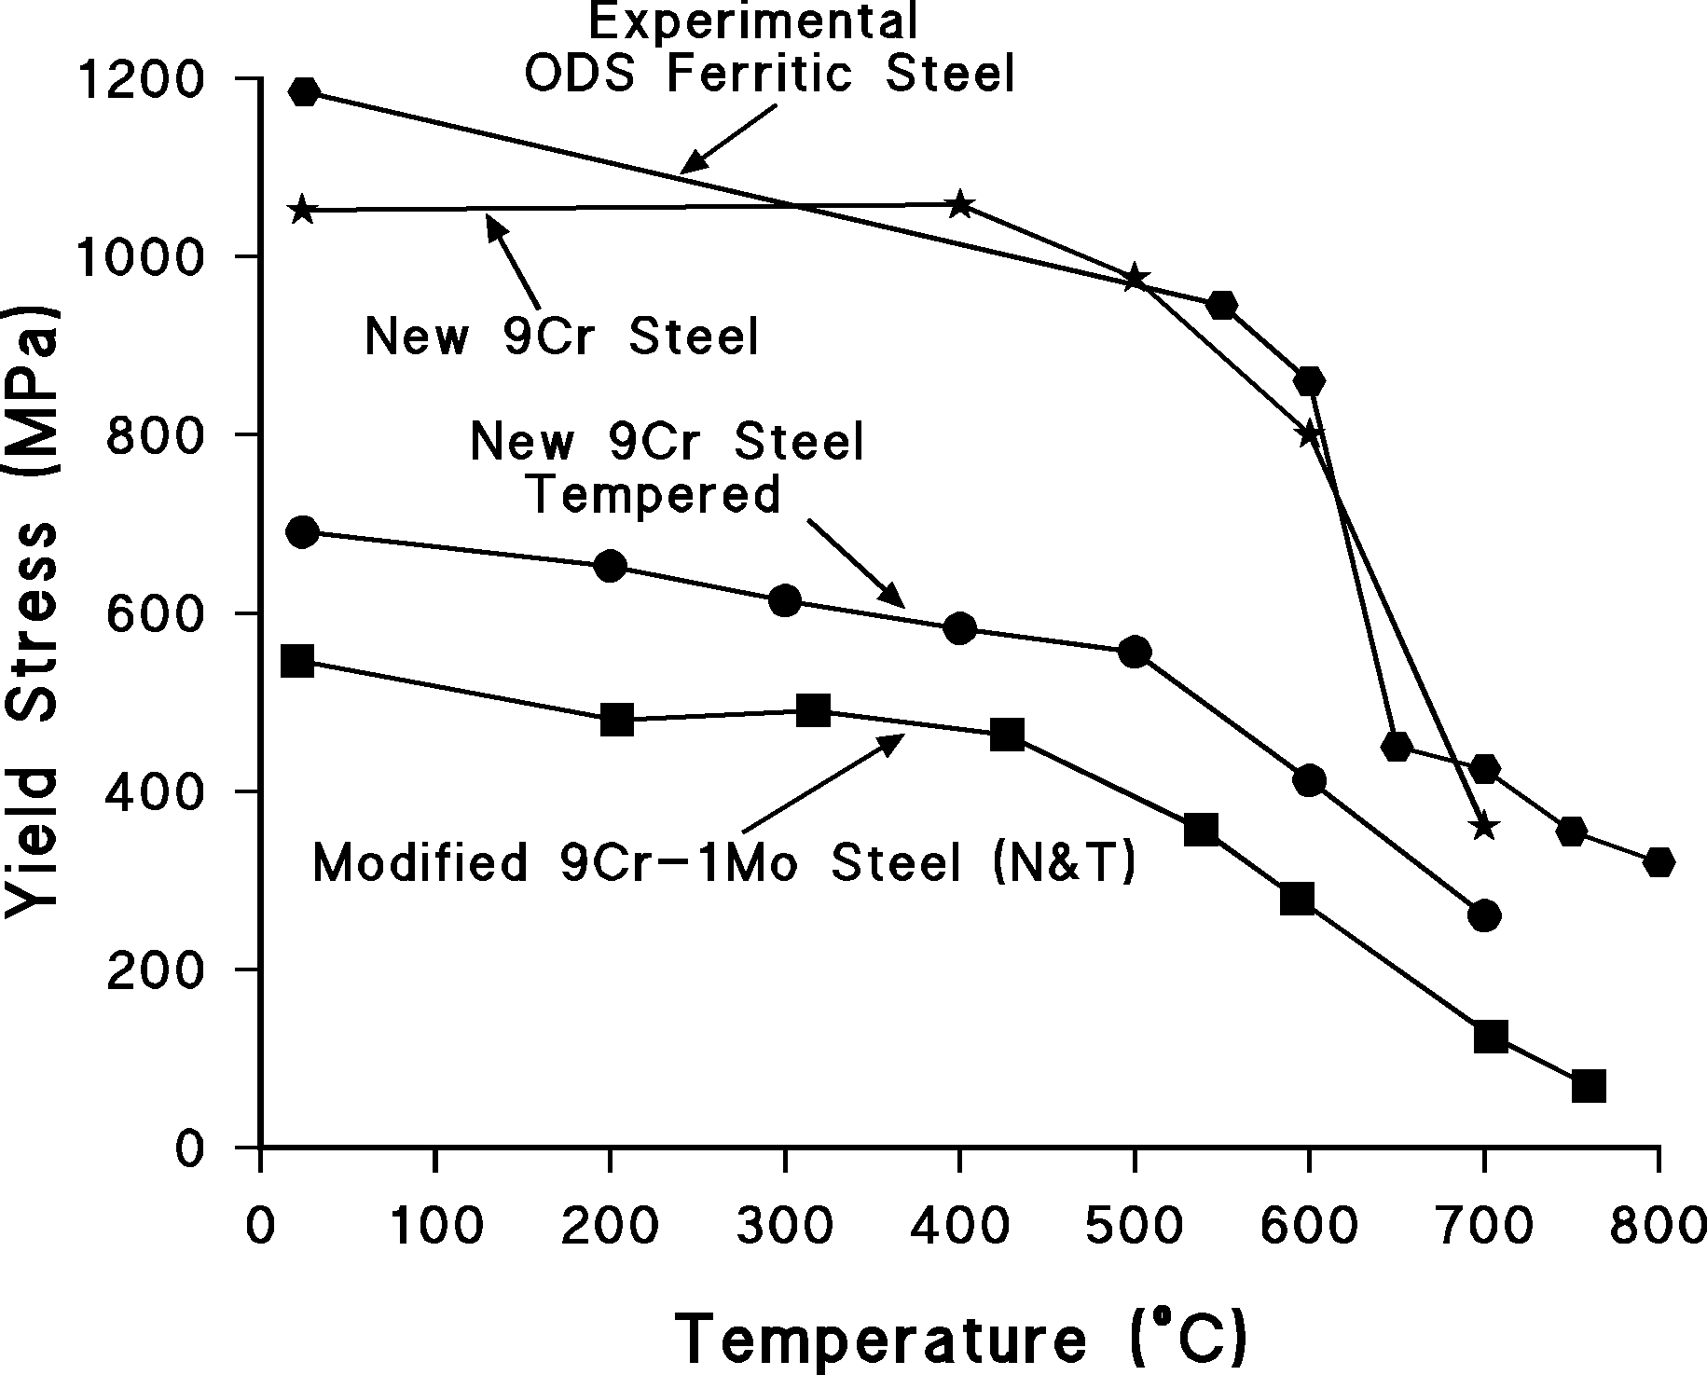
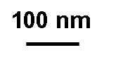
Current status and recent highlights for fusion materials
Reduced activation ferritic martensitic steels are the leading fusion structural material option worldwide, due to good properties, generally favorable fission neutron irradiation resistance, and extensive industrial capability
  Key uncertainties include ductile-brittle transition temperature (DBTT) increase due to fusion H, He effects and dose limits in fusion neutron environment
  Risk mitigation options include oxide dispersion strengthened (ODS) steels and new ferritic/martensitic steels with a very high precipitate density designed with computational thermodynamics tools.
Notes:
RAFM is equivalent to the Tokamak in plasma physics; Gen IV steels are equivalent to AT or ST versions
ODS steels are akin to stellarators
SiC/SiC are akin to other advanced configuration concepts (RFPs, etc.)

Slide 6
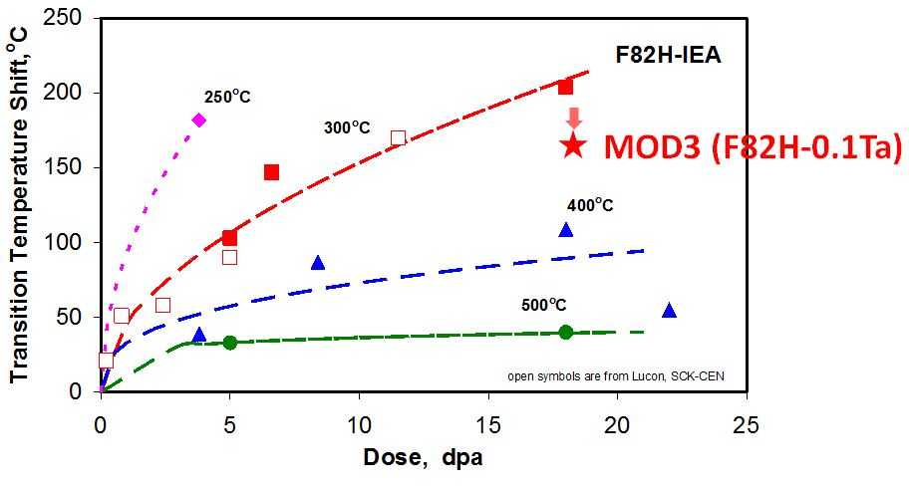
Provisional temperature and dose regimes for radiation-induced embrittlement of current fusion grades of ferritic/martensitic steels have been identified
Fission neutron irrad. (<5 appm He)
T_{irr}=
M.A. Sokolov ICFRM15 and H. Tanigawa
Lower operating temperature limit due to neutron embrittlement is ~300ºC
Steels with modified thermomechanical treatment can offer slightly improved DBTT
Notes:
Radiation-induced DBTT shifts are large for irradiation temperatures of 300C and lower. Modifications in the microstructure of RAFM steels can mitigate the DBTT shift by ~50C.

Slide 7
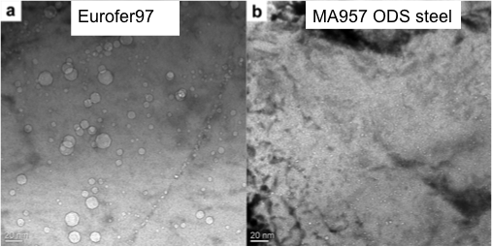
Effect of fusion-relevant He production on ferritic/martensitic steels is being investigated using simulation techniques
EUROFER, <10 appm He
Significant void swelling observed in ferritic/martensitic steel after 1400 appm He and 25 dpa at 500°C (56 appm/dpa)
EUROFER, 10-500 appm He
G.R. Odette (ICFRM-15); He injection from Ni foil during fission reactor irradiation
Good resistance to simulated fusion irradiation environment observed up to ~20 dpa
Open question: Are B-doping and He-injector (Ni foil) simulation tests prototypic for actual fusion reactor condition?
E. Gaganidze et al., KIT
Notes:
Co-production of fusion-relevant He can enhance void swelling ((0.5% in left hand photo)

Slide 8
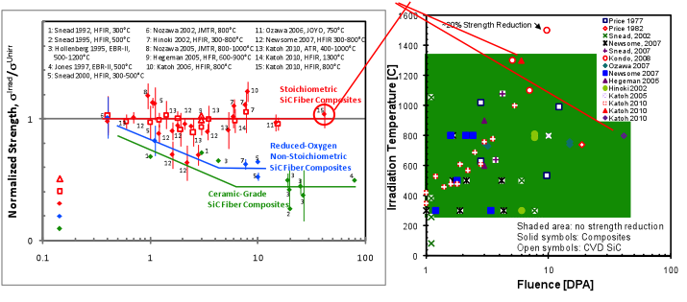
Status and recent highlights: SiC/SiC composites
Fission reactor irradiation stability up to 40 dpa recently confirmed for SiC/SiC composites at 800ºC
Scoping low dose irradiation studies on SiC joints found no degradation
Outstanding issues include improvements in leak-tightness and fabrication (complexity and cost) and development of structural design criteria
Data from recent US/J HFIR study
Notes:
SiC/SiC are akin to other advanced configuration concepts (RFPs, etc.)

Slide 9
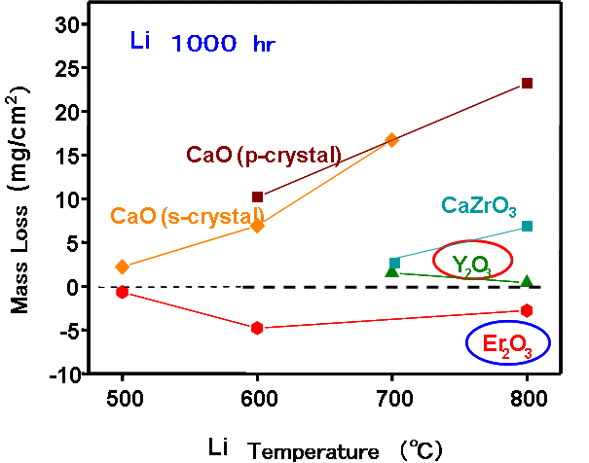
Status and recent highlights: V alloys and coatings
Higher strength V alloys have been demonstrated using mechanical alloying approach
New processes for fabricating Er2O3 and Y2O3 MHD insulator and T₂ barrier coatings are being developed (suitable for coating complex geometries)
Li temperature (ºC)
600
o
Mechanical Alloying
700
C
400
Cold-work and precipitation
Stress/MPa
100-1000x
Standard
200
0
0
2
4
6
8
10
12
14
16
Strain/%
(Chikada, Shimada, J-US TITAN Program)
Notes:
V alloys and SiC/SiC are akin to other advanced configuration concepts (RFPs, etc.)

Slide 10
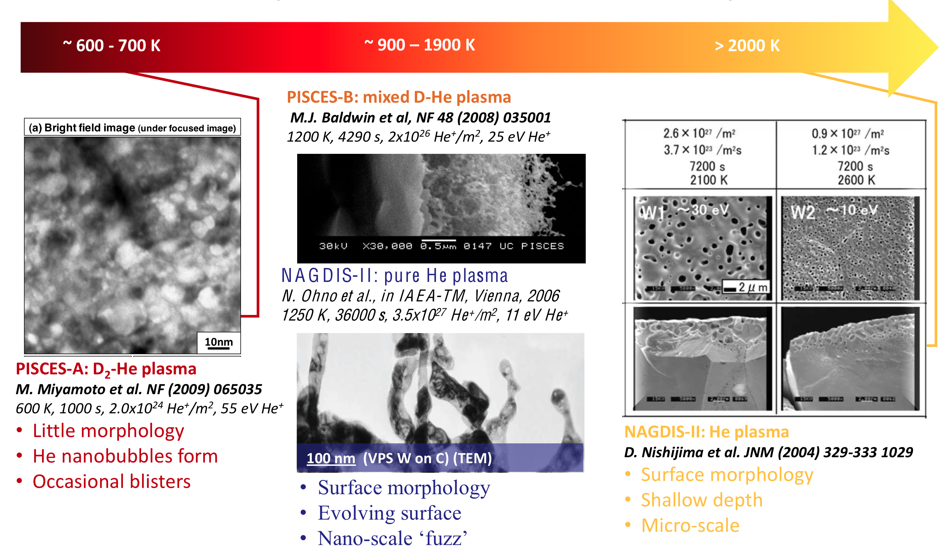
Status and recent highlights: Tungsten
Hot wall operation introduces several new phenomena
  e.g., Nanofuzz surface formation during plasma exposure
R.P. Doerner, UCSD

Slide 11
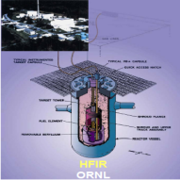
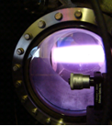
Status and recent highlights: Tungsten (cont’d)
Hot wall operation introduces several new phenomena
  enhanced D/T retention after neutron irradiation (due to trapping at defect complexes)
Modeling
Experiment
Thermal desorption
T_{irr}~70ºC
Neutron irradiation in HFIR
D plasma exposure in TPE
Calculated fraction of hydrogen that is trapped in the vicinity of a 2 nm radius He bubble in tungsten at 900 K (B.D. Wirth).
Hatano et al. FTP 4-1 (Friday)
Desorption experiments on W neutron-irradiated at high temperature are scheduled to be performed in the near future

Slide 12
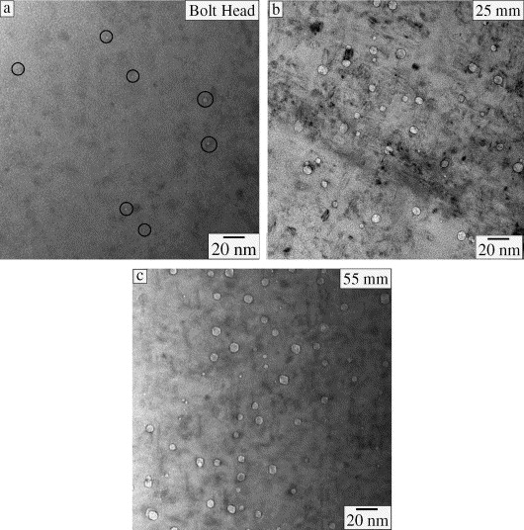
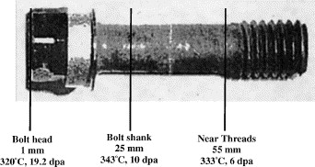
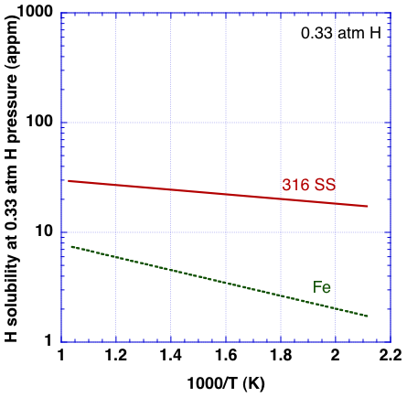
H retention increases dramatically in the presence of cavity formation
3 to 5x increase in retained hydrogen when cavities are present, even with 2-3x reduction in neutron fluence exposure
500-700 appm H
(few cavities)
1700-3700 appm H
(rad.-induced cavities present)
Retained H level is ~100x higher than expected from Sievert’s law solubilities
Baffle-former bolt removed from Tihange-1 (Belgium) pressurized water reactor
Type 316 austenitic stainless steel
F.A. Garner et al., J. Nucl. Mater. 356 (2006) 122
Notes:
Note: 1000 appm corresponds to 5 kg Tritium per 100 tonnes of steel
Note FFTF samples in contact with Na (H solubility equipartition coefficent of 170-320 for Ni and Fe at 500C, respectively) still had retained H contents of 320-570 appm in 316 SS samples with ~0.3 to 8% cavity swelling; also note that Na H content was maintained at 1ppm H by cold trapping.
I presume Sieverts law curves for Fig. 6 in Garner paper were generated by assuming 1 atm H pressure & then multiplying bulk H solubility by volume fraction of cavities (CH~d^3)

Slide 13
3 High-Priority Materials R&D Challenges
Is there a viable divertor & first wall PFC solution for DEMO/FNSF?
  Is tungsten armor at high wall temperatures viable?
  Do innovative divertor approaches (e.g., Snowflake, Super-X, or liquid walls) need to be developed and demonstrated?
Can a suitable structural material be developed for DEMO?
  What is the impact of fusion-relevant transmutant H and He on neutron fluence and operating temperature limits for fusion structural materials?
  Is the current mainstream approach for designing radiation resistance in materials (high density of nanoscale precipitates) incompatible with fusion tritium safety objectives due to tritium trapping considerations?
  Is the reduced activation mandate too restrictive for next-step devices, considering that ITER will utilize materials that are not reduced activation?
  Can recent advanced manufacturing methods such as 3D templating and additive manufacturing be utilized to fabricate high performance blanket structures at moderate cost that still retain sufficient radiation damage resistance?
What range of tritium partial pressures are viable in fusion coolants, considering tritium permeation and trapping in piping and structures?
  What level of tritium can be tolerated in the heat exchanger primary coolant, and how efficiently can tritium be removed from continuously processed hot coolants?

Slide 14
Urgency for a high-intensity fusion-relevant neutron source
The second materials R&D challenge and parts of the 1st and 3rd R&D challenge listed above require an intense neutron source for their resolution.
  Scientific studies of radiation degradation phenomena and tritium trapping issues in candidate HHF/blanket materials exposed to prototypical fusion operating environment.
Obtaining engineering data from an intense fusion neutron source is a significant critical path item for DEMO design and licensing
  Prioritize research on a limited number of DEMO material and blanket concepts (e.g., is ODS steel or another special material required?)

Slide 15
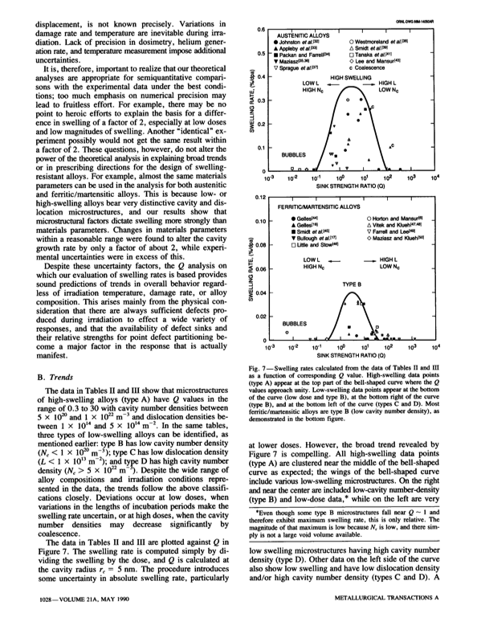
Void Swelling is typically maximized when the cavity and dislocation sink strengths are comparable
High He/dpa ratio
(e.g., spallation neutrons)
low He/dpa ratio
(e.g., fission neutrons)
Moderate He/dpa ratio
(e.g., DT fusion neutrons)
E.H. Lee & L.K. Mansur, Met. Trans. A 21 (1990) 1021
Notes:
Low swelling values at balanced sink condition are associated with very high cavity densities that cause a delay in bubble to void conversion

Slide 16
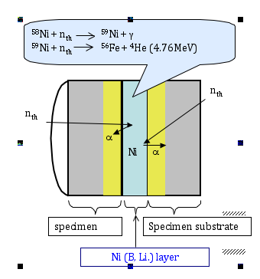
Recent in situ He injector study during fission reactor (HFIR) irradiation suggests void swelling may emerge as an issue at ~25 dpa for ferritic/martensitic steels
MA957 (ODS steel) and Eurofer97 9%Cr ferritic/martensitic steel
Eurofer97: 7.5x10²² cavities/m³ with bimodal size distribution (1.3 nm bubbles & 5 nm voids - precursor to significant swelling)
MA957: 7.8x10²³ bubbles/m³ & no voids
1400 appm He and 25 dpa at 500°C (56 appm/dpa)
Eurofer97
MA957 ODS steel
Odette et al. ICFRM-15, Charleston, South Carolina
Notes:
∆V/V~0.5% for Eurofer; many bubbles have converted to voids; cavity sink strength is ~2*pi*d*N~1.5e15/m2, which is somewhat higher than dislocation sink strength.
He/dpa is ~5 times higher than fusion-relevant value

Slide 17
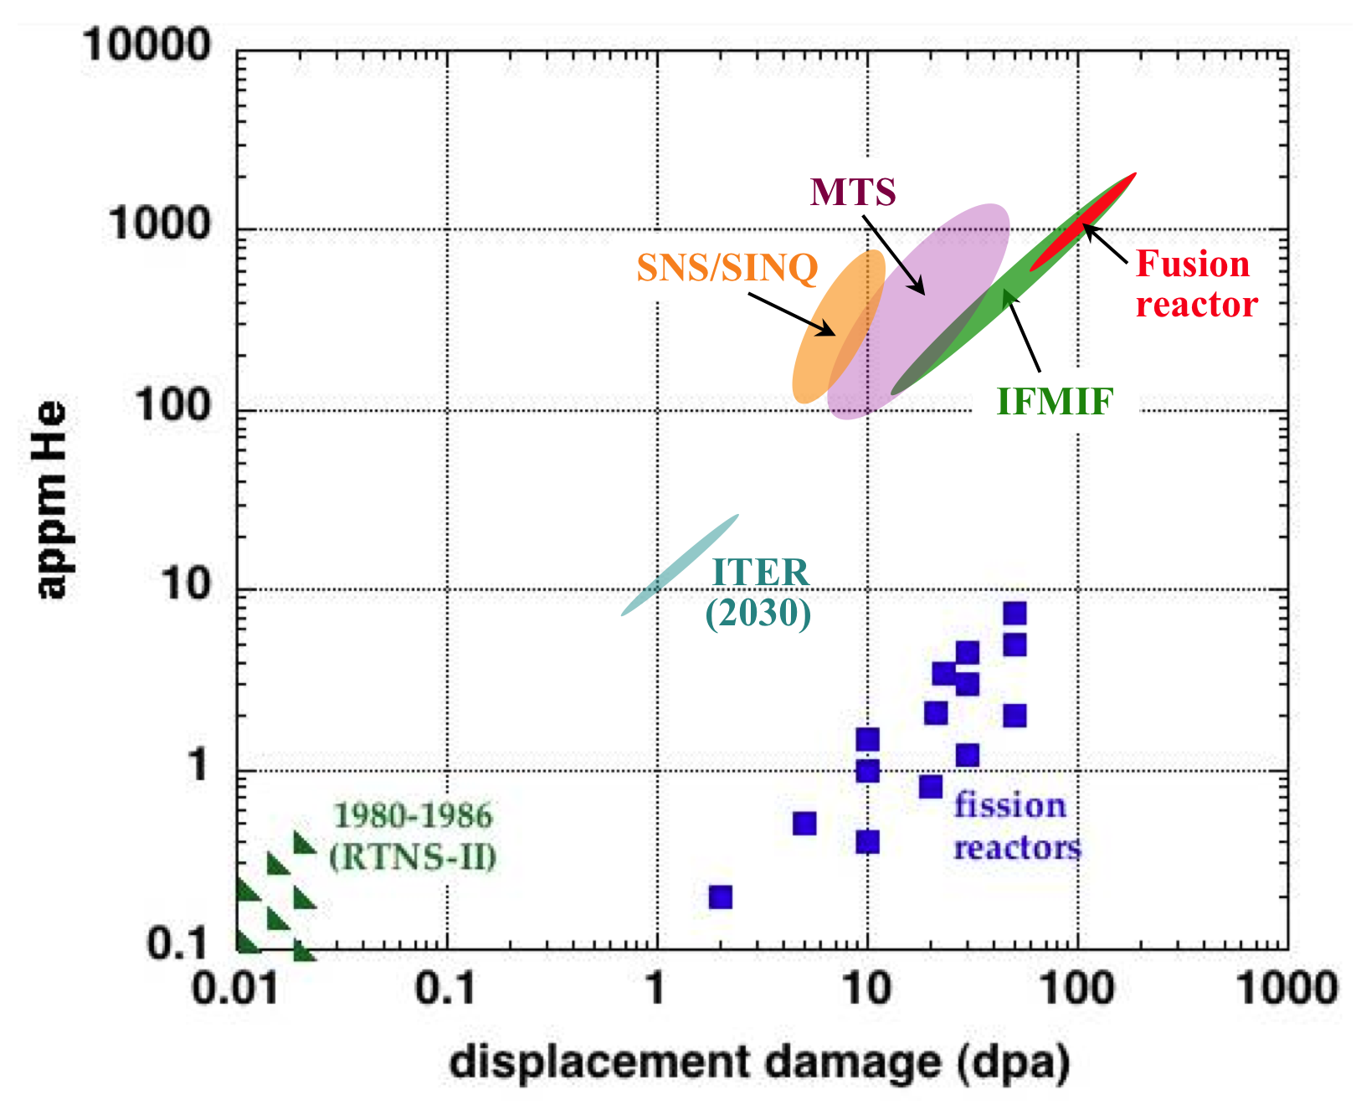
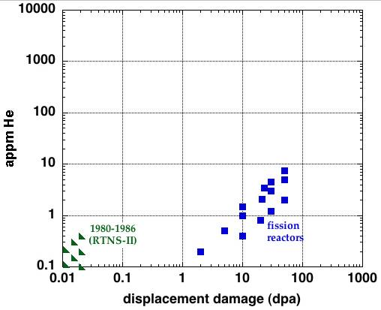
There are several options to close the current knowledge gap in fusion-relevant radiation effects in materials
An intense neutron source (in concert with enhanced theory and modeling) is needed to improve understanding of basic fusion neutron effects and to develop & qualify fusion structural materials
Current knowledge base on ferritic steels
Fusion
reactor
Option A: IFMIF + fission reactors +ion beams + modeling
Option B: robust spallation (e.g., MTS) + fission reactors + ion beams + modeling
Option C: modest spallation (e.g.,SNS/SINQ) + fission reactors + ion beams + modeling
Notes:
Massively parallel computing will also play an important role
ITER DT results on TBM components would only be available after 2030

Slide 18
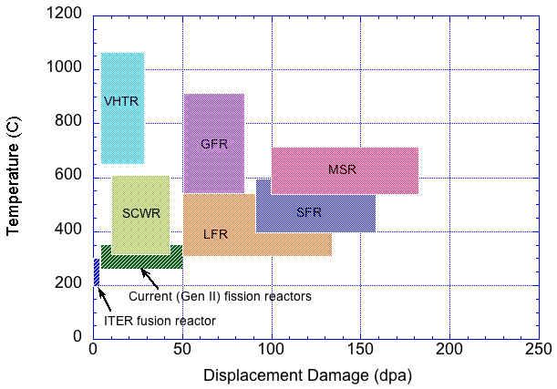
Comparison of Gen IV and Fusion Structural Materials Environments
SiC
fusion
V alloy, ODS steel
F/M steel
S.J. Zinkle & J.T. Busby, Mater. Today 12 (2009) 12
S.J. Zinkle ,OECD NEA Workshop on Structural Materials for Innovative Nuclear Energy Systems, Karlsruhe, Germany, June 2007
All Gen IV and Fusion concepts pose severe materials challenges

Slide 19
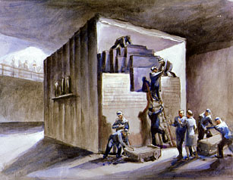
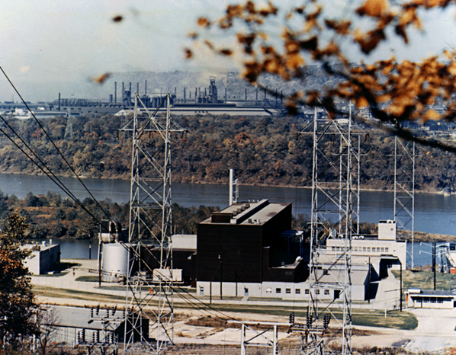
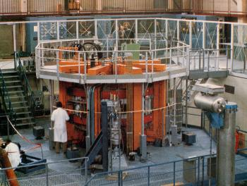
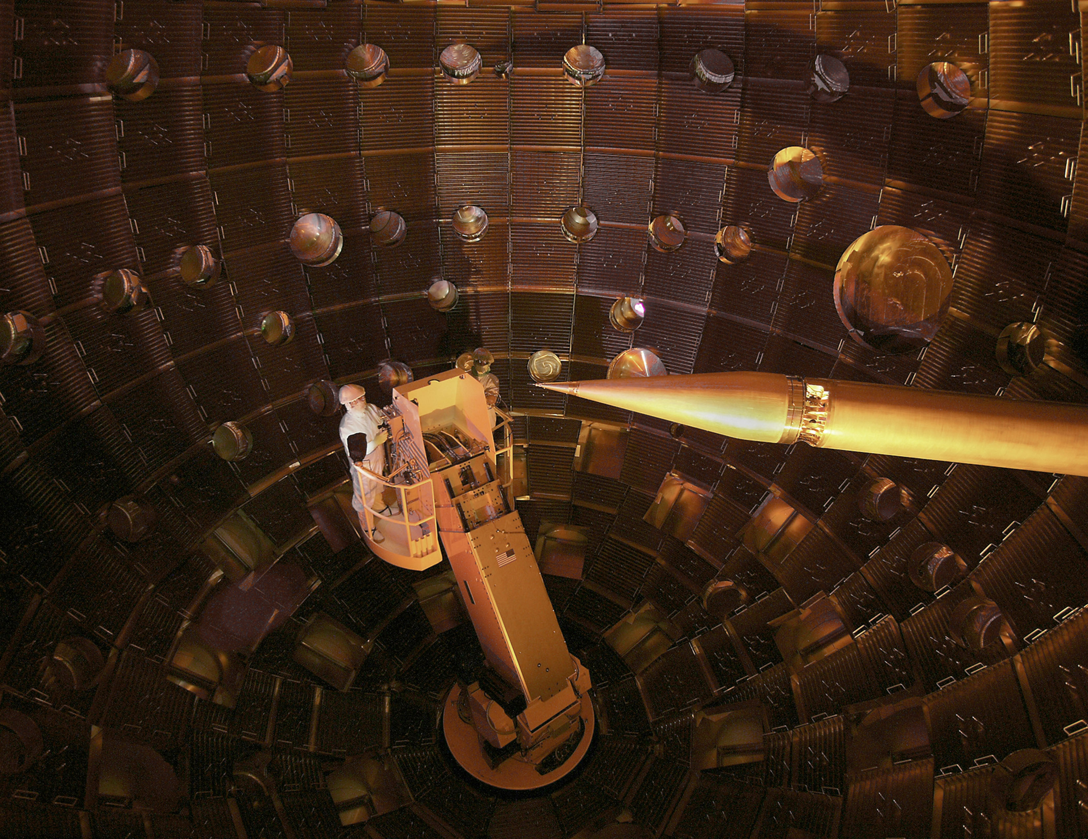
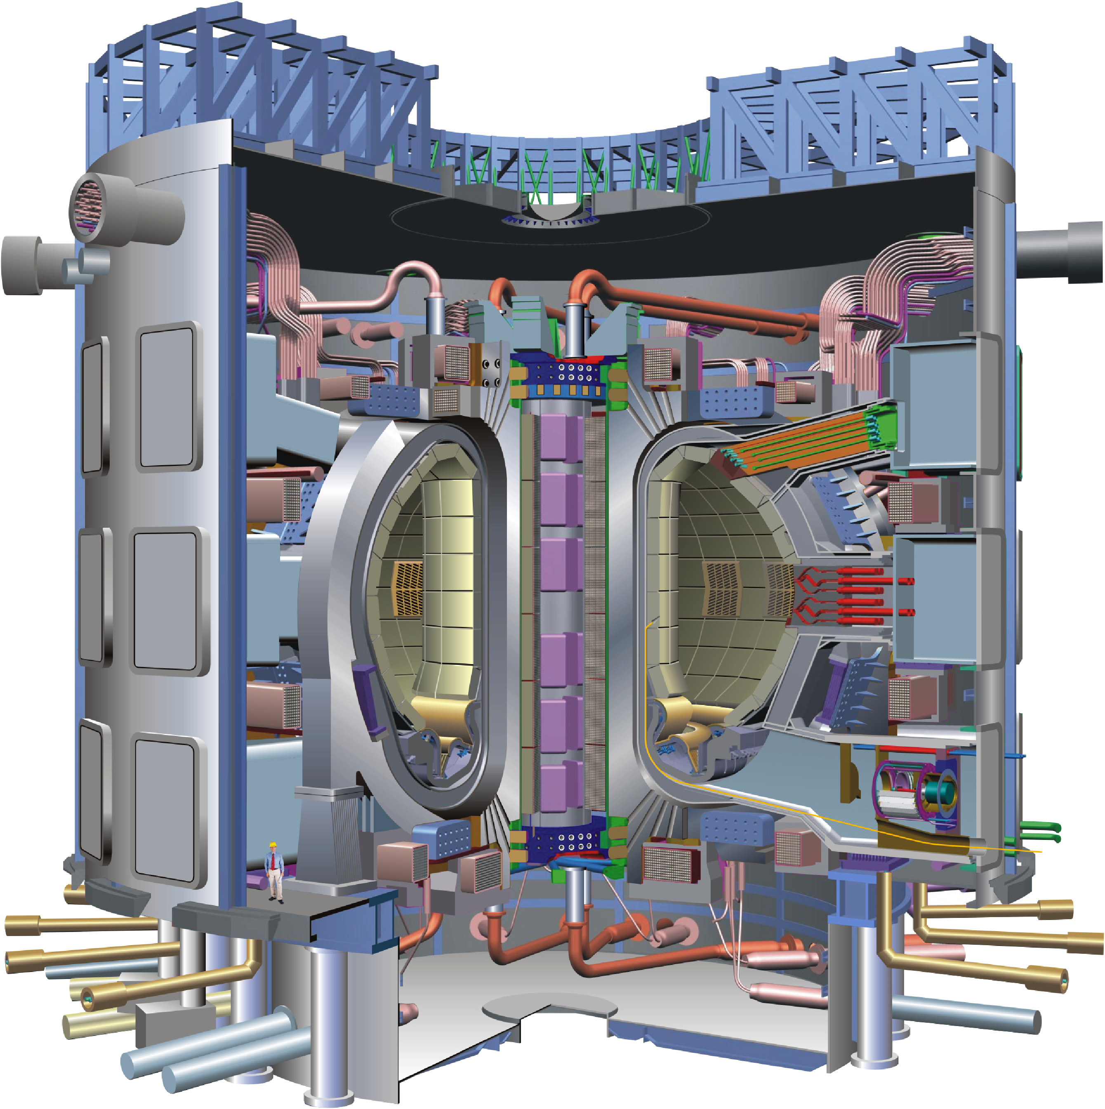
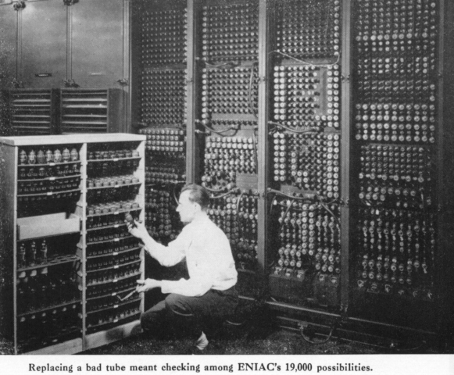
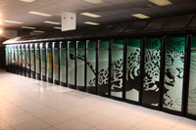
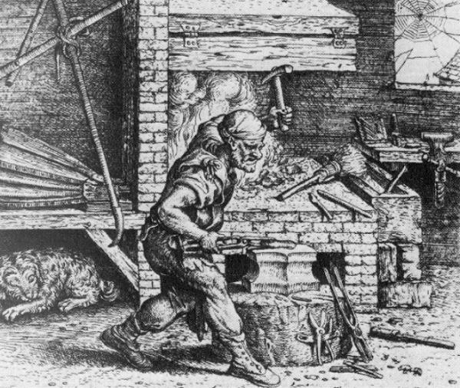
Timeline of some key events for nuclear energy and materials and computational science
Tokamak era begins
NIF
CP-1
Shippingport
Graphite
JET: Q=0.65, 0.5s
ITER
reactor
1st stellarator
& Tokamak
Nuclear >10% US electricity
JT-60: Q_{eq}=1.25
TFTR: Q=0.27
1940
1950
1960
1970
1980
1990
2000
2010
Development of Mat. Sci.
1 Tflops
1 Pflops
ENIAC
as an academic discipline
1 Gflops achieved;
high performance
computing centers
established
1st MD simulation of radiation damage
(500 atoms, 1 min. time step)
multimillion atom MD simulations
(~1 fs time step)
Notes:
1968: T3 Tokamak at Kurchatov Inst. In Russia (Tokamak concept originally designed in 1951; T1 tokamak first became operational in 1958)
1st MD simulations of radiation damage by BNL group (G.H. Vineyard and coworkers)
JT60: DT-equivalent Q of 1.25 was obtained using DD plasma (highest recorded Q for DT plasma was 0.65 in JET)
TFTR: max fusion power=10.7 MW; JET max fusion power=16MW

Slide 20
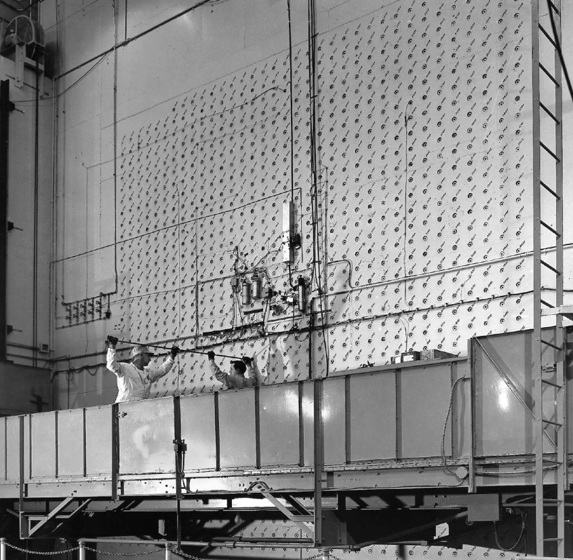
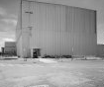
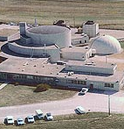

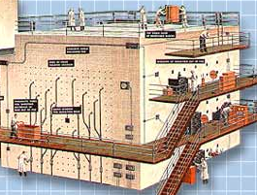
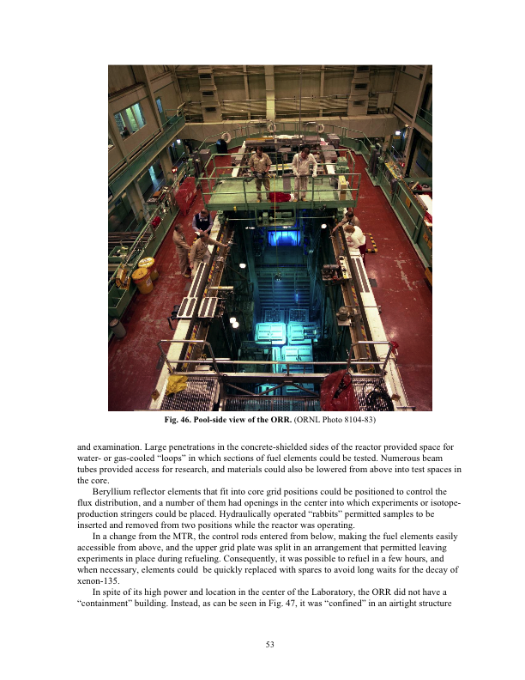
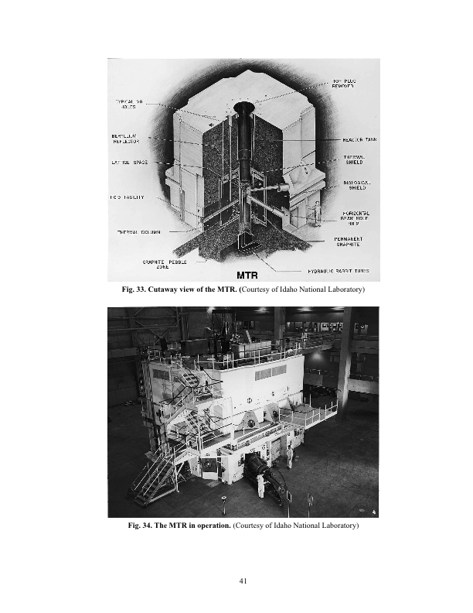
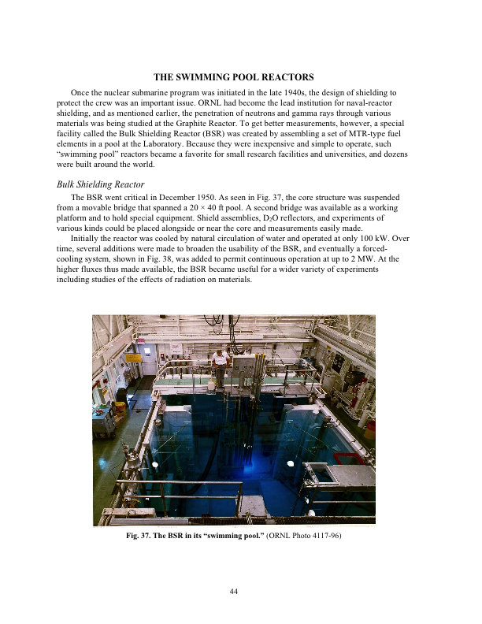
Detailed timeline of some key facilities for nuclear energy and materials
MTR
ETR
ORR
BSR
CP-1
Graphite reactor
CP-5
1942
1944
1946
1948
1950
1952
1954
1956
1958
BGRR
Obninsk AM-1
Calder Hill
Shippingport
1st radiation damage paper
E.P. Wigner
J. Appl. Phys. 17 (1946) 857
Notes:
Note: ~30 reactor piles were constructed at Columbia University by Fermi, Szilard and coworkers in 1941-1942 (with improving material impurity, etc.) prior to the Chicago Pile
1946: Eugene Wigner advocates construction of a high flux test reactor for nuclear physics research AND radiation effects on materials
Note evolution in reactors from physics to materials research and technology (e.g., shielding) missions; similar evolution also occurred in accelerators (X-section measurements, then radiation effects studies)
EBR-I: 1st electricity-producing nuclear power plant (Dec. 20, 1951); operated until 1964.
52 reactors have been built to date at the Idaho test site; 3 were specifically dedicated to materials radiation effects research (MTR, ETR, ATR)
As of 1959 there were at least 7 materials test reactors available with the correct neutron spectrum for performing materials irradiation tests

Slide 21
Contribution of major facilities to Materials degradation science and technology issues
Non-nuclear test stands
Fusion-relevant neutron source
Red: TRL 1-3 issues
Yellow: TRL 4-6 issues
Green: TRL 7-9 issues
Ion & fission irrad.
ITER-
TBM
FNSF
Demo
after DOE/SC-0149 (2012); ITER TBM column revised/corrected by materials degradation subpanel
Notes:
Several items for the ITER TBM column have been revised upward relative to the FESAC report (FESAC report column was initially prepared for ITER, not for ITER TBM).

Slide 22
Conclusions
Substantial progress continues to be made in understanding and developing high-performance fusion structural materials.
  Ferritic/martensitic steels appear to be suitable for fusion doses up to ~20 dpa
  Higher performance options (e.g., ODS steels) may offer significantly better radiation resistance, but joining technology and others issues need to be resolved.
In order to accelerate the pace for developing practical fusion energy, the construction of an intense fusion neutron source is needed.
  Tritium retention (fusion safety)
  Viability of blanket and first wall structural materials
  Engineering database activities for design and licensing purposes, when a viable candidate has been identified

