Slide 1
Science and technology research & development in support to ITER and the Broader Approach
A. Bécoulet & the CEA-IRFM Team
J. Abiteboul, J. Achard, T. Alarcon, J. Alba-Duran, L. Allegretti, S. Allfrey , S. Amiel, J.M. Ané, T. Aniel, G.Antar¹, A. Argouarch, A. Armitano, J. Arnaud, D. Arranger, J.F Artaud, D. Audisio, M. Aumeunier, E. Autissier, L. Azcona, A. Back², A. Bahat, X. Bai, B. Baiocchi, D. Balaguer, S. Balme, C. Balorin, O. Barana, D. Barbier, A. Barbuti, V. Basiuk, O. Baulaigue, P. Bayetti, C. Baylard, S. Beaufils, A. Beaute, A. Bécoulet, M. Bécoulet, , Z. Bej, S. Benkadda², F. Benoit, G. Berger-By, J.M. Bernard, A. Berne, B. Bertrand, E. Bertrand, P. Beyer², A. Bigand, G. Bonhomme³, G. Borel, A. Boron, C. Bottereau, H. Bottollier-Curtet, C. Bouchand, F. Bouquey, C. Bourdelle, J. Bourg, S. Bourmaud, S. Bremond, F. Bribiesca Argomedo⁴, M. Brieu, C. Brun, V. Bruno, J. Bucalossi, H. Bufferand⁵ , Y. Buravand, L. Cai, V. Cantone, B. Cantone, E. Caprin, T. Cartier-Michaud, A. Castagliolo, J. Castelo Madeira Belo⁶, V. Catherine-Dumont, G. Caulier, J. Chaix, M. Chantant, M. Chatelier, D. Chauvin, J. Chenevois, B. Chouli, L. Christin, D. Ciazynski, G. Ciraolo⁵, F. Clairet, R. Clapier, H. Cloez, M. Coatanea-Gouachet, L. Colas, G. Colledani, L. Commin, P. Coquillat, E. Corbel, Y. Corre, J. Cottet, P. Cottier, X. Courtois, I. Crest, R. Dachicourt, M. Dapena Febrer, C. Daumas, H.P.L. de Esch, B. De Gentile, C. Dechelle, J. Decker, P. Decool, V. Deghaye, J. Delaplanche, E. Delchambre-Demoncheaux, L. Delpech, C. Desgranges, P. Devynck, J. Dias Pereira Bernardo⁶, G. Dif-Pradalier, L. Doceul, Y. Dong⁷, D. Douai, H. Dougnac, N. Dubuit², J. Duchateau, L. Ducobu, B. Dugue, N. Dumas, R. Dumont, A. Durocher, A. Durocher, F. Duthoit, A. Ekedahl, D. Elbeze, A. Escarguel², J. Escop, F. Faïsse, G. Falchetto, J. Farjon, M. Faury, N. Fedorzack, P. Féjoz, C. Fenzi, F. Ferlay, P. Fiet, M. Firdaouss, M. Francisquez⁸, B. Franel, J. Frauche, Y. Frauel, R. Futtersack⁹, X. Garbet, J. Garcia, J. Gardarein¹¹, L. Gargiulo, P. Garibaldi, P. Garin, D. Garnier, E. Gauthier, O. Gaye, A. Geraud, M. Gerome, V. Gervaise, M. Geynet, P. Ghendrih, I. Giacalone, S. Gibert, C. Gil, S. Ginoux, L. Giovannangelo, S. Girard, G. Giruzzi, C. Goletto, R. Gonde, M. Goniche, R. Goswami, C. Grand, V. Grandgirard, B. Gravil, C. Grisolia, G. Gros, A. Grosman, J. Guigue, D. Guilhem, C. Guillemaut, B. Guillerminet, Z. Guimaraes Filho², R. Guirlet, J. P. Gunn, O. Gurcan⁷, F. Guzman¹⁰, S. Hacquin, F. Hariri, F. Hasenbeck¹², J.C Hatchressian, P. Hennequin-Blondet⁷, C. Hernandez, P. Hertout, S. Heuraux³, J. Hillairet, G.T. Hoang, C. Honore⁷, G. Hornung, M. Houry, I. Hunstad, T. Hutter, P. Huynh, V. Icard, F. Imbeaux, M. Irishkin, L. Isoardi, J. Jacquinot, J. Jacquot, G. Jiolat, M. Joanny, E. Joffrin, J. Johner, P. Joubert, L. Jourd'Heuil, M. Jouve, C. Junique, D. Keller, C. Klepper¹³, D. Kogut, M. Kubič, F. Labassé, B. Lacroix, Y. Lallier, V. Lamaison, R. Lambert, S. Larroque, G. Latu, Y. Lausenaz, C. Laviron, R. Le, A. Le Luyer, C. Le Niliot¹¹, Y. Le Tonqueze, P. Lebourg, T. Lefevre, F. Leroux, L. Letellier, Y. Li, M. Lipa , J. Lister¹⁴, X. Litaudon, F. Liu, T. Loarer, G. Lombard, P. Lotte, M. Lozano, J. Lucas, H. Lütjens⁷, P. Magaud, P. Maget, R. Magne, J. Mahieu, P. Maini, P. Malard, L. Manenc, Y. Marandet², G. Marbach, J-L. Marechal, L. Marfisi, M. Marle, C. Martin², V. Martin, G. Martin, A. Martinez, P. Martino, R. Masset, D. Mazon, N. Mellet, L. Mercadier, A. Merle, D. Meshcheriakov, P. Messina, O. Meyer, L. Millon, M. Missirlian, J. Moerel¹⁵, D. Molina, P. Mollard, V. Moncada, P. Monier-Garbet, D. Moreau, M. Moreau, P. Moreau, P. Morel⁷, T. Moriyama¹⁶, Y. Motassim, G. Mougeolle, D. Moulton, G. Moureau, D. Mouyon, M. Naim Habib, E. Nardon, V. Négrier, J. Nemeth¹⁷, C. Nguyen, M. Nguyen⁷, L. Nicolas, T. Nicolas, S. Nicollet, E. Nilsson¹⁸, B. N'Konga¹⁹, F. Noel, A. Nooman, C. Norscini²⁰, R. Nouailletas, P. Oddon, T. Ohsako, F. Orain, M. Ottaviani, M. Pagano, F. Palermo²¹, S. Panayotis, H. Parrat, J-Y. Pascal, C. Passeron, P. Pastor, J. Patterlini, K. Pavy, A-L. Pecquet, B. Pégourié, C. Peinturier⁷, T. Pelletier, B. Peluso, V. Petrzilka²², Y. Peysson, E. Pignoly, R. Pirola, C. Pocheau, E. Poitevin, V. Poli, S. Poli, F. Pompon²³, I. Porchy, C. Portafaix, M. Preynas, P. Prochet, M. Prou, A. Ratnani, D. Raulin, N. Ravenel, S. Renard, B. Ricaud, M. Richou, G. Ritz, H. Roche, P. Roubin², C. Roux, K. Ruiz, F. Sabathier, R. Sabot, A. Saille, F. Saint-Laurent, R. Sakamoto²⁴, S. Salasca, T. Salmon, T. Salmon, F. Samaille, S. Sanchez, A. Santagiustina, B. Saoutic, Y. Sarazin, P. Sardain, J. Schlosser, M. Schneider, J. Schwob, J. Segui, N. Seguin, G. Selig, D. Serret, J. Signoret, J. Signoret, A. Simonin, M. Soldaini, B. Soler, C. Soltane, S. Song²⁵, F. Sourbier, J. Sparagna, P. Spitz, P. Spuig, A. Storelli⁷, A. Strugarek, P. Tamain, M. Tena, J. Theis, O. Thomine , D. Thouvenin, A. Torre, L. Toulouse, J. Travere, B. Turck, J. Urban, J.-C. Vallet, J. Vallory, A. Valognes, J. Van Helvoirt¹⁵, S. Vartanian, J-M. Verger, L. Vermare⁷, C. Vermare, D. Vezinet, K. Vicente, J. Vidal, N. Vignal, T. Vigne, F. Villecroze, E. Villedieu, B. Vincent, B. Volpe, D. Volpe, R. Volpe, J. Wagrez, H. Wang, T. Wauters, O. Wintersdorff, E. Wittebol¹⁵, B. Zago, L. Zani, D. Zarzoso, Y. Zhang, W. Zhong, X.L. Zou

Slide 2

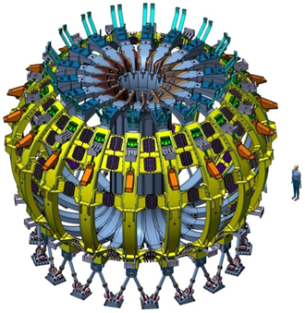





OUTLINE
Support the Broader Approach
JT-60SA
IFMIF-EVEDA
IFERC
Bayetti FTP/P1-29
Giruzzi TH/P2-03

Slide 3
DIRECT ContributION to the Broader Approach Projects
JT60-SA
Procure 9 TF coils + structures. 5 HVPS. Test facility
Procure full Cryoplant
Joint EU/Japan revision of Research Plan. Design scenarios
IFMIF/EVEDA. Design/Validate the Accelerator Facility
IFERC. Procure “Helios” HPC 1.5 Petaflop/s peak
Bayetti FTP/P1-29
Giruzzi TH/P2-03
Coil Cold Test Facility, CEA-Saclay
18TF coil test before shipping
to Japan
JT60-SA TF coil structures
Support BA Projects

Slide 4
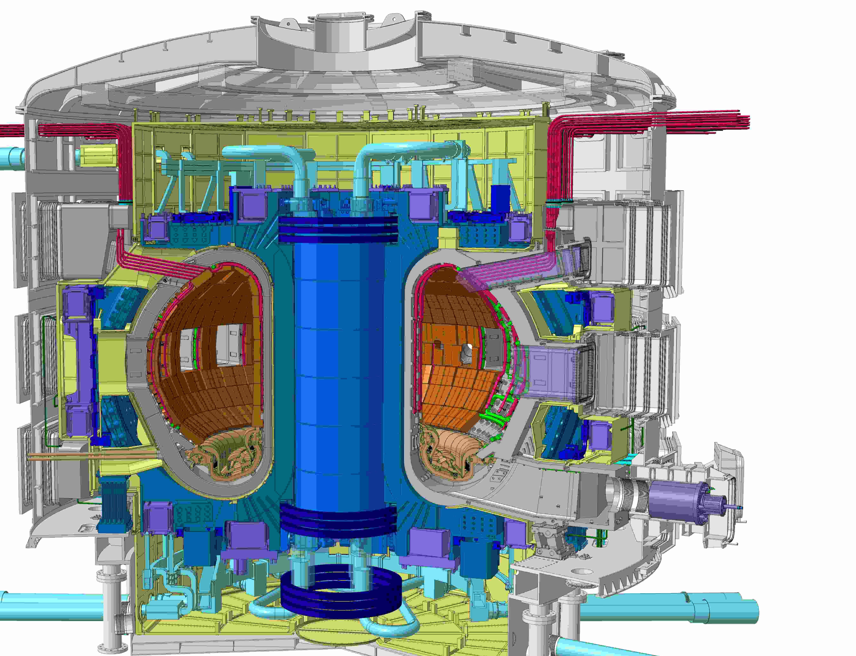




OUTLINE
Prepare ITER scenarios.
Mitigate performance limitations
ITER limiter start-up
First principle simulations: ELM mitigation, MHD, Transport
Monier-Garbet EX/P5-26
M. Bécoulet TH/2-1
Sarazin THC/P7-09
Garbet TH/P3-21

Slide 5
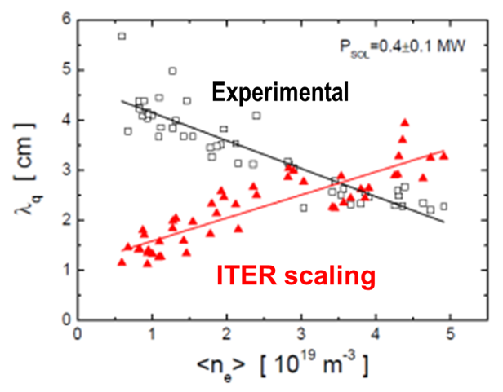
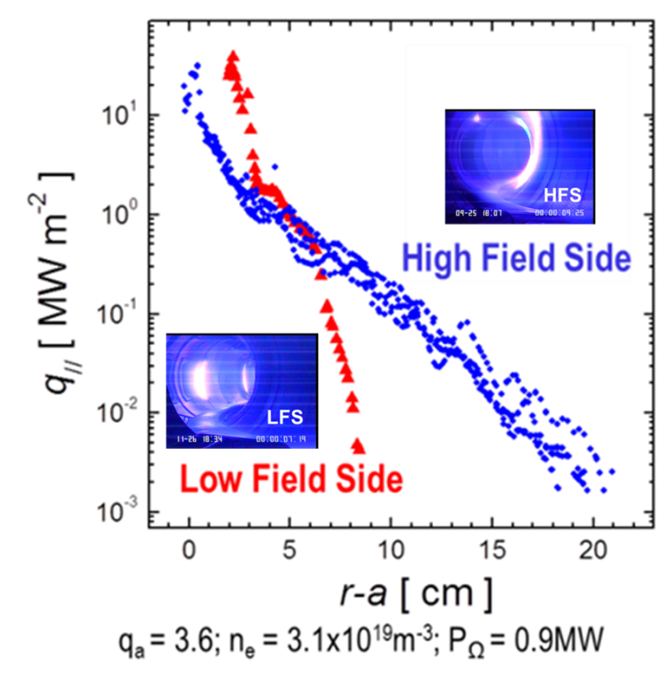
PROVIDE guide choice FOR start-up mode:
ITER start-up experiments in Tore Supra
Monier-Garbet EX/P5-26
Plasmas leaning on High Field Side limiters exhibit
broad SOL profiles with low heat fluxes on the LCFS
Opposite behavior for LFS contacting plasmas
For inboard-leaning plasmas, λ_{q} α P_{SOL} ^{-0.6 ± 0.1}
For a given P_{SOL}, λ_{q} decreases with density, whereas the ITER scaling law predicts the opposite behaviour
Prepare ITER scenarios

Slide 6
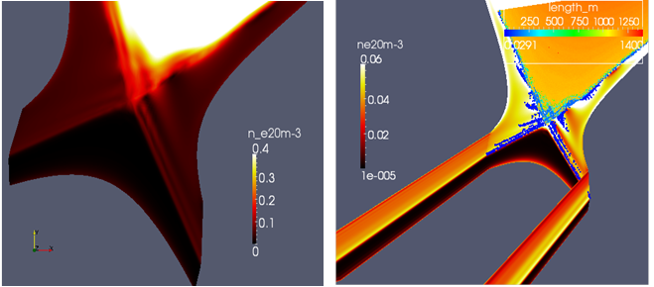
RMP generated by external coils
COULD IMPACT SEPARATRIX IN ITER
M. Bécoulet TH/2-1
Nonlinear MHD code JOREK includes extra physics:
toroidal rotation source, neocl. poloidal viscosity, 2-fluid diamagnetic effects
RMPs more screened at low resistivity and/or strong rotation.
Small erosion of density and temperature observed near the X-point.
Deformation of the separatrix, though not impacting wall loads.
ITER standard H-mode
(15MA/5.3T) IVC n=3
Icoil=54kAt
Edge density
Small erosion of density near the X-point
Magnetic topology on target
Small splitting on LFS.
Mitigate Performance Limitations

Slide 7
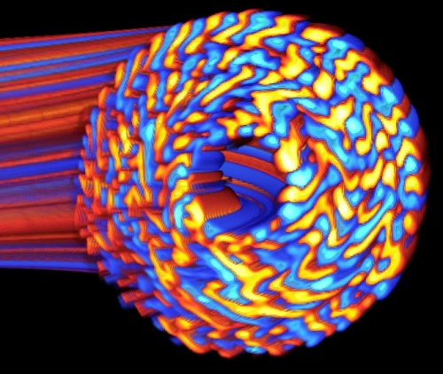
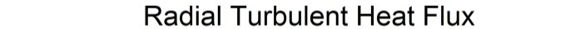
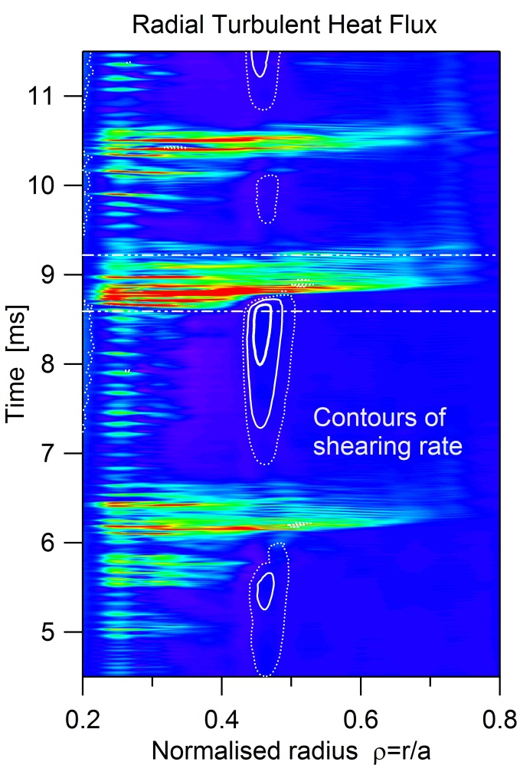
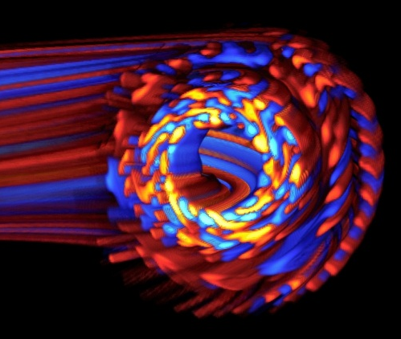



Unraveling Turbulent Transport Control with Flux Driven Gyrokinetic Simulations (GYSELA)
Sarazin THC/P7-09
Issue: controlling turb. transport with E×B shear flow v_{Eθ} (ω~0 & ω=ω_{EGAM})
Main findings: Energetic Part. → EGAMs → oscillating v_{Eθ} → regulation
Vorticity source → static v_{Eθ} → Transport Barrier relaxations
Zarzoso ,submitted PRL
Strugarek submitted PRL
  Generation of E×B shearing rate in flux-driven gyrokinetic simulation (source of vorticity S_{Ω})
  Transport Barrier (TB) develops
  Quasi-periodic crashes of TB due to transient screening of S_{Ω} by Zonal Flows
During Crash
During Transport Barrier
Capture some physics of experimental core & edge transport barrier dynamics
Snapshots of non-axisymmetric
electric potential fluctuations
  GYSELA
Mitigate Performance Limitations

Slide 8
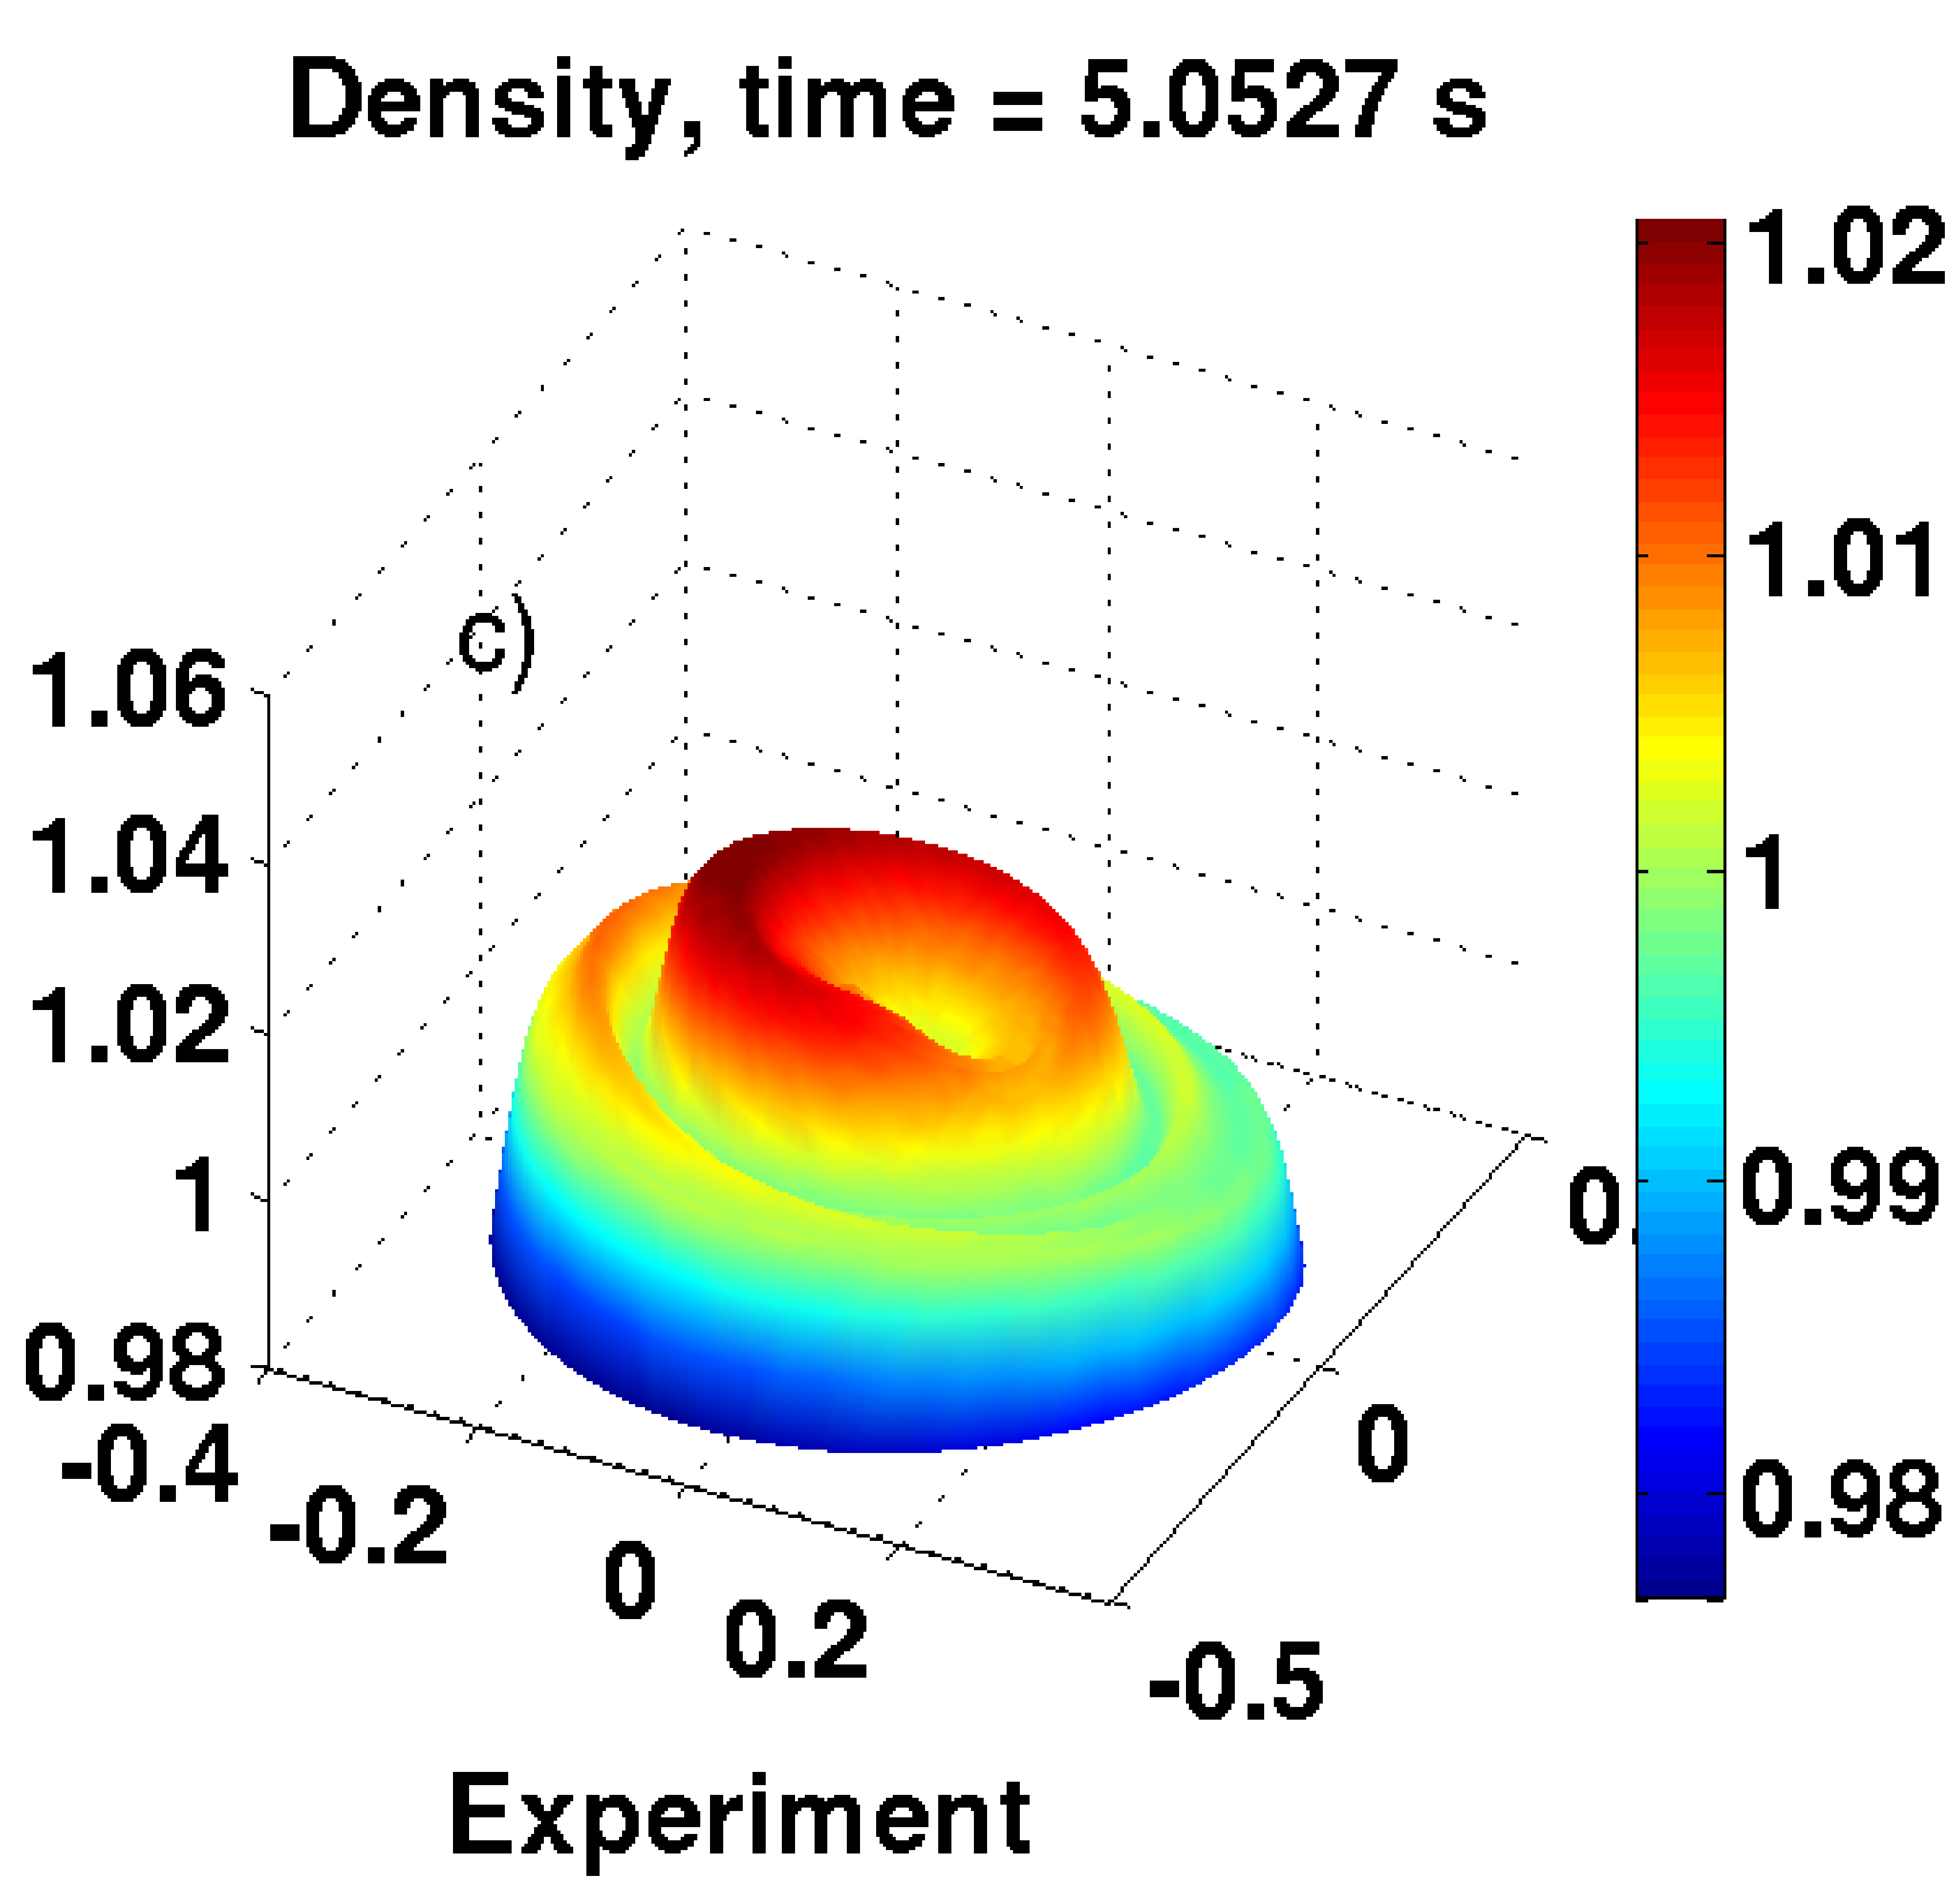
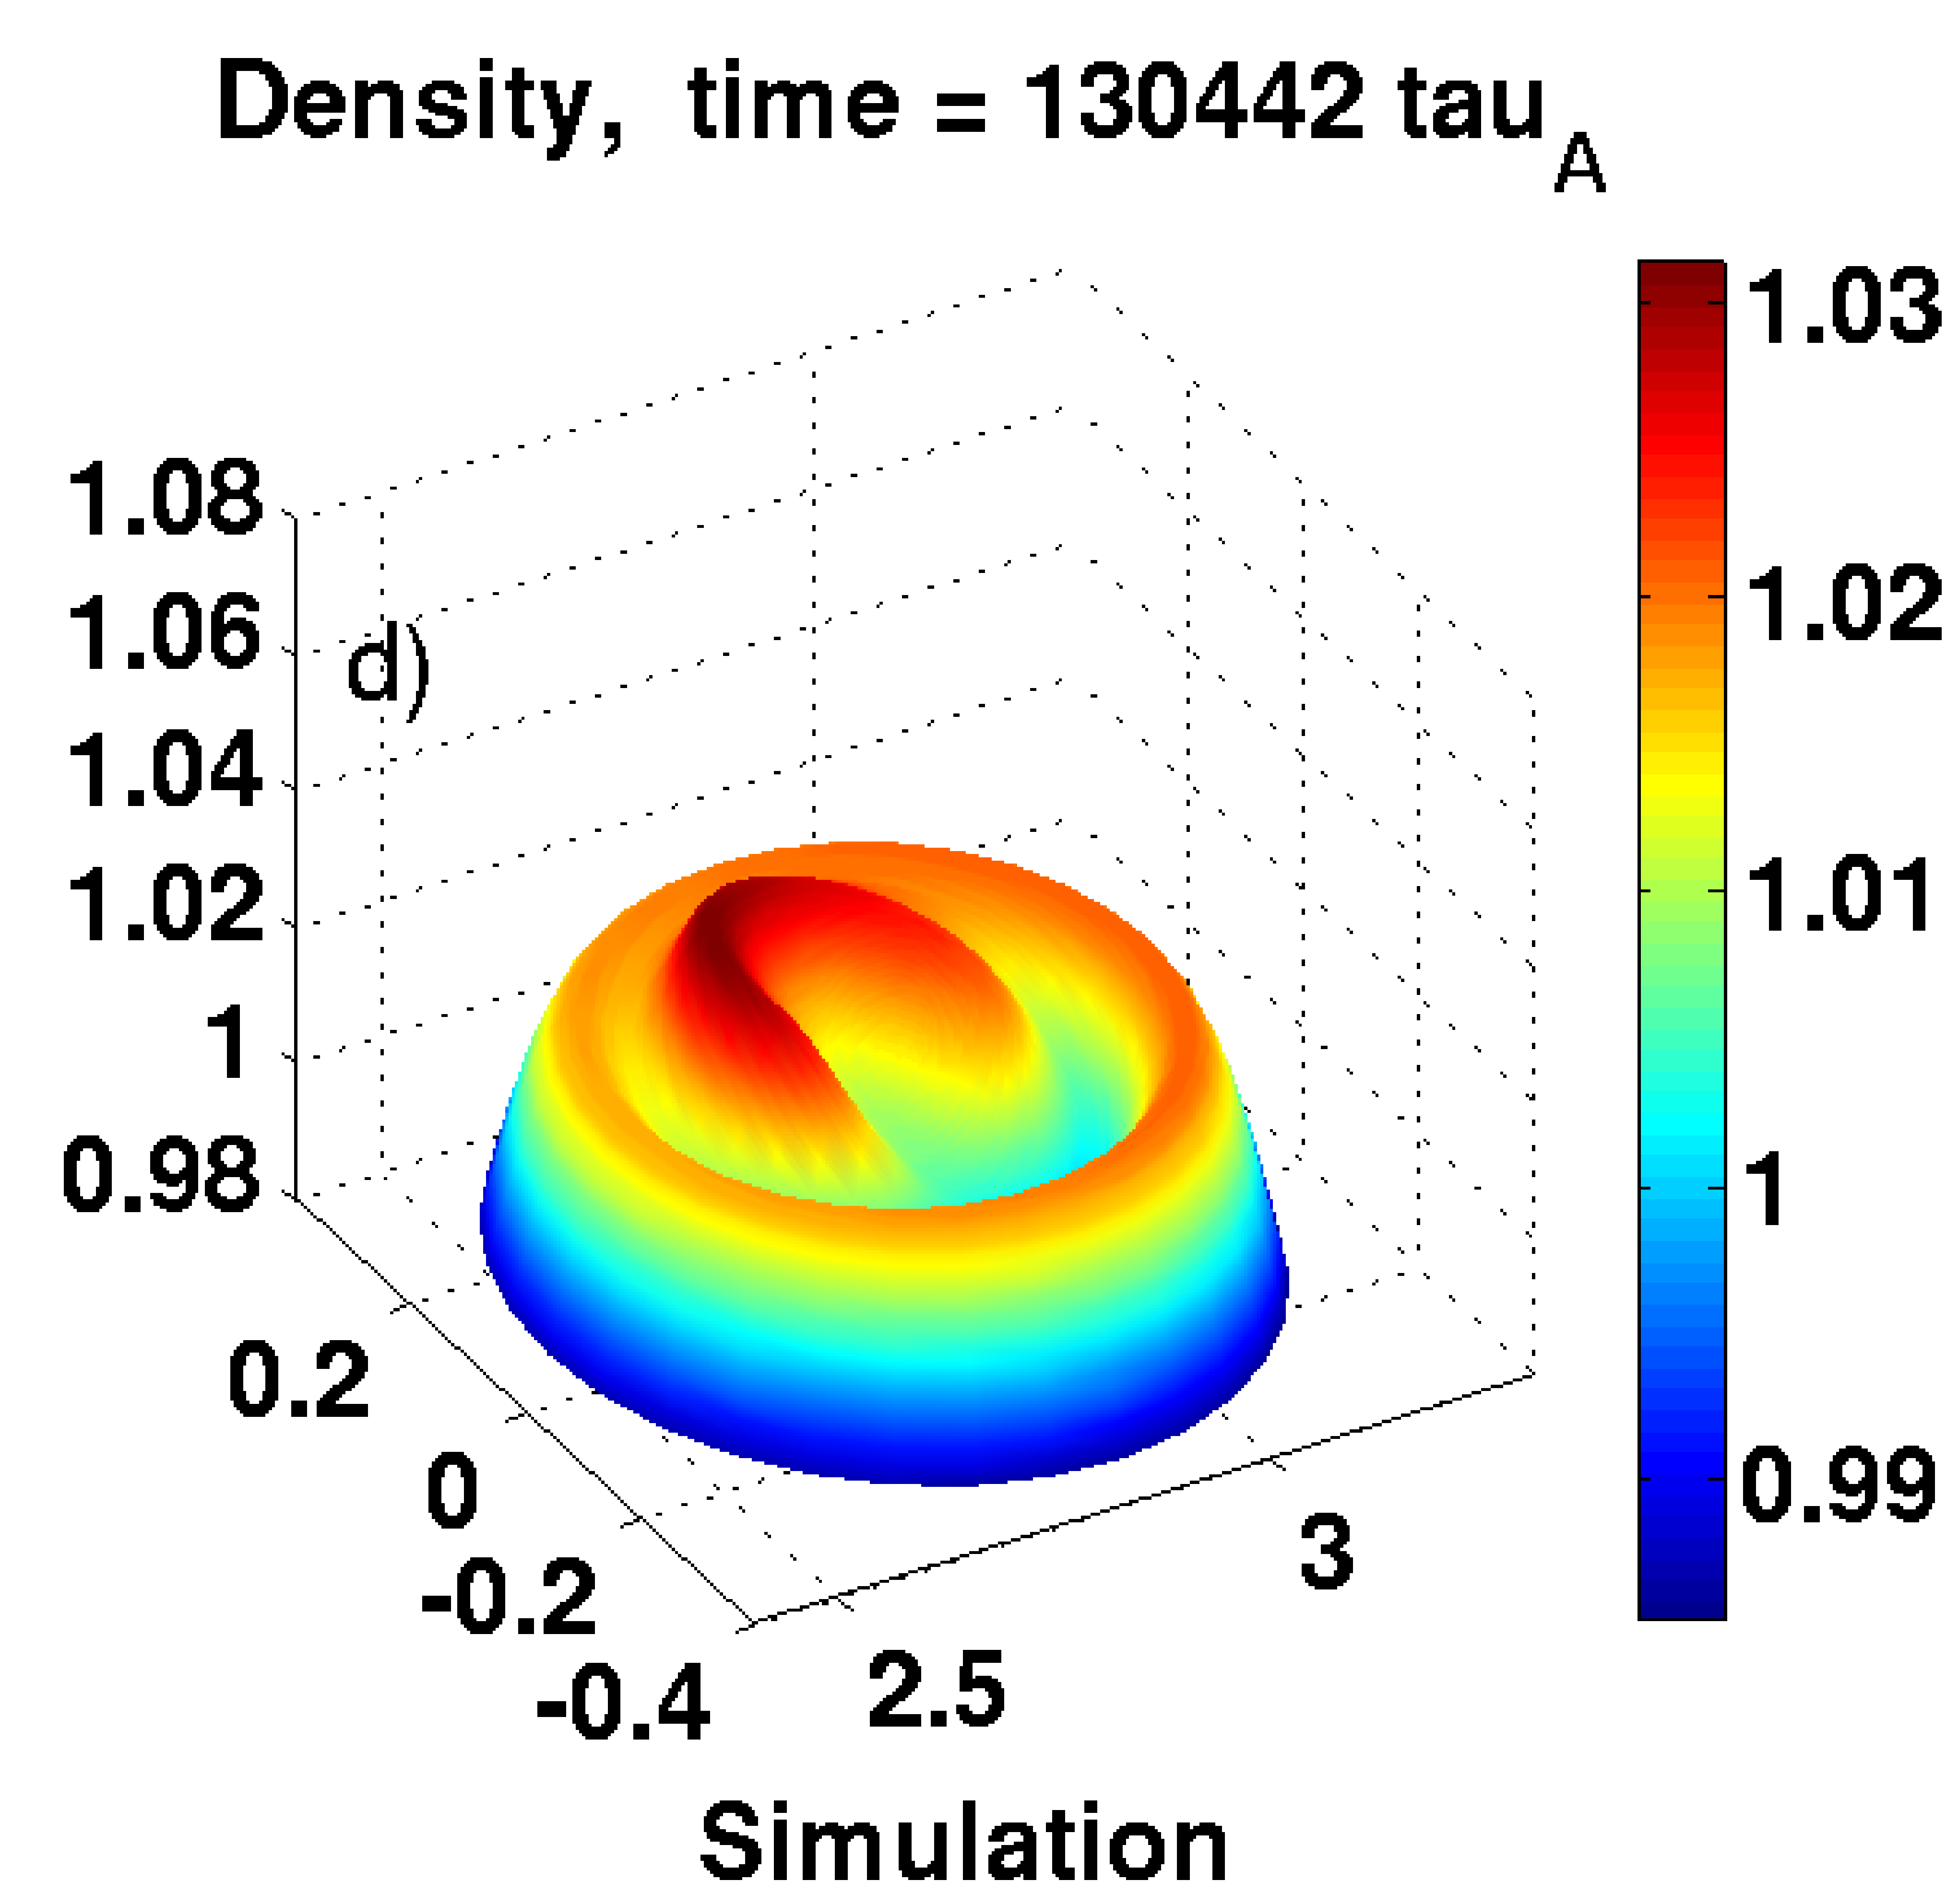
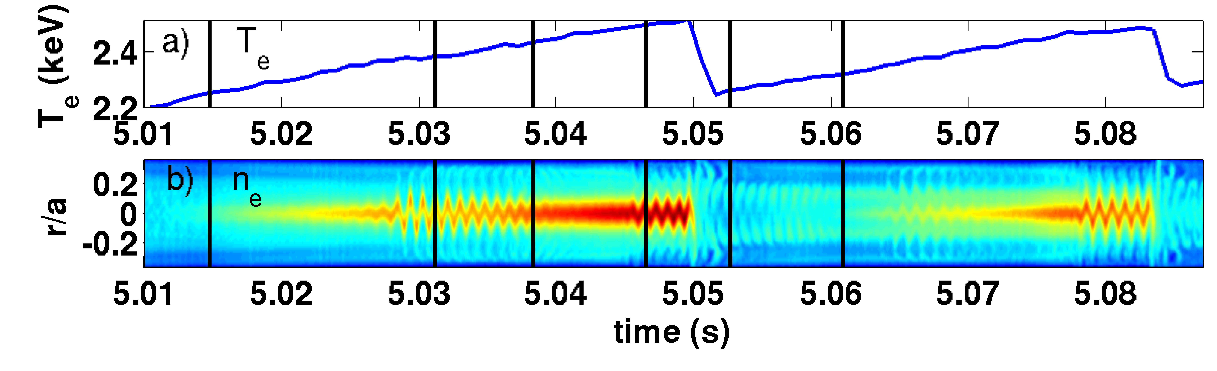
Interplay between MHD and particle transport during sawtooth
Garbet TH/P3-21
Detailed structure of core density observed in experiments
reproduced by nonlinear MHD simulations
  Significant part of density inside q=1 not evacuated by sawtooth
  May play an important role on radial transport of core impurities
XTOR-2F Lütjens 2010
T. Nicolas
submitted PRL
Mitigate Performance limitations

Slide 9







OUTLINE
Prepare ITER operation
RF HCD CW systems
Hillairet EX/P6-24
Litaudon EX/P6-10

Slide 10
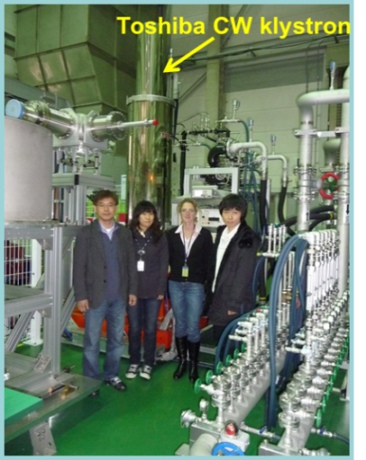
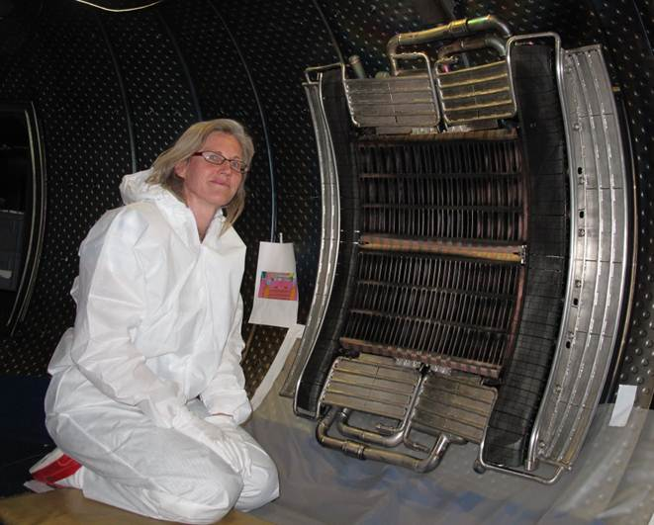
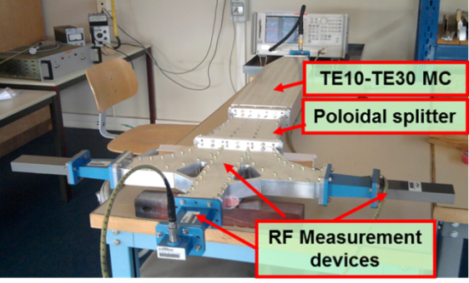
Prepare LOW Hybrid Current drive for long pulse operation
Validate 5GHz mode converter prototype at low power
Commission 5GHz/CW klystron with NFRI, POSTECH
Operate CW system on Tore Supra
  Validate actively cooled Passive Active Multijunction launcher 25MW/m² for 78 s
  Validate 16 CW/3.7GHz klystrons ~10MW / 1000s
  First 8 klystrons > 4MW on plasma Delpech 2011
Hillairet EX/P6-24
5GHz klystron
test stand
CW 3.7GHz PAM Launcher
25MW/m2 for 78 s
Do 2011
5GHz mode converter
Efficiency 99%
Reflection -40dB
9.7GJ accumulated injected energy after 500 pulses [Ekedahl 2011]
Hillairet 2011
Prepare ITER SS Operation

Slide 11
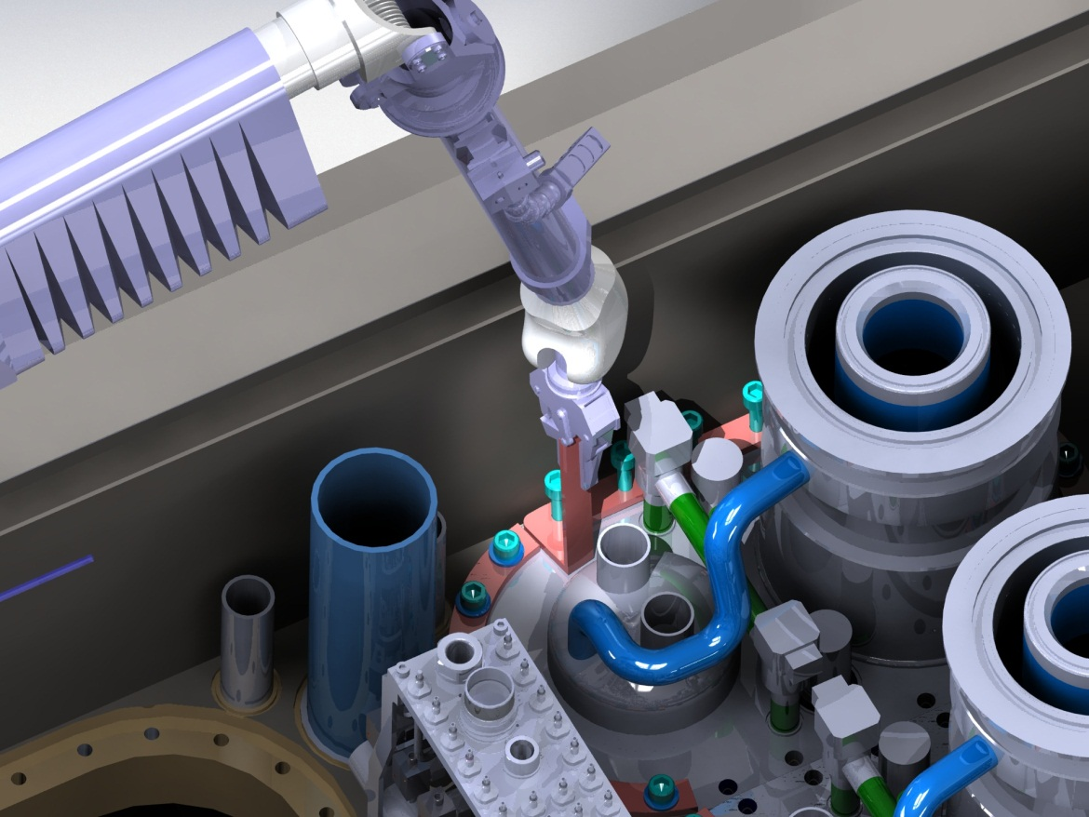
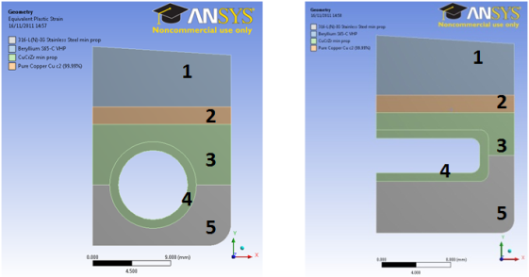
PREPARE ITER ION CYCLOTRON RESONANT HEATING
ANTENNA SYSTEM
Provide relevant RF sheath rectification model.
Revisit CD capability of ICRF in ITER
  FWCD efficiency 0.1-0.2 A/W/m³ in DT, 0.05A/W/m³ in DT(³He)
  Dumont 2012
Litaudon EX/P6-10
Design antenna & associated diagnostics. Faraday screen bar mock-up under fabrication.
Design remote handling tools.
RVTL Maintenance in Hot cell
ITER requirements for hot cell work
8 RVTL to be exchanged
Handling, tilting, cutting, welding, study
Specific tools proposed
Colas 2012
Be
Be
Simulation of the captive bolt dismounting in the CEA 3D Virtual Reality room .
Bernard 2012
Ferlay 2012
Prepare ITER Operation

Slide 12

OUTLINE
Ensure ITER safe operation
SC magnet quench detection
Mitigate disruptions
Duchateau ITR/P5-02
Saint-Laurent EX/P8-06

Slide 13
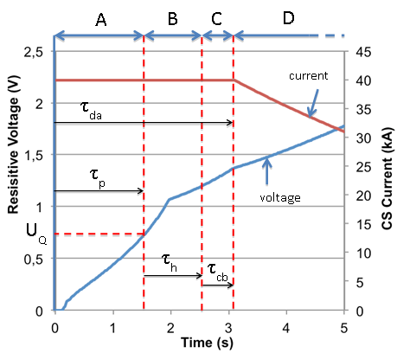
Mitigate quenches of ITER magnet systems
Duchateau ITR/P5-02
Two detection techniques proposed with associated methodology:
Primary detection based on an technique of voltage measurements
Secondary detection based on thermohydraulic behavior of external cryogenic circuit (pressure, mass flow, temperature)
Primary detection of CS system
  Propagation phase ~1s
  Holding phase to identify quench ~1s
  Opening current breakers ~ 0.5s.
Coatanea 2011; Nicollet 2011
Ensure ITER Safe Operation

Slide 14
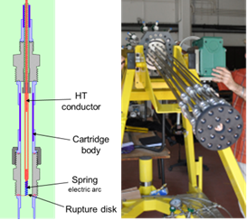
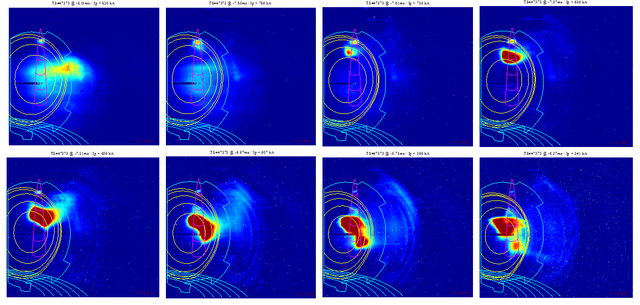
MITIGATE RUNAWAY ELECTRONS during disruption
Saint-Laurent EX/P8-06
New ultra-fast gas injector concept
  Successfully tested in Tore Supra
  Suitable to ITER radiation environment close to the plasma
Dense gas jet injected during the disruption current quench phase.
  Squeezing current profile -> MHD -> secondary disruption
Fast Injection by rupture disk Explosion Technique
Busting disk opening time < 300 μs.
Success rate 95% on test bed;
60% in plasmas.
Propagation of Ne injected from the top of the machine during plasma current quench.
Ensure ITER Safe Operation

Slide 15









OUTLINE
Ensure ITER safe operation
PFC protection
Travère ITR/2-2Ra
Salasca ITR/P5-27

Slide 16
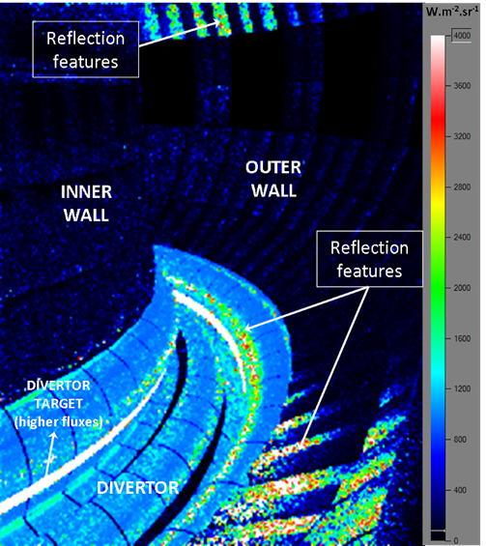
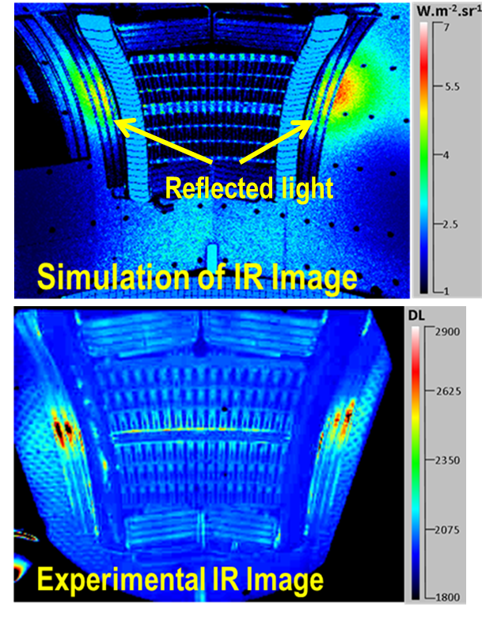
Infra-Red Imaging for REAL time PFC Protection: From Simulation to VIRTUAL Reality
Travère ITR/2-2Ra
  Realistic ITER simulations
Assess light propagation in a 3-D complex environment and photon-material interaction, based on a ray-tracing Monte Carlo model
  Discriminate between hot spots and light-reflection
ITER
Tore Supra
Assuming the temperature of the first wall uniform 175°C and the temperature of the divertor 1600°C
IR view of Tore Supra LHCD launcher in Ohmic plasma
Aumeunier 2011, 2012
Ensure ITER Safe Operation

Slide 17
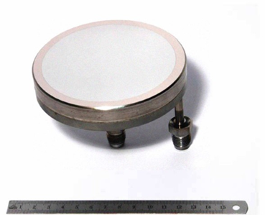
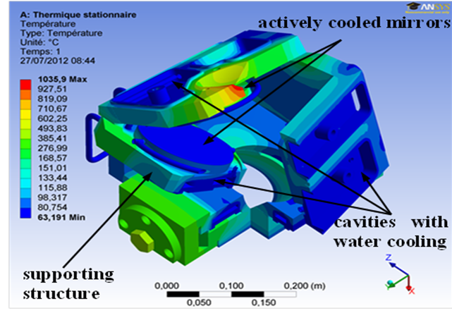
Prototypes of Metallic Mirror for ITER DIAGNOSTICS
Salasca ITR/P5-27
Eight cooled full scale ITER mirrors manufactured
Tested under various ITER relevant conditions (vacuum, pressure, cooling)
Allow identifying R&D needs to satisfy ITER RAMI constraints
Diameter 109 mm
Rhodium or Molybdenum thick reflective coating layers (5µm) on stainless steel
Water cooling 30bars, 100°-150°C
Temperatures in WAVS Head Mirror Assembly in operating conditions
Joanny 2012
Ensure ITER Safe Operation

Slide 18
OUTLINE
Mitigate risks for ITER divertor
The WEST project
Courtois ITR/P5-07
Ghendrih TH/P4-26

Slide 19
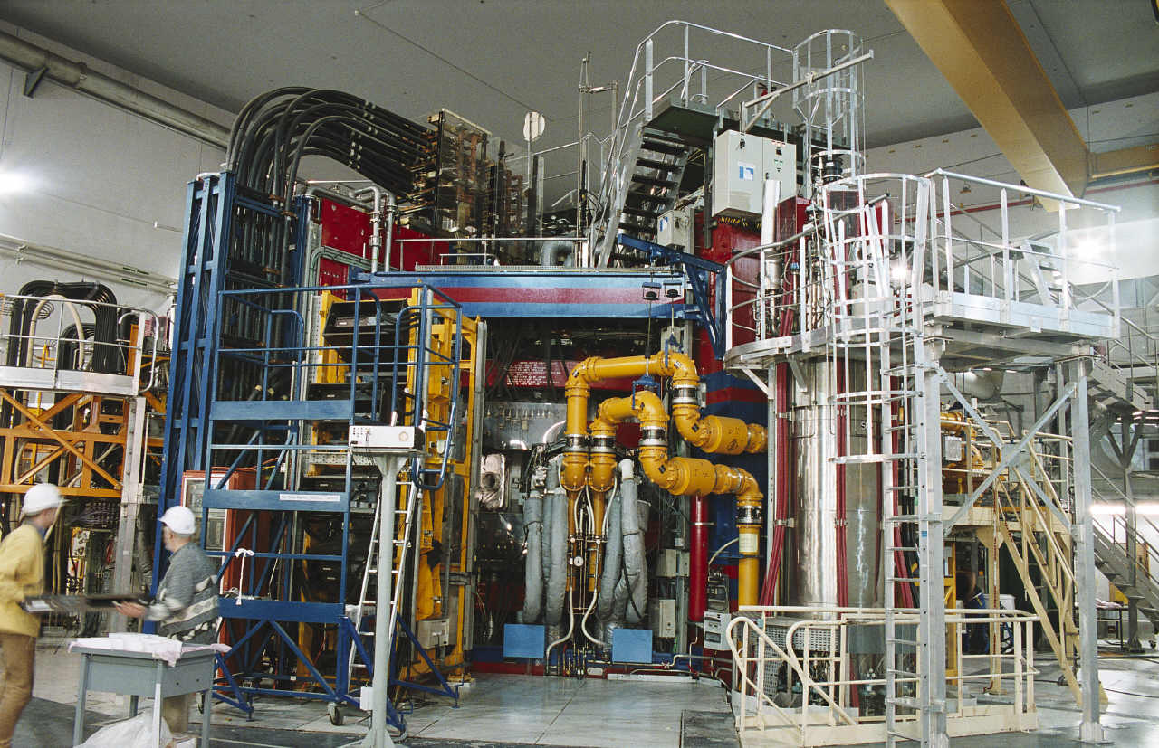
The TORE supra EXPERIMENT
1988: first plasma
1996: plasma duration overcomes 2min
2002: first wall & PFC 100% actively cooled
2003: world record: 6’30’’ pulses and 1GJ injected/extracted
2010: increased steady-state current drive capability: >6MW LHCD + passive-active multijunction antenna
Transfers towards W7-X, ITER & JT60-SA: SuperConducting magnets, actively cooled PFC and surface temperature monitoring&control, steady-state discharges (RF power, current drive, feedback control)

Slide 20

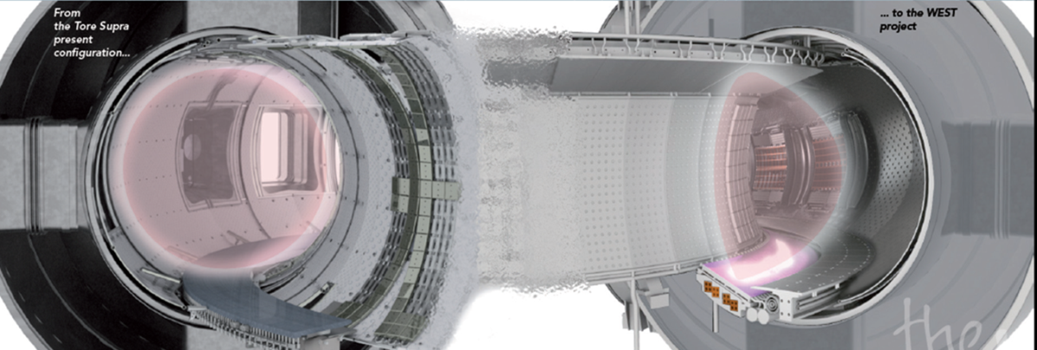
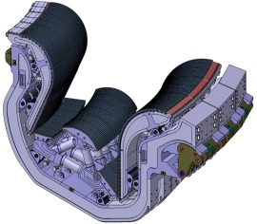
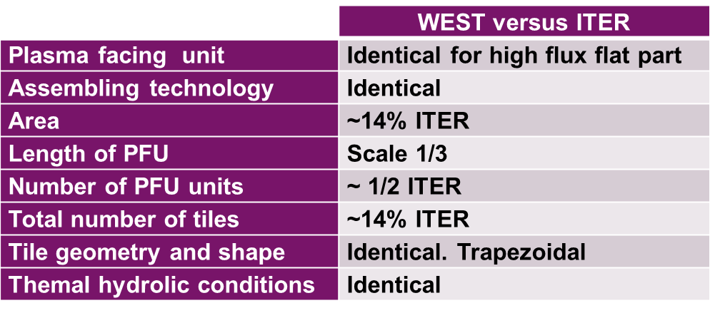
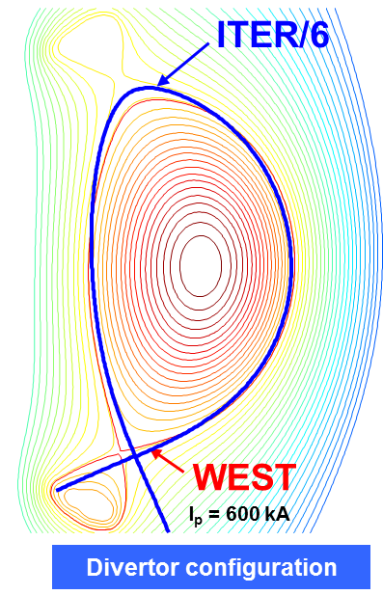
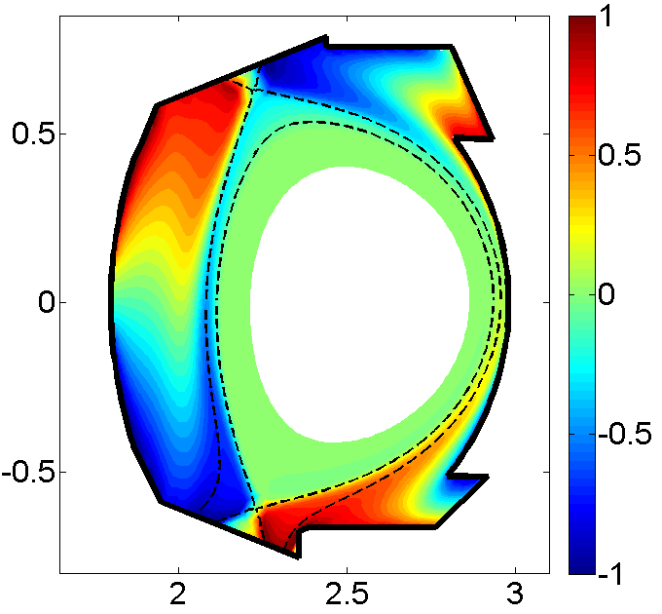
TURNING TORE SUPRA INTO USER FACILITY
DEDICATED TO ITER TUNGSTEN DIVERTOR
ITER
WEST
Tore Supra
Tore Supra
Mach Number
WEST
Thermal hydraulic conditions
Ghendrih TH/P4-26
Mitigate risks for ITER Divertor

Slide 21
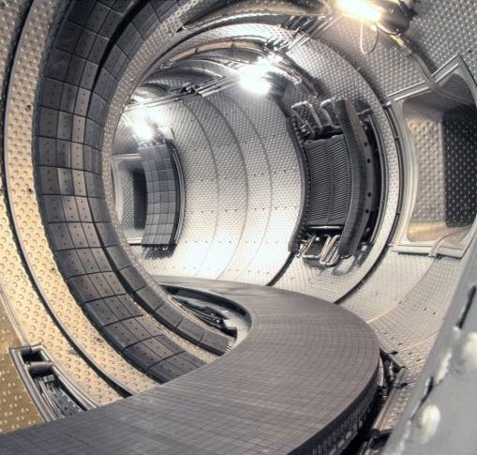
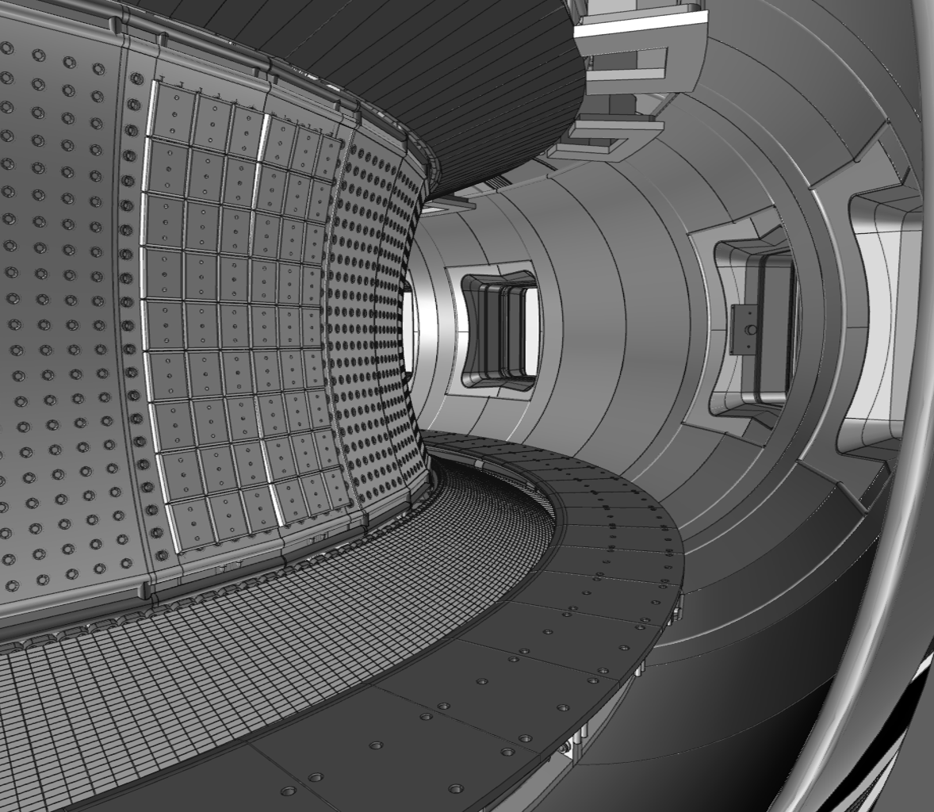
THE WEST PROJECT
Upper target
W-coating
Ripple / VDE
W-coating
Antennae protections
Outboard
limiter
~ 1 MW/m² (steady-state / single null)
up to 5 MW/m² (steady-state / double null)
Water cooled stainless steel panel
Tore-Supra
present configuration
Bumper
W-coating
Bucalossi 2011
Water cooled stainless steel panel
Baffle W-coating
up to 3 MW/m2 steady-state
Lower target
« ITER Technologies »
ITER requirement* (and beyond)
* 10 MW/m² in steady state
20 MW/m² in slow transient ( < 10s)
[Courtois ITR/P5-07]
Mitigate risks for ITER Divertor

Slide 22

WEST in time for ITER
ITER Divertor Installation
2012
2015
2016
2018
2022
2023
2025
ITER
Preparation phase
Production phase
Operation phase
WEST
Prep. phase
Production phase
Operation phase II
Operation phase I
WEST
platform
ready
for plasma
WEST PFC manufacturing as
early industrial prequalification
Provide valuable experience for ITER procurement and operation as early as 2016
Grosman 2012
Mitigate risks for ITER Divertor

Slide 23
SUMMARY
Develop quench detection techniques with associated methodology for ensuring safe ITER magnet system operation [Duchateau ITR/P5-02]
Develop/Test ultra-fast gas injection for mitigation runaway electrons, ensuring safe ITER operation [Saint Laurent EX/P8-06]
Develop/Test of IR imaging for ensuring safe PFC operation [Travère ITR/2-2Ra; Salasca ITR/P5-27]
Develop/Validate RF H&CD CW systems [Litaudon EX/P6-10, Hillairet EX/P6-24]
Prepare ITER operation/scenarios, ensuring high plasma performance
  Develop ITER limiter start-up and high radiating regime [Monier-Garbet EX/P5-26]
  Mitigate ELM [M.Bécoulet, TH/2-1]
  Discover interplay MHD & core particle transport [Nicolas TH/P3-21]
  Understand Transport Barrier physics from Gyro-kinetic simulations [Sarazin THC/P7-09]
  Explore ICRF wall conditioning [Douai EX/P5-09]; In vessel fuel inventory [Tsitrone EX/P5-07]
  Integrated Tokamak Modeling [Falchetto TH/P2-25; Litaudon TH/P2-05; Ghendrih TH/P4-26, Moreau ITR/P1-20, Peysson TH/P6-05]
Contribute to the BA projects: e.g., Petaflops-class “Helios” supercomputer, Cryoplant , TF coils, Research program…[Bayetti FTP/P1-29, Giruzzi TH/P2-03]
Minimize risks of ITER divertor procurement and operation [Courtois ITR/P5-07]
-> Transform Tore Supra into WEST with International Fusion Partners and Industries

