Slide 1

Overview of Experimental Results and Code Validation Activities at Alcator C-Mod
IAEA Fusion Energy Conference
San Diego, October 8, 2012
M. Greenwald - presenting for Alcator Group
Work Supported by DoE

Slide 2
Background and Outline
This talk will address the unique capabilities of C-Mod for validating physics relevant to ITER
  All metal walls and reactor-like heat fluxes
  RF scenarios at ITER B_{T}, n_{e}, RF frequencies
  Transport studies without core particle or momentum sources
  RF actuators
  Core Transport
  Pedestals and Edge Barrier Physics
  Boundary Plasmas/Plasma Wall Interactions
  Disruptions

Slide 3
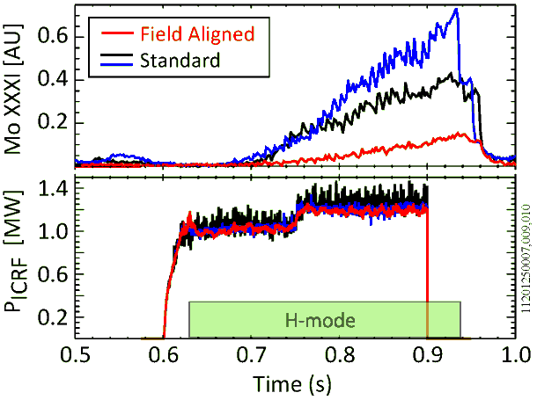
An Innovative ICRF Antenna Has Been Developed To Address The Issue Of Metallic Impurity Generation
Critical issue for metal machines like ITER
Hypothesis: RF sheath rectification and acceleration of ions into wall
  Large RF potentials measured far from antenna (EX/P5-39 Terry)
Antenna designed to minimize E
Results:
  Improved RF power handling
  Reduced Mo radiation
  Discrepancies with models remain
FTP/1-1 Wukitch
Field Aligned Antenna
Standard Antenna

Slide 4
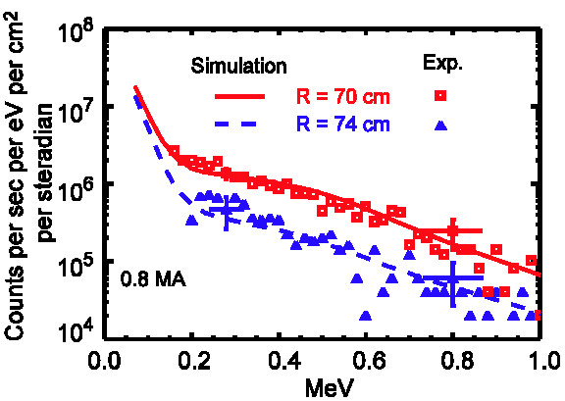
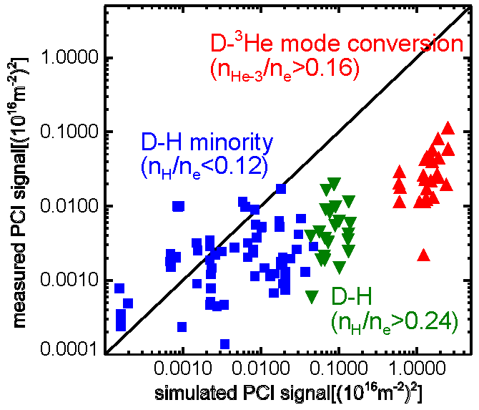
Substantial Progress in Modeling ICRF Heating Regimes
Experiments to validate full-wave ICRF heating simulations (TORIC/AORSA/CQL3D)
Compare to fast ion spectra
  Generally there was good agreement with the equilibrium fast ion population and scaling with I_{P} and P_{ICRF}
  Disagreement on transient formation and decay of the fast ions levels
  (Bader NF 2012)
Comparison to RF waves in plasma (PCI)
  Agreement in Minority heating regime
  For mode-conversion regime, measured wave intensity was 50x lower than code
  Is this evidence for nonlinear effects?
  (Tsujii PoP 2012)

Slide 5
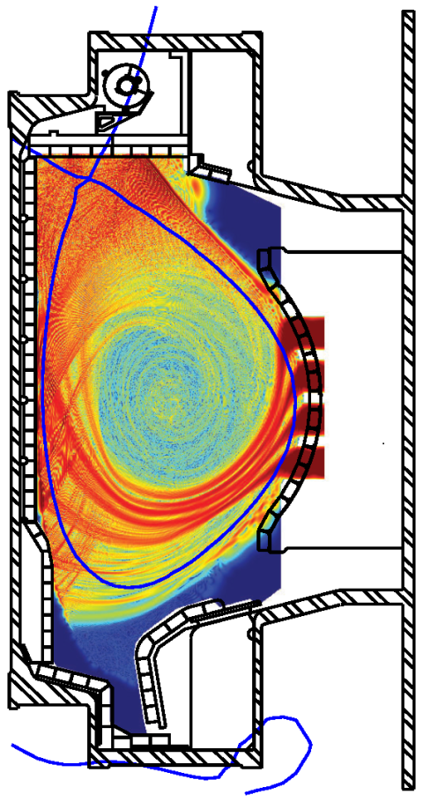
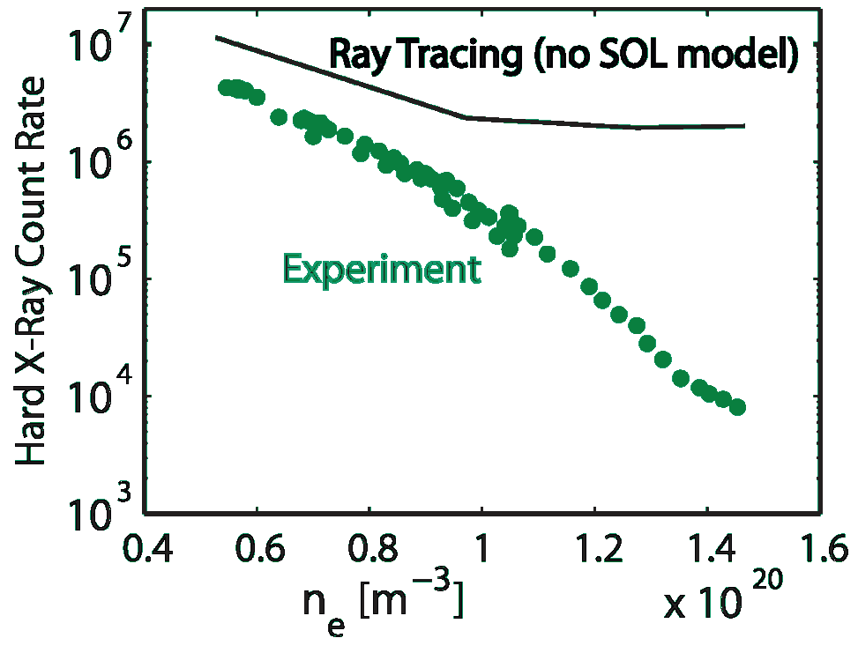
LH Is An Efficient Current Driver
At The ITER B_{T}, Density and RF frequency
100% non-inductive plasmas have been achieved at 5.4T, 5x10¹⁹
  Modification of current profile leads to formation of an internal transport barrier
At higher density (>1x10²⁰), driven current and fast electron populations drop below simple predictions
  Not linear wave accessibility issue
EX/P2-16
Shiraiwa
Full wave (LHEAF/VERD) FE and ray tracing models (GENRAY) find that large fraction of wave energy propagates in plasma edge and SOL at high densities

Slide 6
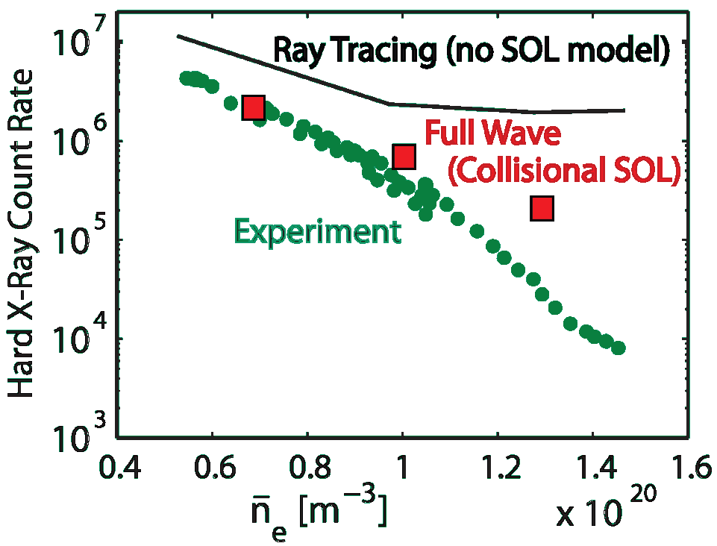
LH Is An Efficient Current Driver
At The ITER B_{T}, Density and RF frequency
100% non-inductive plasmas have been achieved at 5.4T, 5x10¹⁹
  Modification of current profile leads to formation of an internal transport barrier
At higher density (>1x10²⁰), driven current and fast electron populations drop below simple predictions
  Not linear wave accessibility issue
EX/P2-16
Shiraiwa
Full wave (LHEAF/VERD) FE and ray tracing models (GENRAY) find that large fraction of wave energy propagates in plasma edge and SOL at high densities

Slide 7
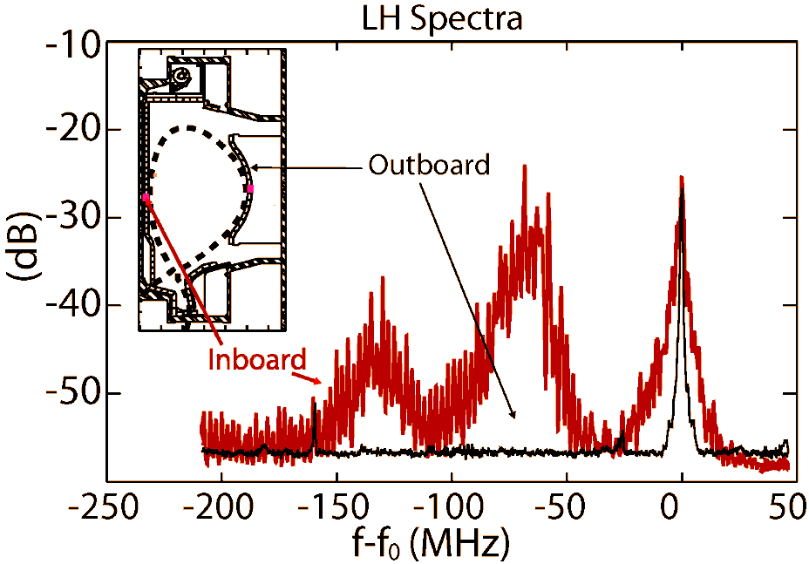
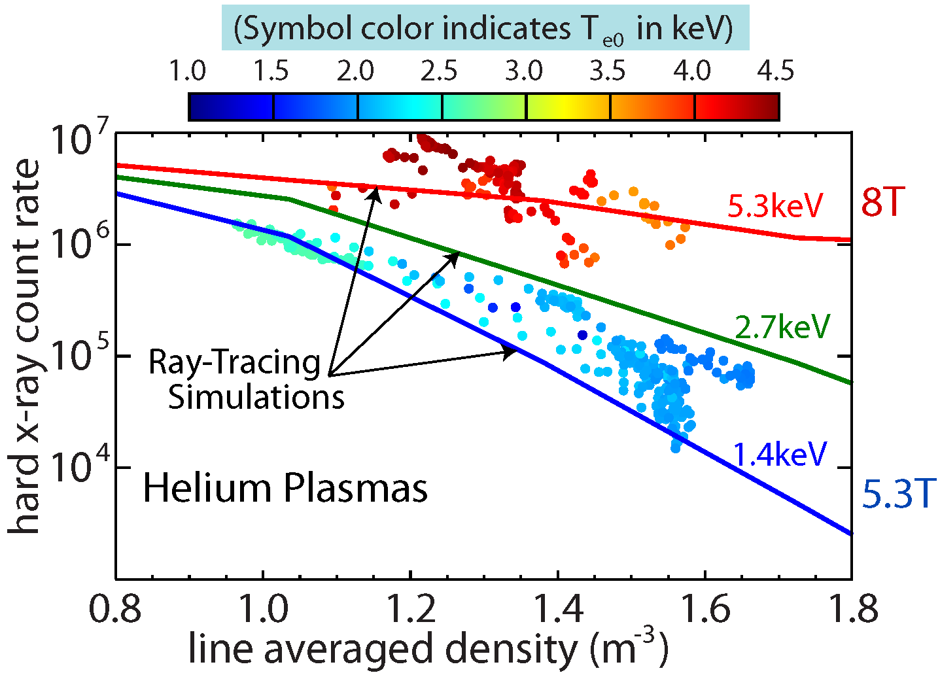
LHCD Modeling Focused on Physics of “Density Limit”
Mechanisms connected to low single-pass absorption
  High-frequency probe measurements find evidence of PDI on high-field side
  Collisional wave damping in edge
  Loss of fast electrons created near plasma edge
Solution is to run with higher single-pass absorption (as ITER will)
  Higher T_{e} and/or change in poloidal location of launcher
  Additional poloidally displaced launcher is planned
EX/P2-16 Shiraiwa
FTP/P1-22 Wallace

Slide 8
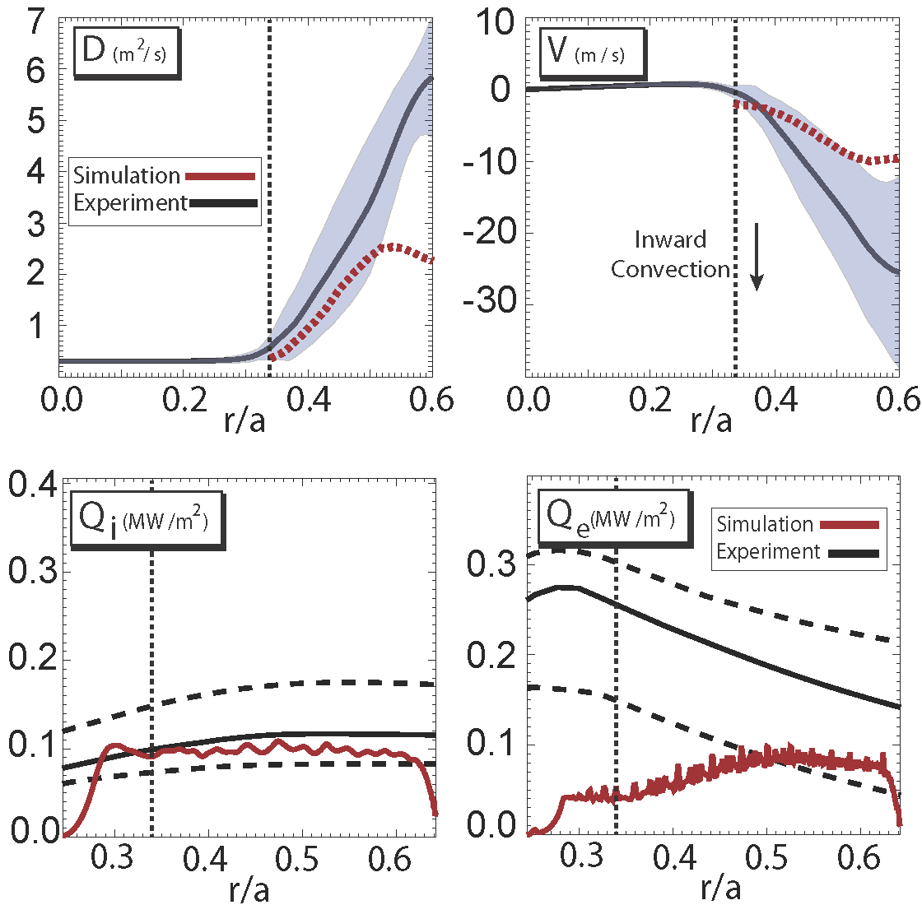
Core Impurity Transport – Validation of Gyrokinetic Model
Impurity transport studied using LBO method – well defined, non-intrinsic source
  Time-dependent Ca¹⁸⁺ brightness profiles measured with x-ray-imaging
  STRAHL used in iterative loop to determine experiment D,V profiles and experimental uncertainties
GYRO used for nonlinear modeling and sensitivity studies
Simultaneous agreement achieved for ion heat and impurity D and V; but not with electron heat transport
  Extension of simulations to higher k modes does not solve discrepancy
Parallel impurity transport theory extended to account for ICRF fast ions – agrees with observed poloidal impurity density asymmetry
EX/P3-23 Howard
EX/P3-01 Reinke

Slide 9
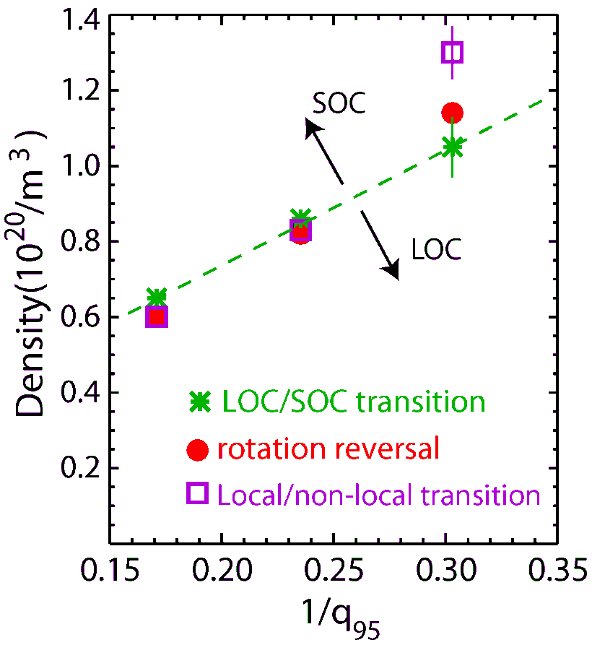
Transport Explored at Transition Between Electron and Ion Dominated Transport
For OH discharges - simultaneous changes in
  Energy confinement scaling; electron to ion dominated transport
  Disappearance of higher freq. density fluctuations, T_{e} fluctuations
  Flow reversal at q≈3/2 surface
  Non-local to local heat transport
  Edge impurity asymmetry
In L-mode, self-generated rotation profile transitions from peaked to hollow as n_{e} goes from 1 to 1.2 x10²⁰ (at I_{P} = 0.8 MA)
  Correlated change in momentum and impurity pinch velocities (but with opposite signs)
  Transition is not at the predicted linear-gk ITG/TEM boundary.
Ohmic phenomena occur at q dependent, critical density (or ν* at q≈3/2) EX/2-2 Rice

Slide 10
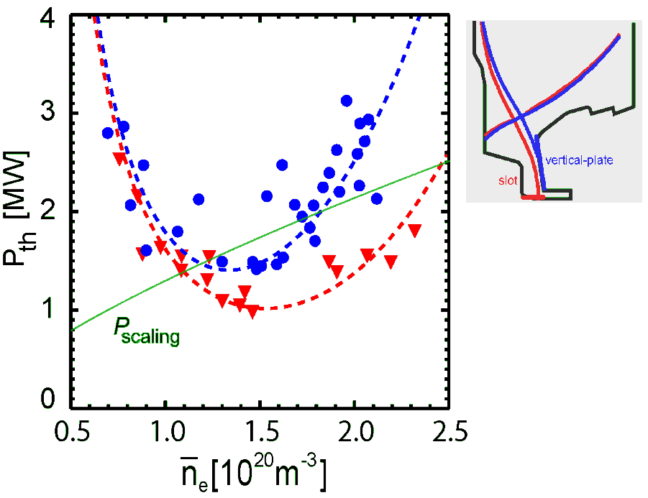
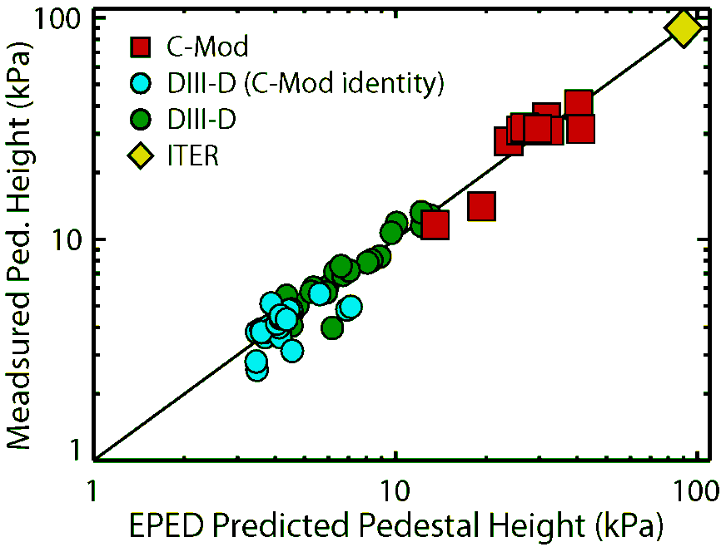
Thresholds and Pedestal Structure
Critical Extrapolations for ITER
L-H power threshold
  Density dependence is unlike power-law fit derived from multi-machine scalings
  Threshold minimum scales with B_{T} (not I_{P} or q)
  Significant drop in threshold power for “slot” divertor – effect of long divertor arm
  Testing data against local and global threshold models - RDZ/Guzdar/FM³ EX/P2-04 Ma
Pedestal structure for ELMy discharges
  C-Mod extends pedestal pressure range
  Pedestal width consistent with KBM-like, weak β_{P} scaling
  Pedestal height matches EPED predictions, ELITE stability calculations
EX/P4-15 Hughes; EX/11-4 Groebner

Slide 11
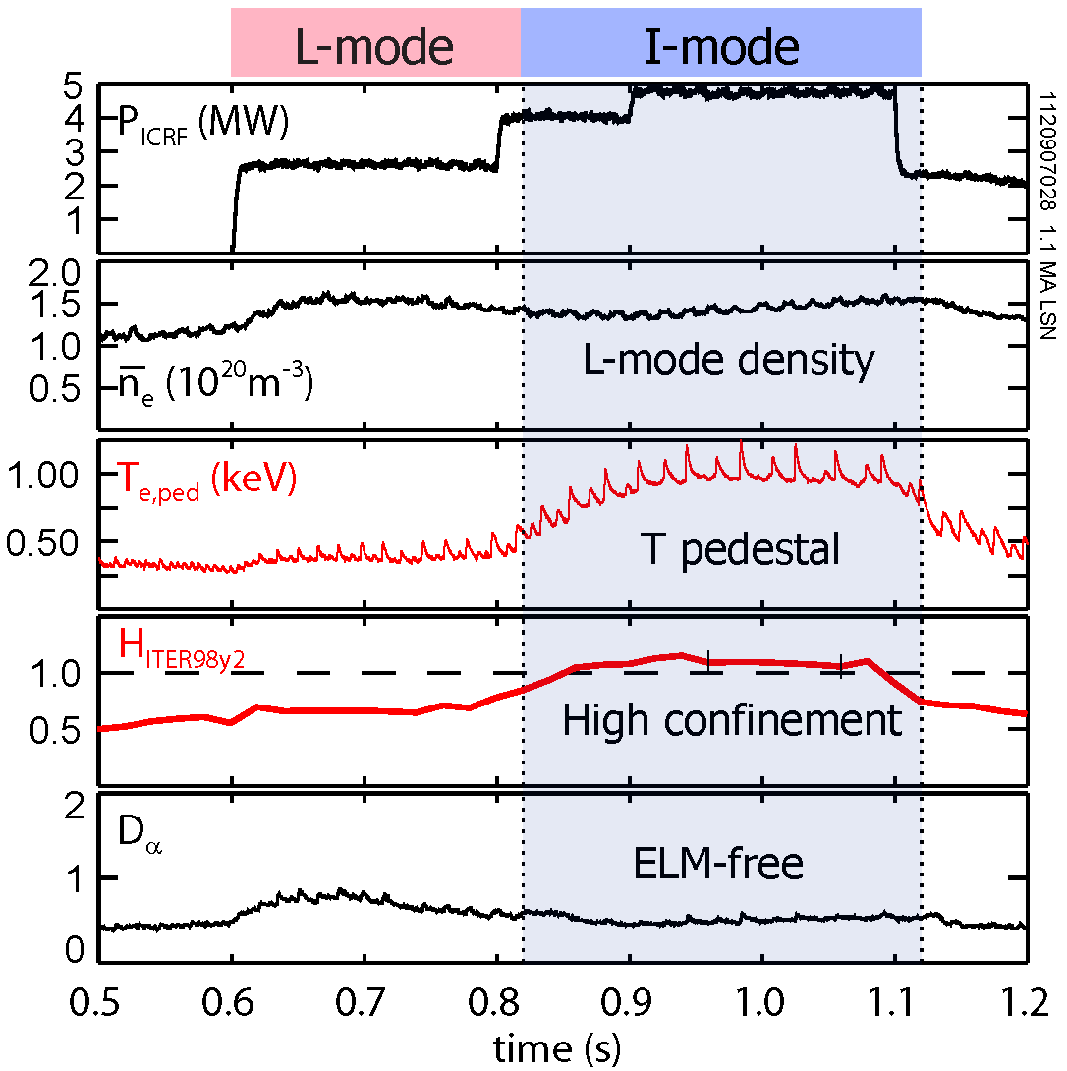
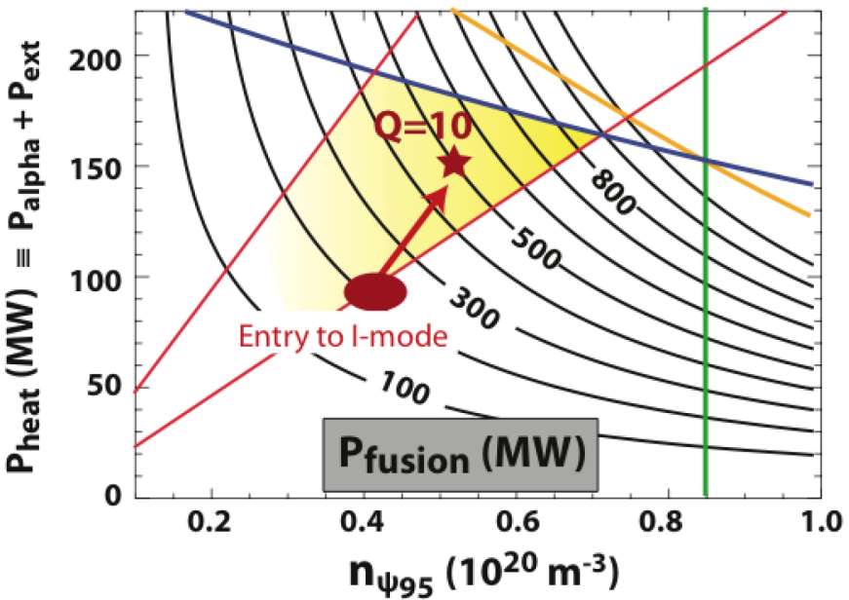
I-mode Provides High Performance
Without ELMs Or Impurity Accumulation
Usually accessed by running at high power with ∇B drift in unfavorable direction
  H-mode-like energy transport & T_{e} pedestal
  L-mode-like particle transport & n_{e} profile
Clear separation of particle and density barriers:
Lack of ELMs consistent with ELITE modeling
Encouraging extrapolation to ITER (Q≈10)
  I-mode is currently a focus of multi-machine studies (ITPA)
  Need more information on density, power and size dependence for access
EX/1-3 Hubbard; EX/P4-22 Lin; EX/P4-15 Hughes

Slide 12
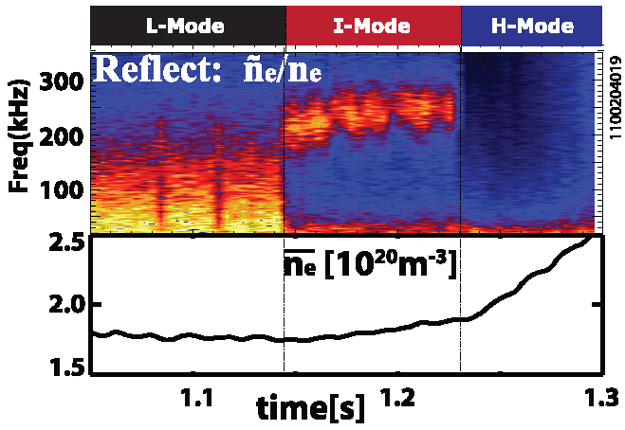
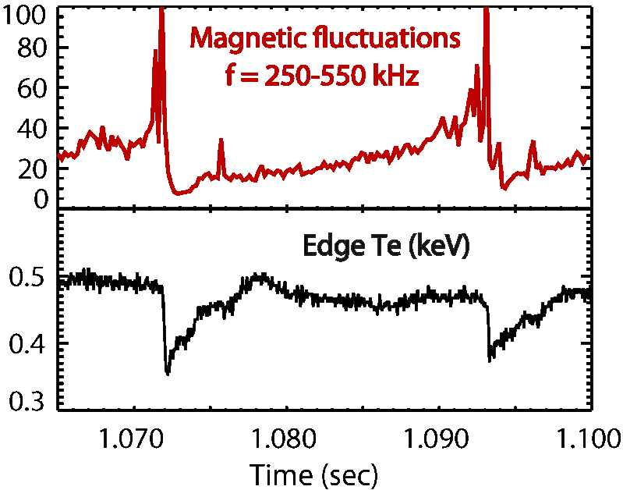
Short Wavelength EM Fluctuations Seen in Alcator C-Mod
May Regulate Profiles in Edge Barriers
Weakly Coherent Mode in I-mode
  (200-300 kHz, δf/f≈20-100%, k≈1.5 cm⁻¹)
  Particle diffusivity scales with WCM amplitude
  Energy barrier associated with drop in lower frequency fluctuations
Fluctuations between ELMs in ELMy H-mode
  (250-550 kHz, δf/f≈30%, k≈0.6-0.7 cm⁻¹)
  Amplitude increases as profiles recover between ELMs
  Evidence for predicted Kinetic Ballooning Mode?

Slide 13
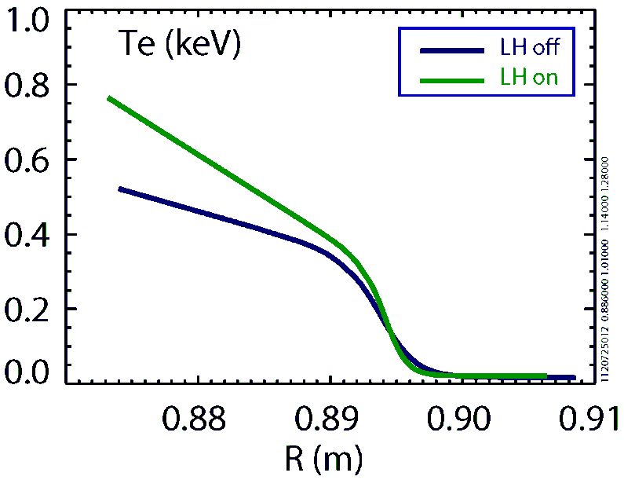
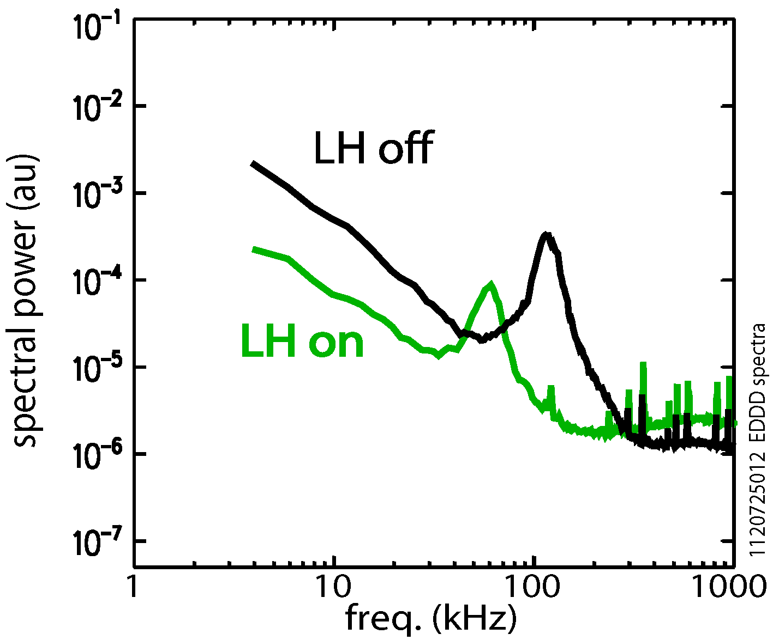
LH Waves Offer Possibility For
A Pedestal and Confinement Control Tool
Strong change in profiles, transport
  Increase in T_{e}, T_{i} - Drop in n_{e}
  30% increase in stored energy
  Accomplished with 0.6MW LH added to 3MW ICRF
Order of magnitude drop in edge fluctuations
Substantial impact, even under conditions where LH waves (n = 1.9) do not have access to the core plasma

Slide 14
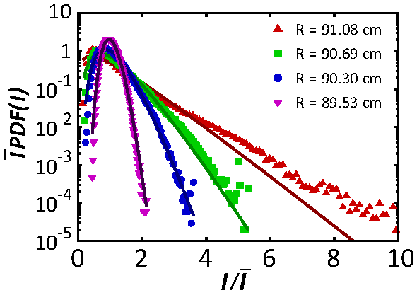
“Blob” Analysis Suggests A Unique Opportunity
To Validate Edge Turbulence Models
Generated in near SOL then propagate into far-SOL and to wall
Data has huge dynamic range measured in event size, and probability
Blobs show exponentially distributed waiting time and amplitude
Statistical model developed (Garcia PRL 2012)
Two numbers completely characterize process
  Birth duration
  Average waiting time
PDFs and their profiles reproduced with high accuracy

Slide 15
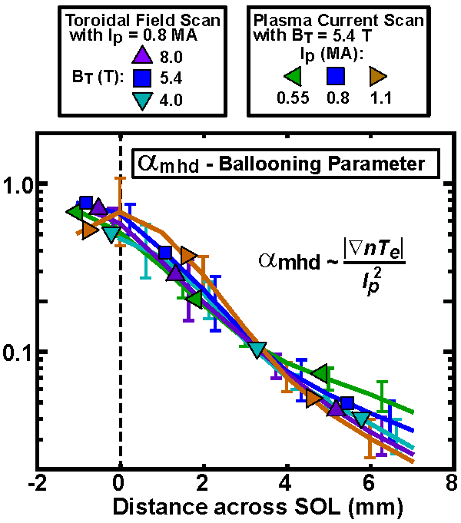
Heat Flux Footprint – Connected to Midplane Edge Turbulence
Midplane pressure maps to divertor and to divertor heat-flux footprint
  Width independent of B_{T}, q₉₅, P_{IN} or connection length
I_{P} (or B_{P}) is the dominant control parameter (as it is for the pedestal)
Data at midplane point to dominance of turbulent perpendicular transport - near marginal stability
  MHD ballooning parameter, α_{MHD} brings wide range of data together
Implies importance for ratio of pressure gradient length to field curvature length
Suggests heat footprint will scale with machine size
  Apparently inconsistent with multi-machine regression – must sort out for ITER

Slide 16
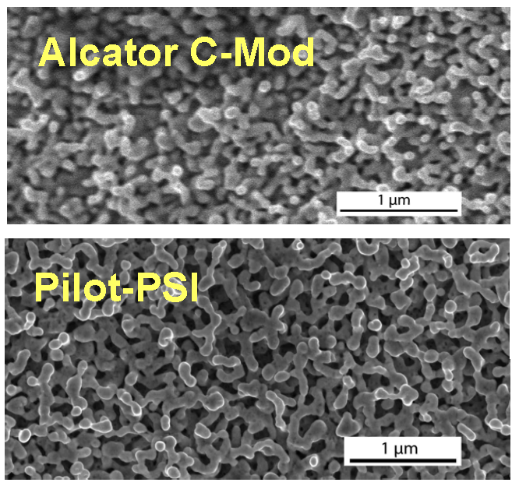
Tungsten Nanostructures Observed In C-Mod
Growth of W nano-structures have been observed in PWI test-stands
  Hypothesis: Small filaments “extruded” by helium bubbles captured in metal substrate
  Could be major source of erosion and dust production in future reactor – if process occurs in that environment
Open question: Could these processes occur, undisturbed in operating tokamak environment?
On C-Mod, careful experiments were performed to raise sample to correct temperature range (~2000˚K)
EX/P5-03 Wright
Morphology (tendrils ~100nm) and growth rates (~600nm in 13 sec) match
Provides confidence that key growth parameters, from linear devices, can be used for prediction in future devices.

Slide 17
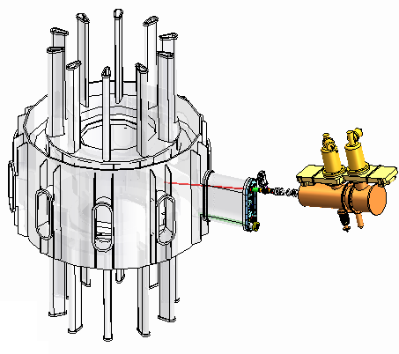
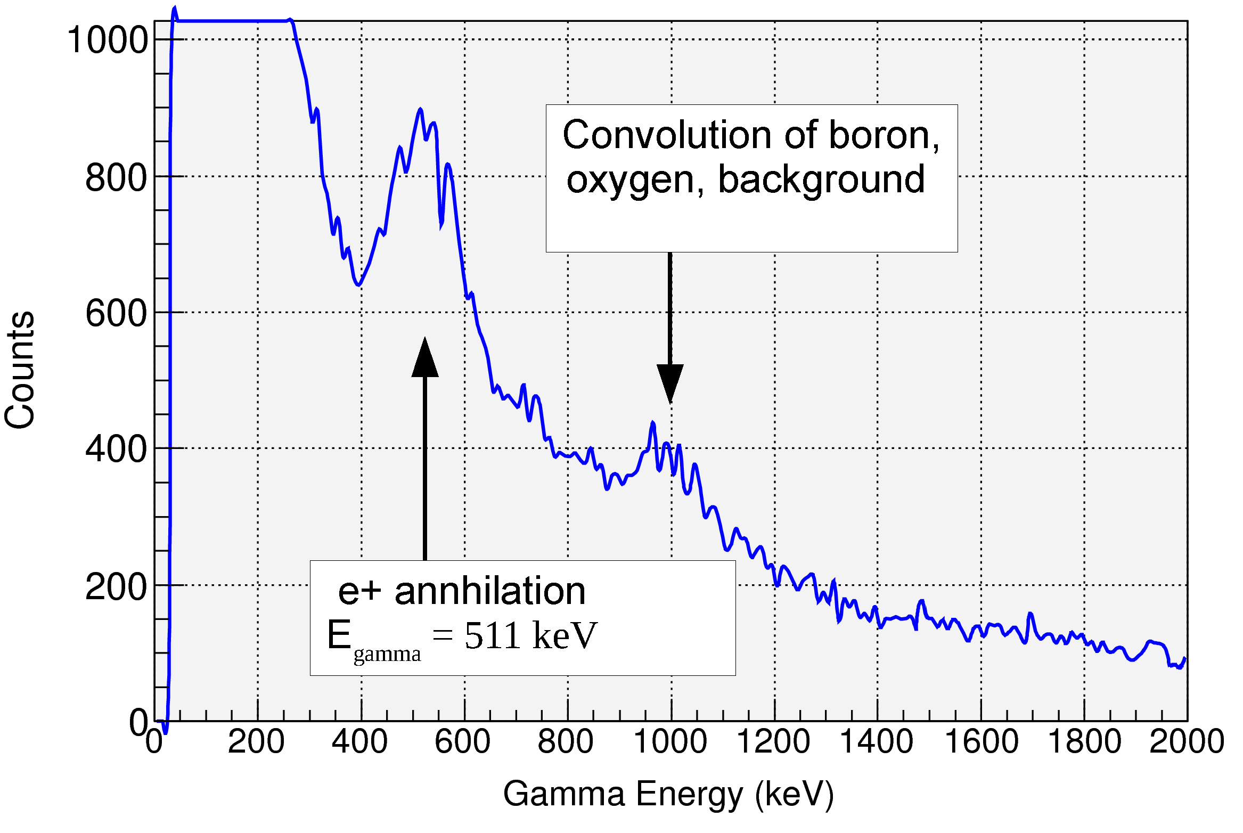
Tokamak Plasma-Wall Processes
First Time-Resolved, in situ Measurements
1 MeV deuteron ion beam installed for time-resolved, in-situ measurements of plasma-wall interactions
reactions exploited:
  D + B¹¹ ⇒ P + B¹² + γ
  (Measures boron surface coating)
  D + D ⇒ He³ + n
    (Measures fuel retention)
Time to make measurement: < 5 minutes
  Between shots
  Samples not removed from machine
Measurements of boron overcoating
  5x reduction in boron in 1 run day
Ability to scan wall poloidally and toroidally demonstrated

Slide 18
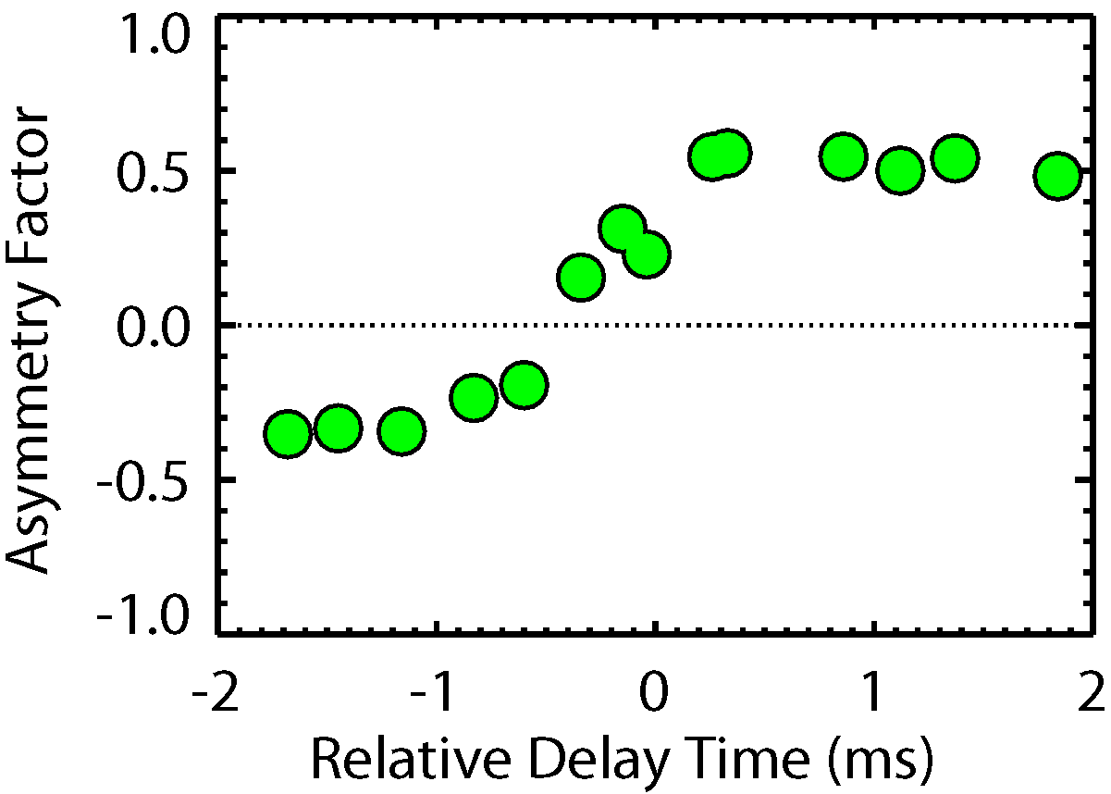
Disruption Mitigation – Radiation Symmetry Is A Critical Issue For ITER
Using massive gas injection , C-Mod observes toroidal peaking factors 1.2-2.3
  Peaking factor > 2 could lead to local melting on ITER
Can 2nd valve reduce asymmetry?
Toroidal radiation symmetry studied with multiple gas valves and array of XUV diodes
It is possible to reduce asymmetry in pre-thermal quench by careful control of geometry and timing
BUT…..
Asymmetry depends on n=1 MHD and thus sensitively on magnetic geometry and q₉₅
More asymmetry seen with faster MHD growth rates
Modeling underway with NIMROD
EX/P8-09 Granetz; TH/P3-13 Izzo

Slide 19
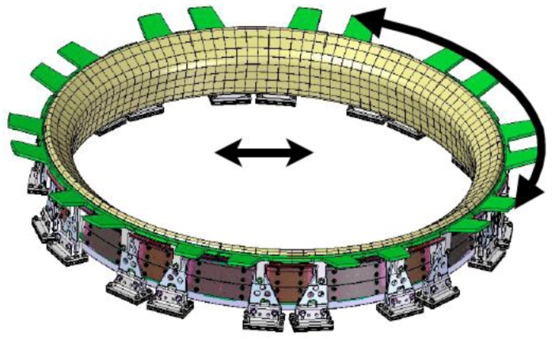
Future Plans: Further Develop Unique Capabilities
Deploy hot (1000K), continuous, solid tungsten divertor
Required for reactor level heat fluxes in C-Mod
Prototypical for Reactor

Slide 20
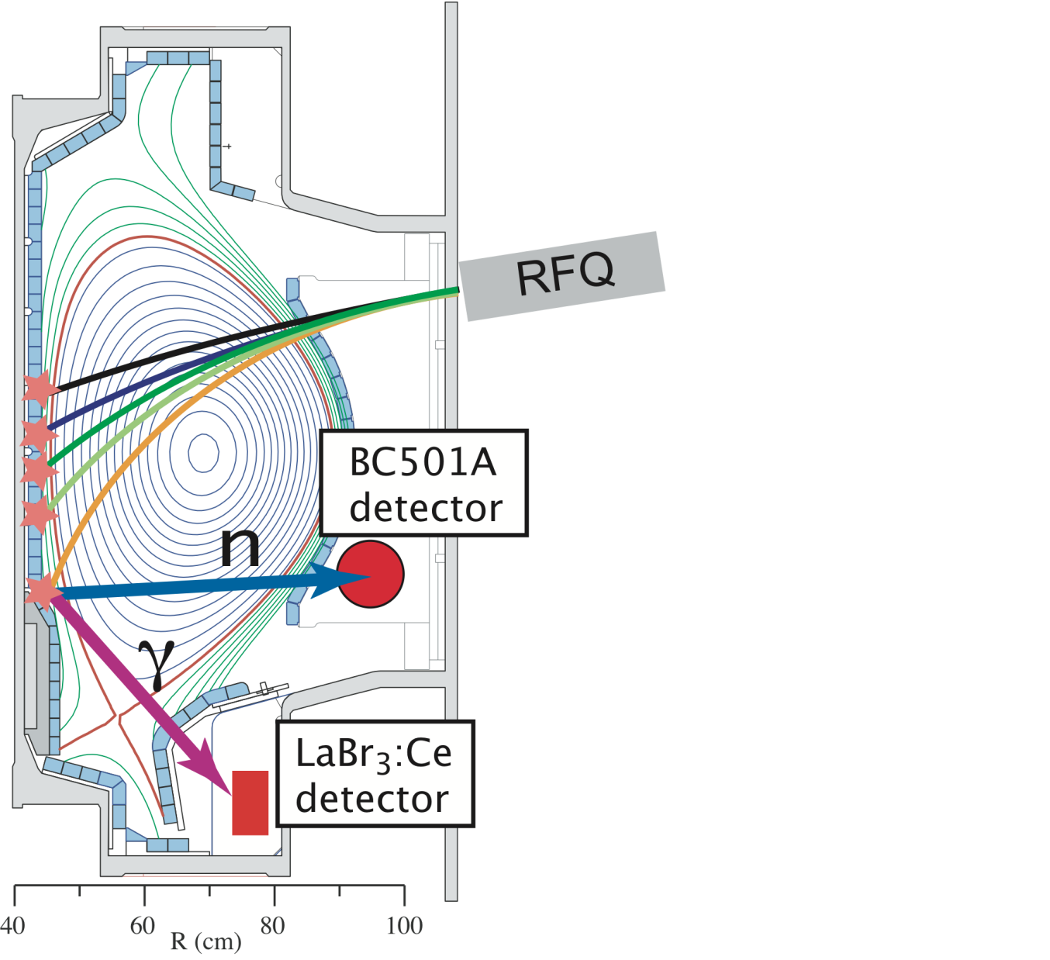
Future Plans: Further Develop Unique Capabilities
Exploit capabilities for in-situ measurements of plasma wall interactions

Slide 21
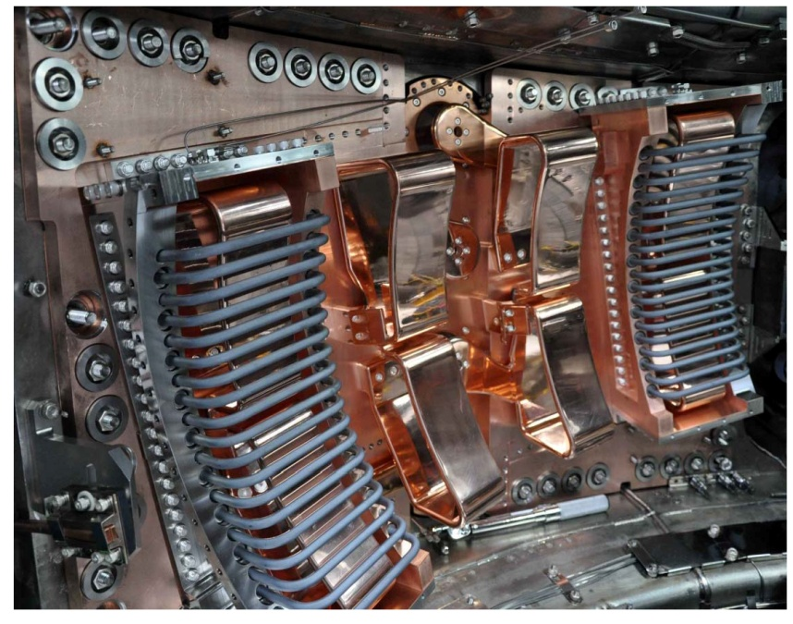
Future Plans: Further Develop Unique Capabilities
Study and Exploit Field-Aligned ICRF Antenna

Slide 22
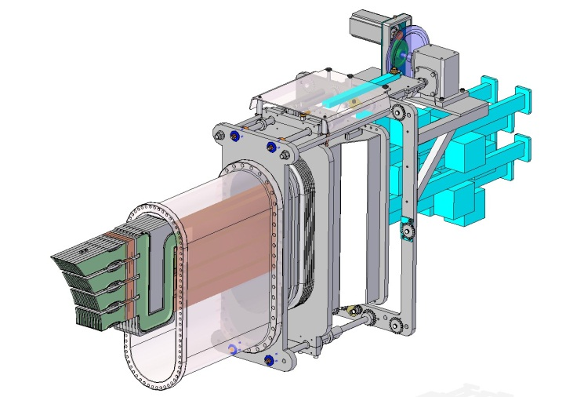
Future Plans: Further Develop Unique Capabilities
Develop Advanced Off-Midplane LH Launcher
Better single-pass absorption

Slide 23
C-Mod IAEA Papers/Posters (1)
Time | Author | Topic
Monday
OV/2-3 | Greenwald | C-Mod overview
FTP/1-1 | Wukitch | Evaluation of optimized ICRF and LHRF antennas
Tuesday
EX/1-3 | Hubbard | I-mode
EX/2-2 | Rice | Rotation reversals, LOC-SOC, and non-local transport
FTP/P1-22 | Wallace | Advances in LHCD technology
EX/P2-02 | Kessel | Modeling of ITER demonstration discharges
Th/1-1 | Murakami | Toroidal flow generation via ICRF minority heating
EX/P2-04 | Ma | H-mode thresholds
EX/P2-16 | Shiraiwa | Steady-state regimes with LHCD

Slide 24
C-Mod IAEA Papers/Posters (2)
Time | Author | Topic
Wednesday
EX/P3-01 | Reinke | Parallel impurity transport and poloidal asymmetries
EX/P3-13 | Porkolab | Gyrokinetic analysis of Ohmic plasmas
EX/P3-23 | Howard | Gyrokinetic modeling of impurity transport
EX/P3-28 | Fiore | Stabilization of ITBs by self-generated rotation
EX/P4-14 | Delgado-Aparicio | Impurity generated “snakes”
EX/P4-15 | Hughes | Pedestal stability and transport
EX/P4-22 | Lin | NTMs in high-performance I-mode plasmas
Thursday
EX/P5-03 | Wright | Tungsten nano-structures
EX/P5-39 | Terry | Fine-scale SOL Er structure in ICRF heated plasmas
TH/P6-11 | Bonoli | LHCD Modeling
Friday
EX/P8-09 | Granetz | Symmetry of mitigated disruptions
EX/11-4 | Groebner | Multi-machine pedestal studies

Slide 25
Authors
Greenwald, M.¹, Bader, A.², Baek, S.¹, Barnard, H.¹, Beck, W.¹, Bergerson, W.³, Bespamyatnov, I.⁴, Bitter, M.⁵, Bonoli, P.¹, Brookman, M.⁴, Brower, D.³, Brunner, D.¹, Burke, W.¹, Candy J.⁶, Chilenski, M. ¹, Chung, M.¹, Churchill, M.¹, Cziegler, I.¹⁰, Davis, E. ¹, Dekow, G.¹, Delgado-Aparicio, L. ⁵, Diallo, A.^{5,} Ding, W.³, Dominguez, A. ⁵, Ellis, R. ⁵, Ennever, P. ¹, Ernst, D. ¹, Faust, I. ¹, Fiore, C. ¹, Fitzgerald, E. ¹, Fredian, T. ¹, Garcia, OE.⁸, Gao, C. ¹, Garrett, M. ¹, Golfinopoulos, T. ¹, Granetz, R. ¹, Harrison, S. ⁵, Harvey, R.¹¹, Hartwig, Z. ¹, Hill, K.⁵, Hillairet, J.¹⁴, Howard, N. ¹, Hubbard, A.¹, Hughes, J. ¹, Hutchinson, I. ¹, Irby, I. ¹, Kanojia, A. ¹, Kasten, C. ¹, Kesner, J. ¹, Kessel, C. ⁵, Kube, R.⁸, LaBombard, B. ¹, Lau, C. ¹, Lee, J.¹, Liao, K. ⁴, Lin, Y. ¹, Lipschultz, B. ¹, Ma, Y. ¹, Marmar, E. ¹, McGibbon, P.¹, Meneghini, O.⁶, Mikkelsen, D. ⁵, Miller, D. ¹, Mumgaard, R. ¹, Murray, R. ¹, Ochoukov, R. ¹, Olynyk, G. ¹, Pace, D.⁶, Park, S. ¹, Parker, R. ¹, Podpaly, Y.¹², Porkolab, M. ¹, Preynas, M.¹⁴, Pusztai, I. ¹, Reinke, M. ¹, Rice, J. ¹, Rowan, W. ⁴, Scott, S. ⁵, Shiraiwa, S. ¹, Sierchio, J. ¹, Snyder, P.⁶, Sorbom, B. ¹, Soukhanovskii, V.⁷, Stillerman, J. ¹, Sugiyama, L. ¹, Sung, C. ¹, Terry, D.¹, Terry, J.¹, Theiler, C. ¹, Tronchin-James, A.⁷, Tsujii, N. ¹, Vieira, R. ¹, Walk, J. ¹, Wallace, G.¹, White, A.¹, Whyte, D. ¹, Wilson, J.⁵, Wolfe, S.¹, Woller, K.¹, Wright, G.¹, Wright, J.¹, Wukitch, S.¹, Wurden,G.¹³, Xu, P. ¹, Yang, C.⁹, Zweben, S.⁵

Slide 26
Author Affiliations
¹Massachusetts Institute of Technology, Cambridge, MA, 02139, USA
²University of Wisconsin, Madison, USA
³University of California, Los Angeles, USA
⁴University of Texas, Austin, TX, USA
⁵Princeton Plasma Physics Laboratory, Princeton, NJ, USA
⁶General Atomics, San Diego, USA
⁷Lawrence Livermore Laboratory, CA, USA
⁸University of Tromsø, Norway
⁹Institute for Plasma Physics, Hefei, China
¹⁰University of California, San Diego, USA
¹¹CompX Corporation, Del Mar, CA, USA
¹²National Institute of Standards and Technology, Gaithersburg, MD, USA
¹³Los Alamos National Laboratory, NM, USA
¹⁴CEA, IRFM, Saint Paul lez Durance, France

