Slide 1
On Edge Plasma, First Wall, and Dust Issues in Fusion Devices
S. I. Krasheninnikov¹, J. R. Angus¹, J. Guterl¹, A. Yu. Pigarov¹, R. D. Smirnov¹, R. P. Doerner¹, M. Umansky², T. D. Rognlien², D. K. Mansfield³, A. L. Roquemore³, C. H. Skinner³,
E. D. Marenkov⁴, and A. A. Pisarev⁴
¹University of California at San Diego, La Jolla, CA 92093, USA
²Lawrence Livermore National Laboratory, Livermore, CA 94551, USA
³Princeton Plasma Physics Laboratory, Princeton, NJ 08543, USA
⁴Nuclear Research National University MEPhI, Moscow, 115409, Russia
24th IAEA Fusion Energy Conference, San Diego, USA
October 8-13, 2012

Slide 2
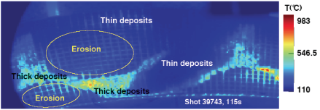
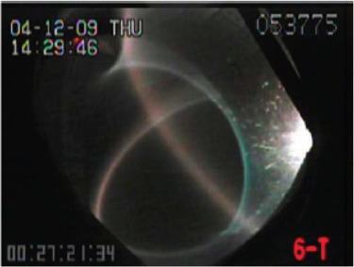
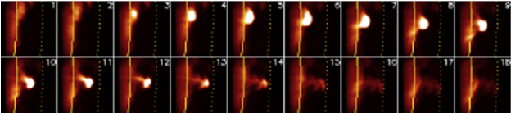
Introduction
The processes at the plasma edge and first wall are very diverse
They play crucial role in both performance and design of any fusion reactor
“Hot spots” in TS limit
heating power (Ekadahl, 2009)
H-mode blob in NSTX hits the wall (Maqueda, 2011)
“Sparks” in LHD terminate
discharges (Saito, 2007)

Slide 3
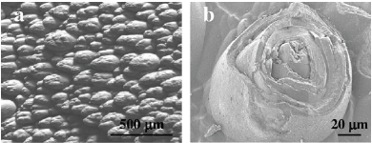
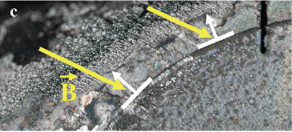
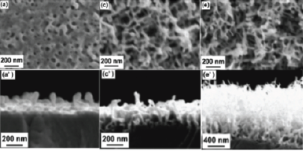
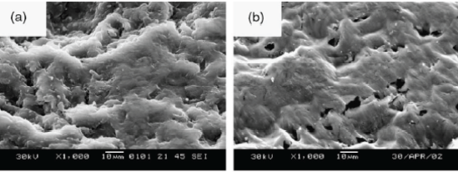
Introduction (con-ed)
In particular, wall related processes, including: H retention, physics of co-deposits, ”fuzz”, etc., are complex and still poorly understood
Co-deposits in TEXTOR, TS and LHD
“Fuzz” growth on W surface irradiated with He (Kajita, 2009)

Slide 4
Introduction (con-ed)
In this talk we address some issues related to the edge plasma and wall physics, including:
  dynamics of mesoscale-structures (blobs and ELM filaments) in edge plasma
  modeling of intermittent edge plasma with 2D transport codes
  transport of H/He species in wall material
  physics of coupled plasma-wall interactions
  impact of dust on ITER edge plasma performance

Slide 5

  Blob dynamics
Dynamics of individual blobs in edge plasma can be described with vorticity and continuity equations (assuming cold ions and constant electron temperature)
2D solutions of these equations predict ballistic propagation of blobs toward outer wall with the speed ~ 1 km/s (Krasheninnikov, 2001)
However, 3D nature of these equations allows also an onset of resistive drift-wave turbulence (RDWT), which can dissipate blobs before they hit the wall

Slide 6
  Blob dynamics (con-ed)
We study 3D effects on blob dynamics with BOUT++ code (Umansky, 2009)
Simple consideration suggests that the effects of RDWT can become important when
Since the size of the most 2D structurally stable blobs, has weak dependence on R (Krasheninnikov, 2008), this inequality implies that the onset of the RDWT on blobs will be more pronounced in large size devices like ITER
R is the tokamak
major radius, and
δ_{b} is the blob
cross B-field size

Slide 7
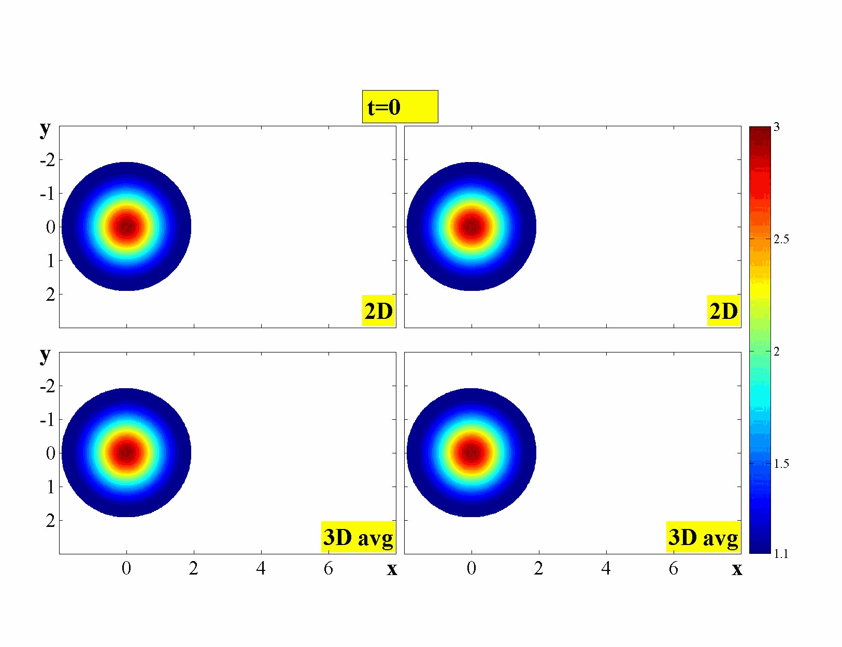

  Blob dynamics (con-ed)
3D modeling results of blob dynamics with BOUT++ support this conclusion (Angus, 2012)
Plasma density
contours averaged
along B

Slide 8
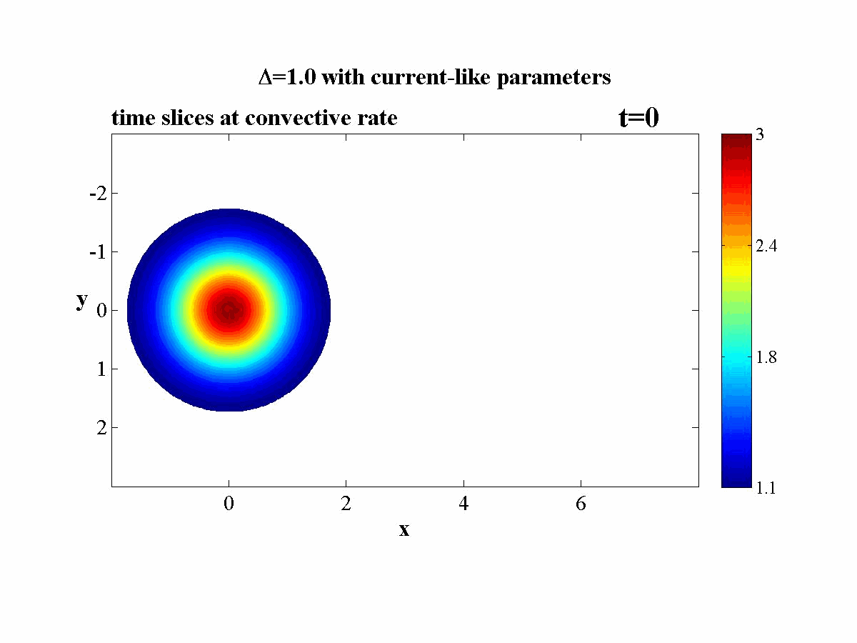
  Blob dynamics (con-ed)
3D modeling also clearly shows initial development of the RDWs with further transition into turbulent regime (Angus, 2012)
Cross B field slice of plasma density contours for:

Slide 9
  2D modeling of intermittent edge and SOL plasma transport
Standard 2D edge plasma transport codes like UEDGE and SOLPS, which are heavily used for the modeling of edge plasma and heat loads on the PFCs in ITER, are based on the assumption that the fluctuations of plasma velocity, density, and temperatures are small
Moreover, all other quantities (e.g. pressure, atomic rate constants, wall sputtering, etc,) are also calculated with these averaged plasma parameters
However, blobs and ELM filaments cause large intermittent bursts, which violate the applicability of the UEDGE and SOLPS models (Krasheninnikov, 2009) since:
what is needed
current approach

Slide 10
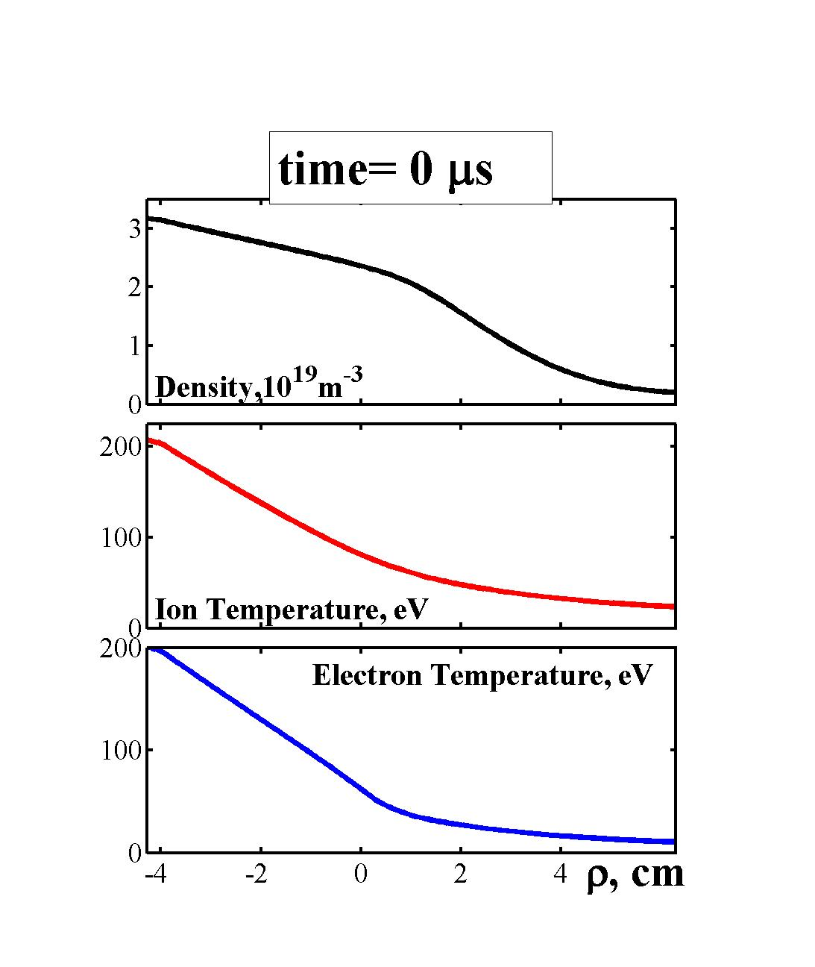
  2D modeling of intermittent edge and SOL plasma transport (con-ed)
In order to resolve this issue, a novel “Macro-Blob” (MB) approach was developed and implemented into 2D UEDGE code (Pigarov, 2011, 2012)
In the MB approach we use a coherent spatiotemporal variation of anomalous cross-field convective plasma velocity to reproduce the ballistic motion of spatially localized plasma fluid elements from the separatrix to the wall
radial slice of plasma
parameters at the outer
side of torus

Slide 11
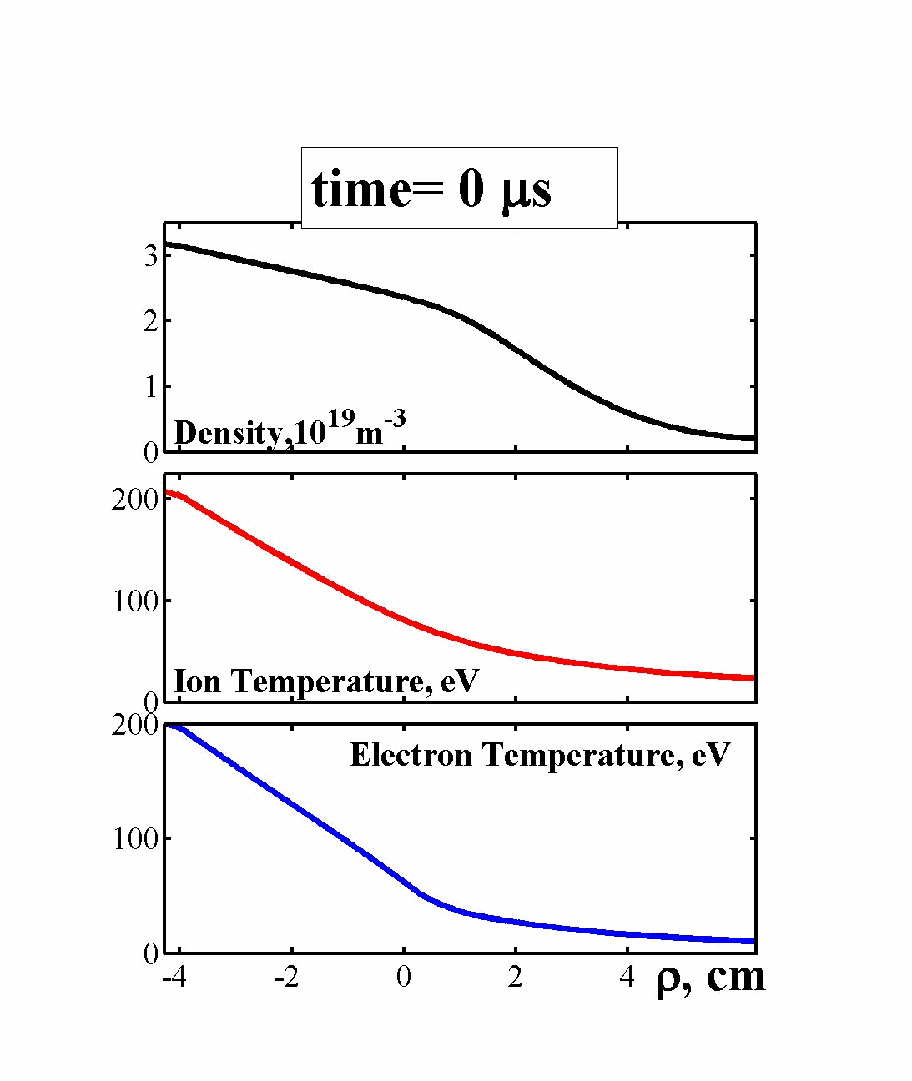
  2D modeling of intermittent edge and SOL plasma transport (con-ed)
In order to resolve this issue, a novel “Macro-Blob” (MB) approach was developed and implemented into 2D UEDGE code (Pigarov, 2011, 2012)
In the MB approach we use a coherent spatiotemporal variation of anomalous cross-field convective plasma velocity to reproduce the ballistic motion of spatially localized plasma fluid elements from the separatrix to the wall
radial slice of plasma
parameters at the outer
side of torus

Slide 12
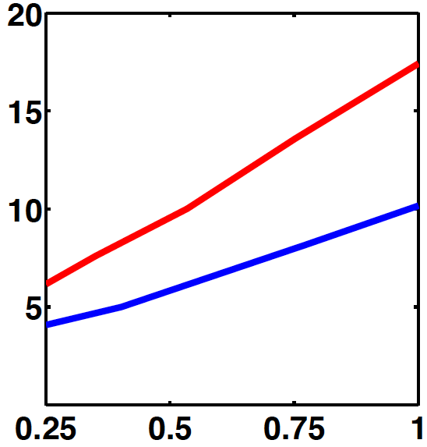
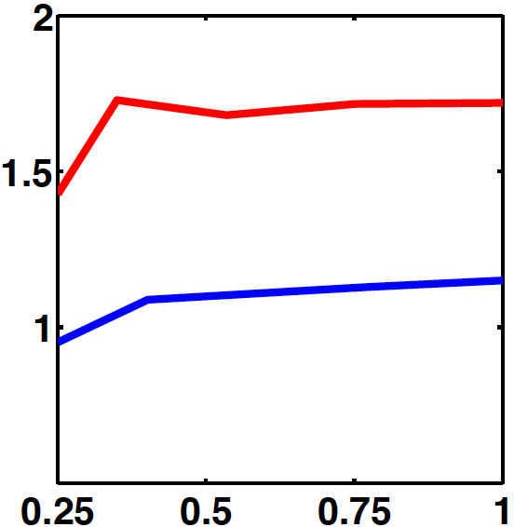
  2D modeling of intermittent edge and SOL plasma transport (con-ed)
P_{wall}/P_{SOL}, %
To find time-averaged characteristics in the fluctuating edge plasma we simulated a discharge with a large sequence of macro-blobs by using the UEDGE-MB model (Pigarov, 2012)
As a result we find the dynamic equilibrium of averaged edge plasma parameters
We have simulated L-mode DIII-D data with the MB model and found a large increase of both wall loading and sputtering in comparison with a standard time-average convective transport
Plasma flux to the wall, kA
Sputtering
yield, %
Plasma flux to the wall, kA

Slide 13
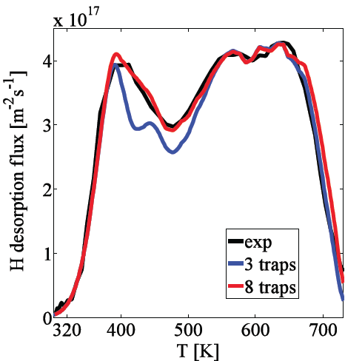
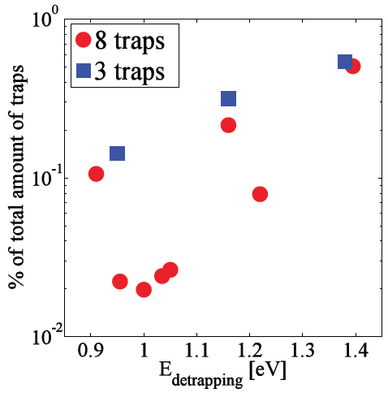
  Transport of H/He species in wall material
To assess H trapping in wall material we developed the FACE code (Smirnov, 2012), which was also used for the analysis of the Temperature Desorption Spectra (TDS) of H irradiated samples
Unlike widely used TMAP code, which only can treat up to three traps, the FACE is capable of using unlimited amount of traps, which is crucial in many important fusion applications (e.g. for the TDS analysis of complex co-deposited structures)
Modeling of W sample TDS with FACE shows vital impact of broad-band traps

Slide 14
  Transport of H/He species in wall material (con-ed)
For the case of a broad energy spectrum of H traps one can use a lattice “random walk” model with continuous spectrum of trapping energy determining the distribution, P_{τ}(τ), of the “waiting time”, τ, for each step:
τ
E is the trapping energy, T is the temperature

Slide 15
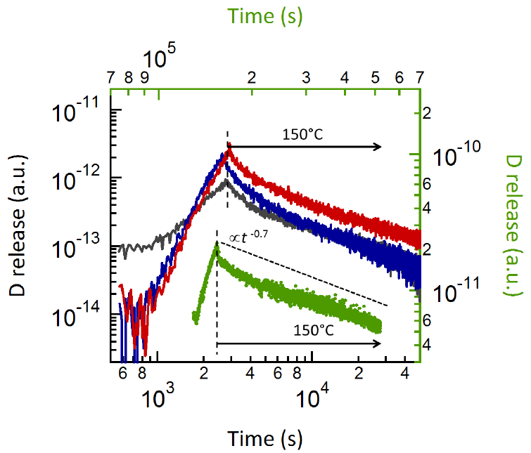
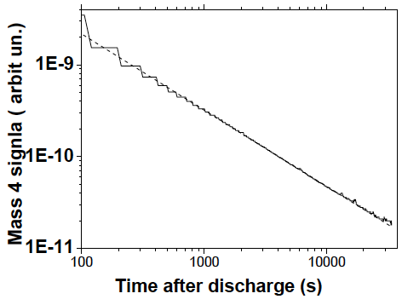
  Transport of H/He species in wall material (con-ed)
For we have , which describes H subdiffusion process (0<α<1):
,
This may explain outgassing flux (α=0.6) found in JET and TS (Phillips, Pegourie,2012)

Slide 16
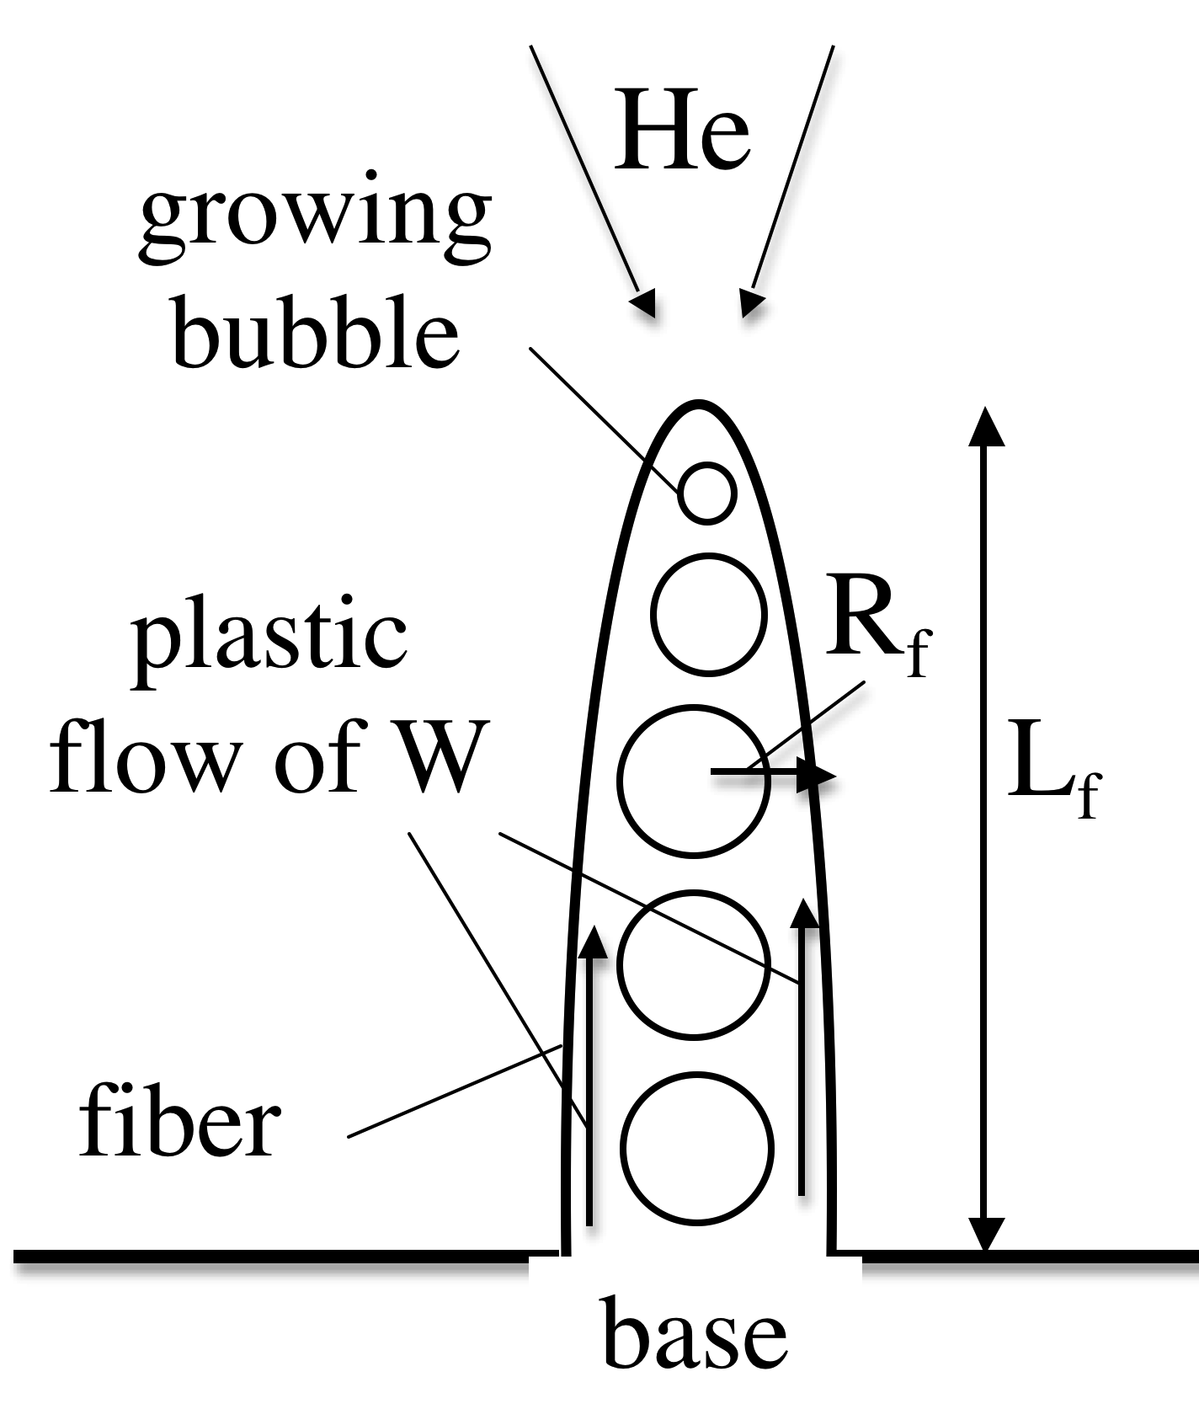
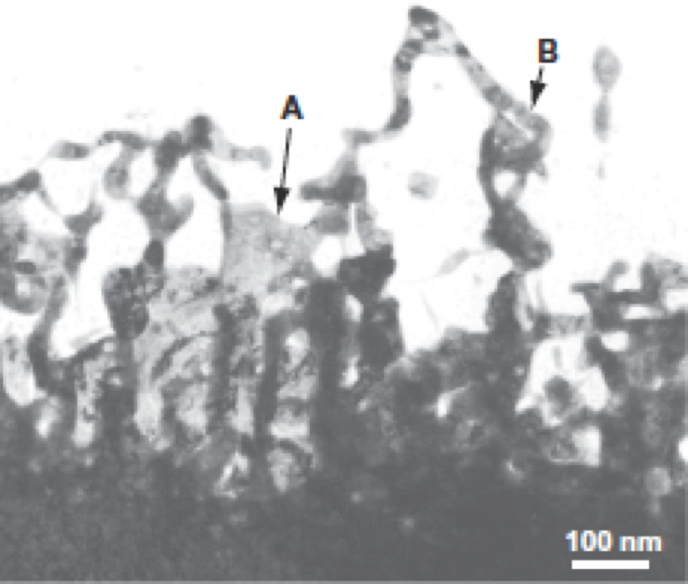
  Transport of H/He species in wall material (con-ed)
“fuzz”
A model (Krasheninnikov, 2011) describing the growth of “fuzz”, based on a plastic deformation of He reach W caused by the stress imposed by a newly growing bubble at the tip of the fiber, fits rather well all available experimental observations
However, it assumes plastic deformation of W due to dissolved He, while so far it was neither experimental nor theoretical confirmation of such effect

Slide 17
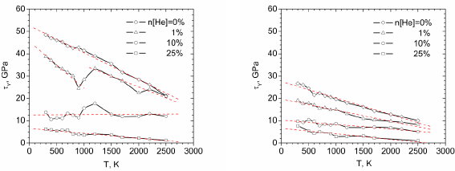
Transport of H/He species in wall material (con-ed)
To verify our idea we performed the MD simulation of the W yield dependence on He concentration and the sample temperature (Smirnov, 2012)
The results support the assumption made in our “fuzz” model (Krasheninnikov, 2011)

Slide 18
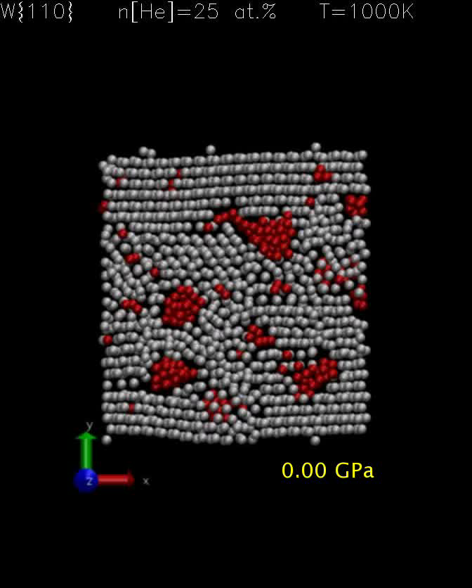
Transport of H/He species in wall material (con-ed)
Moreover, our MD simulations also show that plastic deformation of tungsten facilitates coagulation of He nano-bubbles/clasters, which otherwise are practically immobile (Smirnov, 2012)

Slide 19
  Physics of coupled plasma-wall interactions: dynamic wall response
ELM bursts are accompanied by a fast degradation of H-mode plasma pedestal
It is widely assumed that the pedestal recovery is determined solely by plasma transport processes
However, the reduction of total amount of hydrogen in tokamak after the ELM crash is due to accumulation of hydrogen in the first wall
Therefore, density pedestal recovery can be controlled by the physics of H outgassing from the first wall

Slide 20
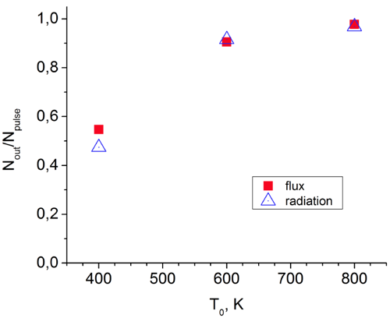
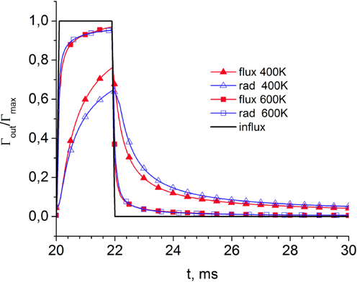
  Physics of coupled plasma-wall interactions: dynamic wall response (con-ed)
We study the effect of dynamic wall response on periodic bursts of plasma flux with the FACE code
We find that for W wall and temperature below 500 K, wall physics can control the recovery of pedestal plasma density (Marenkov, 2012)

Slide 21
  Impact of dust on edge plasma performance
Dust has been observed on most current tokamaks and it is projected that dust production in ITER will increase significantly
However, dust also can be deliberately injected to plasma to alter edge plasma parameters (e.g. it was done in the NSTX experiments)
Here we present the results of the modeling with DUSTT-UEDGE code an impact of carbon dust injection into ITER-like discharge
Notes:
21

Slide 22
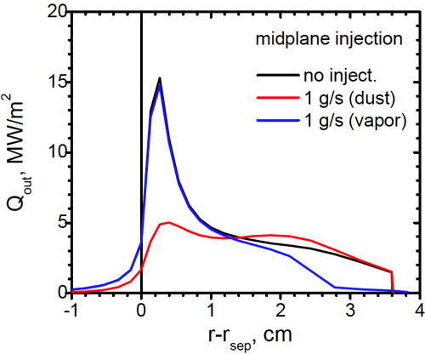
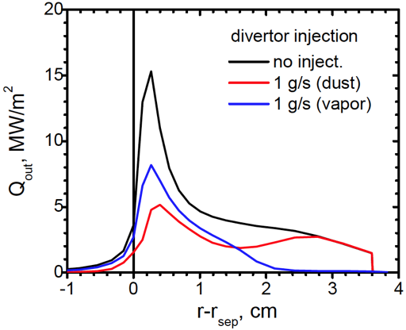
  Impact of dust on edge plasma performance (con-ed)
10 µm carbon grains were injected close to midplane and into the outer divertor
For comparison we also simulate injection of atomic carbon with the same rates and at the same locations as for dust injection
We found that dust injection causes more pronounced effect on the heat loading
Notes:
22

Slide 23
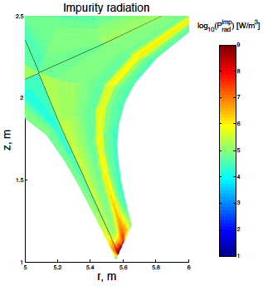
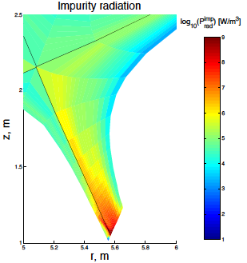
  Impact of dust on edge plasma performance (con-ed)
This also can be seen from the radiation patterns
gas
dust
Notes:
23

Slide 24
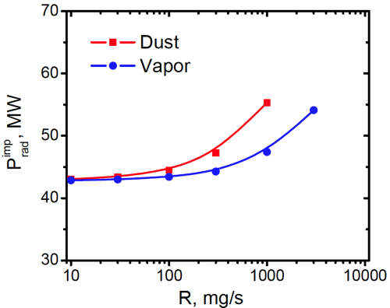
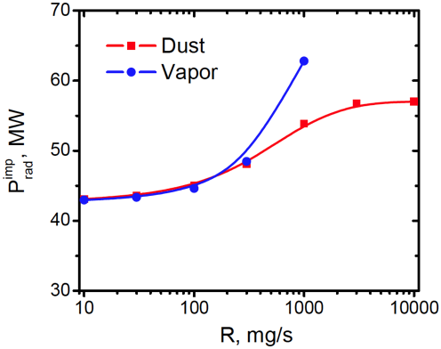
  Impact of dust on edge plasma performance (con-ed)
We also study the amount of carbon influx which ITER can tolerate before MARFE develops
We found that unlike all other cases, carbon dust injection into outer divertor does not result in the MARFE formation
MARFE
MARFE
divertor
midplane
Notes:
24

Slide 25
Conclusions
BOUT++ modeling shows that in ITER, the onset of the RDWT can dissipate blobs and ELM filaments before they hit the chamber wall
Intermittent edge plasma transport modeling with a novel “Macro-Blob” approach implemented into UEDGE predicts higher heat load on and sputtering of the chamber walls than the standard model does
The wall code FACE has been developed and used to study H transport and analysis of TDS data. It allows the usage of unlimited amount of traps, which can result in H sub-diffusion transport and power-law time dependence of H outgassing flux seen in experiments
Notes:
25

Slide 26
Conclusions (con-ed)
Modeling of the wall dynamic response on plasma particle flux bursts associated with ELMs shows that plasma density pedestal recovery can be impacted by the wall outgassing processes
MD simulation of W plastic deformation shows that the presence of large amount of dissolved He strongly reduces the yield, which supports recently developed “fuzz” model. It also shows that plastic deformation strongly facilitates coagulation of He clusters and nano-bubbles
DUSTT-UEDGE modeling of carbon dust injection into ITER plasma shows the possibility of significant reduction of divertor heat load. Preferential location of dust injection is the outer divertor, otherwise MARFE formation can be triggered for injection rate > 1 g/s
Notes:
26

Slide 27
Acknowledgements
This work was supported in part by the US DoE under the Grants DEFG02-04ER54852, DE-FG02-04ER54739, DOE PSI Science Center Grant DE-SC0001999 at UCSD, and Russian Ministry of Education and Science Grant “FZP-kadry 14.740.11.1171” at MEPhI.
Notes:
27

