Slide 1
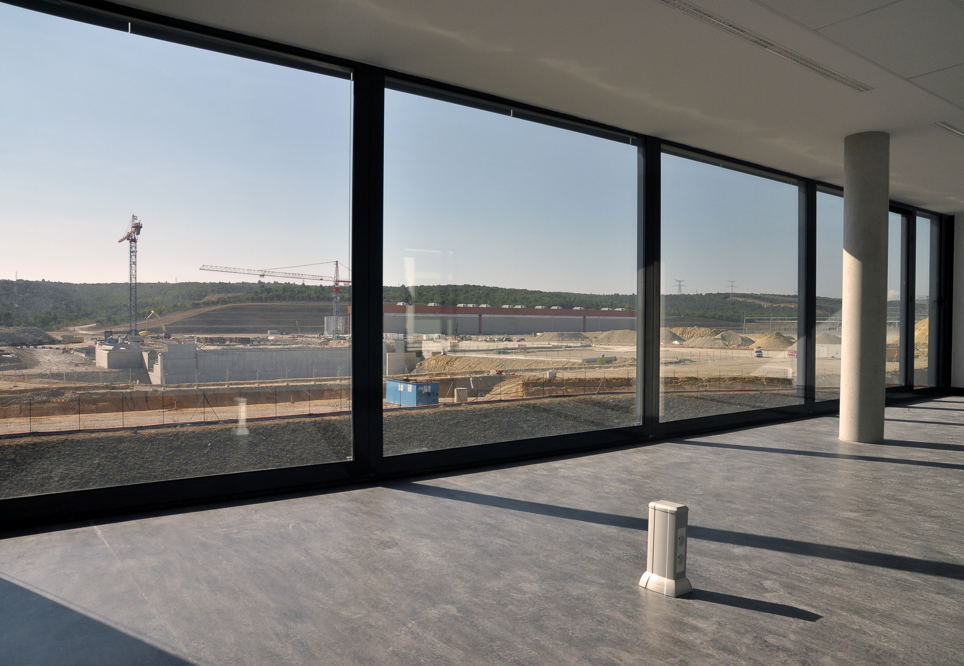
Status of ITER Project
24th IAEA Fusion Energy Conference
San Diego, USA, 8-13 October 2012
Osamu Motojima
Director-General of the ITER Organization
St. Paul-lez-Durance

Slide 2
Introduction
The 24th Fusion Energy conference marks the 5th anniversary of the establishment of the ITER Project;
Over the last two years, the ITER project has made the transition from building up the infrastructure of IO and 7 DAs;
Design completion is leading a real construction of in-kind components;
Our aim and responsibility are to show the progress of ITER construction keeping the project risk for ITER scope, cost, and schedule to an acceptable level.
A new IO management structure was introduced in 2010;
Decision making processes were streamlined and procedures simplified;
Establish several new communication channels with 7 DAs; Unique ITER Team
Faster decision making and a better performance of the combined Unique ITER Team (IO + DAs);

Slide 3
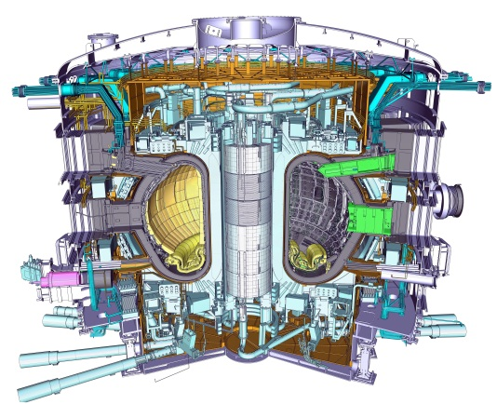
Contents to Report you
Introduction/General ITER Project Status
Schedule Structure and Management
ITER Research Plan and Physics Operations
Disruption Mitigation/ELM Mitigation
  The Key Technical Challenges
Vacuum Vessel/Cryostat/Coils/In-Vessel Components
Site Construction and Logistics
Summary
Unique ITER Team
R=6.2 m, a=2.0 m, I_{p}=15 MA, B_{T}=5.3 T, 23,000 tons

Slide 4
Schedule
ITER Level 0 Reference Schedule
Machine completion and First Plasma November 2020
D-T Operation 2027
Level 0 Reference Schedule within Baseline Boundaries
We are addressing some potential schedule delays (Building, VV, PF Coils etc.) and working with the DAs on resolving them.
IO and DAs as UIT are working hard to maintain this schedule.
IO proposes to install a W-divertor from the beginning (first priority)
IO proposes phased installation of heating :
67MW at non-nuclear phase
full 73 MW at pre-nuclear shutdown)
IO proposes to defer installation of some component and system from the construction to the operation phase (potential items, Heating systems, T-Plant, Hot Cell Tools, ELM/VS coil & PS, and TBM)
IO is investigating the simplified assembly scenario

Slide 5
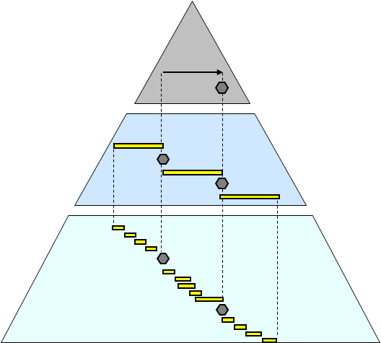
Achievement of Schedule Structure and Management
Completion of DWS
Level 0 Overall Project Schedule (OPS):
~ 50 Activities……………..………………………….
Level 1 Strategic Management Plan (SMP):
~ 3000 Activities ……………………………
Level 2 Detailed Working Schedules (DWS): ~ 150k Activities…………....
(Including IO and DAs)
DWS has been completed on 28th June and reviewed
Milestones are monitored and become controlled.

Slide 6
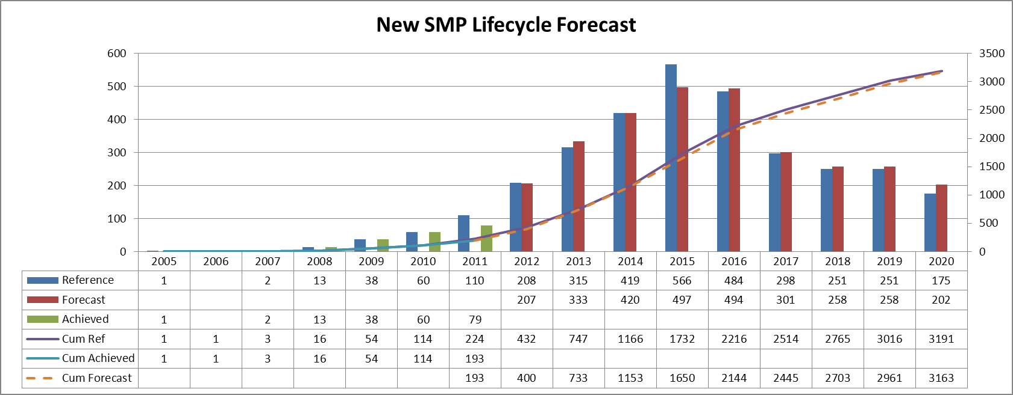
New SMP Lifecycle Forecast
Previous
New
Using the new SMP post 2012
IO and DAs Implementing strong schedule recovery action

Slide 7
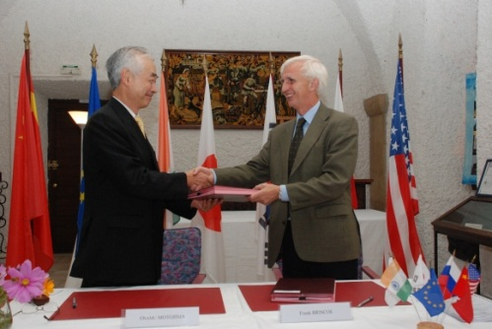
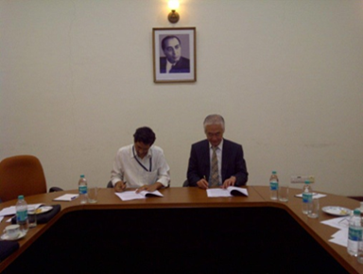
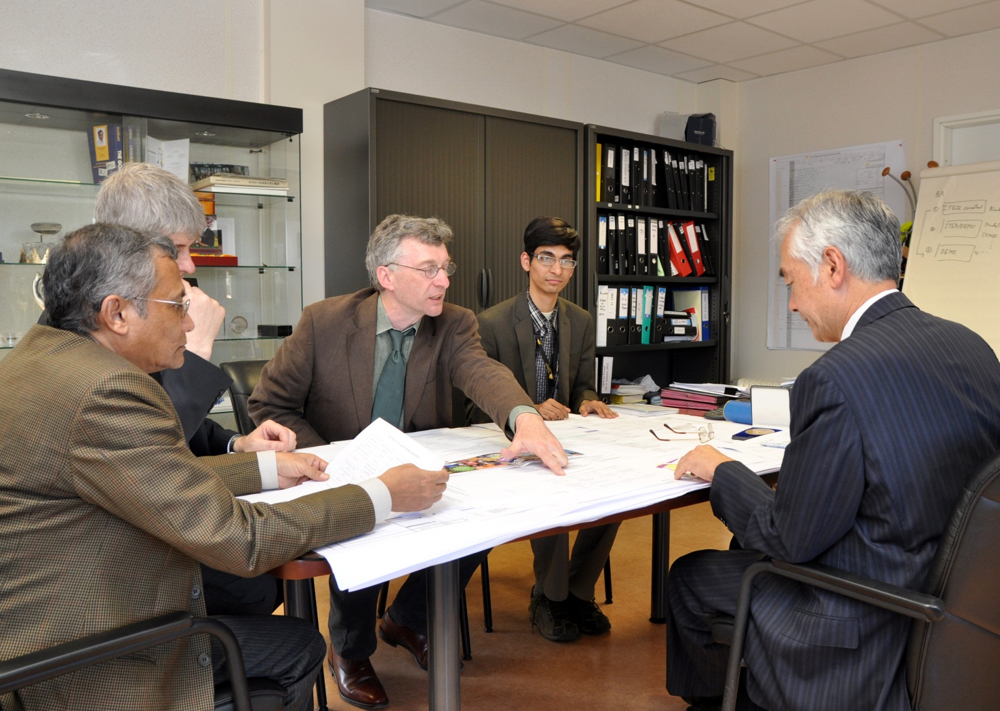
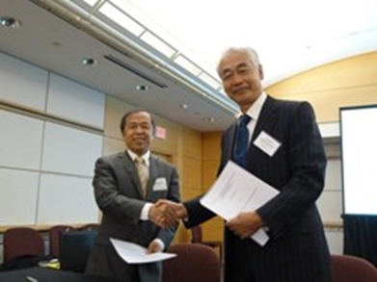
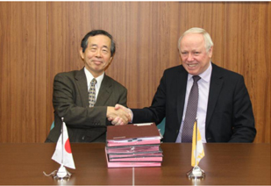
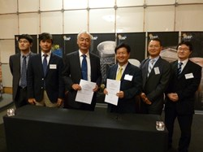
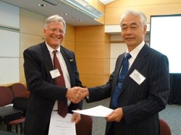
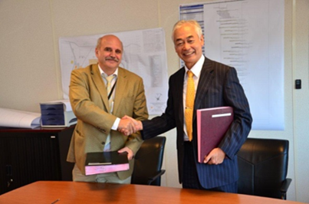
Procurement Arrangements (PA) are important milestones
Total number of signed PA is now 80 out of a total of 137
The achieved value to date is 2338.86109 kIUA out of a total In-Kind project value of 2880.52391 kIUA; 81.2 % of value achieved
EU
IN
CN
JA
KO
US
RF

Slide 8
Challenges of Plasma Physics
Significant progress in modelling of physics processes underlying ELMs and ELM control
Disruption Mitigation System Conceptual Design
Full revision of predicted heat loads on PFCs in support of First Wall and Tungsten Divertor design
Conceptual design of Plasma Control System moving towards completion
Extensive experimental and modelling R&D continuing in support of development of ITER disruption/ runaway electron mitigation systems

Slide 9
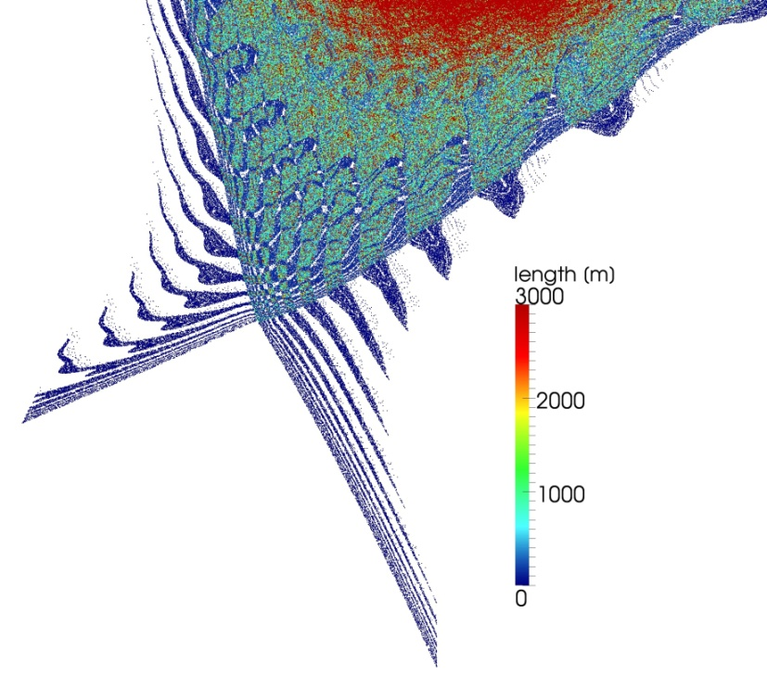
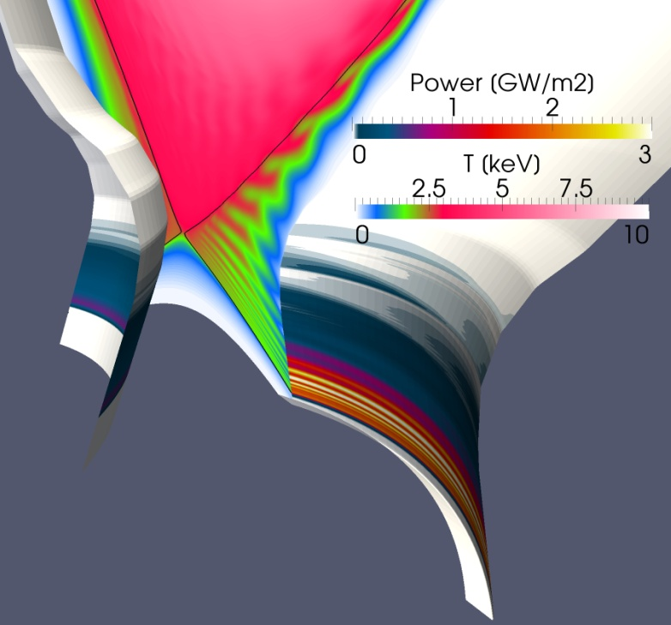
Non-linear Simulation of ELM Energy Deposition
ELM simulations in ITER Q=10 plasma scenario (JOREK code)
Conductive ELMs :
  large magnetic perturbation leads to ergodic edge with homoclinic tangles
  parallel conduction on perturbed magnetic field lines
  broadening of energy deposition scales with magnetic perturbation
Convective ELMs:
  filament formation, energy density losses in parallel direction
  broadening energy deposition due to radial distance travelled relative to parallel transport
Conductive ELM in ITER Q=10 plasma

Slide 10
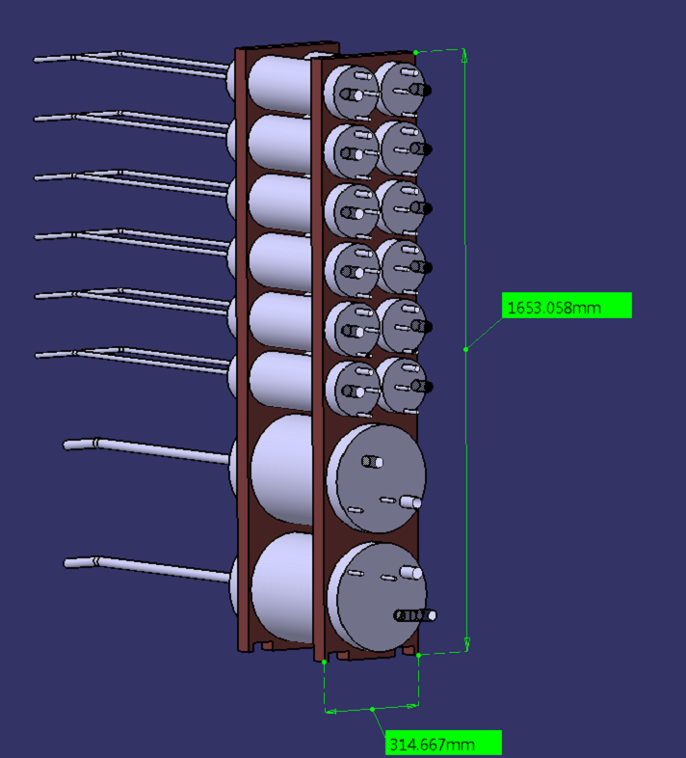
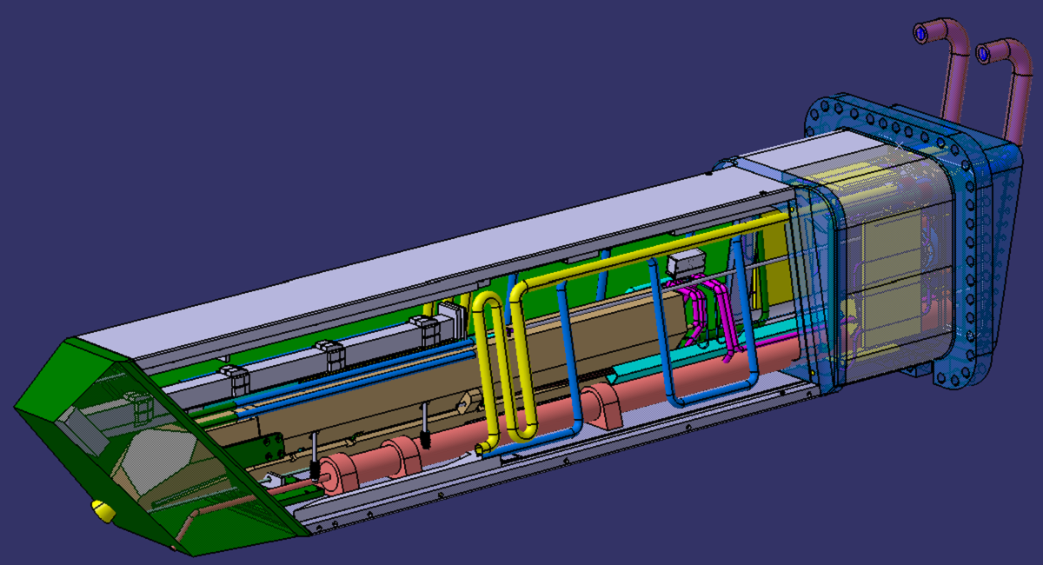
Disruption Mitigation System Conceptual Design
Disruption Mitigation System is planned to consist of two subsystems:
  3 Upper Ports primarily for Disruption Mitigation
    probably a single injection system in each port
  1 Equatorial Port for Disruption Mitigation and RE Mitigation multiple injection systems
Preliminary drawing
Preliminary drawing

Slide 11
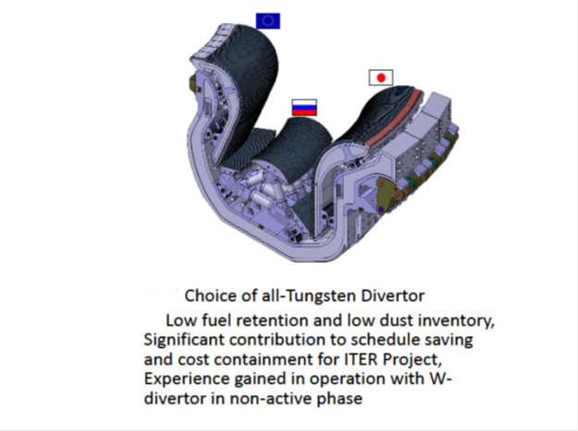
All-Tungsten Divertor
Status
The design of an all-tungsten divertor is currently under development at the IO.
Low fuel retention and low dust inventory
Significant contribution to schedule saving and cost containment for ITER Project
Experience gained in operation with W-divertor in non-active phase
The final design phase is planned to be completed by the end of 2013.
Challenges
A technology qualification and prototyping programme is being executed in EU, JA, RF responsible for procurement of the W plasma-facing components;
Target value are 1000 cycles at 10 MW/m² (Normal & Steady), 500 cycles at 20 MW/m² (Off-Normal);
Within the Physics R&D Community and ITPA, efforts are underway to provide an assessment of the risks faced by ITER;
From the physics point of view, the main risk elements are well recognized;
Work remains to try and quantify them sufficiently well to inform a decision by the IO with regard to a full-W divertor start;
IO is expecting a lot of important JET results with the ITER-like Wall and AUG etc;

Slide 12
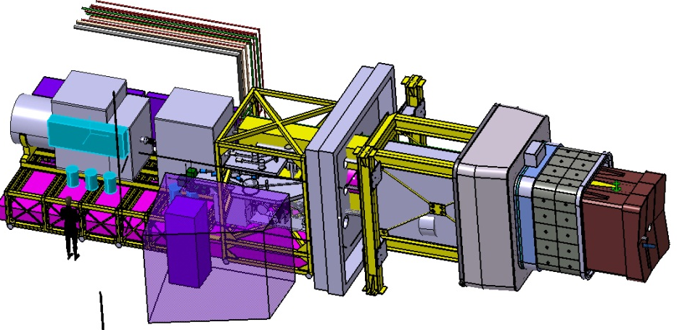
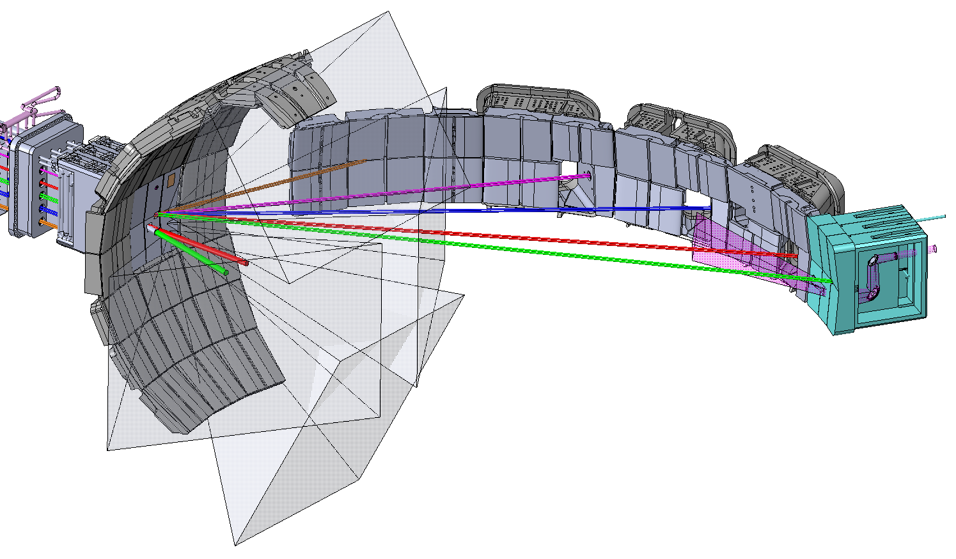
Diagnostic System
ITER has approximately 45 plasma diagnostic systems.
More than 70% of the diagnostic systems have been through the Conceptual Design Review process
At least one PAs with all the DAs
Concept of shared catalogue being developed to reduce overall costs
Port Plug
Interspace
Port Cell Structures
Port Plug 9 incorporates:
- TIP, VIR, and ECE
- Detailed optical layout is being performed

Slide 13
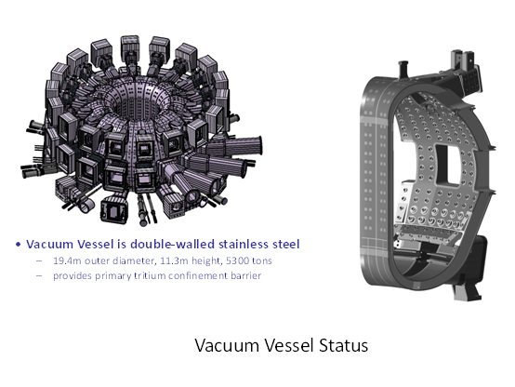
Key Technical Challenges of ITER
Vaccum Vessel
Challenges
The vacuum vessel is the SIC (Safety Important Component) component
The first boundary of the nuclear safety;
Status
The design of VV and ports by IO was complete and the manufacturing stage has already started;
The VV manufacturing design is under preparation by the contracted suppliers of the main vessel, ports and IWS in the EU, Korea and India;
Mock-up fabrication and testing programs are underway in EU, IN, KO and RF. The material manufacturing already started after the ANB approval;
All the VV materials, including the main material 316 L(N) IG and bolt materials XM-19 and Inconel 625, were already qualified by the ANB.
Contract of VV field Joint will be made soon by IO. Evaluation committee made a report;

Slide 14
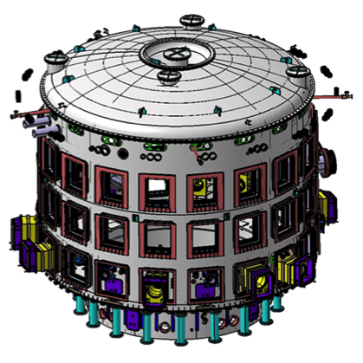
Cryostat
Status
One of the most important and critical systems in the ITER project, and has very large number of complex interfaces;
The cryostat manufacturing contract was signed in August 2012;
3D View of Cryostat
OD: 28.54 m, HT: 29.25 m
Mass: ~3500T
Challenges
The site workshop will be ready for the cryostat assembly in 2014;
The first deliveries of components for assembly in the tokamak pit will occur in September 2015;
Pre-manufacturing activities such as the Manufacturing and Inspection Plan, manufacturing CAD design and drawings and quality plan are being initiated between the ITER organization, INDA and their industrial partners.

Slide 15
Toroidal Field Coils
Status
The production of the TF coils is split into 3 main production areas: The TF conductors; The TF structures; and the TF windings and coils;
The TF conductors, which comprise 450t of Nb3Sn, are supplied by EU, RF, JA, KO, CN and US. Over 70% of required 450t of Nb3Sn strand has already been produced;
It is anticipated that the rest will be completed in two years;
JADA has signed a series production contracts with Japanese and Korean suppliers to build
Manufacturability study of large TF coil components by Toshiba and its sub-contractor KHI
a first of series for TF winding and for the fabrication of the TF structural section;
Challenges
Both China and Korea have fabricated dummy conductor, which has been supplied to Europe for TF winding trials;
The TF structures are to be assembled by welding in Japan and Korea.
The manufacturing feasibility of these large components has already been undertaken by the Japanese Domestic Agency and its industrial partners.

Slide 16
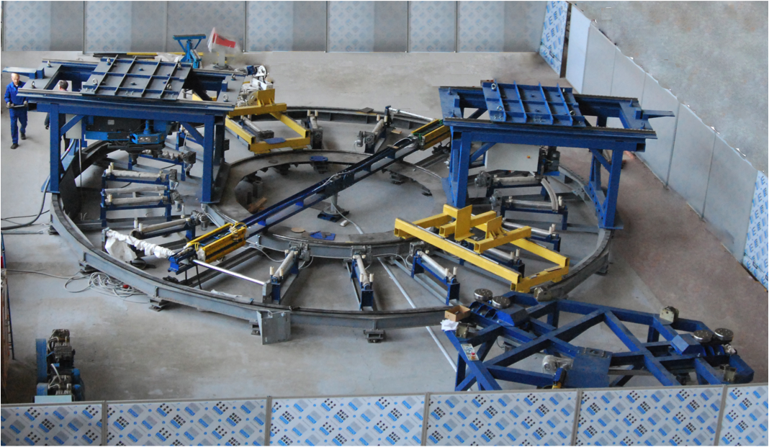
Poloidal Field Coils
The ITER Poloidal Field (PF) magnet system consists of six PF coils procured by EU (PF2~6) and RF (PF1);
The two PAs between IO and each domestic agency have been signed;
Contract with industry by EU will soon made;
Central Solenoid
US is responsible for the supply of the Central Solenoid for which JA supplies the conductors;
The CS consists of six identical coils and is 13.6m tall, has a diameter of 4.2 m and weighs approximately 1000t;
The contract for CS module fabrication was placed by the UA in July 2011;
This was followed by a successful Preliminary Design Review in September 2011. Manufacturing input to structures design is being provided by US industry.
The assembly tooling is on track for Preliminary Design Review in September 2012.
Conductor test is at its final stage. We will complete several additional tests soon, but we have already one conductor satisfying necessary condition.
PF1 winding equipment in place in the Efremov Institute.

Slide 17
Test Blanket Module (TBM) Program
Status
TBM program provides the first experimental data on the performance of the breeding blankets in the integrated fusion nuclear environment;
Detailed desing studies of TBM integration into ITER facility and related maintenance strategy performed;
Agreement on generic TBM Arrangement achieved; right of intellectual properties, nuclear/non-nuclear liability, post irradiation test
View of TBM Port Cell Area
Challenges
The ITER Members are in charge of the design, manufacturing and delivery of the TBSs to the ITER site.
IO is developing all required interfaces with the other ITER systems and buildings based on input data given by the Members;
IO is performing all the design work necessary for the TBSs integration into ITER facility;
The six TBMs are in three dedicated ITER equatorial ports;

Slide 18
Buildings and Site Infrastructure
Status
50 Hectare level platform finished
All infrastructure needed to support construction is complete
400kV electrical substation constructed
Poloidal field coils winding building constructed
Tokamak Excavation, foundation slab and anti-seismic plinths completed
All 493 anti-seismic bearings fabricated and installed
New Headquarters building completed and occupied from 8 October 2012
100 km “Special Itinerary” to allow the transport of large components from Marseille port to ITER is complete
Challenges
Building is the biggest critical path of schedule control
Improvements to “robustness” of some structural elements is being implemented
Engagement with industry is required to mitigate schedule challenges
Innovative technical solutions need to be investigated to minimize risks to cost and schedule

Slide 19
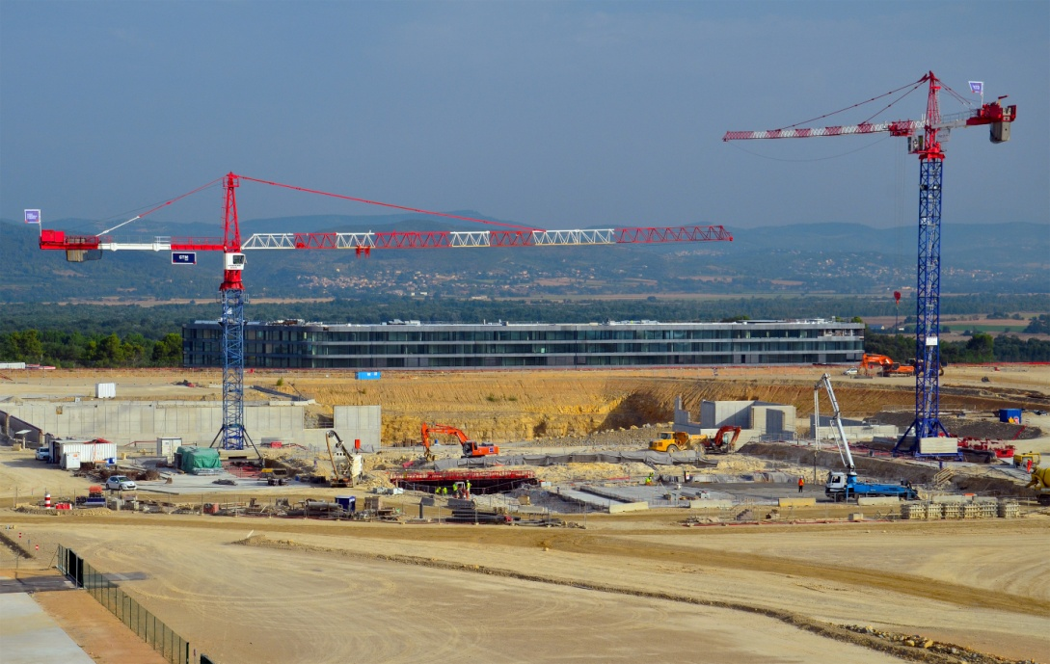
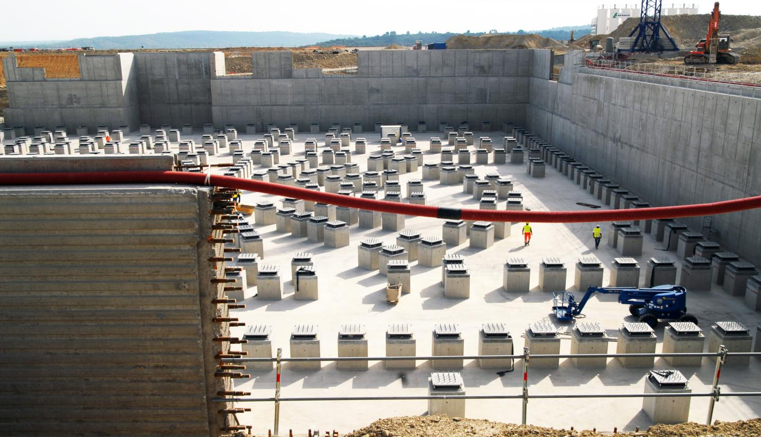
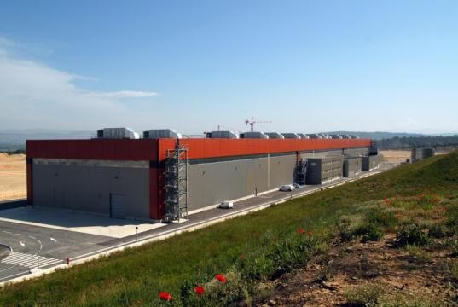
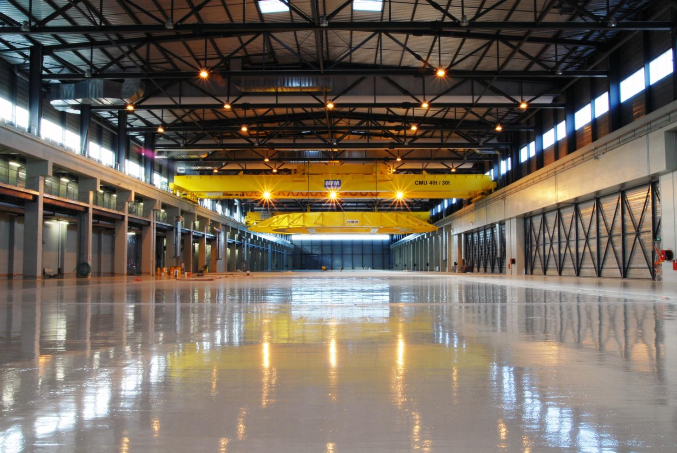
Site Construction Progresses (1)
View of the On-site Construction
Lower Basemat and Anti-seismic isolators
PF Coil Winding Building
Inside PF Coil Building

Slide 20
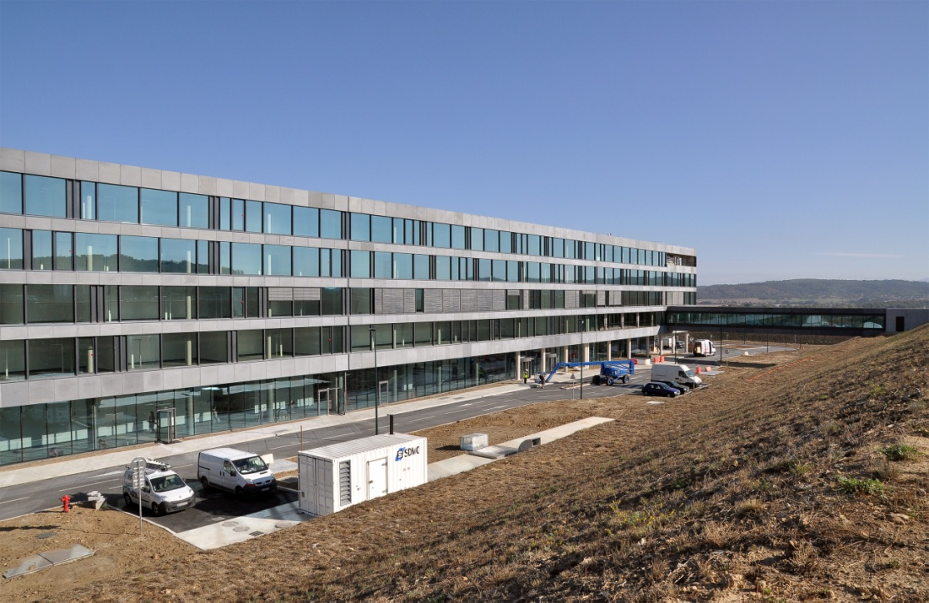
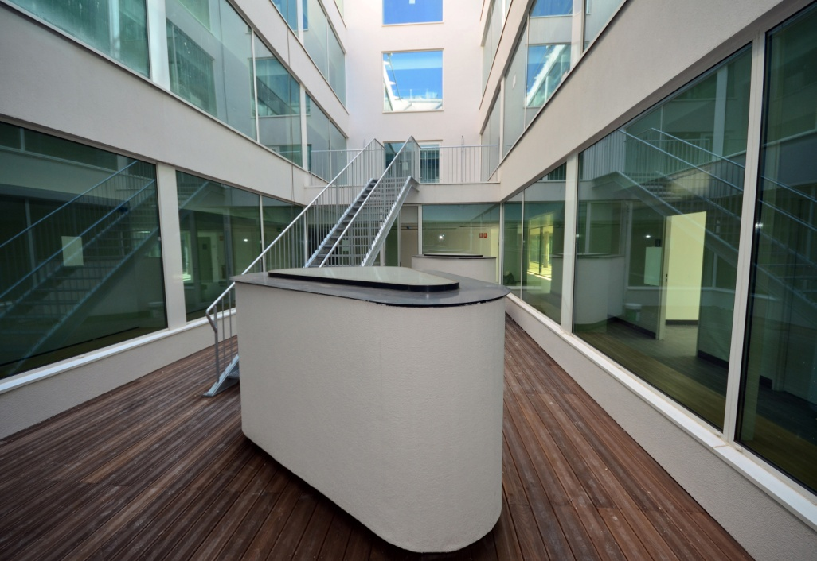
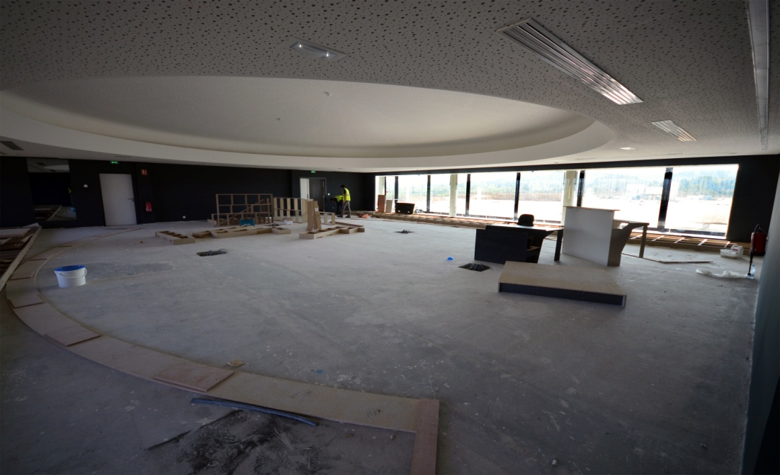
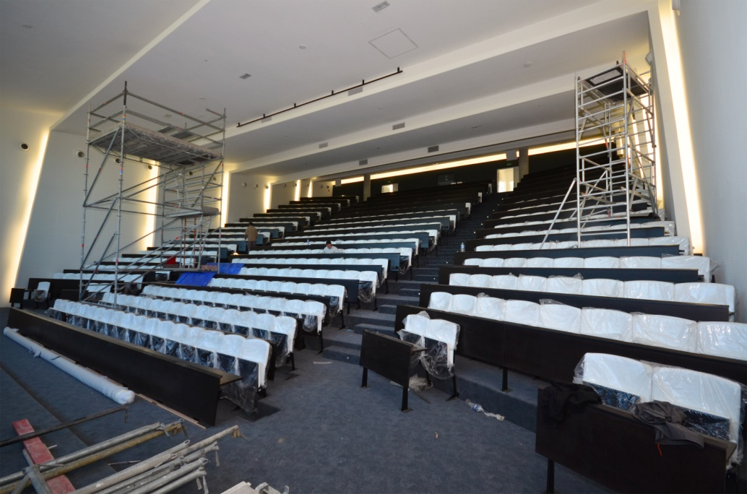
Site Construction Progresses (2)
ITER New HQ Building
Inside HQ Building
Future ITER Council Room
ITER New Amphitheatre

Slide 21
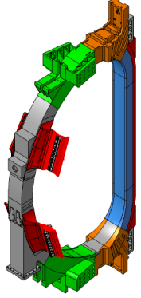
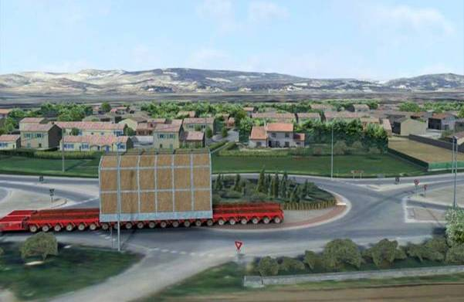
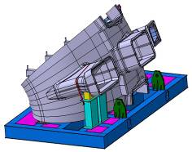
FRANCE
ITER Itinerary
Local Communities Provided Road Upgrades
TF Coil ~360 t
16 m Tall x 9 m Wide
VV Sector ~400 t
12 m Tall x 9 m Wide
Heavy Component on Road
(TF Coils, VV Sectors, and PF1 Coil)
PF1 Coil ~200 t
9.4 m Dia
Itinerary: March 2013 Test Convey
Beginning of 2014 Real Component will arrive at ITER
Notes:
10 October, March 2013にテストコンボイ, 2014から実際に動き出す。道路の39%に現状問題が発見、itinerary planは完成

Slide 22
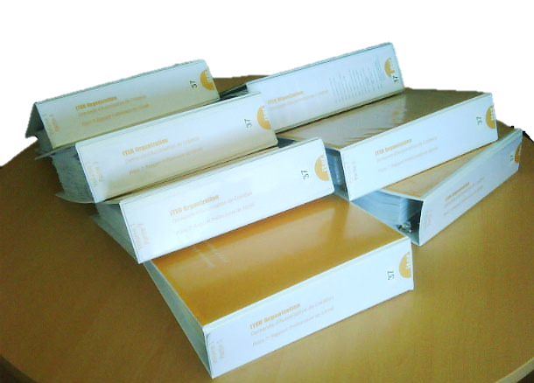
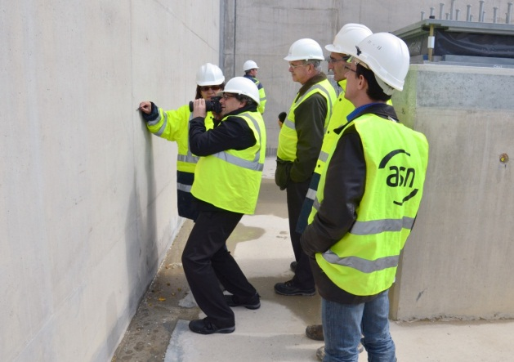
Safety and Licensing
The ITER is a nuclear facility
The ITER facility is being licensed in France as a Basic Nuclear Installation (INB)
In November-December 2011, meetings of the Groupe Permanent, a standing committee of experts convened by ASN
In parallel, in July-August 2011, Public Enquiry held in towns surrounding ITER
In July 2012, ASN announced its decision to grant the decree to authorize the creation of the ITER facility
  decree now in draft and being discussed - hopeful for signing before end of 2012
ITER files (DAC) submitted in March 2010
~ 5000 pages
> 700 questions asked by regulator
~ 10,000 questions during public enquiry
~ 180 recommendations and commitments now to be answered in next 2 years
Representatives of the French nuclear regulator (ASN) make regular inspections of ITER.
Here they inspect the civil works (April 2012).

Slide 23
In Summary
ITER is well and truly off the starting blocks.
ITER is presently well into the construction phase and is facing the problems to be expected in such phases.
The large size and unique requirements of ITER have presented many technical challenges for the design and manufacturing.
ITER designs, R&D and manufacturing mock-ups are addressing these challenges.
ITER will develop key components necessary for the development of fusion.
We are learning a great deal from ITER.
The achievements over the last 2 years have shown that an international cooperation such as ITER can work successfully
SMP/DWS completed
Effort to create Unique ITER Team to deal with the usual problems which arise in large and technically ambitious construction projects.
ITER has a more complex organization and procurement scheme than other large science projects
IO and DAs Implementing strong schedule recovery action.
I am very glad to ask you watch and listen to our presentations this week.

