Slide 1
Physics Guidelines for a Tokamak DEMO
¹H. Zohm, ¹C. Angioni, ¹E. Fable, ²G. Federici, ³G. Gantenbein, ¹T. Hartmann,
¹K. Lackner, ¹E. Poli, ⁴L. Porte, ⁴O. Sauter, ⁵D. Ward, ¹M. Wischmeier
¹MPI for Plasma Physics, D-85748 Garching, Germany, EURATOM Association
²EFDA PPP&T Department, D-85748 Garching, Germany
³KIT, IHM, D-76021 Karlsruhe, Germany, EURATOM Association
⁴CRPP, EPFL, CH-1015 Lausanne, EURATOM Association
⁵CCFE Culham, Oxfordshire OX14 3DB, United Kingdom, EURATOM Association
Introduction: ITER Physics Guidelines
Towards DEMO Physics Guidelines
Application: An ‚improved H-mode‘ DEMO
Conclusions
Presented at 27th IAEA FEC, San Diego, USA, 12.10.2012

Slide 2
Introduction – ITER Physics Guidelines
ITER will address key issues for DEMO beyond present day experiments, the most prominent example being α-heating
ITER design based on sound physics base, first outlined in ‘ITER Physics Design Guidelines’ and then augmented by the ‘ITER Physics Base’
The EU programme has identified ‘DEMO physics issues’ (items not needed for ITER Q=10, but absolutely vital for DEMO and an FPP)
Steady state tokamak operation (β_{DEMO} ≥ 2 β_{ITER})
High density operation (n/n_{GW,DEMO} ≥ 1)
Power exhaust (R_{DEMO}/R_{ITER} = 1.2, but P_{DEMO}/P_{ITER} = 4)
Disruptions (W_{DEMO}/W_{ITER} > 5)
Reliable control with minimum sensors and actuators
In the following the ITER physics base is examined and updates are proposed related to the issues above (points 4 and 5 not covered today)
N.B.: where needed, DEMO technology constraints into account, too

Slide 3
Areas examined in our work
Area | Issues
Equilibrium | Shaping vs. A
MHD stability | Fast particle effects on β_{max,th}, stability of fast particle driven modes
Energy balance | Transport at high β, n/n_{GW} and P_{rad}, T_{e} profile shape
Particle balance | Density profile shapes @ n/n_{GW}, impurity transport
Power exhaust | Detachment physics, λ_{power} in detached divertor, other divertor concepts, ELM mitigation
H&CD physics | Full optimisation NBCD localisation
Dynamical phases | Realistic times for recharge
Disruptions | Timescales

Slide 4
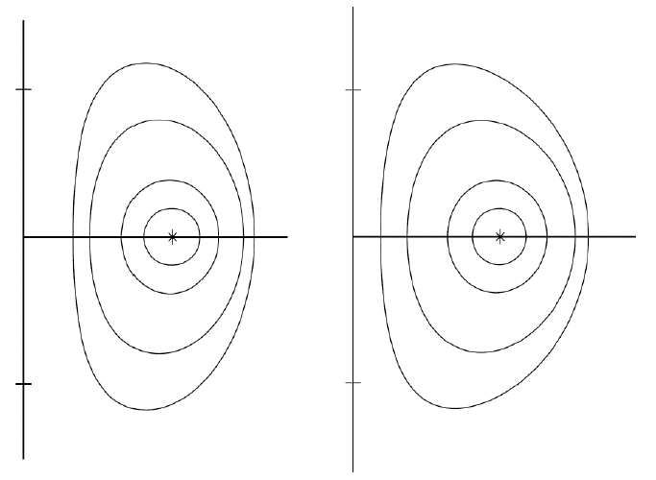
Equilibrium
A ~ 1.5
A ~ 2
A ~ 3
A ~ 5
Example: ‚natural‘ elongation
κ = 0.5/(A-1) + 1
Adjusting for ITER geometry:
κ = 0.5/(A-1) + 1.5
l_{i} = 0.5 l_{i} = 1
The physics of MHD equilibrium is well understood
Plasma configuration has to be consistent with DEMO-like coil set
shaping and control will be more restricted than in present day devices
important for larger A and ‚new‘ divertor configurations
TF ripple should be considered consistently

Slide 5
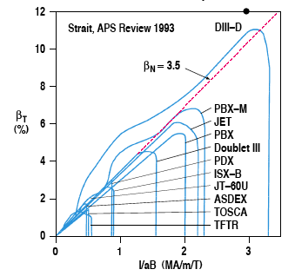
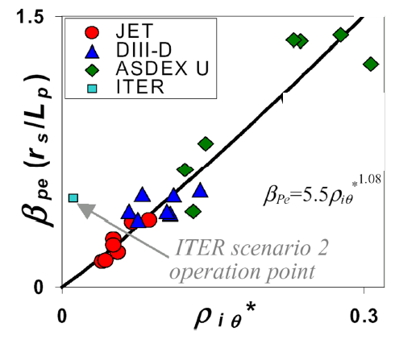
Stability – limits to thermal β_{N}
R. Buttery et al., FEC 2008
β_{N}=β/(I/aB)=3.5
DEMO
(indicative)
Ideal MHD limits well understood
Troyon scaling β_{N,max} = 4 l_{i}
corrections for pressure peaking
and active RWM control?
Resistive (NTM) stability important
conventional operational points
will be metastable to NTMs
active avoidance/control (ECCD)?

Slide 6
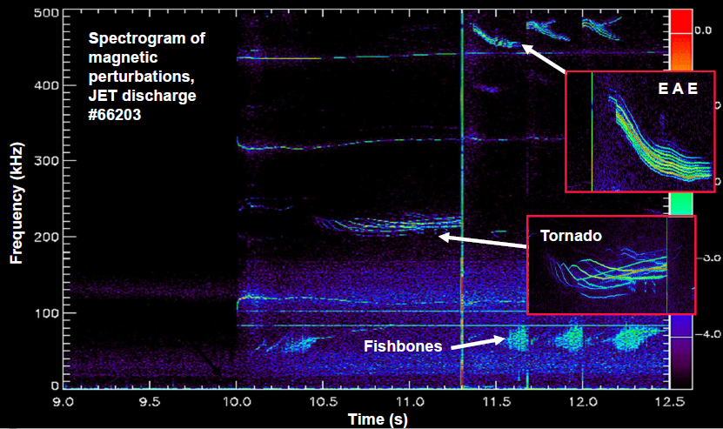
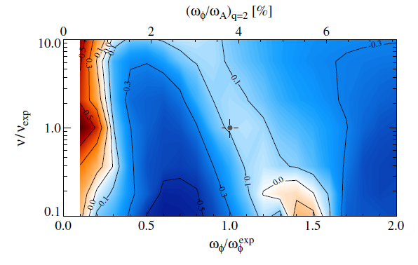
Stability – limits to fast particle β
stabilised
by bounce
modtion
stabilised by
precession
drift
NSTX, J. Berkery et al., Phy. Rev. Lett (2010)
Fast particle contribution is twofold
destabilisation of otherwards stable modes (XAEs, EPMs)
orbit effects can stabilise global MHD modes (example: RWM)
Depends on subtleties of profiles / nonlinear saturation – can trends be captured by 0-d fits?

Slide 7
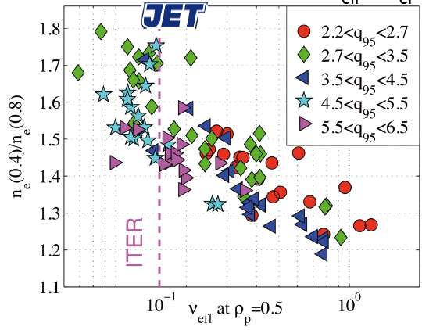
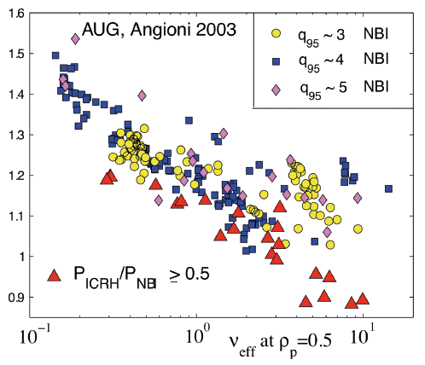
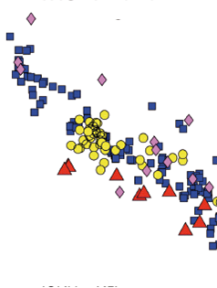
Particle transport – density profiles
Angioni et al. 2003
AUG
Initial ITER assumption: density profiles are flat at n~n_{GW}
Recent finding: peaking depends on ν_{eff} rather than n/n_{GW}
proposal: density limit applies to n_{e,ped}/n_{GW} (< 1)
calculate density peaking from first principles (include also β!)

Slide 8
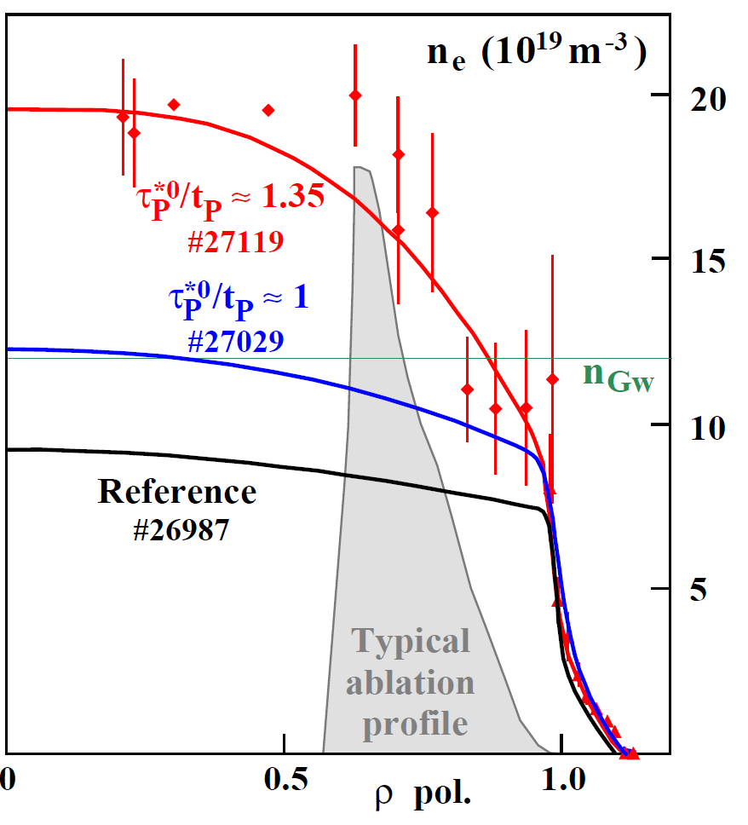
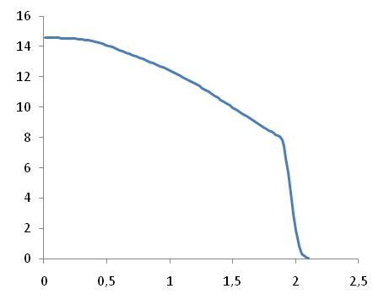
Particle transport – density profiles
ITER, low β
n (10¹⁹m⁻³)
ASDEX Upgrade
pellet fuelling
r (m)
G. Pereverzev et al NF 2005 P.T. Lang et al., this conference
Initial ITER assumption: density profiles are flat at n~n_{GW}
Recent finding: peaking depends on ν_{eff} rather than n/n_{GW}
proposal: density limit applies to n_{e,ped}/n_{GW} (< 1)
calculate density peaking from first principles (include also β!)

Slide 9
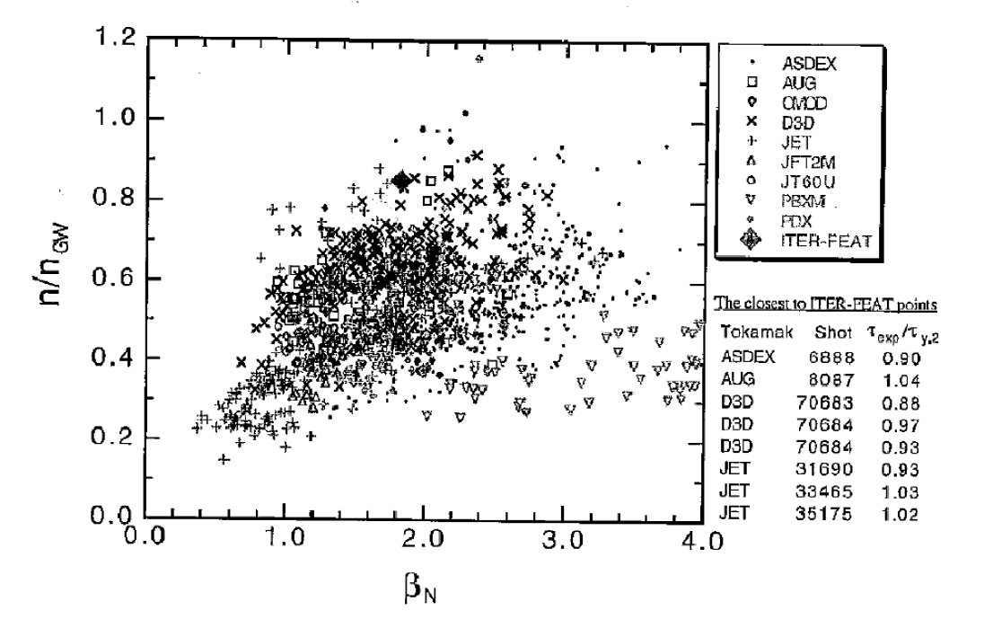
Heat transport: validity of IPB98(y,2)
DEMO
ITER
Due to the higher β_{N}, n/n_{GW} and P_{rad,core} (see later), IPB98(y,2) not necessarily valid for DEMO
Notes:
9

Slide 10
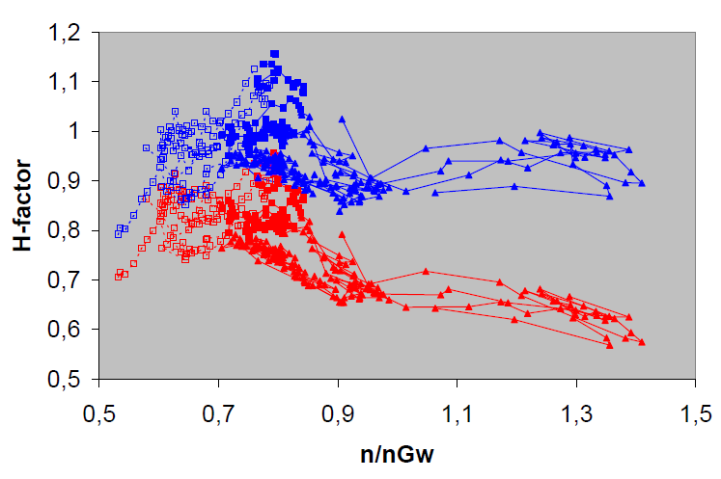
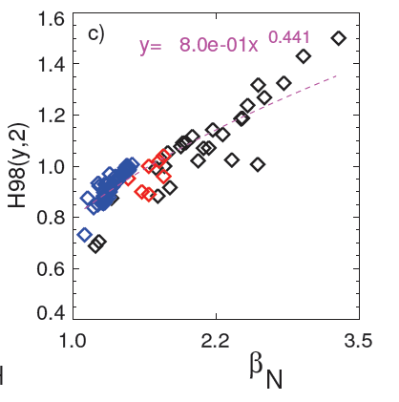
Heat transport: validity of IPB98(y,2)
A. Kallenbach et al., this conference
Same dataset, normalised to:
Kardaun 2006
IPB98(y,2)
AUG
C-Mod
JET
(but note ν*, ρ* variation)
H-mode confinement tends to increase with higher β_{N} (IPB98: ~ β^{-0.9})
H-mode confinement tends to decrease with higher n/n_{GW} (IPB98: n^{0.4})
in addition, not clear how to correct for highly radiating discharges
This should be addressed, based on our increasing physics understanding

Slide 11
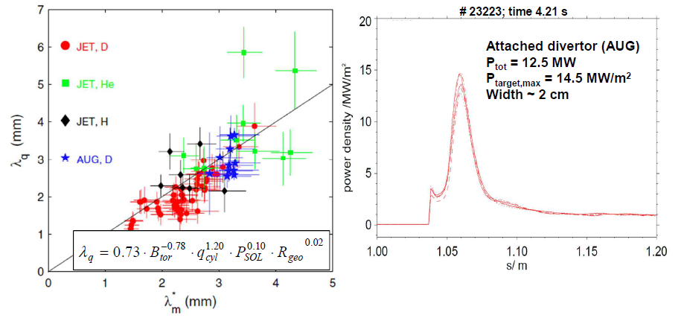
Exhaust of power through a divertor in DEMO
T. Eich et al. Phys. Rev. Lett. 2011
Technology limit stricter than in ITER (high n-fluence): P_{target} ≤ 5 MW/m²
Under attached conditions, no R-scaling of λ_{q}
expect 1-2 mm in midplane, 1-2 cm at the target ⇒ 200 MW/m²
need to (partially) detach divertor and add substantial radiative losses

Slide 12
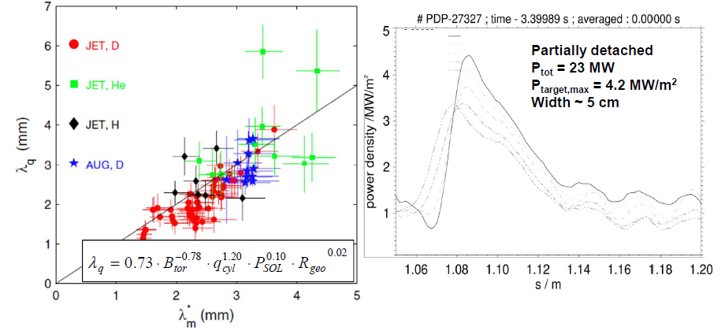
Exhaust of power through a divertor in DEMO
Technology limit stricter than in ITER (high n-fluence): P_{target} ≤ 5 MW/m²
Under attached conditions, no R-scaling of λ_{q}
expect 1-2 mm in midplane, 1-2 cm at the target ⇒ 200 MW/m²
need to (partially) detach divertor and add substantial radiative losses

Slide 13
Design guidelines for power exhaust in DEMO
Long term: develop predictive capability for divertor detachment
Interim solution: use P_{sep}/R divertor scaling together with P_{sep}>P_{HL}:
Lower bound: ASDEX Upgrade result: P_{sep} / R = 7 MW/m
Upper bound: ITER assumption: P_{sep} /R = 15 MW/m
An unprecedented ‚core‘ radiation level will be needed in DEMO!
P_{rad}(r) must be tailored consistent with confinement needs
N.B.: we are also missing quantitative guide lines for the first wall load!

Slide 14
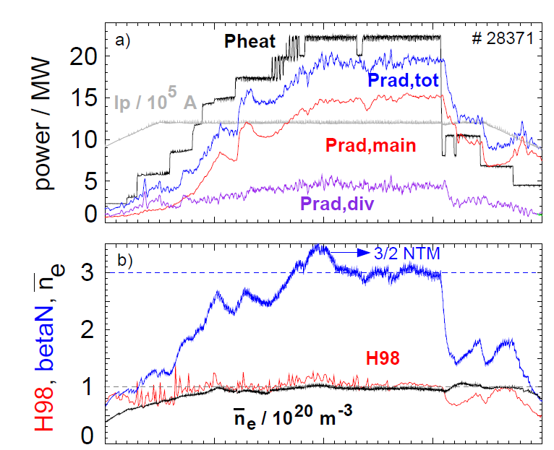
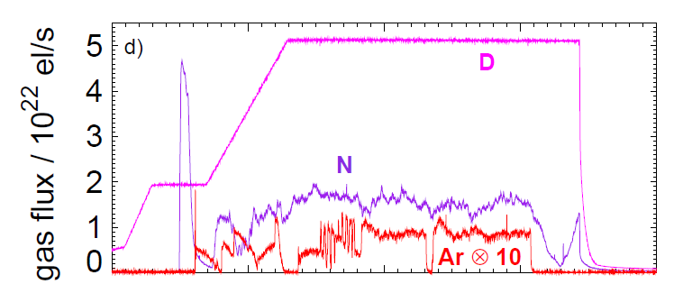
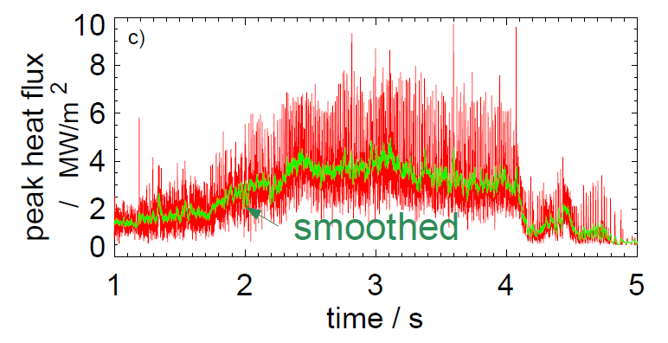
Double Radiation Feedback on ASDEX Upgrade
A. Kallenbach, subm. to Nucl. Fusion
P_{rad,main} controlled by Ar-seeding, T_{div} controlled by N-seeding
P_{heat,tot} = 23 MW, but q_{div} < 5 MW/m² and P_{rad,core} = 15 MW (67%)
close to P_{thres}, but still H=1 and β_{N} = 3!

Slide 15
Heating and current drive in DEMO
 | LHCD | ECCD | FWCD | NBCD
γ [Α/(Wm²)] | 0.3-0.4 (indep. of T_{e}) | 0.1-0.2 (ITER prediction) | ≤ 0.1 (ITER prediction) | 0.3-0.4 (ITER prediction)
Remark | very peripheral absorption | potential for optimisation (next slides) | small exp. Basis | off-axis CD not fully understood
Physics is relatively well understood, but efficiencies can be improved
w.r.t. ITER by a targeted optimisation, trading off flexibility

Slide 16
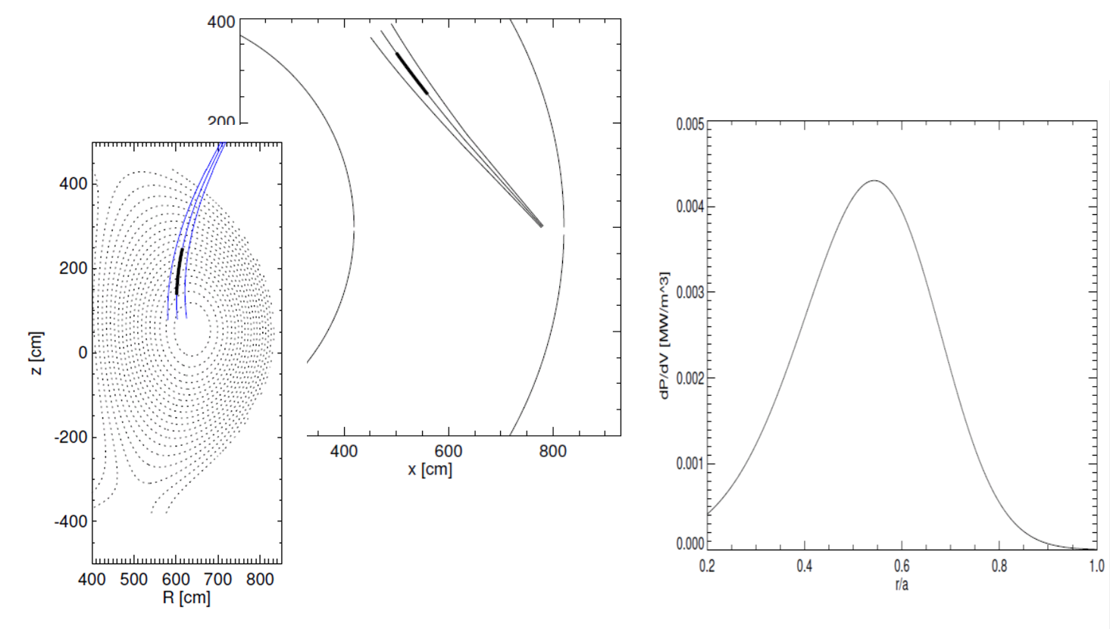
Example: Optimisation of ECCD for DEMO
E. Poli et al.,
subm. to Nucl. Fusion
Higher f_{ECCD} gives higher γ_{CD}, limited by parasitic 2nd harmonic absorption
This can be circumvented by using top launch!

Slide 17
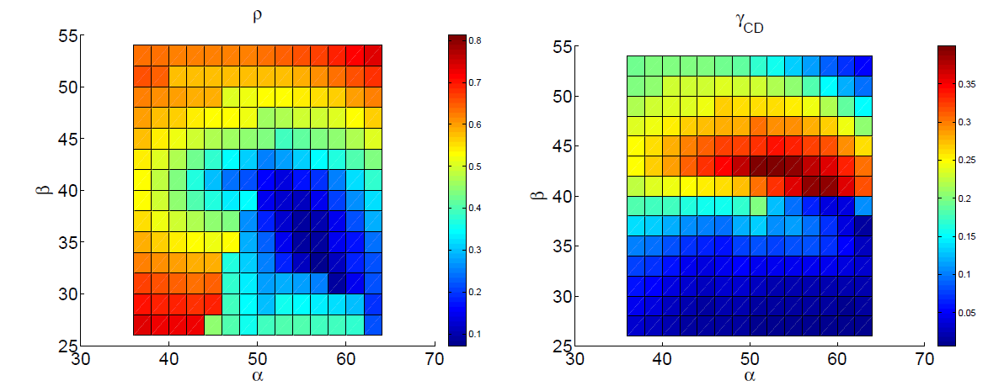
Results for top launch (here, f_{ECCD} = 230 GHz)
Deposition radius
Efficiency γ_{CD}
Toroidal launch angle
Toroidal launch angle
Poloidal launch angle
Poloidal launch angle
Increasing f_{ECCD}, on-axis CD efficiency can go up to γ_{CD} = 0.4 (!)
launch position must be optimised for each desired CD position
then, current drive efficiencies come close to values for NBCD!

Slide 18
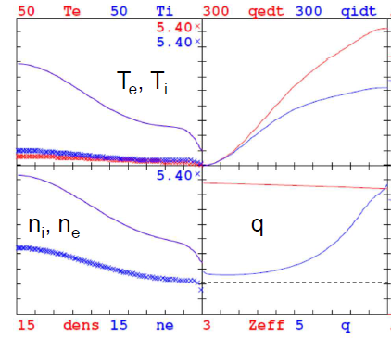
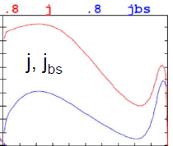
First studies on an ‘improved H-mode’ DEMO
R=8.5 m
a =2.84 m
B=5.75 T
I_{p} = 17.6 MA
q₉₅=4
β_{N} = 3,
P_{fus}=2.2 GW
f_{bs} ~ 0.5
G. Tardini (IPP)
Based on ASDEX Upgrade profile shapes with peaked density
for f_{rec} = 0.4, need to drive 8.8 MA with 150 MW (γ_{CD} = 0.5) at η_{CD} = 0.5
Tough constraint on overall efficiency η_{CD}γ_{CD}, but in reach for NBCD/ECCD!

Slide 19
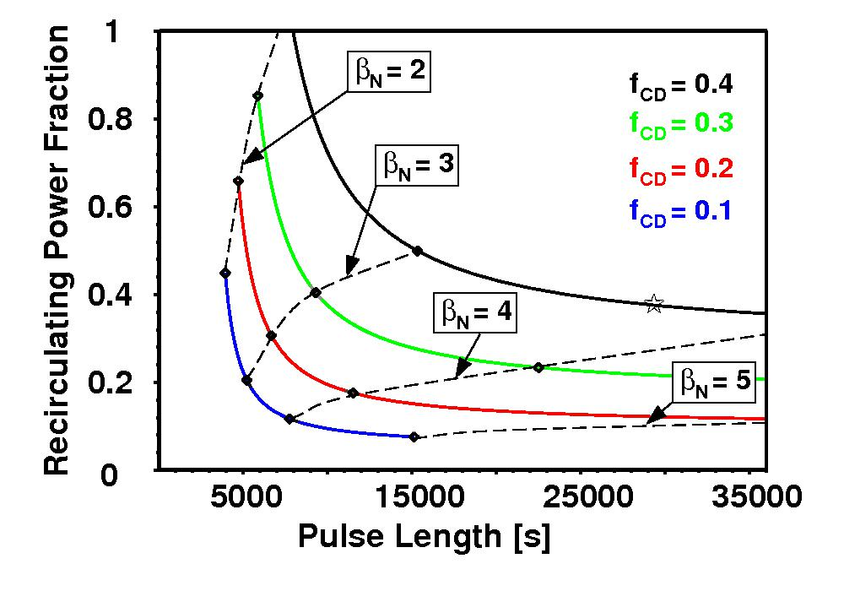
The ‘ITER’ case: R₀=7.5 m, B_{t}=5.2 T, A=3.1
Improved technology and physics (η_{CD}=0.5, γ_{CD}=0.4,H=1.2, β_{N} = 3.5)
* β_{N} = 3.5
τ_{pulse} = 8 hrs
f_{rec} = 37%
P_{el,net} = 500 MW
Long pulses in reach, but achieving steady state challenging stability limits…
pulsed and steady state options to be studied in parallel (different A!)!
high efficiency of H&CD systems becomes crucial!
H. Zohm, Fus. Sci. Technology (2011)

Slide 20
Conclusions
Area | Issues
Equilibrium | Shaping vs. A
MHD stability | Fast particle effects on β_{max,th}, stability of fast particle driven modes
Energy balance | Transport at high β, n/n_{GW} and P_{rad}, T_{e} profile shape
Particle balance | Density profile shapes @ n/n_{GW}, impurity transport
Power exhaust | Detachment physics, λ_{power} in detached divertor, other divertor concepts, ELM mitigation
H&CD physics | Full optimisation NBCD localisation
Dynamical phases | Realistic times for recharge
Disruptions | Timescales
Color code
Sound physics base
Restricted applicability
Major progress needed
Target: agree on DEMO Physics Guidelines across parties

