Slide 1
Understanding ELM mitigation by resonant magnetic perturbations on MAST
Andrew Kirk
on behalf of
I. Chapman, Yueqiang Liu, G. Fishpool, J.R. Harrison, S.Saarelma, R. Scannell, A.J. Thornton
EURATOM / CCFE Fusion Association
A. Allen, P. Denner, B. Dudson
University of York
Yunfeng Liang
EURATOM/FZ Julich
P. Cahyna, M. Paterka
EURATOM/IPP.CR, Prague
E. Nardon
Euratom/CEA Cadarache
CCFE is the fusion research arm of the United Kingdom Atomic Energy Authority

Slide 2
Motivation
Type-I ELMs are predicted to be a factor 20 too large in ITER baseline scenario
One technique that has been shown to reduce the size of ELMs is the application on Resonant Magnetic Perturbations (RMPs)
Need to understand how RMPs control ELMs to make predictions for ITER
MAST is equipped with a flexible coil set – 6 coils in the upper row and 12 coils in the lower row
Can produce a wide variety of configurations
n=3: Even, Odd, 30L, 90L
n=4
n=6
Unique potential to adjust angle of perturbation during the shot

Slide 3
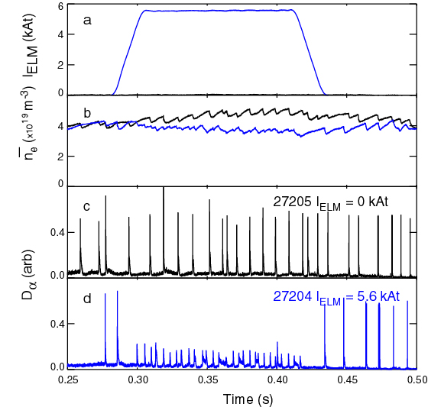
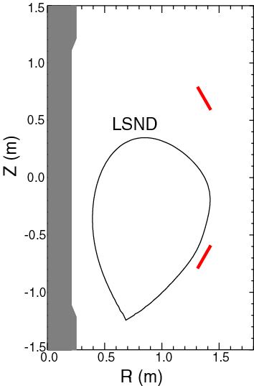
ELM mitigation – LSND
ELM mitigation established on MAST using RMPs with n=4 or 6 in LSND discharges
ELM frequency increased by up to a factor of 5

Slide 4
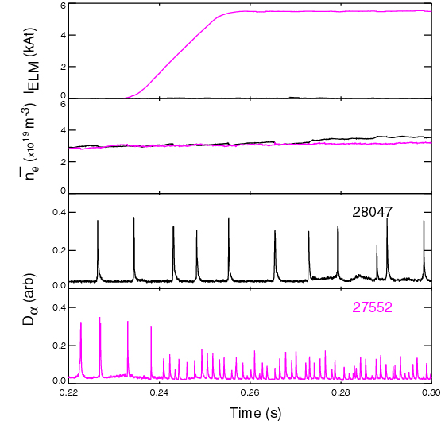
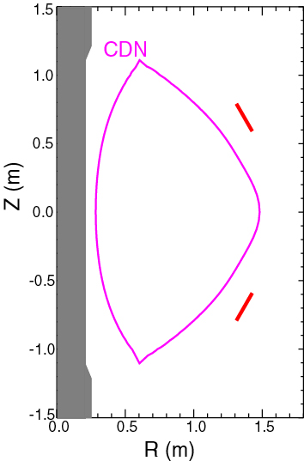
ELM mitigation - CDN
ELM mitigation established on MAST using RMPs with n=3 in CDN discharges
ELM frequency increased by up to a factor of 9

Slide 5
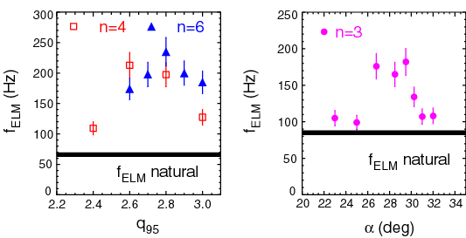
Parameter scans
Scans have been performed over many plasma parameters
RMP strength, density, collisionality, plasma shape, RMP alignment….
q₉₅ scan Pitch angle of perturbation
ELM mitigation established over a wide range of discharges but no ELM suppression

Slide 6
Parameter scans
Scans have been performed over many plasma parameters
RMP strength, density, collisionality, plasma shape. RMP alignment….
q₉₅ scan Pitch angle of perturbation
ELM mitigation established over a wide range of discharges but no ELM suppression
So what parameters determine the onset and level of mitigation?

Slide 7
Modelling the effect of RMPs

Slide 8
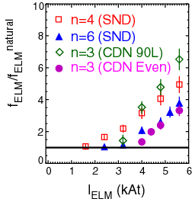
Threshold for onset of ELM mitigation
ELM frequency increases linearly with I_{ELM} above a threshold value that is scenario and ELM coil configuration dependent
Can we find a single parameter from modelling that unites these threshold values?

Slide 9
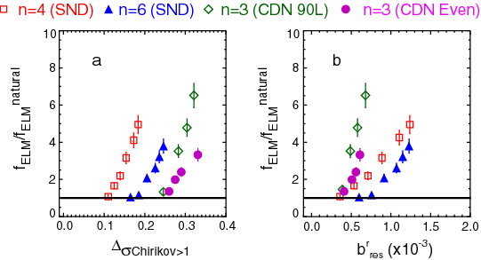
Vacuum modelling
I_{ELM} scan converted to Δ_{σChirikov>1} or b^{r}_{res} using ERGOS
Threshold depends on the plasma scenario and
ELM coil configuration

Slide 10
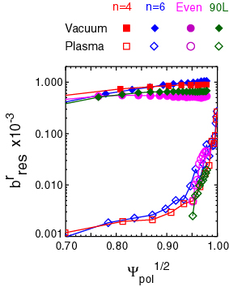
Plasma response modelling
Plasma response modelling using MARS-F
Included plasma effects using MARS-F which is a single fluid linear MHD code, which solves the full resistive MHD equations in full toroidal geometry
– the code allows for plasma response and screening due to toroidal rotation to be taken into account
Large reduction in size of resonance components

Slide 11
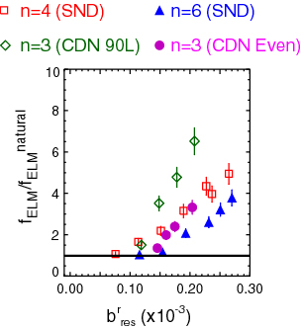
I_{ELM} scan – Plasma response modelling
Plasma response modelling using MARS-F
Large reduction in size of resonance components
Spread reduced but still no clear threshold
ELM mitigation for b^{r}_{res} >0.1x10⁻³

Slide 12
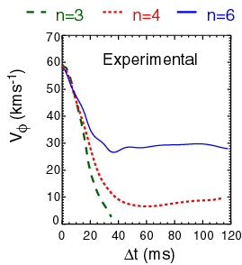
Plasma response modelling
Effect of RMPs on LSND core plasma rotation
After RMPs are applied the core rotation is strongly braked
Braking so severe in n=3 case that back transition to L-mode occurs
n=4 and n=6 saturated non-zero levels are reached
RMP penetration has been modelled with the quasi-linear MARS-Q code, which includes both the JxB and NTV torques

Slide 13
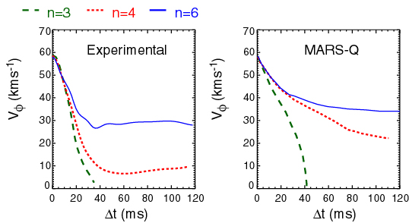
Plasma response modelling
Effect of RMPs on core plasma
Good agreement found in the braking time and the resulting saturated levels

Slide 14
ELM energy loss and
target heat loads

Slide 15
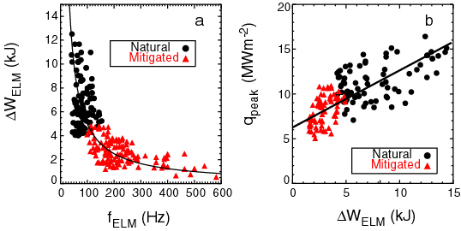
ELM energy losses
ΔW_{ELM}.f_{ELM}~const
W_{MHD} decreases by ~10 %
from ~60 to ~55 kJ

Slide 16
ELM energy losses
ELM mitigation does reduce target heat loads
q_{peak} decreases but more slowly than ΔW_{ELM}
3x decrease in ΔW_{ELM} →1.5 decrease in q_{peak}
ΔW_{ELM}.f_{ELM}~const
W_{MHD} decreases by ~10 %
from ~60 to ~55 kJ

Slide 17
Effect of RMPs on
ELM and
pedestal characteristics

Slide 18
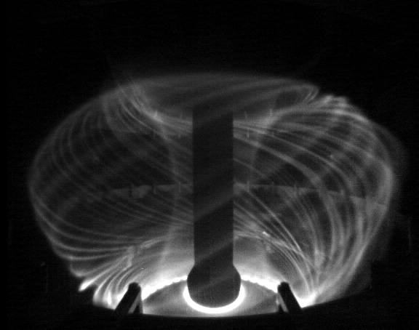
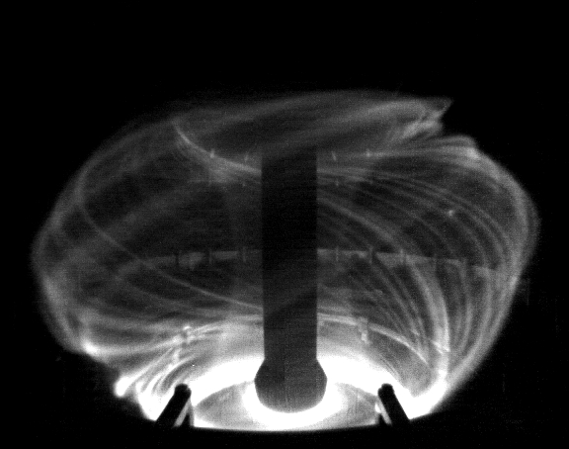
Effect of RMPs on ELM filaments
26580 I_{ELM}= 0 kAt
26579 I_{ELM}= 5.6 kAt
Natural and Mitigated ELMs look very similar

Slide 19
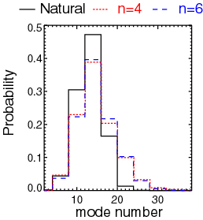
Effect of RMPs on ELM filaments
26580 I_{ELM}= 0 kAt
26579 I_{ELM}= 5.6 kAt
An analysis of the mode number of the filaments suggests that:
- the mitigated ELMs are still type I ELMs
- they are just smaller and more frequent

Slide 20
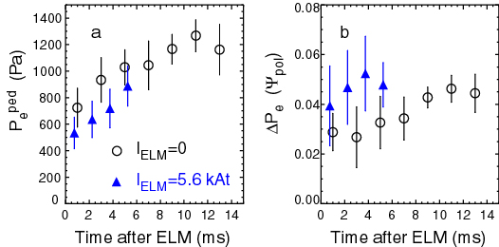
Change in pressure pedestal
Effect of
Pedestal height evolution similar
– just ELM period shorter
But wider pedestal throughout ELM cycle
RMPs cause a drop in the pressure gradient

Slide 21
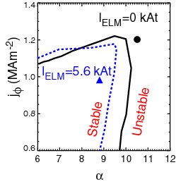
Change in pressure pedestal
Effect of
Stability analysis using the ELITE code
Applying RMPs moves plasma inside the P-B stable region

Slide 22
Change in pressure pedestal
Effect of
Stability analysis using the ELITE code
Applying RMPs moves plasma inside the P-B stable region
So what causes the ELM destabilisation?

Slide 23
Lobes at the X-point

Slide 24
Observation of lobes near the X-point
The data presented are from a He II filtered camera system viewing the lower divertor
~1.8mm spatial resolution in tangency plane and with 500 Hz temporal resolution

Slide 25
Observation of lobes near the X-point
Application of RMPs in n=6
I_{ELM} (kA)
The data presented are from a He II filtered camera system viewing the lower divertor
~1.8mm spatial resolution in tangency plane and with 500 Hz temporal resolution
Lobe structures are observed when
I_{ELM}>I_{THR}

Slide 26
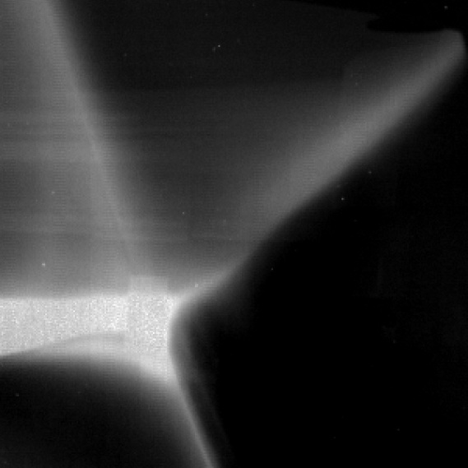
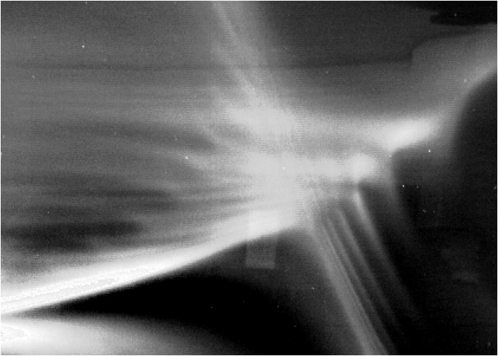
Lobe characteristics
No RMP
X-point structures form due to the
application of RMPs
“Lobes” appear when RMP coil current is above a threshold
Only observed when perturbation is resonant,
i.e. induces pump-out in L-mode or increases ELM frequency in H-mode
Beyond threshold, lobe extent varies linearly with coil current
n=6 RMP

Slide 27
Lobe characteristics
n=4 RMP
X-point structures form due to the
application of RMPs
“Lobes” appear when RMP coil current is above a threshold
Only observed when perturbation is resonant,
i.e. induces pump-out in L-mode or increases ELM frequency in H-mode
Beyond threshold, lobe extent varies linearly with coil current
Number and location of lobes vary with RMP configuration
Shot 27813, 238ms
n=6 RMP

Slide 28
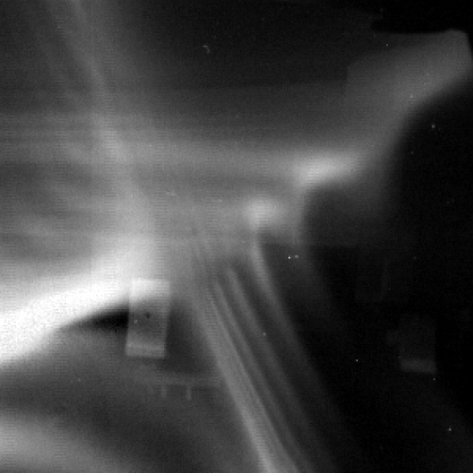
Comparison with modelling
Camera Image
Lobe location and extent calculated by following magnetic field lines within 3D fields with ERGOS
Lobes are 3D structures, varying with toroidal location
Shot 27813, 320ms
n=6, I_{ELM}=5.6kAt

Slide 29
Comparison with modelling
Camera Image
Lobe location and extent calculated by following magnetic field lines within 3D fields with ERGOS
Lobes are 3D structures, varying with toroidal location
Mapping onto image shows good agreement with the number and location of the lobes but they appear too large
Shot 27813, 320ms
n=6, I_{ELM}=5.6kAt

Slide 30
Comparison with modelling
Camera Image
Lobe location and extent calculated by following magnetic field lines within 3D fields with ERGOS
Lobes are 3D structures, varying with toroidal location
Mapping onto image shows good agreement with the number and location of the lobes but they appear too large
Shot 27813, 320ms
n=6, I_{ELM}=5.6kAt
When comparing calculated lobe structure and experimental data, need to account for:
The distribution of light emission in the plasma
Plasma screening of the applied fields
Parallel and perpendicular transport

Slide 31
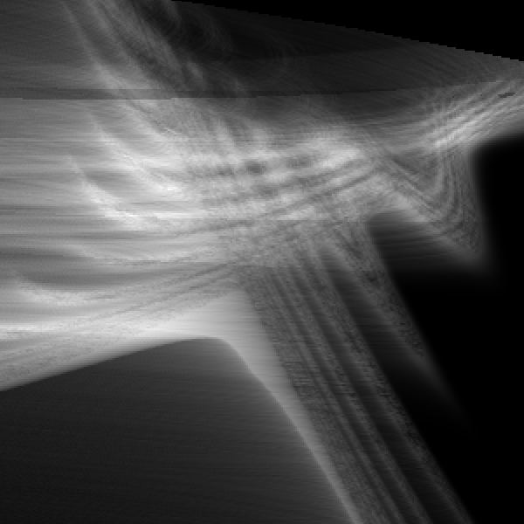
Image simulations
Camera Image
Camera images have been simulated using ray tracing of camera lines of sight through plasma emission
Light distribution (ψ_{n}) determined from comparison with data before RMPs applied
⇒ Lobes appear too large
Shot 27813, 320ms
n=6, I_{ELM}=5.6kAt
Modelled Image (n=6, I_{ELM} = 5.6kAt)

Slide 32
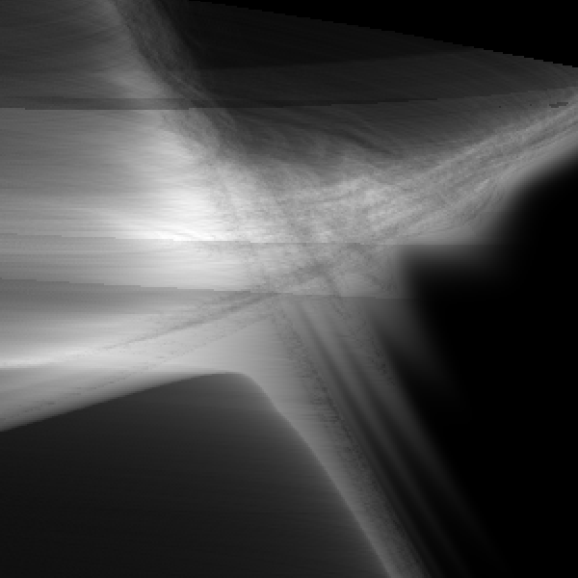
Image simulations
Camera Image
Camera images have been simulated using ray tracing of camera lines of sight through plasma emission
Light distribution (ψ_{n}) determined from comparison with data before RMPs applied
Including plasma screening assuming ideal plasma response out to Ψ_{N}~0.97-0.98
⇒ Good description of lobe length and width
Suggesting that the fields penetrate 2-3% inside the plasma
Shot 27813, 320ms
n=6, I_{ELM}=5.6kAt
Modelled Image (including screening)

Slide 33
Possible implication on stability

Slide 34
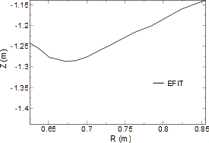
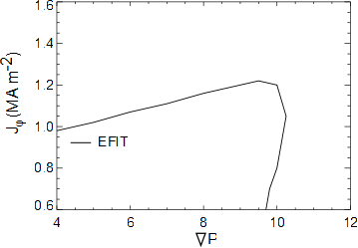
Possible effect on ELM stability
In H-mode, edge pedestal evolves between ELMs
Pressure increases until it reaches peeling-ballooning stability boundary
Triggers ELMs
P-B Stability boundary
Cartoons

Slide 35
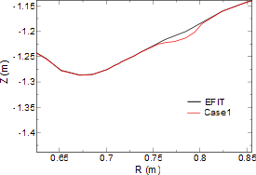
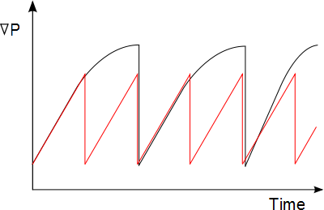
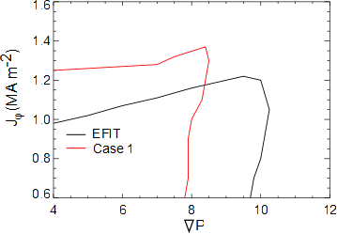
Possible effect on ELM stability
In H-mode, edge pedestal evolves between ELMs
Pressure increases until it reaches peeling-ballooning stability boundary
Triggers ELMs
Lobes or 3D effects decrease the P-B boundary
P-B Stability boundary
Cartoons
Triggering ELM earlier in the ELM cycle

Slide 36
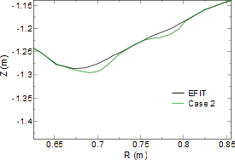
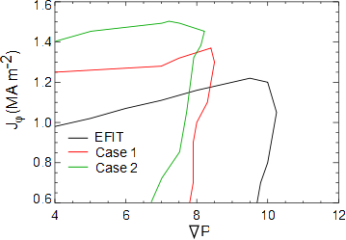
Possible effect on ELM stability
In H-mode, edge pedestal evolves between ELMs
Pressure increases until it reaches peeling-ballooning stability boundary
Triggers ELMs
Lobes or 3D effects decrease the P-B boundary
P-B Stability boundary
Cartoons
Triggering ELM earlier in the ELM cycle

Slide 37
Summary
ELM mitigation has been obtained in MAST LSND and CDN plasmas using RMPs with toroidal mode numbers n=3, 4 and 6
Scans of various parameters have shown that f_{ELM} can be increased by up to a factor of 9 but ELM suppression has not been obtained
In the ELM mitigated phases the edge pressure gradient is reduced
Associated with this mitigation Lobe structures have been observed near the X-point, and the length of these lobes is correlated with the increase in ELM frequency
These lobes or other 3D effects are not currently included in peeling-ballooning stability calculations – their inclusions may help explain how ELM mitigation occurs

Slide 38
Backup slides

Slide 39
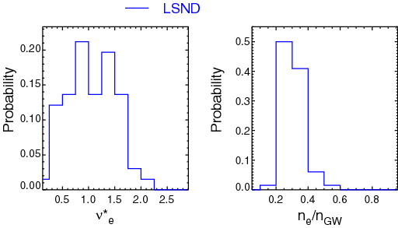
Operational range explored
ELM mitigation established but no ELM suppression
Collisionality range “misses” the DIII-D suppression windows
ν*_{e} < 0.3 or ν*_{e}>2
Marginal overlap with AUG type I ELM suppression window
n_{e}/n_{GW}>0.53

Slide 40
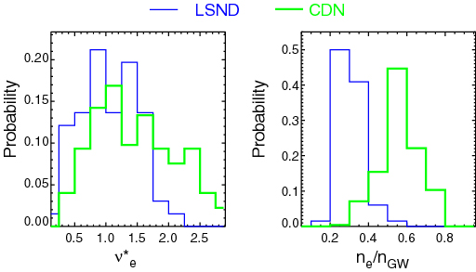
Operational range explored
ELM mitigation established but no ELM suppression
CDN plasmas are in the DIII-D (ν*_{e}>2) and AUG (n_{e}/n_{GW}>0.53)
suppression windows
BUT neither device has reported a window to get ELM suppression in CDN

Slide 41
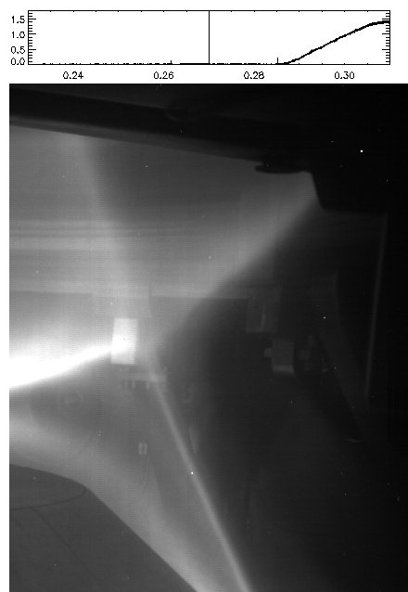
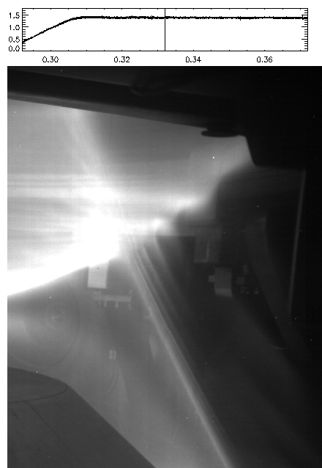
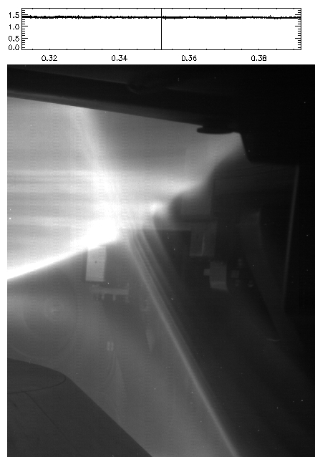
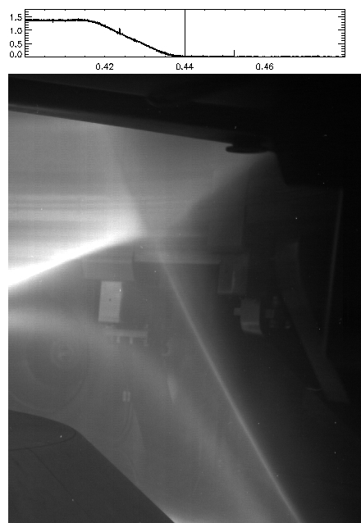
Observation of lobes near the X-point
X-point observed with a filtered camera
~1.8mm spatial resolution in tangency plane
500 Hz temporal resolution
Only observed when I_{ELM}>I_{THR}

Slide 42
Lobe characteristics
n=4
X-point structures form due to the
application of RMPs
“Lobes” appear when RMP coil current is above a threshold
Only observed when perturbation is resonant,
i.e. induces pump-out in L-mode or increases ELM frequency in H-mode
Beyond threshold, lobe extent varies linearly with coil current
Number and location of lobes vary with RMP configuration
Shot 27847, 307ms
Shot 27813, 238ms
n=6
Shot 28002, 327ms

