Slide 1

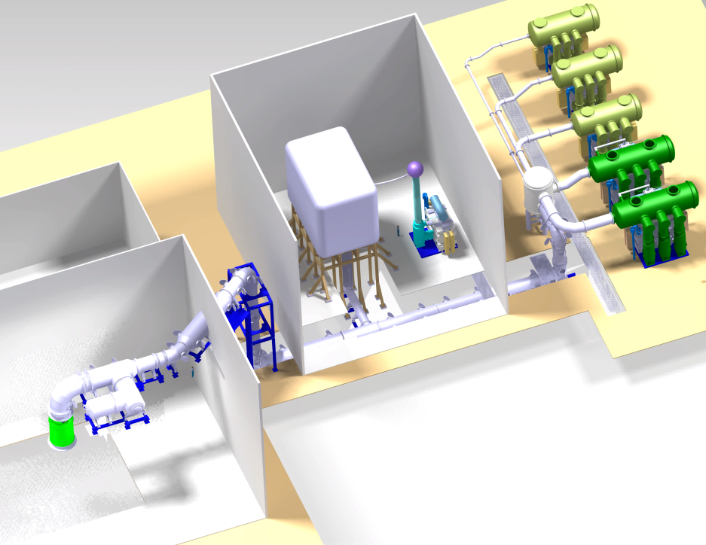
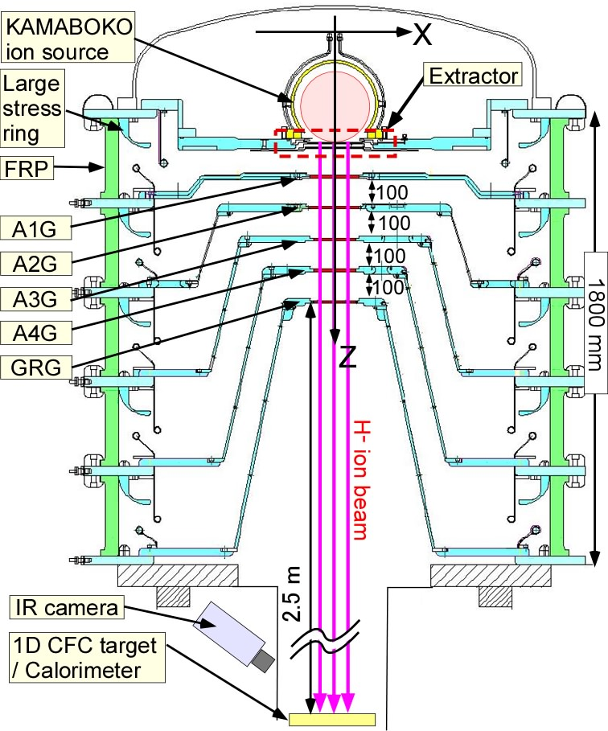
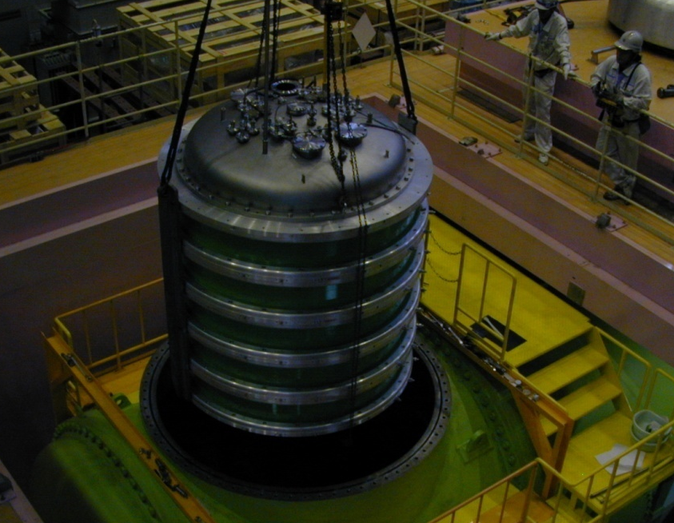
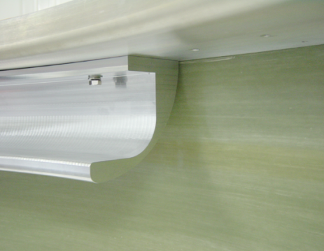
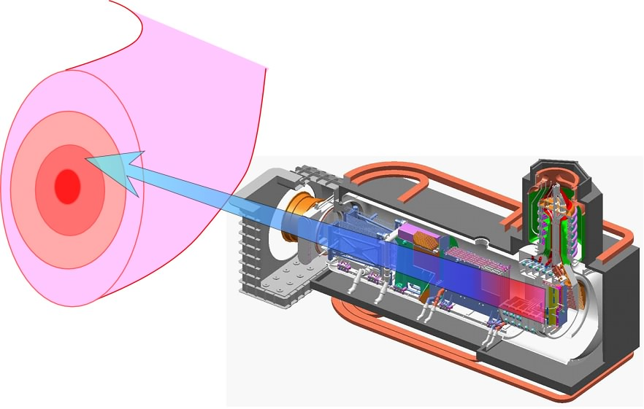
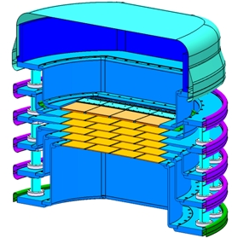
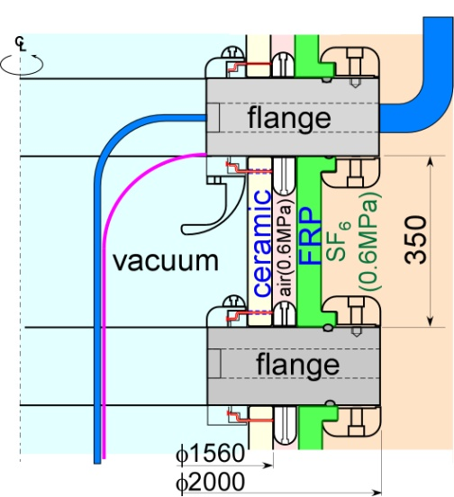

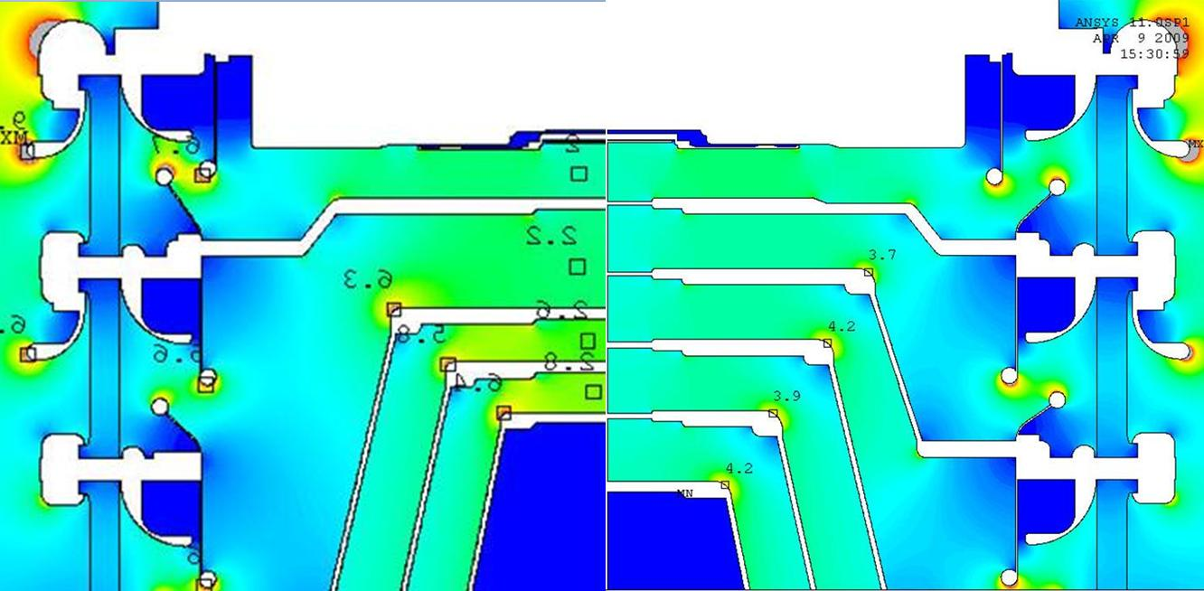
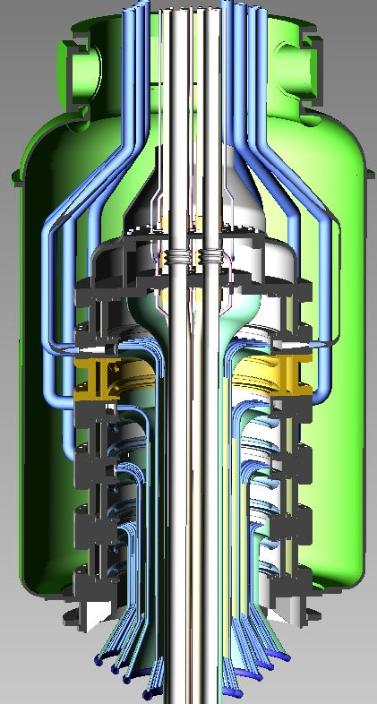
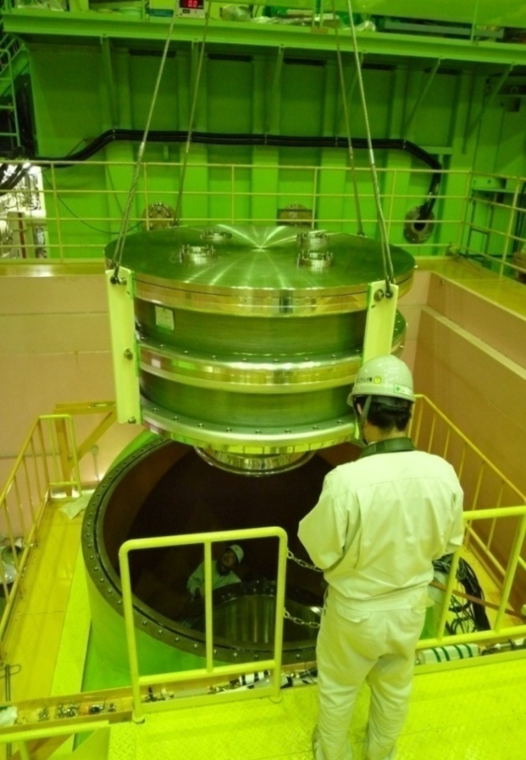
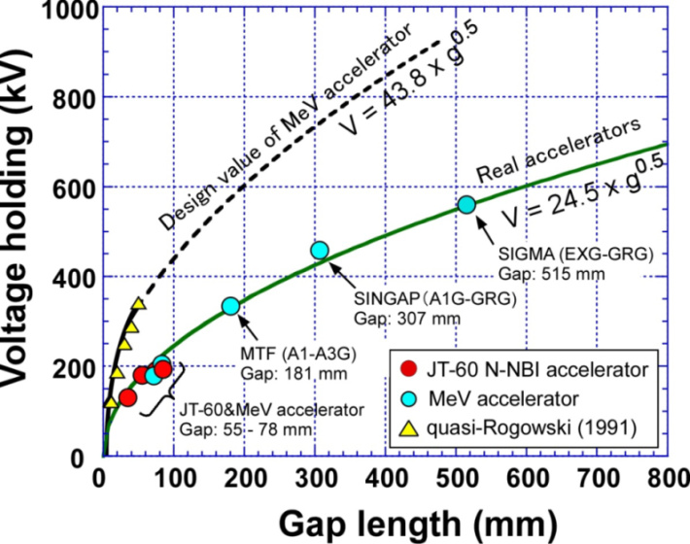
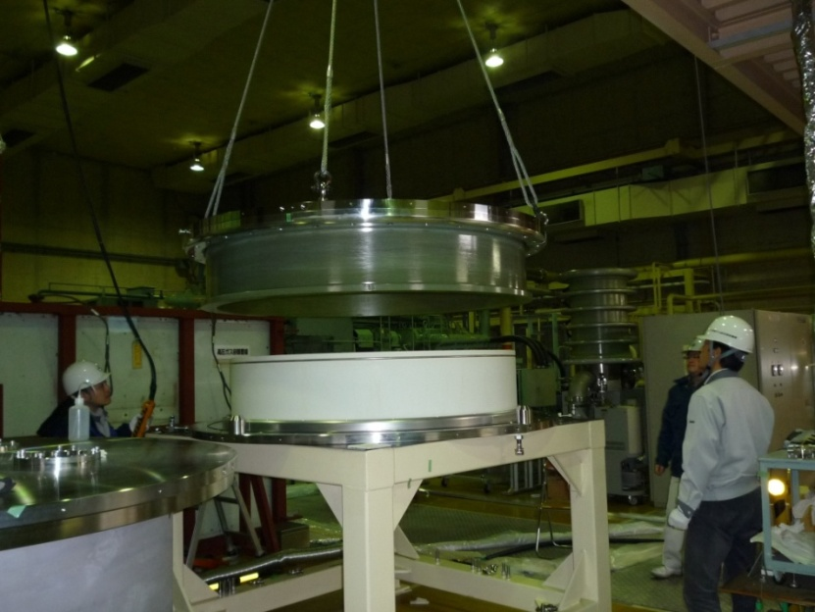
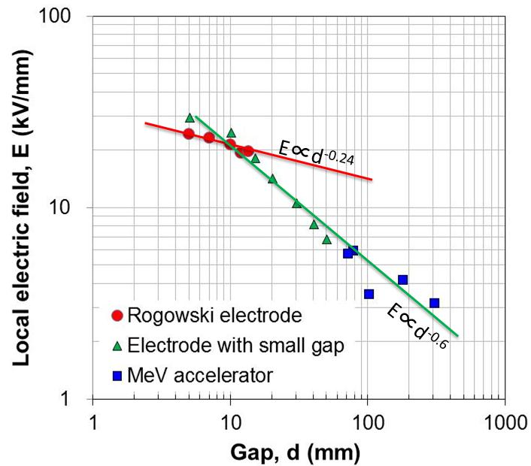
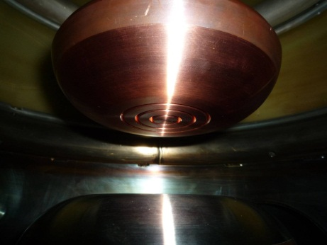
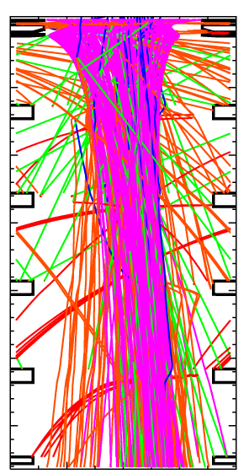
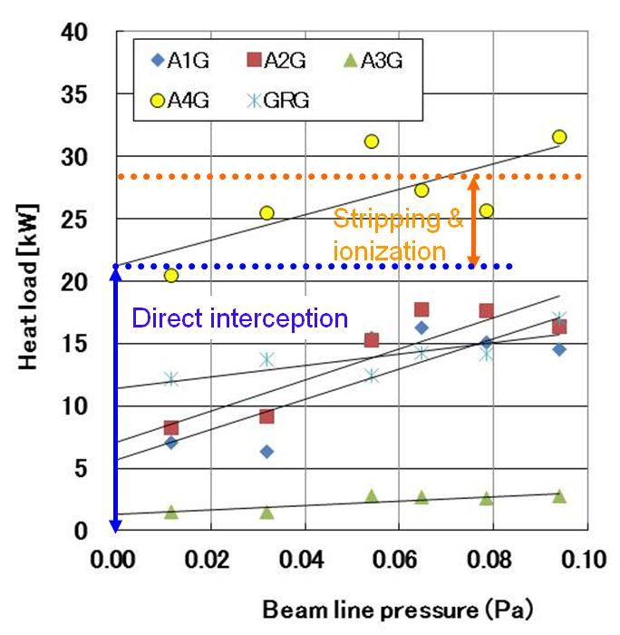
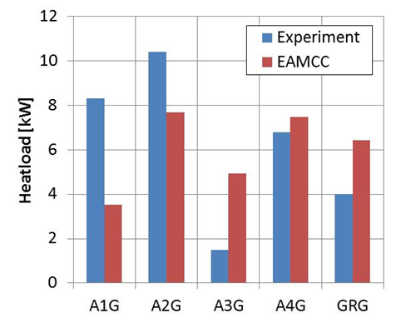
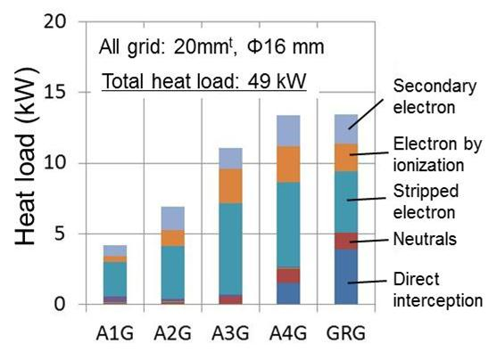
Acceleration of 1 MeV H⁻ ion beams at ITER NB relevant high current density
Takashi INOUE, M. Taniguchi, M. Kashiwagi, N. Umeda, H. Tobari, M. Dairaku,
J. Takemoto, K. Tsuchida, K. Watanabe, T. Yamanaka, A. Kojima, M. Hanada and K. Sakamoto
Japan Atomic Energy Agency (JAEA)
FTP/1-2
24 th IAEA Fusion Energy Conference
San Diego, CA, USA, October 8-12, 2012
NBTF / ITER NB procurement by JA
MeV accelerator for ITER R&D
HV bushing
Feedthrough for bus bars and water pipes
Bulkhead for SF₆ and vacuum.
Double layers:
  f1.56 m ceramic rings
  Large FRP rings
1 MV insulating trans.
DC generators
The MeV accelerator have been developed at JAEA since 1994.
Vacuum insulation, instead of SF₆ gas, for 1 MV high voltage to avoid RIC.
-200kV
HVD2
-400kV
-600kV
MeV accelerator
HVD1
(EU)
-800kV
-1MV
  Five rings in series for 1 MV insulation.
Transmission line
Metal flange
ITER NB Injector
16.5 MW D⁰
at 1 MeV for 1 hour
90m
Large
stress ring
Triple junction
(cathode)
1 MV dc power supply
FRP insulator ring
MAMuG accelerator
Large electrostatic accelerator
Multiaperture
Multigrid
1 MeV, 40 A D⁻ ion beams at 200A/m²
The stress rings suppress surface flashover on FRP.
Issues tackled in 2010 - 2012
Improvement of voltage holding by mitigation of local electric field,
Compensation of beamlet deflection by a 3D trajectory analysis,
Gird heat load reduction by secondary particle suppression.
Procurement arrangement for NBTF signed in Feb. 2012.
Mockup test of HV bushing
① Voltage holding improvement
      Single stage test
      （rated voltage:
      200 kV）
Two stage test
(rated voltage: 400 kV)
with electrostatic screens inside
Insulation of high voltage (160-200 kV) in long vacuum gap (50-100 mm)
From
1 MV PS
(a) Before (b) After
Accelerators show lower voltage holding than equal field.
SF₆ gas
6.3
3.7
5.8
4.2
-1 MV
φ1.56 m
6.4
2.8
4.2
3.9
FRP (outer layer)
Ceramic ring
(inner layer)
Vacuum
~2.5 m
Discharge marks at the opposite sides of edges/steps, where local stress was higher than 3-4 kV/mm.
The gaps were expanded to mitigate the local field.
0 V
Rogowski electrodes
To ion source,
accelerator
Cathode
Breakdowns triggered by local stress
in wide vacuum gaps.
Vacuum insulation improved by lowering local stress, 1 MV for 4,000 s at 2 x 10⁻⁴ Pa.
Beam parameters increased:
879 keV, 157 A/m²
from previous: 796 keV, 140 A/m²
Gap: 0~50 mm
      Vacuum insulation test at HV
      -240 kV （120% of rated voltage) for 2 hours.
      Long period stability test (-220 kV, 5 hours) demonstrated without breakdown.
Anode
HV test interrupted by the 3.11.
Small grooves simulating
high local field in gaps
③ Reduction of secondary particles
Experimental and EAMCC results
  EAMCC analyzes behavior of secondary particle in accelerators.
Measured heat load
by water calorimetry
Comparison of heat loads
(EAMCC: Electrostatic Accelerator Monte-Carlo Code)
Aperture dia. Φ14
An example of EAMCC analysis for MeV accelerator
Stripped electrons generated in and around extractor
PG
EXG
MeV accelerator in 2007 geometry
Stripped electrons deflected by EXG magnet
A1G
Secondary electron emission by collision of H⁰ on grid side wall
A2G
A3G
Direct interception of H⁻ ions
A4G
GRG
H⁻
H⁰
Comparison of heat load by stripping & ionization between EAMCC and experiment. (32 kW by EAMCC and 31 kW by experiment)
Tendency of heat loads in each grids are well represented in EAMCC, such as heat loads high in A2G and low in A3G.
Heat load on A1G is twice higher in exp., suggesting contribution of stray electron/ H⁻ ion or backstreaming, which are not taken into account properly in EAMCC.
  Grid heat loads are mainly caused by:
  1) Stripped electron from extraction gap,
  2) Secondary electrons generated from grid side wall,
  3) Direct interception of H⁻ ions at grid aperture
e⁻
H⁺

Slide 2
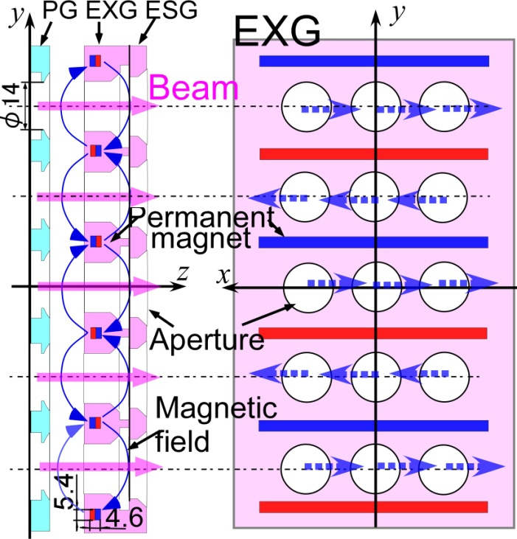
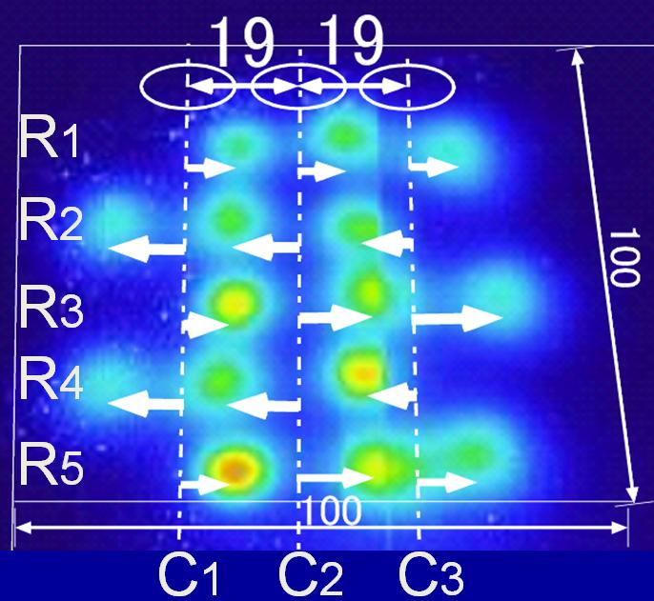
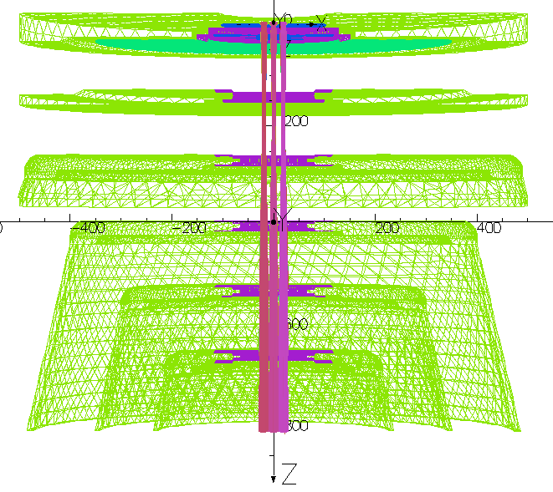
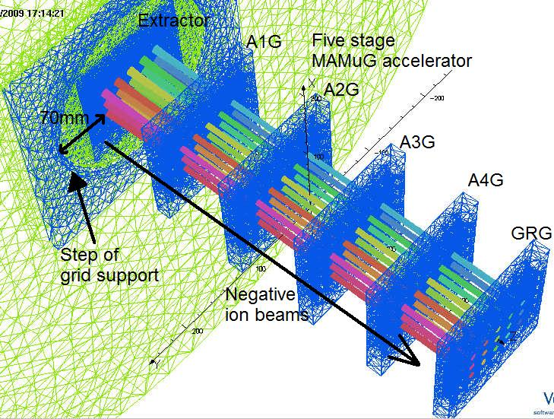
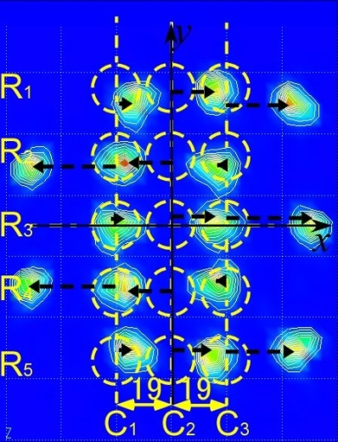
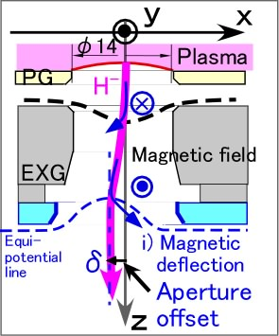
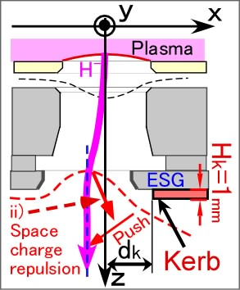
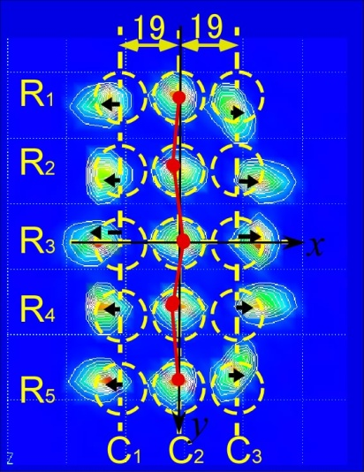
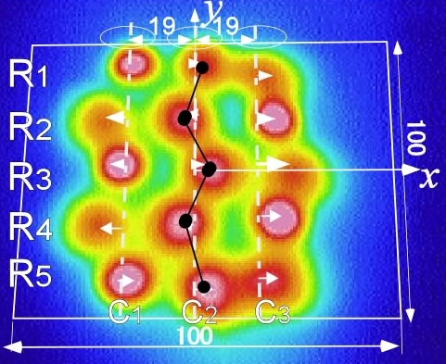
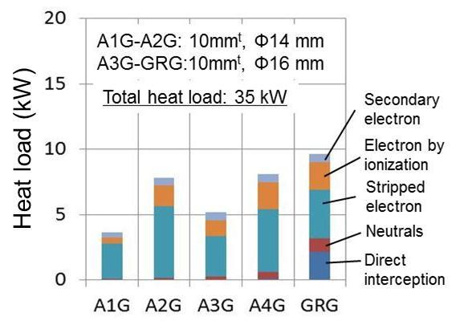
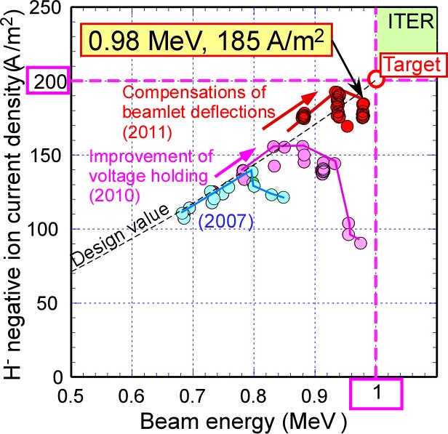
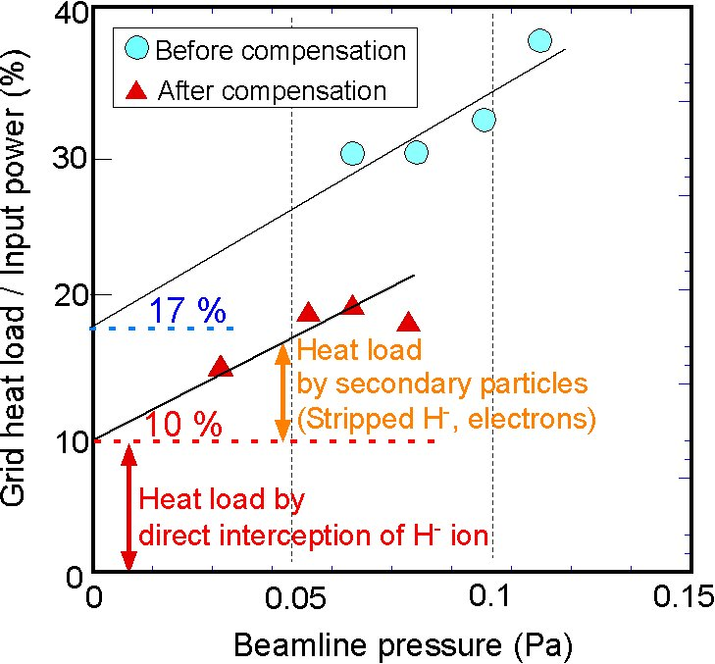
Conclusions
Voltage holding improvement, and compensation of beam deflections have been applied to the MeV accelerator.
Reduction of beam direct interception at grids has brought improvement in voltage holding during beam acceleration at around 1 MV.
0.98 MeV, 185 A/m² H⁻ ion beam acceleration achieved.
This almost satisfies the ITER NB requirements (1 MeV, 200 A/m² D⁻).
EAMCC analysis has started and followings has examined:
  Smaller aperture (f14 mm) in upstream grids (A1G and A2G) to stop electrons before acceleration to high energy,
  Thinner grid to suppress secondary electron generation.
An extrapolation of EAMCC analysis shows that highest grid heat load is to be decreased to 0.84 MW in ITER, which meets the design criteria since ITER EDA (1 MW).
The long pulse test of the MeV accelerator will be restarted in 2013 after recovery of the MeV test facility from damages of the 3.11.
② Beamlet deflections
3D beam trajectory analysis
Extractor
Measured beam footprint at 500 keV
Extractor
●
❍
Magnetic filter and electron suppression magnets
Current reduction by stripping loss
Aperture offset at ESG: 0.8 mm
Kerb at ESG backside：1 mm^{t}
Grid support structure
A1G
A2G
■
A3G
A4G
H⁻ beam
GRG
Deflection direction of the beamlets due to magnetic field.
Peripheral beamlets
were much deflected.
Beam footprint
before compensation

The beamlets in each row are deflected in the alternative directions line by line due to the magnetic field in the extractor.
The peripheral beamlets are deflected outward more due to superposition of i) and ii) space charge repulsion.

4.7
mrad
Compensation techniques; Aperture offset and kerb
9.5
mrad
OPERA-3D code (Vector Fields software)
Aperture offset
against magnetic deflection
Kerb against space charge repulsion
After compensations
At 0.98 MeV
Application
to the experiment
For compensation of the beamlet deflection of 1 MeV beam;
  Aperture offset δ = 0.8 mm
  Kerb with 1 mm in thickness at d_{k} = 16 mm.
The beamlet deflections were compensated in the beam acceleration test as the 3D multi beam analysis.
The compensation techniques were successfully demonstrated using 1 MeV beams.
Suppression of secondary electrons
Achievement of 0.98 MeV H⁻ ion beam
Modification of grid structure:
MeV accelerator in 2010 geometry
Geometry | 2007 | 2010
Thickness | 20 mm | 10 mm
Aperture dia. | φ16 mm | A1-A2G: φ14 A3G-GRG: φ16
Grid heatload load
EAMCC shows reduction in total heat load from 49 kW to 35 kW by reducing thickness and aperture diameter.
  By reduced grid thickness,
    heat loads by secondary electrons decreased in all grids,
    direct interception of H⁻ ions decreased in A4G, GRG.
  By reduced aperture dia. stripped electrons were intercepted in A1G and A2G, and subsequently heat loads on A3G- GRG were decreased.
Compensation of beam deflection resulted in reduction of grid heat load (17% → 10%).
Improvement in voltage holding during beam acceleration,
Consequently the achievement of 0.98 MeV 185 A/m² H⁻ ion beam.
  Maximum heat load is expected to be 9.8 kW on GRG. Extrapolating 9.8 kW on 15 apertures in MeV accelerator to ITER (1280 apertures), total heat load is expected to be 0.84 MW. This is below design target of 1 MW.

