Slide 1
ELM Control in Application of
Non-Axisymmetric Magnetic Perturbations
in KSTAR
Y.M. Jeon¹
J.-K. Park², S.W. Yoon¹, K.D. Lee¹, J.G. Bak¹, G.S. Yun³, Y.U. Nam¹, W.H. Ko¹, S.G. Lee¹,
W.C. Kim¹, Y.K. Oh¹, J.G. Kwak¹, K.S. Lee¹, H.K. Kim¹, H.L. Yang¹, and KSTAR team¹
¹National Fusion Research Institute (NFRI), Korea
²Princeton Plasma Physics Laboratory (PPPL), USA
³Pohang University of Science and TECHnology (POSTECH), Korea
2012.10.10
2012 IAEA-FEC, San Diego, USA

Slide 2
ELM control is critical to ITER
Significant reduction of ELM energy density required (>1/10)
- Expected / Limit ~ 7.0MJ/m² / 0.5MJ/m² ~ 14

Slide 3
ELM control is critical to ITER
Significant reduction of ELM energy density required (>1/10)
- Expected / Limit ~ 7.0MJ/m² / 0.5MJ/m² ~ 14
Various approaches under investigation in KSTAR
ELM pace-making: pellet injection(plan), vertical jogging
edge perturbation by SMBI
3D magnetic field perturbation: RMP
small or no ELM regimes: type II, grassy, QH-mode, I-mode etc

Slide 4
ELM control is critical to ITER
Significant reduction of ELM energy density required (>1/10)
- Expected / Limit ~ 7.0MJ/m² / 0.5MJ/m² ~ 14
Various approaches under investigation in KSTAR
ELM pace-making: pellet injection(plan), vertical jogging
edge perturbation by SMBI
3D magnetic field perturbation: RMP
small or no ELM regimes: type II, grassy, QH-mode, I-mode etc
3D magnetic field (RMP) has been actively investigated from KSTAR 2011 as the most plausible technique

Slide 5
ELMs Suppressed by n=1 RMP in KSTAR 2011
COMPASS-D (n=1) triggered
JET (n=1) mitigated
NSTX (n=3) triggered
MAST (n=3) mitigated
ASDEX-U (n=2) mitigated
(n=1) mitigated
DIII-D (n=3) suppressed
(n=2) suppressed

Slide 6
ELMs Suppressed by n=1 RMP in KSTAR 2011
COMPASS-D (n=1) triggered
JET (n=1) mitigated
NSTX (n=3) triggered
MAST (n=3) mitigated
ASDEX-U (n=2) mitigated
(n=1) mitigated
DIII-D (n=3) suppressed
(n=2) suppressed
We added one more in 2011 …
KSTAR (n=1) Suppressed
* Y.M. Jeon, J.-K. Park, et al., PRL 109, 035004 (2012)

Slide 7
Outline
1. Unique features of KSTAR RMP 3D field
2. Characteristics of ELM-suppressed RMP discharge
3. Altered Te pedestal dynamics
4. Broadband change of magnetic fluctuation
5. Summary

Slide 8
Outline
1. Unique features of KSTAR RMP 3D field
2. Characteristics of ELM-suppressed RMP discharge
3. Altered Te pedestal dynamics
4. Broadband change of magnetic fluctuation
5. Summary

Slide 9
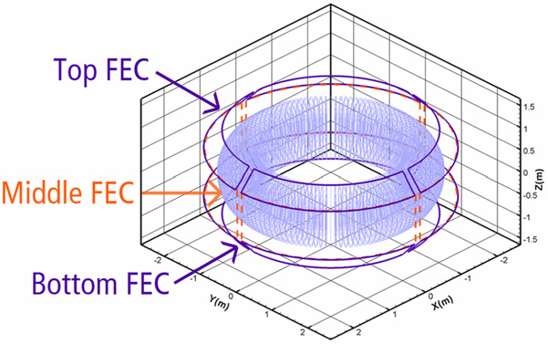
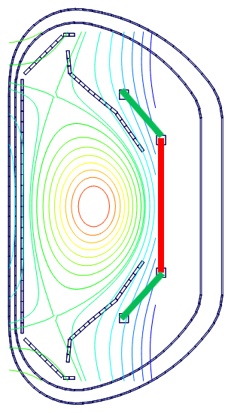
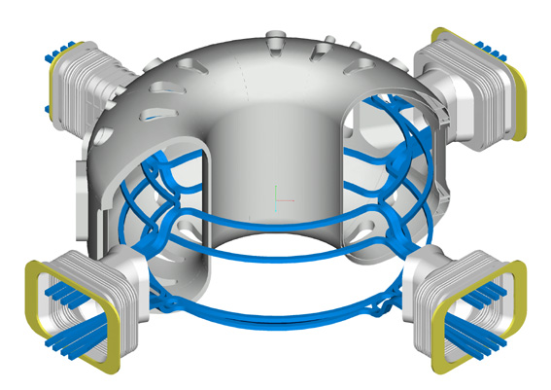
Three Rows of RMP/FEC Coils Can Provide Various Poloidal Magnetic Spectra
All internal coils : effectively coupled to plasma
n=1 or n=2 MP applicable
+B_{R}
n=1
-B_{R}
Top-FEC
Mid-FEC
n=2
Bot-FEC

Slide 10
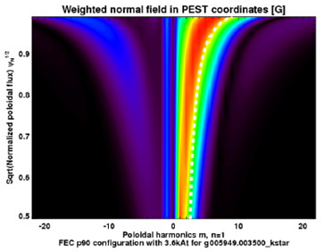
Either purely resonant or non-resonant perturbations are applicable with n=1 MPs
n=1, +90 Phase (RMP)
B_{plasma}
θ
+
+
-
-
top
-
+
+
-
mid
-
-
+
+
bot
φ
I_{P} / B_{T}
→ Purely resonant

Slide 11
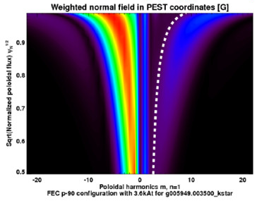
Either purely resonant or non-resonant perturbations are applicable with n=1 MPs
n=1, +90 Phase (RMP)
B_{plasma}
θ
+
+
-
-
top
-
+
+
-
mid
-
-
+
+
bot
φ
I_{P} / B_{T}
→ Purely resonant
n=1, -90 Phase
B_{plasma}
-
-
+
+
top
-
+
+
-
mid
+
+
-
-
bot
→ Purely non-resonant

Slide 12
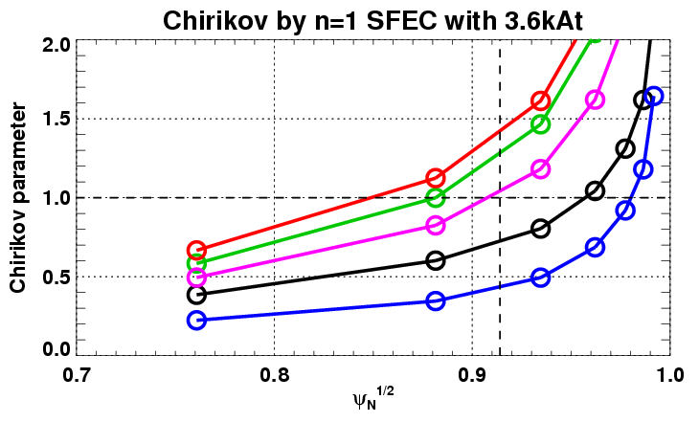
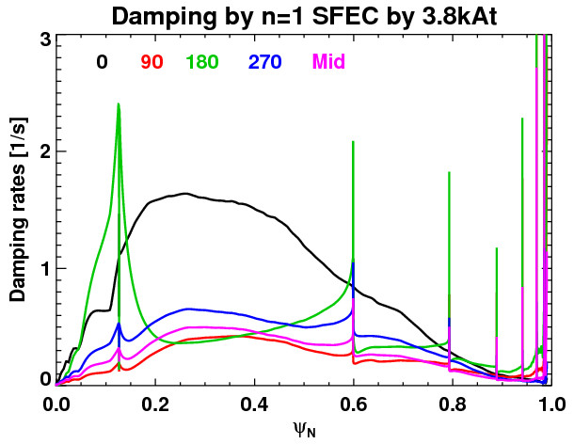
Either purely resonant or non-resonant perturbations are applicable with n=1 MPs
n=1, +90 Phase (RMP)
B_{plasma}
Chirikov Parameter
θ
+
+
-
-
top
0 +90
180 -90
mid-alone
-
+
+
-
mid
-
-
+
+
bot
φ
I_{P} / B_{T}
→ Purely resonant
(I_{RMP}=3.6kAt)
ψ_{N}^{1/2}
n=1, -90 Phase
B_{plasma}
NTV Torque Damping (1/s)
-
-
+
+
top
0 +90 180 -90 mid-alone
-
+
+
-
mid
+
+
-
-
bot
→ Purely non-resonant
ψ_{N}^{1/2}
I_{RMP}=3.6kAt

Slide 13
Either purely resonant or non-resonant perturbations are applicable with n=1 MPs
n=1, +90 Phase (RMP)
B_{plasma}
Chirikov Parameter
θ
+
+
-
-
top
0 +90
180 -90
mid-alone
-
+
+
-
mid
-
-
+
+
bot
φ
I_{P} / B_{T}
→ Purely resonant
(I_{RMP}=3.6kAt)
ψ_{N}^{1/2}
n=1, -90 Phase
B_{plasma}
NTV Torque Damping (1/s)
-
-
+
+
top
0 +90 180 -90 mid-alone
-
+
+
-
mid
+
+
-
-
bot
→ Purely non-resonant
ψ_{N}^{1/2}
I_{RMP}=3.6kAt
“n=1 RMP” ≡ “n=1, +90 phase”
(largest stochasticity + lowest NTV damping)

Slide 14
Outline
1. Unique features of KSTAR RMP 3D field
2. Characteristics of ELM-suppressed RMP discharge
3. Altered Te pedestal dynamics
4. Broadband change of magnetic fluctuation
5. Summary

Slide 15
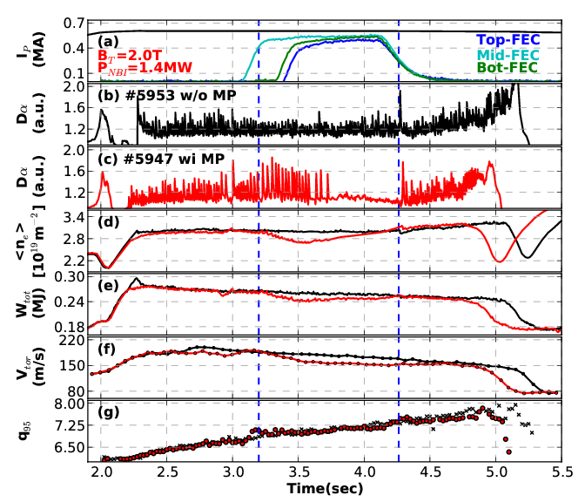
ELMs Suppressed For the First Time by n=1 RMP
q₉₅ =6~8 (I_{p}=0.6MA and B_{T}=2T)
ν*_{e,ped} =0.5~1.0
near DN shape: 1.9<κ<2.0, 0.6<δ<0.8
Two-phase ELM response
ELMs suppressed after initial intensification
Gradual increase of density when ELMs suppressed
Small degradations (<10%)
Less sensitive q₉₅ window (Δq₉₅>0.5)
I_{RMP} ≥ 1.50 kA/t for full suppression

Slide 16
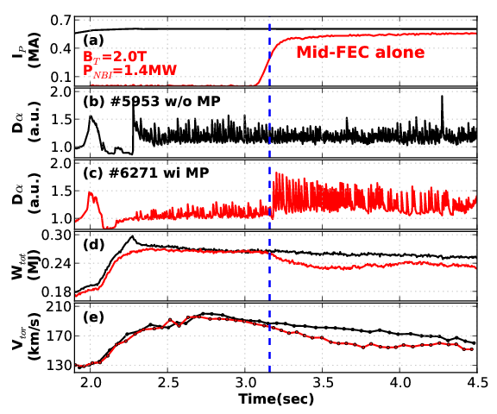
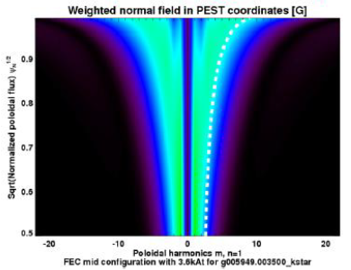
ELMs can be intensified by mid-FEC alone
ELMs were entirely intensified by applying mid-FEC coil alone
It is another ELM response to applied MP.
Two-phase ELM response is due to un-synchronized RMP fields

Slide 17
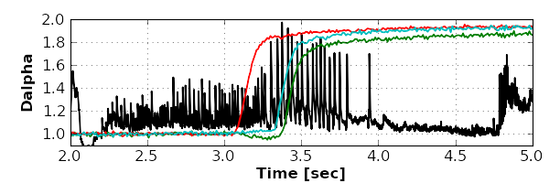
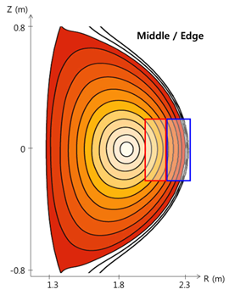
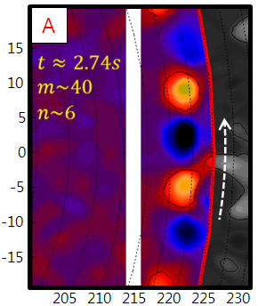
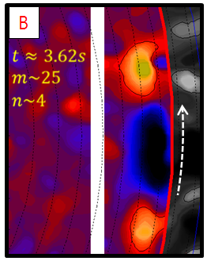
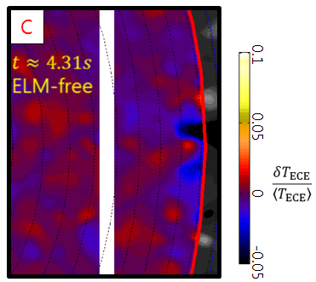
Edge dynamics substantially changed under n=1 RMP
#6123
I_{FEC}=1.9kA/t
A
B
C
Z [cm]
~1 km/s
~10 km/s
R[cm]
* G.S. Yun, et al., PoP 19, 056114 (2012)

Slide 18
Outline
1. Unique features of KSTAR RMP 3D field
2. Characteristics of ELM-suppressed RMP discharge
3. Altered Te pedestal dynamics
4. Broadband change of magnetic fluctuation
5. Summary

Slide 19
Edge Te evolution was altered due to RMP
ELMs suppressed
#5947
What caused the ELM suppression ?

Slide 20
Edge Te evolution was altered due to RMP
ELMs suppressed
#5947
Edge T_{e}

Slide 21
Edge Te evolution was altered due to RMP
ELMs suppressed
#5947
Edge T_{e}

Slide 22
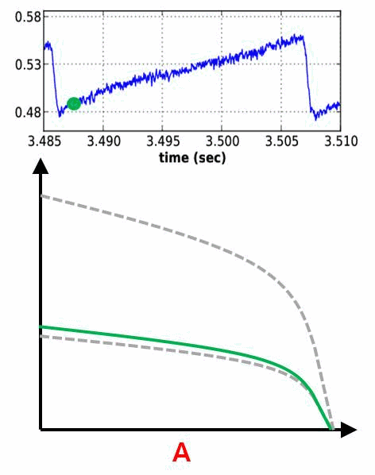
Edge Te evolution was altered due to RMP
ELMs suppressed
#5947
Edge T_{e}
A
A: linear build-up

Slide 23
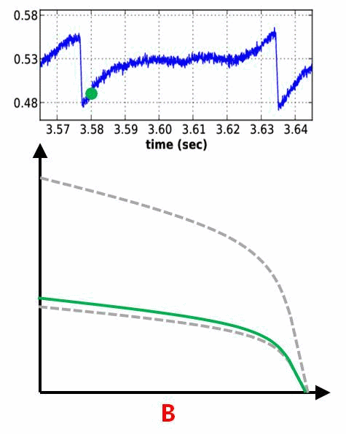
Edge Te evolution was altered due to RMP
ELMs suppressed
#5947
Edge T_{e}
A
B
A: linear build-up
B: saturated by RMP

Slide 24
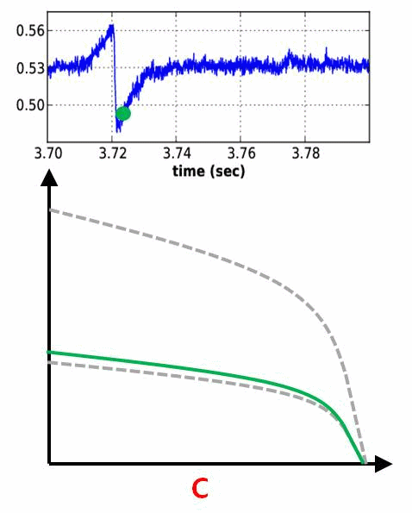
Edge Te evolution was altered due to RMP
ELMs suppressed
#5947
Edge T_{e}
A
B
C
A: linear build-up
B: saturated by RMP
C: stably saturated

Slide 25
Outline
1. Unique features of KSTAR RMP 3D field
2. Characteristics of ELM-suppressed RMP discharge
3. Altered Te pedestal dynamics
4. Broadband change of magnetic fluctuation
5. Summary

Slide 26
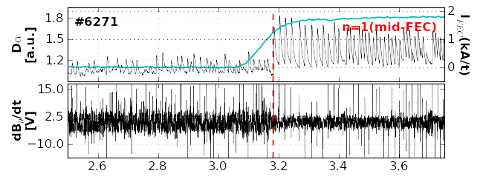
Broadband magnetic fluctuations were changed depending on applied MPs and altered ELMs
1.8
1.5
1.2
2
1
0
dB/dt with ELM intensification
Dα
(a.u.)
I_{FEC}
(kA/t)
15.0
2.5
-10.0
dB/dt
(a.u.)
2.6 2.8 3.0 3.2 3.4 3.6

Slide 27
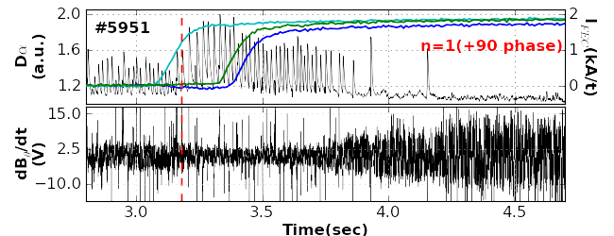
Broadband magnetic fluctuations were changed depending on applied MPs and altered ELMs
1.8
1.5
1.2
2
1
0
dB/dt with ELM intensification
Dα
(a.u.)
I_{FEC}
(kA/t)
15.0
2.5
-10.0
dB/dt
(a.u.)
2.6 2.8 3.0 3.2 3.4 3.6
2.0
1.6
1.2
2
1
0
dB/dt with ELM suppression
Dα
(a.u.)
I_{FEC}
(kA/t)
15.0
2.5
-10.0
dB/dt
(a.u.)

Slide 28
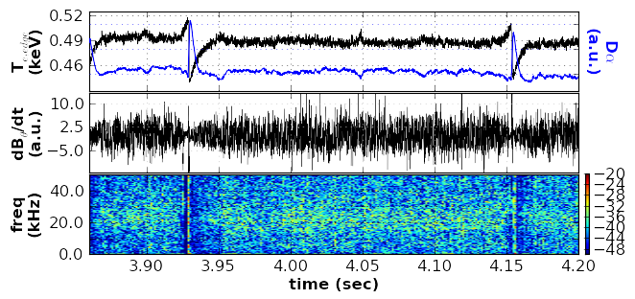
Broadband magnetic fluctuations were changed depending on applied MPs and altered ELMs
1.8
1.5
1.2
2
1
0
dB/dt with ELM intensification
Dα
(a.u.)
I_{FEC}
(kA/t)
15.0
2.5
-10.0
dB/dt
(a.u.)
2.6 2.8 3.0 3.2 3.4 3.6
2.0
1.6
1.2
2
1
0
dB/dt with ELM suppression
Dα
(a.u.)
I_{FEC}
(kA/t)
15.0
2.5
-10.0
dB/dt
(a.u.)
0.52
0.49
0.46
3.0 3.5 4.0 4.5
T_{e,edge}
(keV)
Dα
(a.u.)
Broad-band (not coherent) change of dB/dt
Synchronized with T_{e,edge} saturation
10.0
2.5
-5.0
dB/dt
(a.u.)
40
25
10
-72
-80
-88
freq
(kHz)
log(A)
3.90 3.95 4.00 4.05 4.10 4.15 4.26
Time (sec)

Slide 29
Summary
ELMs suppressed for the first time by using n=1 RMP in KSTAR
Gradual increase of n_{e}, saturated T_{e} pedestal evolution, broadband magnetic fluctuation changes
Various ELM responses
: suppression, intensification, mitigation, locking, triggering
Unique features of KSTAR RMP fields can provide another aspects on ELM-RMP physics study
Either purely resonant or non-resonant fields applicable
Large size middle coil is unique and important for ITER-relavant ELM-RMP study
Further dedicated ELM-RMP experiments with upgraded RMP system and edge diagnostics are on progress now in KSTAR 2012 campaign

Slide 30
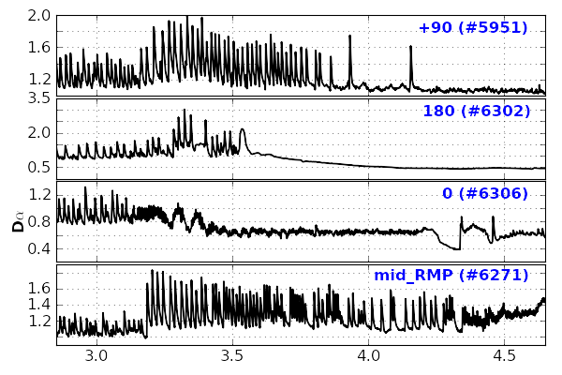
Various ELM Responses to n=1 MPs
(a)
➔ ELM Suppression
(b)
H/L back-transition
➔ H/L Back-transition / Locking
Divertor Dα [a.u.]
➔ ELM (strong) mitigation ~ JET n=1
(c)
(d)
➔ ELM Intensification
(e)
➔ ELM Intensification
Variety of ELM responses to different MP spectra
Various ELM controllability of MPs

Slide 31
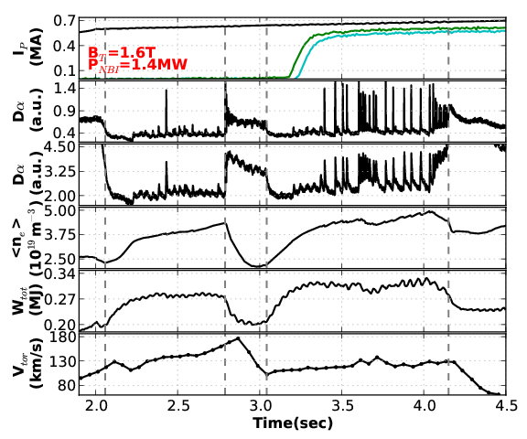
ELMs Triggered by n=2 With Odd Parity
Two ELM-free H-mode periods
n=2 with odd-parity triggered type-I ELMs
V_{φ} didn’t changed after 2nd L/H transition
→ strong mag. braking
Ref to ELM triggering on NSTX by n=3 MP
n=2 (odd)
#6369
Triggered ELMs
Mag. braking

Slide 32
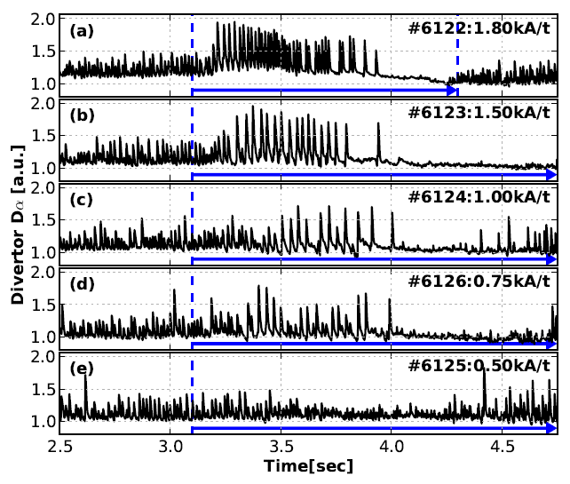
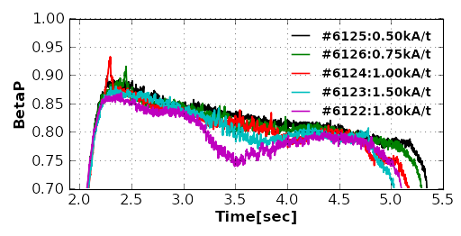
Threshold FEC Current for ELM Suppression
Fully
suppressed
I_{FEC,threshold}
≥ 0.75 kA/t : marginal suppression
≥ 1.50 kA/t : full suppression
(vacuum analysis predicted ≥ 1.00 kA/t)
Δβ_{p} is dependent on I_{FEC}
(similar Δn_{e}, ΔW_{tot}, ΔV_{φ}, …)
Fully
suppressed
Marginally
suppressed
Marginally
suppressed
No effect or
Weakly mitigated
Note that there was no clear change of ELM size on transition
(excitation → suppression), while the ELM frequency decreased dramatically
Notes:
그림 수정할 것

Slide 33
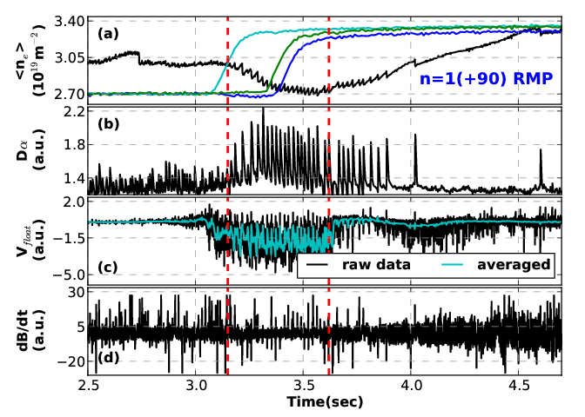
Change on Edge Particle Transport : Reduction of Negative Floating Potential (Divertor)
ELM-intensified phase
n=1 mid-FEC alone
V_{f} < 0
ELM-suppressed phase
n=1, +90 phase
V_{f} ~ 0
Note that V_{f} was abruptly increased at t~3.6s suggesting a sudden change of particle transport due to different MP spectra

Slide 34
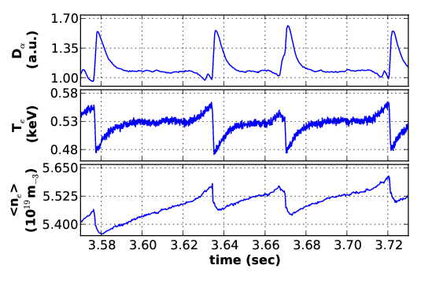
Change of Edge Electron Thermal Transport : Saturated Pedestal Evolutions
KSTAR #5947
Saturated evolution of edge T_{e}
Saturated evolution phase
T_{e,edge} saturated
dn_{e}/dt slowed down
higher base-level of D_{α}
Monotonic evolution phase
Similar dT_{e,edge}/dt and dn_{e}/dt to those in the intensified ELMs
D_{α} drop-down to lower base-level
Thermal (T_{e}) transport clearly enhanced
Saturated evolution of T_{e,edge} might be a key to understand ELM suppression

Slide 35
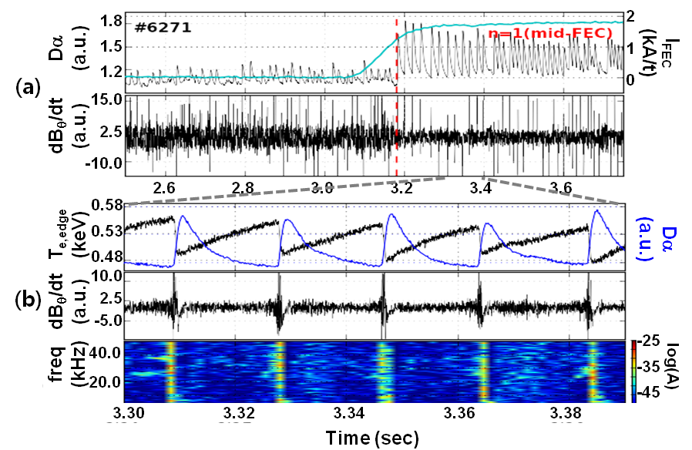
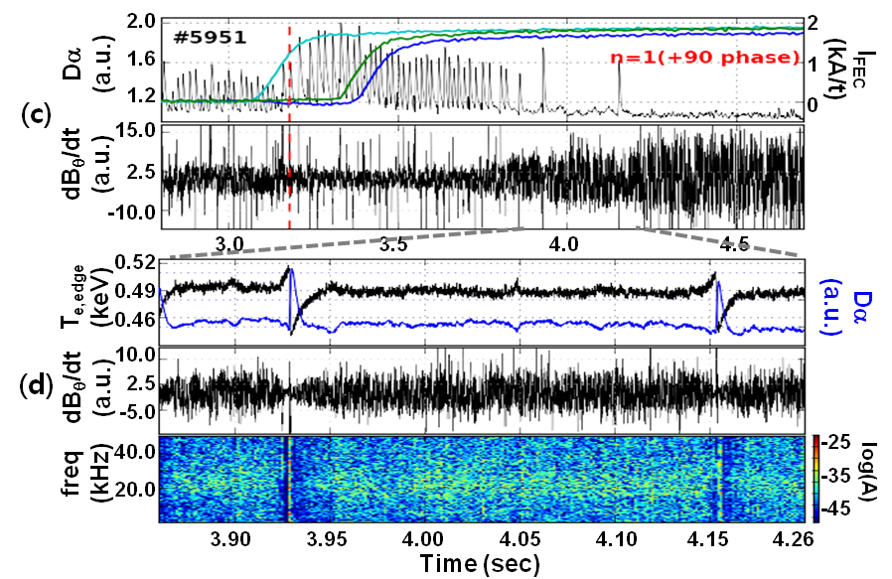
Broadband Changes of Magnetic Fluctuation Depending on MPs and Altered ELMs
Broadband decrease on ELM-intensification
- ELM events clearly seen in spectrogram
Broadband increase on ELM-suppression
- Significant inter-ELM fluctuations
- Fluctuation clearly reduced prior to ELM crash, synchronized with resumed monotonic evolution of edge Te
Distinguished from coherent modes on several ELM-free regimes
such as EHO (QH-mode), QCM (EDA), and WCM (I-mode)

