Slide 1
TH/6-2
Role of external torque and toroidal momentum transport in the dynamics of heat transport in internal transport barriers
Hogun Jhang^{[1]}, S. S. Kim^{[1]}, S. Tokunaga^{[1]}, P. H. Diamond^{[1,2]}
^{[1]} WCI Center for Fusion Theory,
National Fusion Research Institute (NFRI), Rep. of Korea
^{[2]} CMTFO and CASS, Univ. of California, San Diego, USA
IAEA Fusion Energy Conference 2012, 8-13 Oct., San Diego, USA

Slide 2
Motivating issues
Advanced tokamak (AT) operation in ITER requires enhanced core confinement (ITB or reduced profile stiffness)
Most ion ITBs obtained in high-torque environment with strong NBI [Austin et.al., PoP, 2006] or with intrinsic rotation without external momentum input [Fiore et. al., NF, 2010]
Recent JET experiments highlight the combined role of flat q and rotation in profile de-stiffening [Mantica et. al., PRL, 2011]
Weak rotation (i.e. low torque) in ITER/reactors
Physics of ITB formation/de-stiffening in low-torque and intrinsic-
external torque interaction
Coupling of momentum and heat transport
ITB formation/sustainment by ▽V|| contribution to ExB [Kim, NF, 2011]
Correlation between heat and momentum flux PDFs [Ku et. al., NF, 2012]
Role of momentum transport in barrier dynamics?

Slide 3
Contents
Role of external torque and toroidal momentum transport in ITB dynamics
B. *Profile de-stiffening by external torque

Slide 4
Role of external torque and Reynolds stress in ITB dynamics
External-intrinsic torque interaction can either facilitate or hamper ITB formation [Jhang et. al. PoP, 2012]
Intrinsic torque must be taken into account in barrier dynamics.
External torque can be used as a control knob.
Parallel shear flow instability (PSFI) is an important hidden player in ITB dynamics [Kim et.al., PoP, 2012]
▽V|| contribution to E×B shear plays a key role in ITB formation/sustainment. [Fiore et.al., NF 2010, Kim et. al., NF 2011, Jhang et. al., JKPS, 2012]
PSFI and ensuing Reynolds stress change may trigger ITB formation and back transition by re-distribution of toroidal momentum [Kim et. al., PoP, 2012]
Aspects of avalanching heat transport change depending on the degree of turbulence suppression [Tokunaga et. al., PoP 2012]
Weak barrier: quasi-periodic oscillations due to relaxations of ZF
Strong barrier: intermittent, 1/f-type heat avalanches become dominant

Slide 5
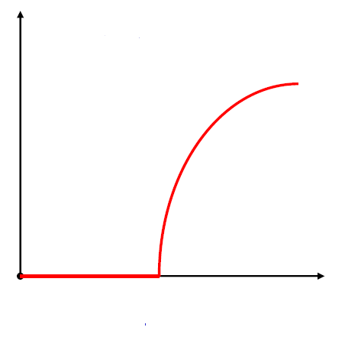
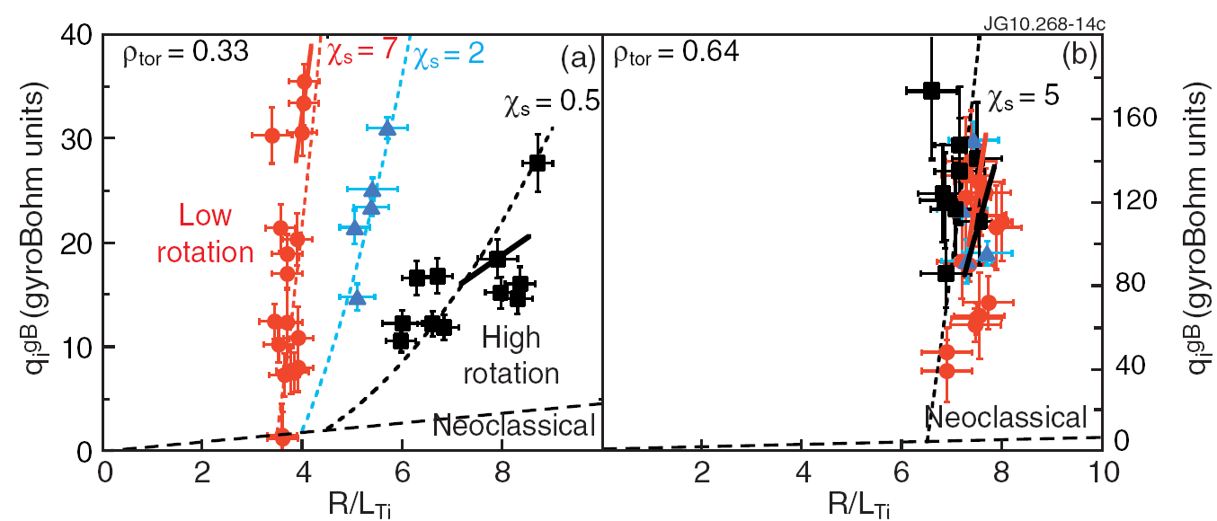
Profile stiffness and de-stiffening
Profile stiffness: tendency of profiles to stay close to marginal stability
Critical Gradient Model (CGM) [Imbeaux & Garbet,
PPCF, 2002, Garbet et. al., PPCF 2004]
α and κ_{c} are determined by microscopic dynamics
Ion temperature profile de-stiffening by combined effects of flat q-profile and rotation [Mantica et. al., PRL 2011]
Q
α
(R/T)(dT/dr)
κ_{c}
Implication to ITER:
→ difficult to get de-stiffening due
to lack of core rotation!
Physics leading to de-stiffening
has not been fully explored
- role of flat q
- rotation vs. torque

Slide 6
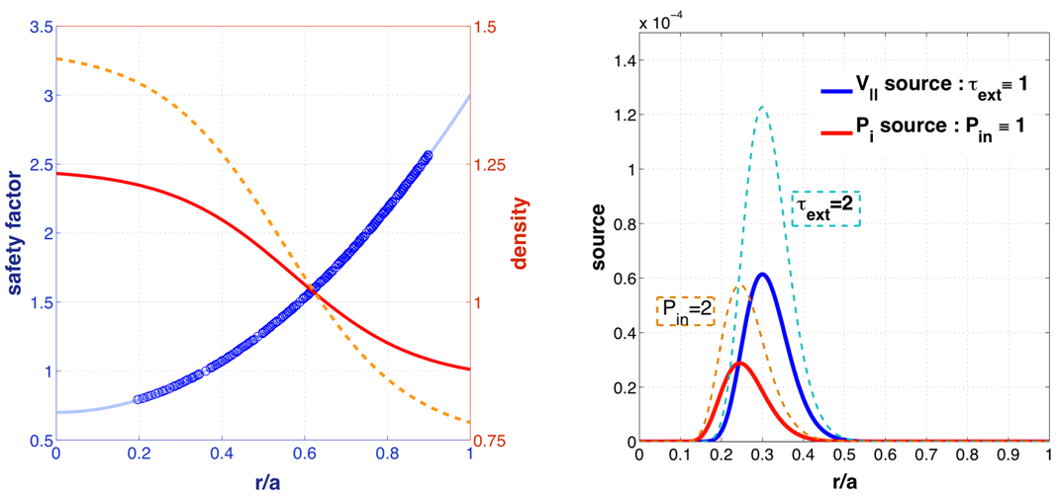
Computational model
Global gyrofluid simulations performed using the revised TRB code [Garbet et. al., PoP 2001, Kim et. al., NF 2011]
Three field model: vorticity, parallel flow, pressure with heat & momentum sources → electrostatic ITG turbulence self-consistently
Flux-driven, self-consistently evolving ion temperature/flow profiles
Fix q-profile (monotonic) & electron density and temperature profiles,
Only resonant modes are retained → not an issue in monotonic q-profile
No-slip boundary condition on V||

Slide 7
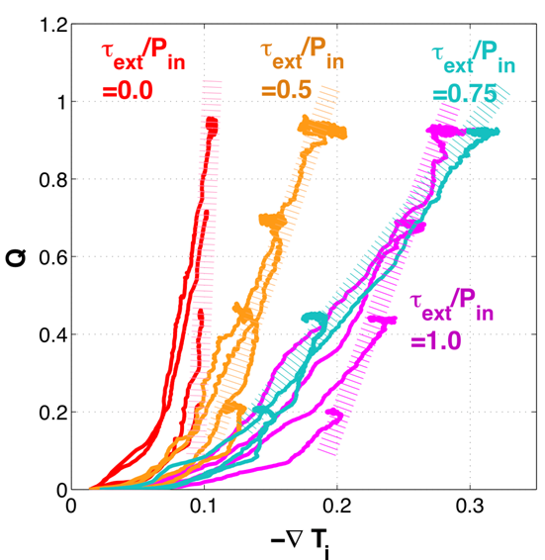
De-stiffening happens when torque is applied
A set of TRB simulations performed varying strength of heat and momentum sources
De-stiffening happens! The key parameter determining the degree of de-stiffening is [Jhang et. al. PoP, 2012]
Restoration of profile stiffness beyond some critical
Profile re-stiffening

Slide 8
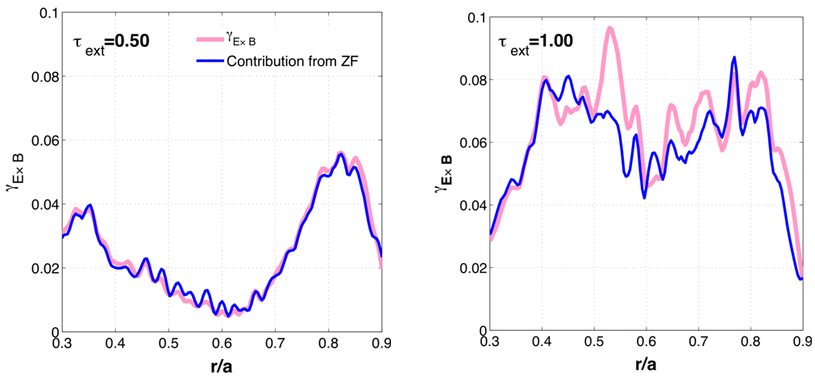
Confinement improvement correlated with ZF shearing
When , E×B shearing rate (ω_{E×B}) closely follows ZF shearing rate (γ_{ZF}), rather than ▽V|| contribution to ω_{E×B}!
De-stiffening may come from the increase of γ_{ZF}!
Suggests a clue for possible new interpretation of profile de-stiffening
phenomena?
P_{in}=1.0
P_{in}=1.00

Slide 9
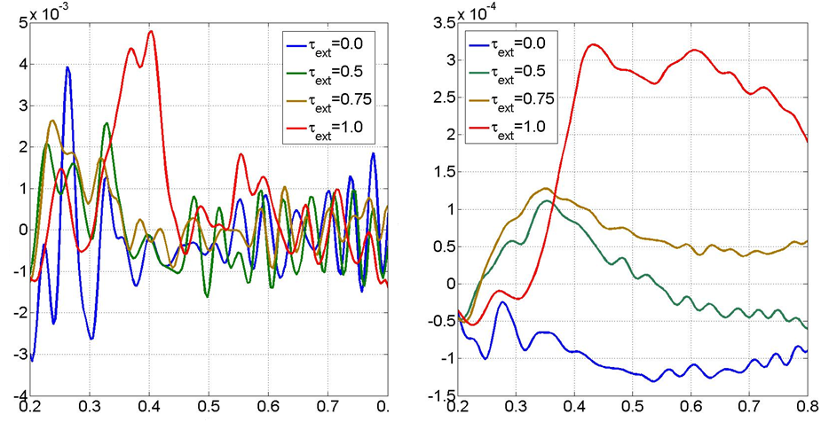
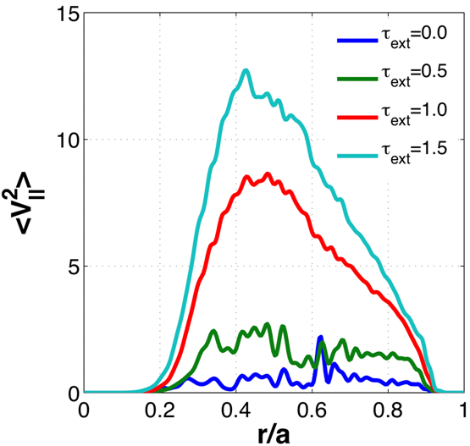
Increase of poloidal Reynolds stress correlated with
Increase of ZF shearing rate comes from increase of poloidal Reynolds stress, resulting in the increase of total γ_{E} when τ_{ext} increases.
likely due to simultaneous increase of (link between parallel and
perpendicular dynamics via potential vorticity flux?)
Adiabaticity
Taylor identity
P_{in}=1.00
−Π_{rθ}

Slide 10
How parallel dynamics couple to ZF?
Drift wave - ion acoustic wave coupling can generate ZF [Wang et. al.,
PPCF 2012, Charlton et. al., PoP, 1994] → Kosuga et. al., TH/P7-02, Friday Morning
→ ZF can be generated even without PE flux and driving term
→ Converts parallel compression into perpendicular flow
Saturated ZF level increases
Dynamical pathway from external torque to ZF shearing
τ_{ext}↑ → ↑ → →
Becomes effective in flat q or RS cases where k|| effect is non-negligible
→ new mechanism leading to de-stiffening in low rotation!
ITG ↔ ion acoustic coupling underway

Slide 11
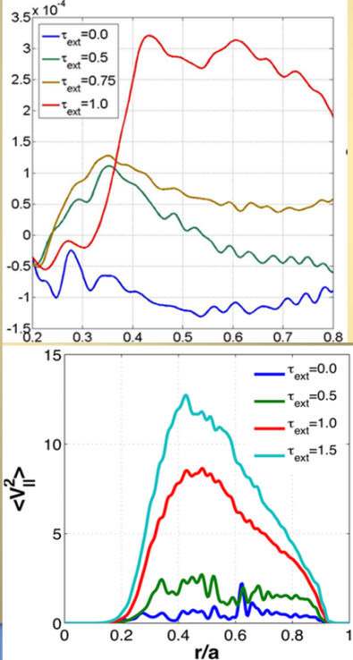
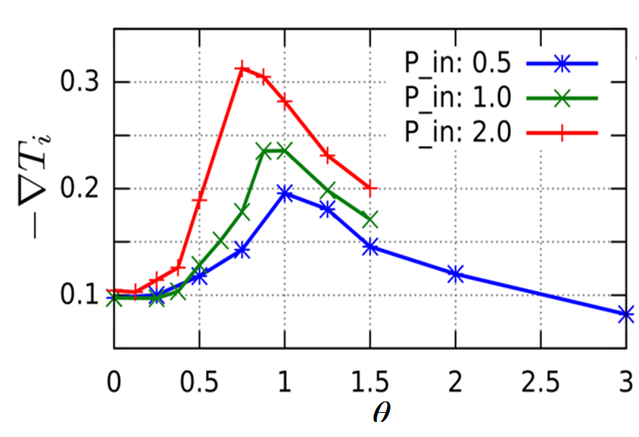
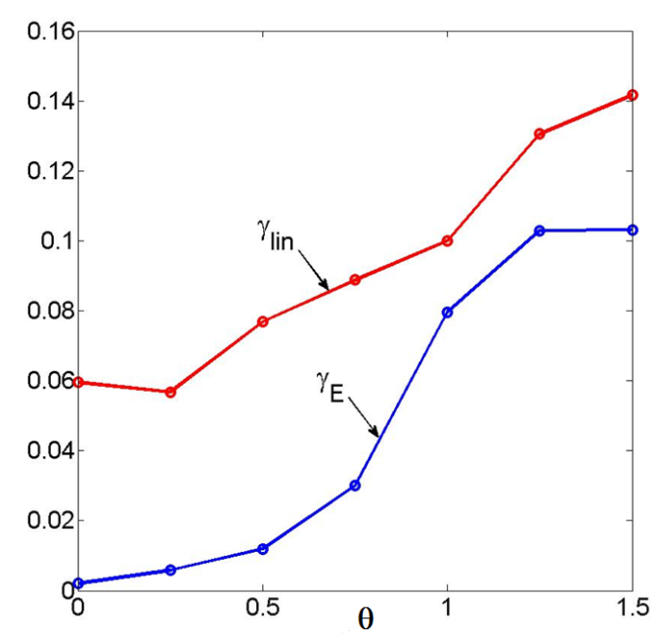
Re-stiffening likely comes from PSFI
Beyond critical , confinement degrades in spite of big jump of poloidal Reynolds stress.
Parallel velocity fluctuations burst when
Onset of PSFI is responsible for re-stiffening → existence of optimum torque for a given power [Parra et. al., PRL 2011, Highcock et. al., PRL 2010].
Ultimate limitation of confinement improvement driven by strong NBI torque → confinement degradation beyond threshold torque
−Π_{rθ}

Slide 12
Conclusions and future directions
Momentum transport is strongly coupled to heat transport in enhanced core confinement regimes.
Suggest a new mechanism for profile de-stiffening and re-stiffening when external torque is applied.
0<θ<θ_{c} ⇨ parallel compression → perpendicular flow ⇨ de-stiffening
θ>θ_{c} ⇨ PSFI ⇨ confinement degradation and re-stiffening
Possibility leading to de-stiffening in low rotation (esp. in flat q/RS)
Ultimate limitation of torque-driven de-stiffening → existence of optimal torque
Fully non-linear consideration (e.g. ZF) is necessary to understand de-stiffening physics
Future directions:
Further study of parallel-perpendicular coupling, esp. in flat-q and RS configurations.
Coupling between momentum and heat transport in SS ITBs or de-stiffened states
De-stiffening in other transport channels: density (TEM, Pinch), Te etc.

Slide 13
Back-Up

Slide 14
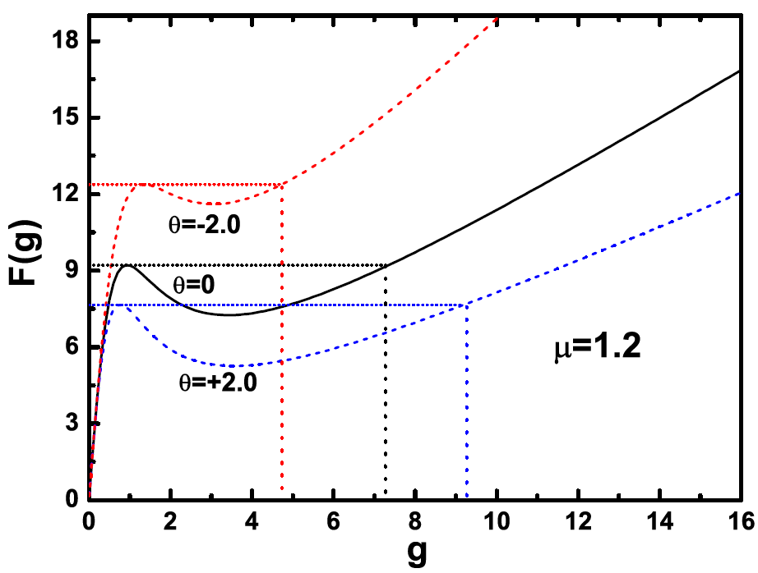
External-intrinsic torque interaction affects ITB formation
Two-field (pressure, toroidal velocity) model with heat and momentum sources:
Residual stress → intrinsic rotation
[Gurcan et. al., PoP, 2007]
plays a role of control parameter
governing transport bifurcation
Positive torque: bifurcation at lower heat flux with stronger ITB (facilitate ITB formation)
Negative torque: bifurcation at higher heat flux with weaker ITB (hamper ITB formation)

Slide 15
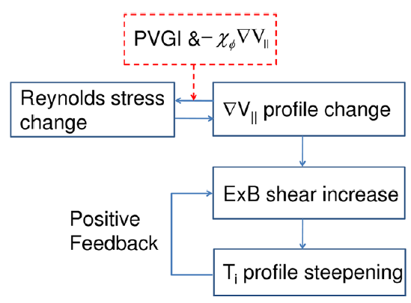
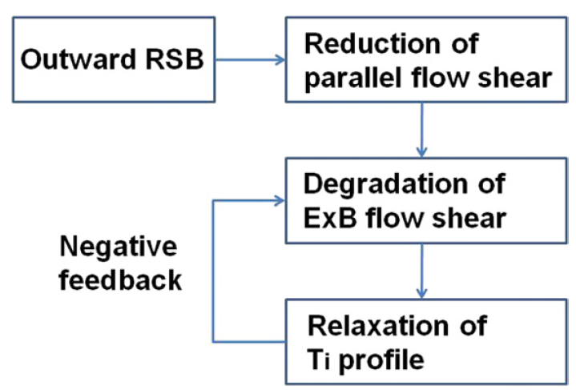
Parallel shear flow instability strongly coupled to ITB dynamics
▽V|| contribution to E×B shear dominant in ITB formation/sustainment. [Fiore et.al., NF 2010, Kim et. al., NF 2011, Jhang et. al., JKPS, 2012]
Parallel shear flow instability (PSFI) found to be a likely hidden play in ITB dynamics by re-distribution of toroidal momentum (hence E×B shear).
ITB formation
[Kim et. al., PoP 2012]
Back transition
[Kim et. al., NF 2011]

