Slide 1


Dynamics of energetic particle driven modes and MHD modes in wall-stabilized high beta plasmas on JT-60U and DIII-D
24th IAEA Fusion Energy Conference
8-13 October 2012
San Diego, USA
EX5-1
G. Matsunaga¹⁾, M. Okabayashi²⁾, N. Aiba¹⁾, J. A. Boedo³⁾, J. R. Ferron⁴⁾,
J. M. Hanson⁵⁾, G. Z. Hao⁶⁾, W. W. Heidbrink⁷⁾, C. T. Holcomb⁸⁾,
Y. In⁹⁾, G. L. Jackson⁴⁾, Y. Q. Liu¹⁰⁾, T. C. Luce⁴⁾, G. R. McKee¹¹⁾,
T. H. Osborne⁴⁾,D. C. Pace⁴⁾, K. Shinohara¹⁾, P. B. Snyder⁴⁾,
W. M. Solomon²⁾, E. J. Strait⁴⁾, A. D. Turnbull⁴⁾,
M. A. Van Zeeland⁴⁾, J. G. Watkins¹²⁾, L. Zeng¹³⁾,
the DIII-D Team and the JT-60 Team
¹⁾JAEA, ²⁾PPPL, ³⁾UCSD, ⁴⁾GA, ⁵⁾Columbia Univ., ⁶⁾SWIP, ⁷⁾UCI,
⁸⁾LLNL, ⁹⁾FAR-TECH, ¹⁰⁾CCFE, ¹¹⁾Univ. Wisconsin, ¹²⁾SNL and ¹³⁾UCLA

Slide 2
JT-60U/DIII-D have discovered ELM triggering by EP driven mode (EPdM) in wall stabilized high-β plasmas
High-β_{N} operation is advantageous to gain higher fusion output density,
  High-β_{N} region above no-wall limit → ”wall-stabilized high-β region”
However, wall-stabilized high-β_{N} region is not fully understood.
JT-60U
DIII-D
Energetic Particles (EPs)
& EP driven modes
MHD modes
↓
  Important for edge stability
  in high-β burning plasmas

Slide 3
Outline
  EP driven mode to trigger ELM and
  its EP transport
  2. Waveform distortion of EPdM
  3. Conditions of ELM triggering/pacing by EPdM
  4. Possible mechanisms of
  ELM triggering by EPdM
  5. Summary

Slide 4
Outline
  EP driven mode to trigger ELM and
  its EP transport
  2. Waveform distortion of EPdM
  3. Conditions of ELM triggering/pacing by EPdM
  4. Possible mechanisms of
  ELM triggering by EPdM
  5. Summary

Slide 5
What is EP driven Mode (EPdM) to trigger ELM?
DIII-D
JT-60U
Appear at high-β_{N} > no-wall β_{N}-limit,
Initial mode frequency ~ Precession frequency of trapped EPs,
Toroidally: mainly n=1, Poloidally: m=3~4 (localized at low field side)
Radially: global(peak @ q=2),
Strong distorted waveform,
NOTE: These modes have been named “Off-axis Fishbone Mode (OFM)” on DIII-D and “Energetic particle driven Wall Mode (EWM)” on JT-60U.

Slide 6
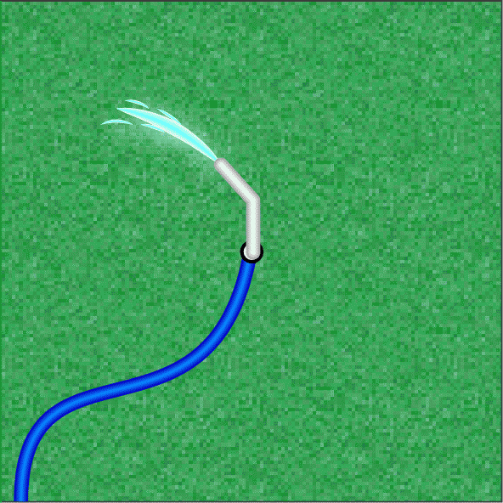

EP diagnostics indicate intense EP transport/loss
DIII-D
like a sprinkler…
2
3
4
5
1
6
Trapped EPs (V||/V = 0.2~0.3,E=65-70keV) are transported by EPdM
Beacon transport/loss

Slide 7
Strong correlation between waveform distortion and EP transport
DIII-D
EP density near plasma edge increases monotonically with distortion increase

Slide 8
Outline
  EP driven mode to trigger ELM and
  its EP transport
  2. Waveform distortion of EPdM
  3. Conditions of ELM triggering/pacing by EPdM
  4. Possible mechanisms of
  ELM triggering by EPdM
  5. Summary

Slide 9
Waveform distortion has helical structure existing only at low field side(LFS).
DIII-D
Waveform distortion is toroidally localized →Snake behavior
EP transport/loss ride on this helical structure

Slide 10
Waveform distortion is composed of higher harmonics
DIII-D
Experiment
MARS-F analysis
Experimentally obtained δB_{θ}(θ, φ) can be reproduced by n=1 & n=2 modes.
Unstable n=1, 2, and 3 modes w/o wall,
(ideal MHD analysis)
Distortion component always rides on maximum amplitude of fundamental component.
→non-linear process?

Slide 11
Outline
  EP driven mode to trigger ELM and
  its EP transport
  2. Waveform distortion of EPdM
  3. Conditions of ELM triggering/pacing by EPdM
  4. Possible mechanisms of
  ELM triggering by EPdM
  5. Summary

Slide 12
ELM triggering by EPdMs occurs with some level of waveform distortion
DIII-D
JT-60U
Some level of waveform distortion seems to be needed,
Not always trigger ELM even with significant distortion level
→ need other conditions satisfied?

Slide 13
ELM triggering depends on time delay since the previous ELM
DIII-D
ELM triggering by EPdMs infrequently occurs after ELM crash,
→Pedestal recovery (marginal edge stability) is needed

Slide 14
Difference of ELM triggering by EPdMs on DIII-D and JT-60U
DIII-D
JT-60U
Partially synchronized
Fully synchronized

Slide 15
ELM pacing occurs when the EPdM repetition frequency is larger than natural ELM frequency
DIII-D
JT-60U
ELM
Pacing
f_{EPdM} < f_{ELM}
  f_{ELM} ≤ f_{EPdM}
Frequent EPdM cycle can pace ELM,
Pacing frequency is determined by balance between pedestal recovery and EP transport.

Slide 16
Outline
  EP driven mode to trigger ELM and
  its EP transport
  2. Waveform distortion of EPdM
  3. Conditions of ELM triggering/pacing by EPdM
  4. Possible mechanisms of
  ELM triggering by EPdM
  5. Summary

Slide 17
Transported EPs to edge affect edge stability
Possibility 1
Possibility 2
DIII-D
&
JT-60U
Peeling-ballooning
(1) Additional ∇p can violate peeling-ballooning stability,
∇p_{ped} = ∇(p_{th} + δp_{EP})
(2) EP contribution (δW_{k}) can narrow stable region.
Transported EPs may act as an additional pressure gradient
or change edge stability boundary

Slide 18
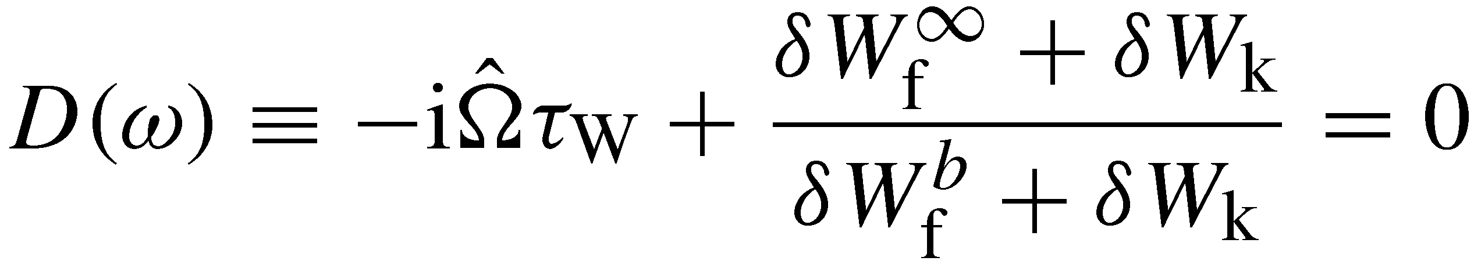
Analytic study says that EPs can destabilize marginal mode
Dispersion relation (with resistive wall) + kinetic contribution:
From bulk plasma w/o wall
From EPs
From bulk plasma with an ideal wall
From EPs
Marginal mode can be destabilized by EP contributions.

Slide 19
Interpretation of ELM triggering by EPdM
Trapped EP can drive EPdM,
EPdM waveform distortion enhances EP transport to edge,
Transported EPs affect edge stability,
ELM triggering occurs.

Slide 20
Summary
• ELM triggering by the EPdMs has been discovered on JT-60U and DIII-D,
  • Waveform distortion composed of higher harmonics strongly correlates with EP transport to edge,
• ELM triggering/pacing by the EPdMs need, (i)some level of waveform distortion and (ii) pedestal recovery,
• Transported EPs to edge affect edge stability as additional pressure or contribute to change stability.
New gate has been opened!
New approach to ELM pacing on ITER and DEMO.

