Slide 1
Test Results of ITER Conductors in the SULTAN Facility
¹P. Bruzzone, ¹B. Stepanov, ¹R. Wesche, ²N. Mitchell, ²A. Devred,
³Y. Nunoya, ⁴V. Tronza, ⁵K. Kim, ⁶Th. Boutboul, ⁷N. Martovetsky, ⁸Wu Yu
¹Ecole Polytechnique Fédérale de Lausanne (EPFL), Switzerland,
²ITER Organization,
³Japan Atomic Energy Agency (JAEA), Japan,
⁴ITER Centre, Moscow, Russia,
⁵National Fusion Research Institute, Korea,
⁶Fusion for Energy, Barcelona, Spain,
⁷Oak Ridge National Laboratory, USA,
⁸Institute of Plasma Physics, Chinese Academy of Sciences, P.R.China
The views and opinions expressed herein do not necessarily reflect those of the ITER Organization

Slide 2
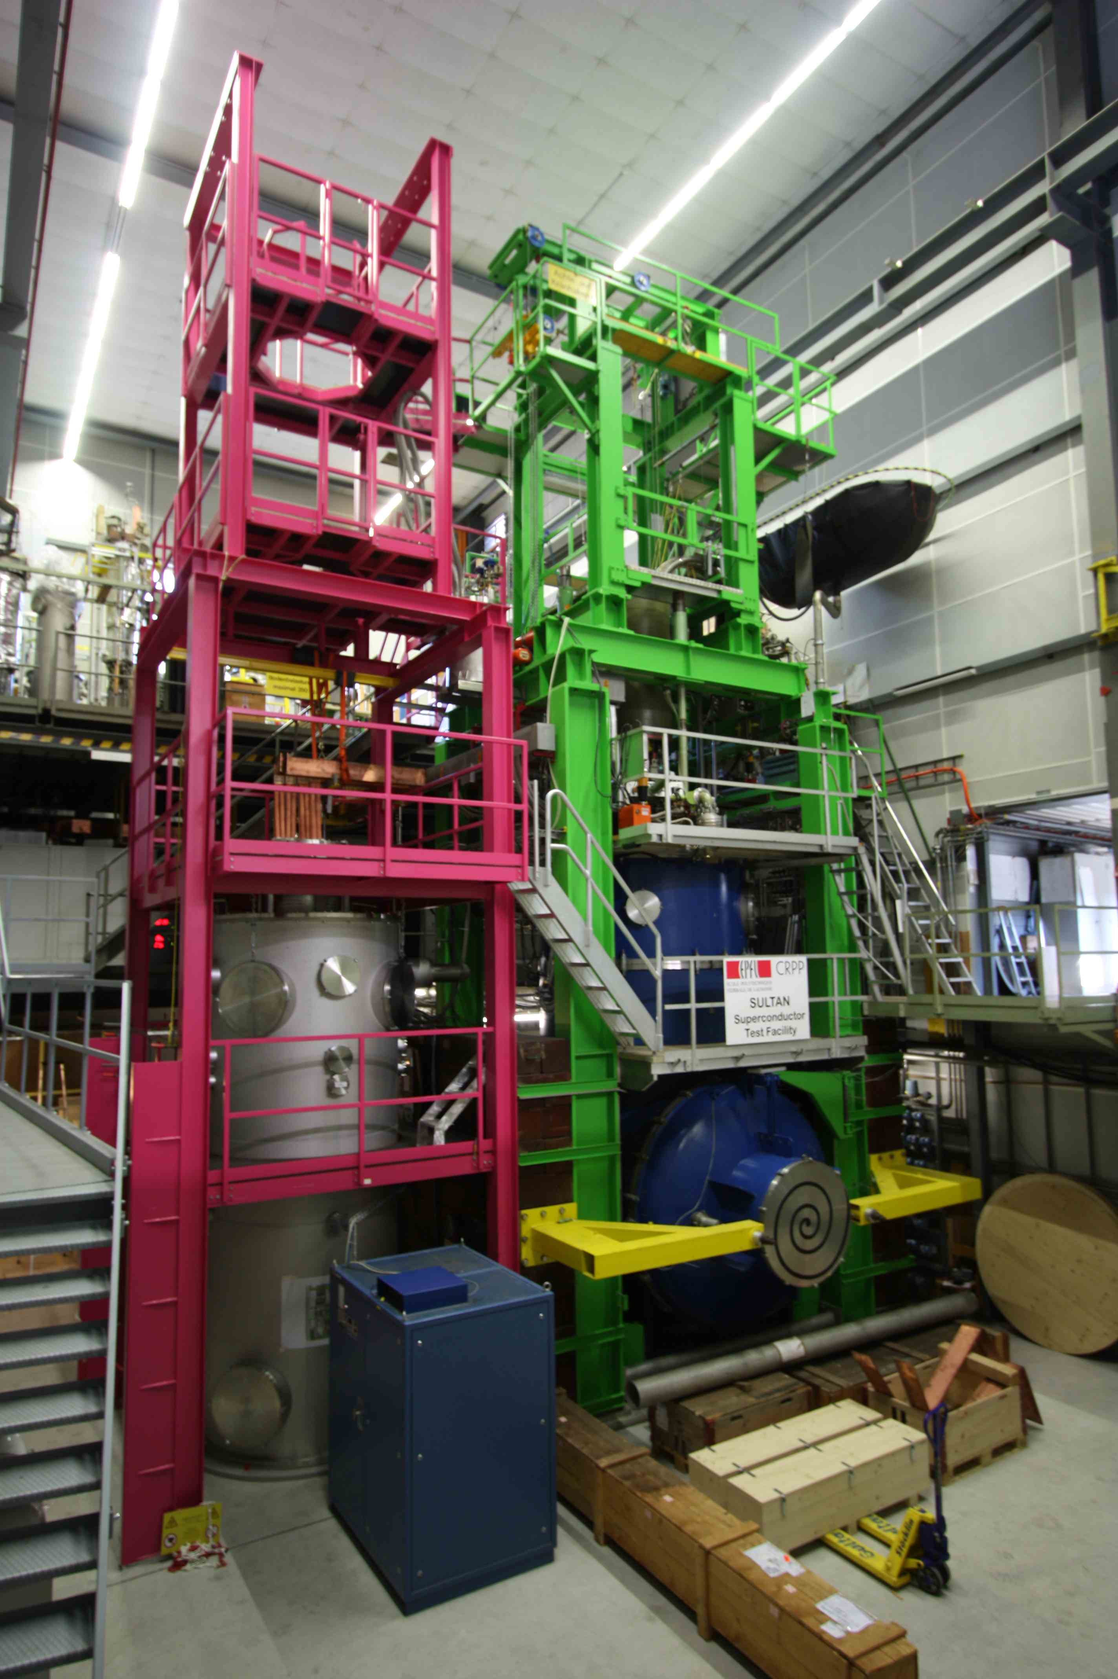
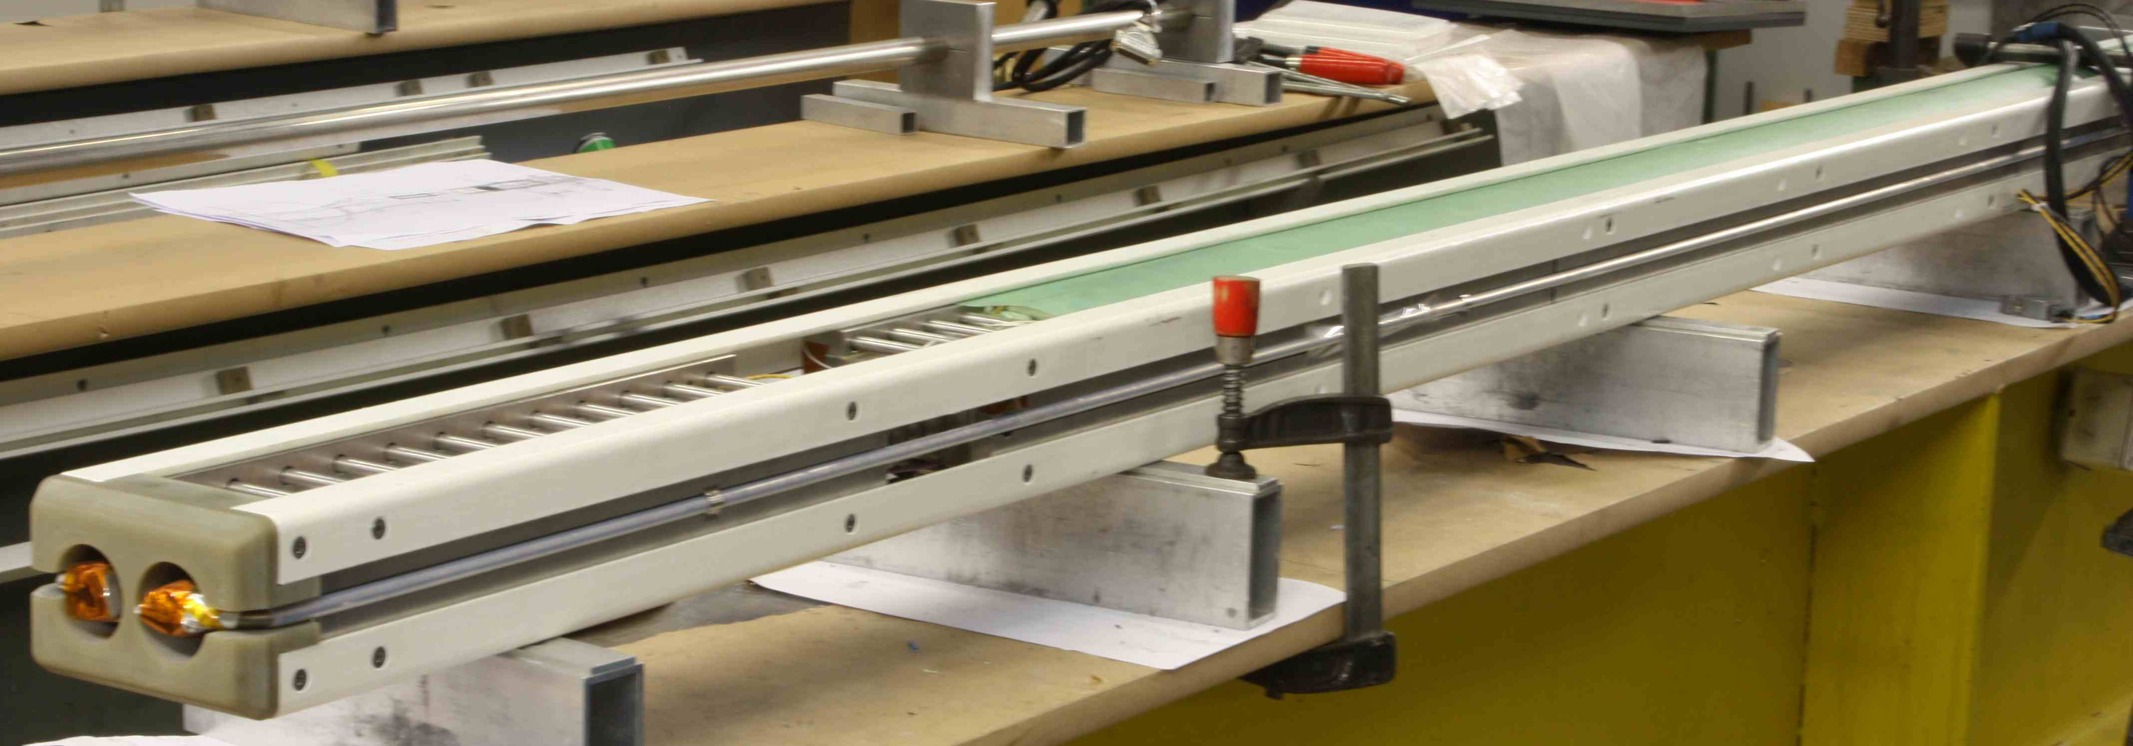
Outline
The test facility for short length conductor
Technical aspects of large sample test
The results for NbTi ITER conductors
The results for TF conductors
The status of CS conductor test
Conclusion
Notes:
See the SULTAN facility next to EDIPO
See an assembled SULTAN Sample

Slide 3
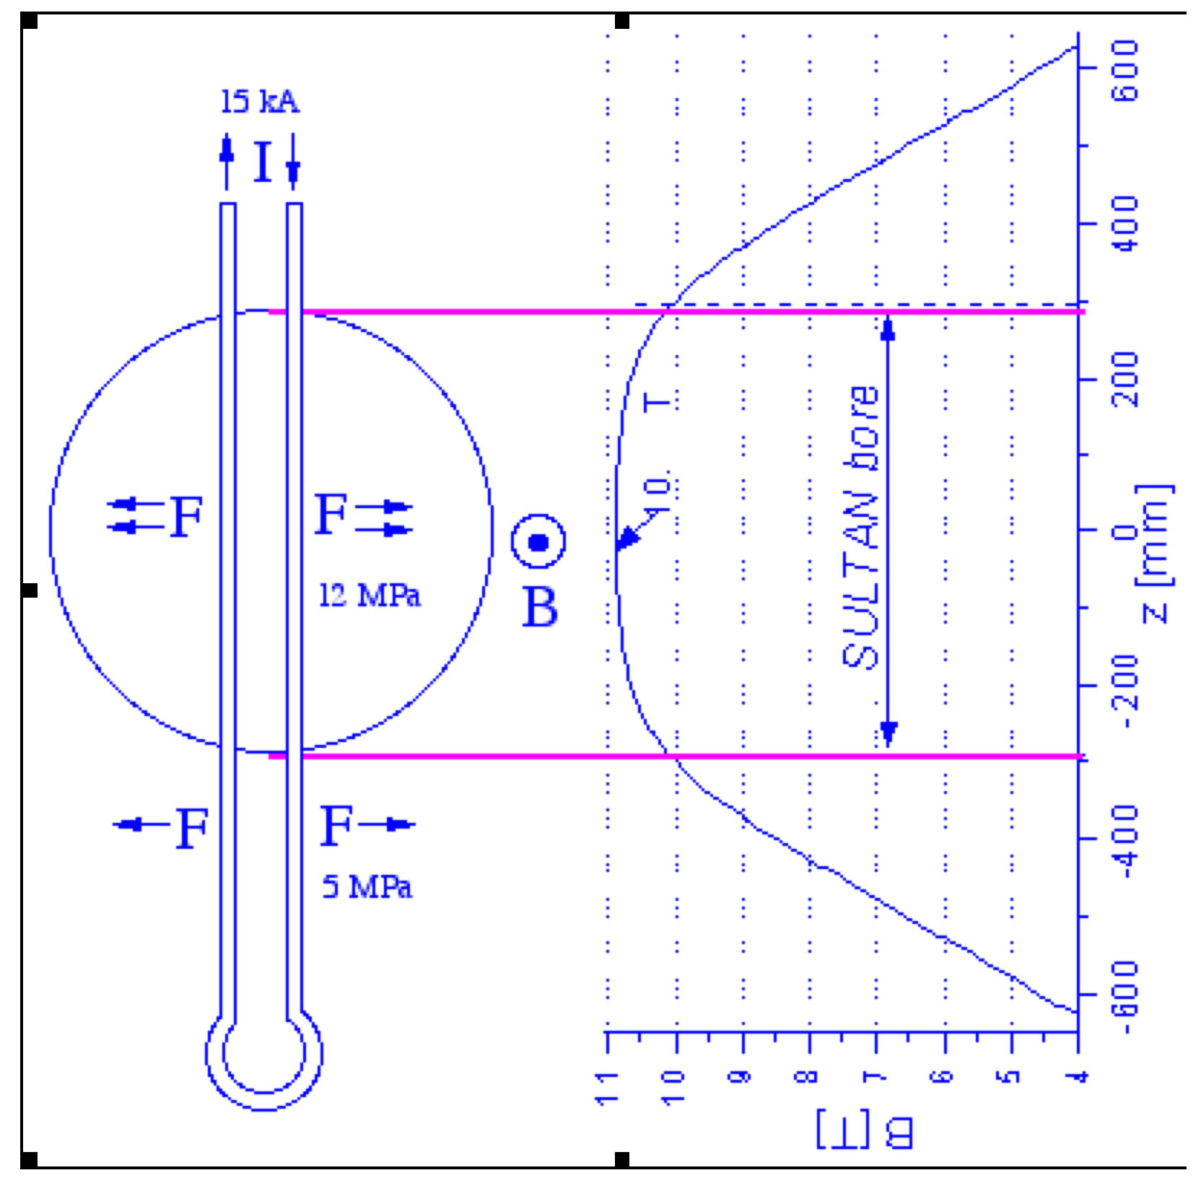
The geometry of the hairpin sample
68 kA
10.85 T
≈ 6m
Notes:
See the sample attached to the transformer unit/sample holder
See the field profile along the conductor, with full transverse load in high field zone

Slide 4
History of ITER Conductor Test in SULTAN
1998 – 2001 Model Coils and Inserts Conductors (Nb₃Sn, Nb₃Al)
2007 – 2012 29 TF Samples: Design Verification (DV), Supplier Qualification (SQ), Process Qualification (PQ), Pre-Production (PP)
2010 – 2012 6 NbTi Supplier Qualification Samples for PF, CC and Busbar
2010 – 2012 4 CS Samples
About 40 more ITER conductor samples will be tested till 2015. The test sequence and the test program is responsibility of IO. The results, analysis and technical issues are discussed within the SULTAN Working Group
Starting May 2012, the preparation of the Nb3Sn samples and the tests in SULTAN are covered by a framework contract IO-CRPP funded by the DAs
Notes:
Sultan is basically fully booked by ITER from 2007 to 2015

Slide 5
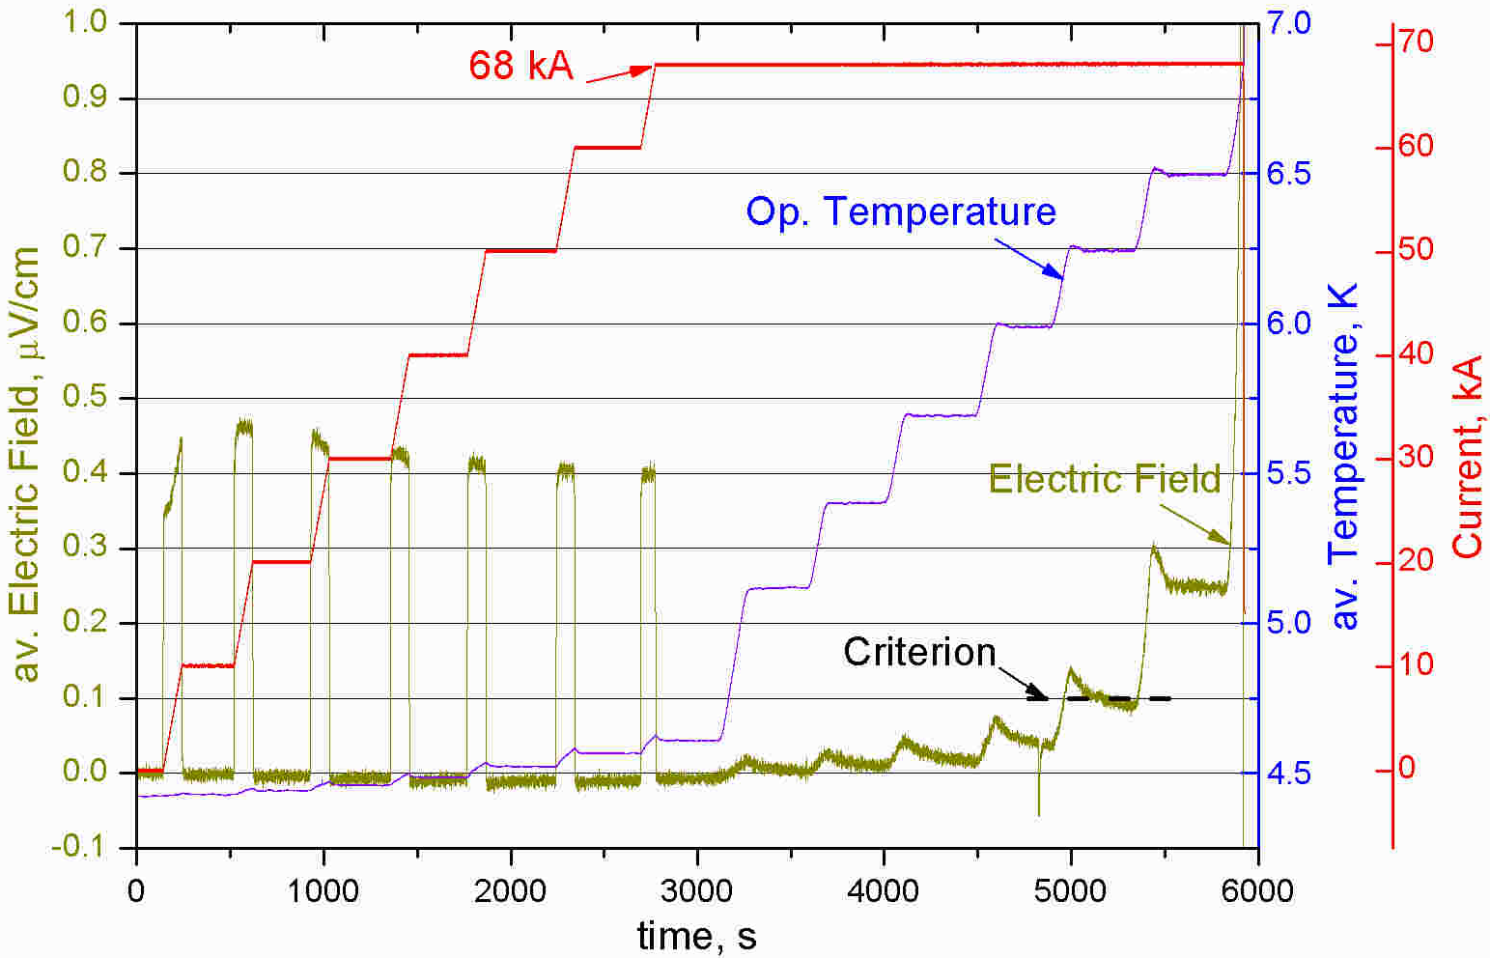
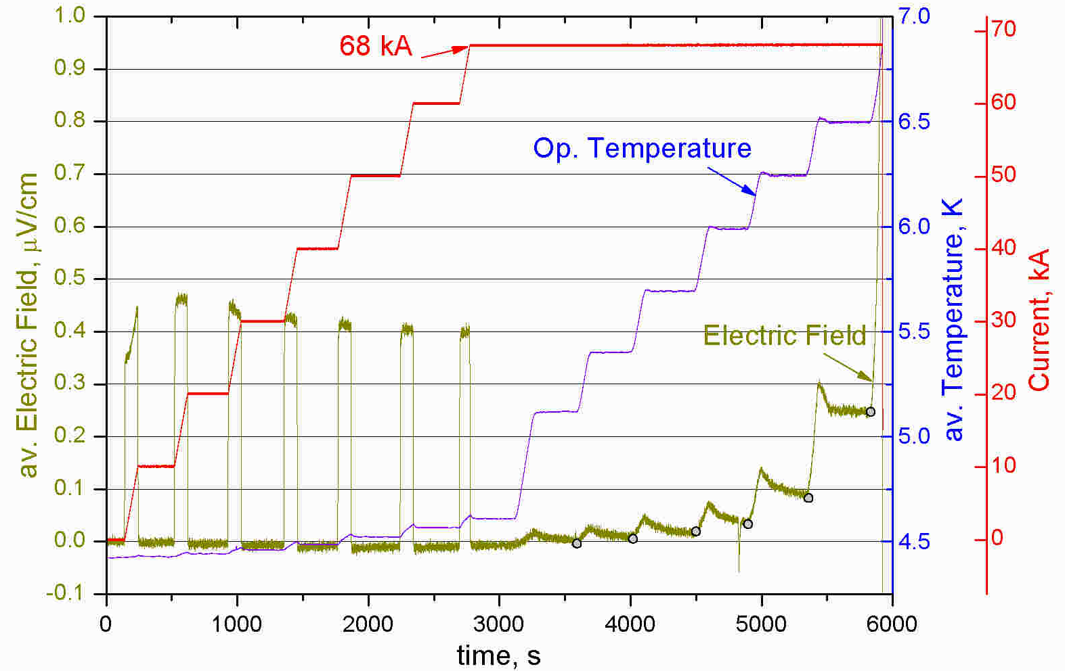
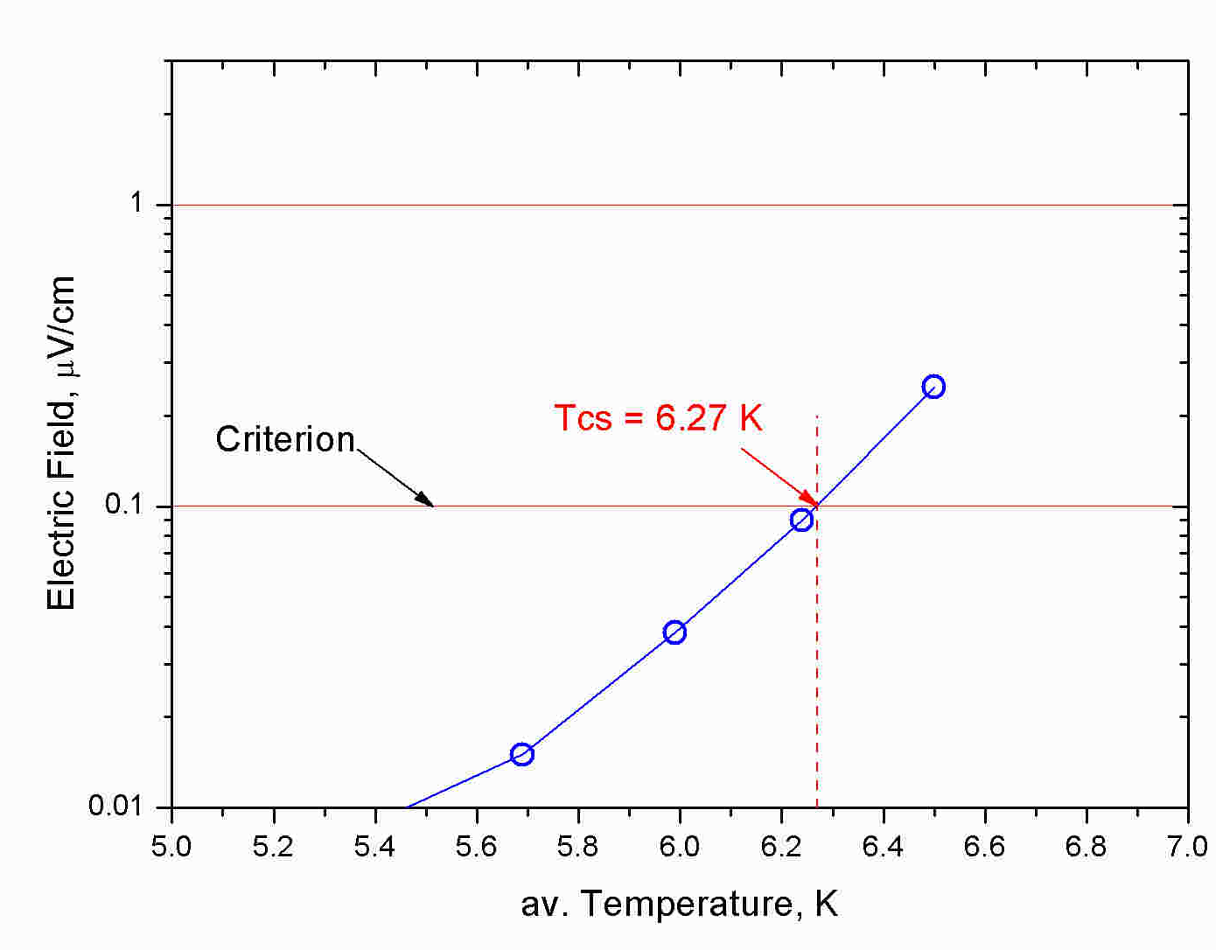
Object of the test for ITER samples
The key test is the current sharing temperature, T_{cs}. At constant operating background field and operating current, the operating temperature is raised in small steps until voltage develops at the high field region. From the reversible voltage-temperature (VT) transition, the measured T_{cs} at 0.1 µV/cm is compared with the requirement of the design, e.g. 5.7 K for TF conductor.
B = 10.78 T
Notes:
From the electric field curve, the gray dots are plot in logarithmic scale versus current. The intercept at the criterion is Tcs

Slide 6
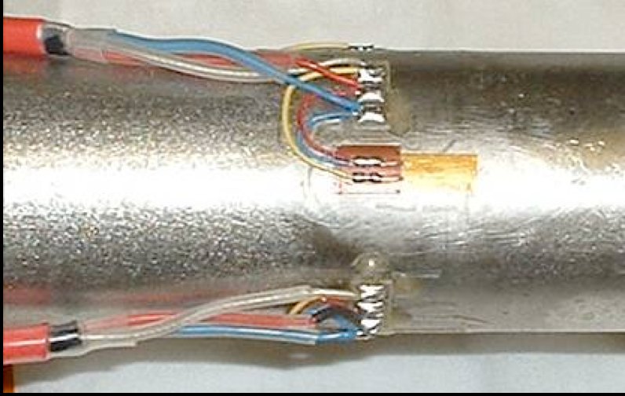
Technical issues for large, short sample test
The demand for accuracy, relevance and reliability of test results led to improvements of the procedures for sample preparation, instrumentation and test:
- Solder filling of electrical termination to improve the current uniformity
Arrays of voltage taps to mitigate the distortion of the baseline
Crimping rings to avoid slippage and preserve the thermal strain in the cable
Enhanced temperature measurement for calorimetric assessment of T_{cs}
Monitoring of strain relaxation and residual strain on the conduit
Notes:
High attention is maintained, with the SWG, to the relevance/validation of the test results

Slide 7
Results of NbTi Conductors Supplier Qualification for each conductor/coil type (PF, CC, Busbar)
Sample | DA | Conductor type | Test date | Reference Point | Measured/Specified T_{cs}
PFCN1 | CN | PF2/PF3/PF4 | May 2010 | 4.2 T – 50.0 kA | 6.33 K / 6.1 K
PFEU1 | RF | PF1/PF6 | September 2010 | 5.65 T – 48.0 kA | 6.02 K / 5.9 K
PFCN2 | CN | PF5 | March 2011 | 4.86 T – 52.0 kA | 6.15 K / 6.1 K
MBCN1 | CN | Main Busbar | July 2011 | 3.22 T – 45.5 kA | 6.95 K / 6.7 K
CCCN2 | CN | Correction Coil | August 2011 | 3.83 T – 10 kA | 7.10 K / 7.0 K
CBCN1 | CN | CC Busbar | August 2012 | 2.63 T – 10 kA | 7.51 K / 7.0 K
The performance qualification is successfully completed in 2012
The results scale satisfactory with the strand properties
The DC performance is stable upon cyclic loading
Notes:
The process qualification samples are starting next.

Slide 8
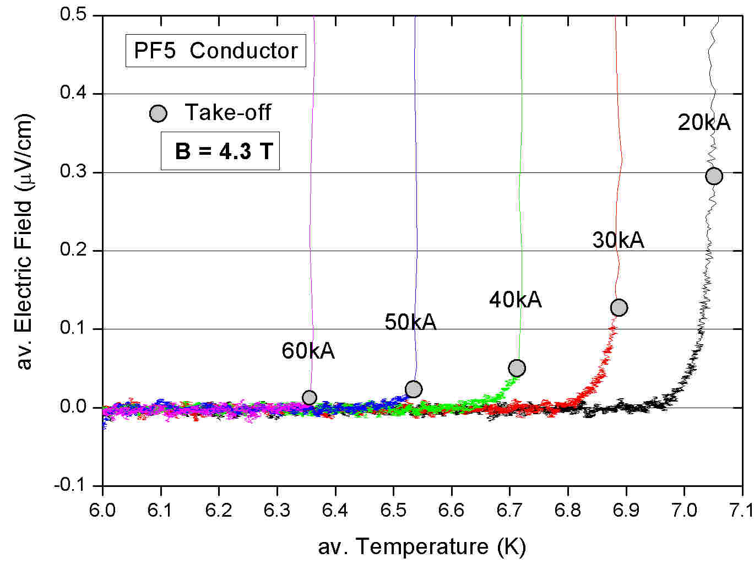
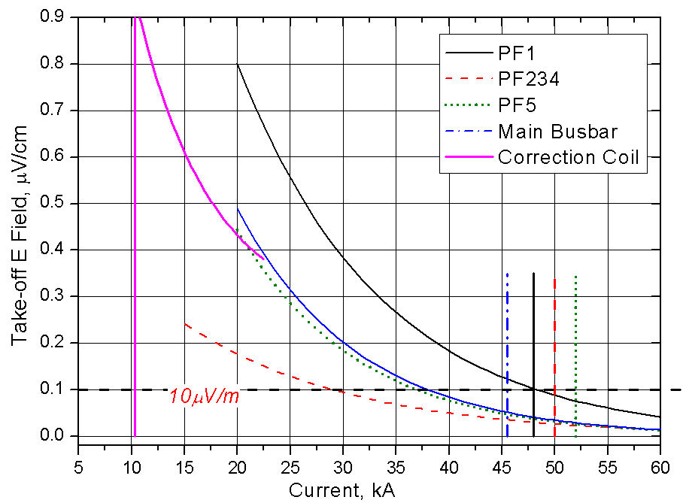
The transition of the NbTi Conductors
As in other NbTi cable-in-conduit, at high operating current the transition width decreases (self field effect) and the take-off electric field becomes < 0.1µV/cm.
For PF234, PF5 and Main Busbar, at the reference point the Tcs cannot be measured and is replaced by the “Temperature at take-off”, Tq
Notes:
The take-off voltage is assessed as gray point (example P5 in left plot)
For each conductor type, the take-off voltage (fitting line) is plot vs operating current

Slide 9
Selection of TF Conductor Results Supplier Qualification (SQ)-Process Qualification (PQ) – Pre-Production (PP) The requirement is Tcs ≥5.7K at 68 kA/10.78 T/1000 load cycles (no thermal cycle)
Sample | Type | Initial T_{cs} | Load/thermal cycles | Final T_{cs}
TFEU3 | SQ / SQ | 6.09 / 7.05* | 1100 / 1 | 5.68 / 6.68
TFEU4 | SQ / SQ | 7.16 / 6.90 | 1125 / 1 | 6.57 / 6.55
TFEU5 | SQ / SQ | 6.61* / 6.35* | 1125 / 1 | 6.24 / 5.98
TFEU6 | SQ/ SQ | 6.26 /6.26 | 1140 / 1 | 5.75 / 5.74
TFEU7 | PQ / PQ | 7.49 / 6.42 | 1000 / 1 | 6.67 / 5.89
TFEU8 | PQ / PQ | 6.13 / 6.27 | 1000 / 1 | 5.66 / 5.67
TFUS1 | DV / SQ | 6.71 / 6.38 | 1200 / 0 | 6.69 / 6.24
TFUS2 | SQ / DV | 7.23 / 5.71 | 915 / 1 | 6.44 / 5.61
TFUS4 | SQ / SQ | 7.13 / 7.12 | 600 / 0 | 6.82 / 6.98
TFJA4 | SQ / SQ | 6.48 / 6.28 | 1000 / 1 | 6.16 / 5.98
TFJA5 | PQ / PQ | 6.22 / 6.33 | 7500 / 4 | 5.03 / 4.95
TFJA6 | PP / PP | 6.19 / 6.04 | 1000 / 1 | 5.56 / 5.35
TFCN1 | SQ / SQ | 7.29 / 7.23 | 1100 / 1 | 6.86 / 6.89
TFCN2 | SQ / SQ | 6.67 / 7.03 | 1200 / 1 | 6.43 / 6.44
TFCN3 | SQ / SQ | 6.42 / 6.24 | 1000 / 1 | 6.08 / 5.93
TFCN4 | PQ / PQ | 6.55 / 6.58 | 1000 / 1 | 6.35 / 6.27
TFKO2 | SQ / SQ | 6.58 / 6.31 | 1000 / 1 | 6.37 / 5.96
TFKO3 | SQ / SQ | 6.83 / 7.22 | 1000 / 1 | 6.62 / 6.90
TFKO4 | PQ / PP | 6.96 / 6.89 | 1000 / 1 | 6.62 / 6.60
TFRF2 | SQ / SQ | 6.44 / 6.44 | 707 / 1 | 6.31 / 6.26
TFRF3 | PQ / PQ | 5.88 / n.a. | 1000 /1 | 6.06 / n.a.
TFRF4 | PP / PP | 5.98 / 5.92 | 1000 /1 | 6.21/ 6.00
* Second Run
Notes:
The table does not include the very early sample “Design Verification” and “developmental”
The requirement is 5.7K after 1000 load cycles. The Final Tcs in the table does not represent the requirement. Depending on the sample, the number of load cycles and thermal cycles is different, mostly in the early samples).
Nothe the highest initial Tcs (TFEU7), the largest number of applied cycles (TFJA5), the best final result (TFKO3) and the Russian samples with performance improvement at the final Tcs (TFRF3 and TFRF4).

Slide 10
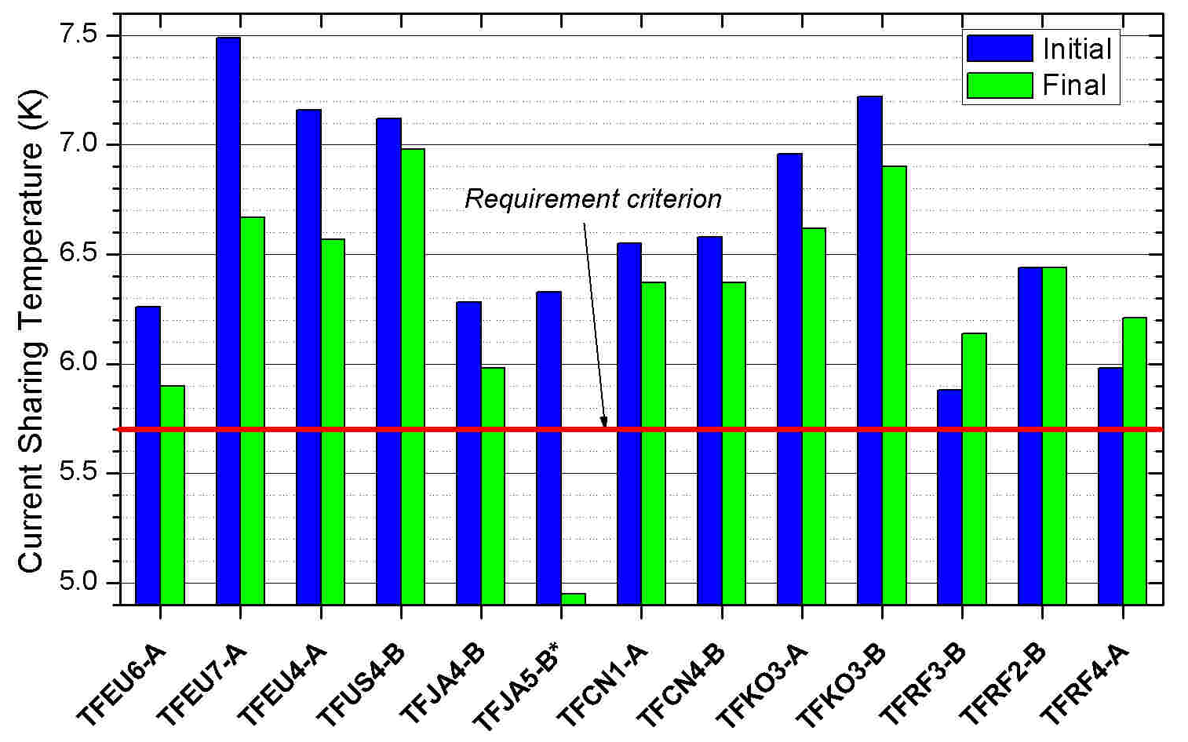
Performance Degradation of TF Conductor Selection of 13 TF conductors
* Extended number of cycles
Notes:
The two identical conductors of TFKO3 have non-identical performance
The Russian TF conductors show performance improvement

Slide 11
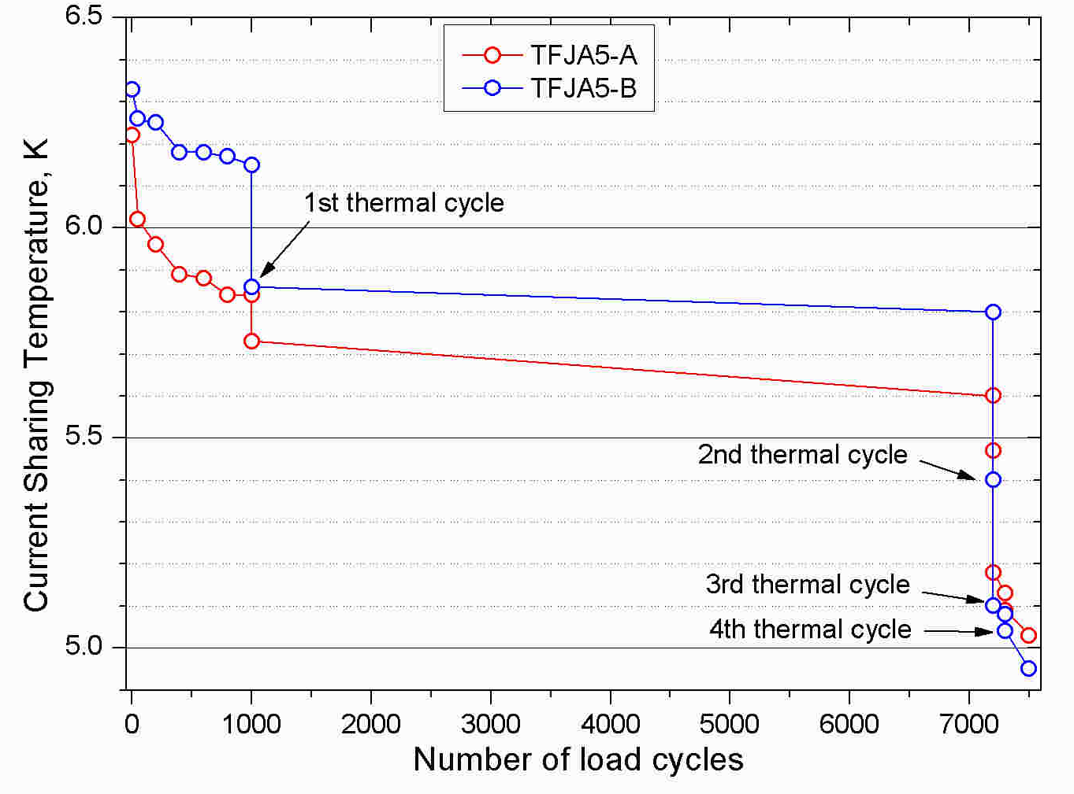
The TF performance degradation
Notes:
On the scale of 1000 cycles, the performance degradation seems to saturate, but the thermal cycle add a hardly predictable performance drop, from about 0 to >0.3K.
On one TF sample, the load cycling was extended up to 7500 cycles, with four intermediate thermal cycles. The combination of thermal and load cycles (never tried on Model and Insert coils) led in this sample to heavy degradation

Slide 12
The CS Conductor Results T_{cs} test at 45.1 kA / 10.85 T
Sample | Start test date | Cable layout | Initial T_{cs} | Load/thermal cycles | Final T_{cs}
¹CSJA1 | October 2010 | DDD 2009 | 5.94 / 6.04 | 6000 / 1 | 4.66 / 5.05
²CSJA2 | June 2011 | DDD 2009 | 7.16 / 6.78 | 17050 / 4 | 6.20 / 5.44
³CSIO1 | January 2012 | 3sc / 2sc+1cu | 7.32 / 6.67 | 11280 / 2 | 6.99 / 6.25
⁴CSIO2 | March 2012 | Short / Long pitch | 6.95 6.99 | 6150 / 2 | 7.14 / 6.70
¹ Layout DDD2009, sample assembled in Japan, possible slippage of cable/jacket
² Layout DDD2009, excellent initial Tcs, degradation rate similar to TF samples
³ DDD2009 (2sc+1) vs. Model coil (3sc): almost same degradation rate
⁴ Long vs. very short cable pitch in triplet: short pitch has very stable performance
Notes:
For CSIO2, as well as for the TFRF samples, a performance improvement is observed.

Slide 13
The CS Conductor Results
Notes:
The maximum number of cycles is limited to 17000 compared to > 50 000 required in ITER

Slide 14
Conclusion - 1
The SULTAN test facility has a long and reliable history in testing conductors for the fusion program. Recently it has found intensive use as the only available test and qualification facility for NbTi and Nb₃Sn conductors for the ITER coils.
The testing rate matches the needs and rate of the coil construction.
The large size of the ITER conductors has necessitated improvements in the sample design and instrumentation and an intensive program of validation has shown that the conductor samples are able to reflect most aspects of the conductor behavior in a coil, except the operating strains.
The Design Verification samples have identified
- sensitivity of some Nb₃Sn strand types to filament fracture under CICC magnetic loads,
- improved CICC cable configurations to mitigate this fracture.

Slide 15
Conclusion - 2
The degradation in Nb₃Sn CICC has a broad range among the suppliers. To mitigate the impact of degradation, large margins are taken in the initial performance. Only two strand-cable combinations show no degradation and a small performance improvement.
The Supplier Qualification Phase is successfully completed
- for all the NbTi conductors (PF, CC and busbars)
for six Nb₃Sn strand-cable combinations for the TF coils
for two Nb₃Sn strand-cable combinations for the CS coils.
Green light for conductor production available
Questions have been raised over 2 TF coil strand types and one strand type proposed for the CS, for which further tests are underway, with back-up options available if the strands are unsuitable.

