Slide 1
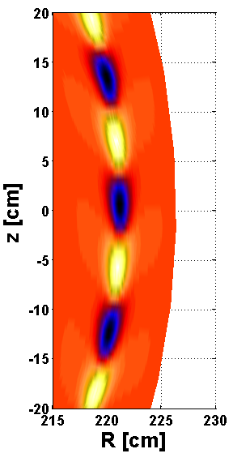
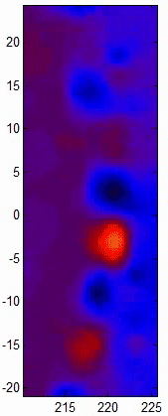






Visualization of ELM dynamics and response to external perturbations via 2D/3D ECEI in KSTAR
Simulated
image
Measured
image
ELMs in KSTAR
Hyeon K. Park
POSTECH,
Pohang, Korea
2D ECEI
window
24th IAEA FEC
Oct. 8 - 12, 2012
San Diego, CA, USA
In collaboration with
M.J. Choi, M. Kim, J. Lee, W. Lee, G.S. Yun (POSTECH), C.W. Domier, N.C. Luhmann, Jr.
(UC Davis), Y.S. Bae, Y.M. Jeon, J.H. Lee, S.W. Yoon (NFRI), I. Joseph, W. Meyer, X.Q. Xu (LLNL), A.J.H. Donné (DIFFER/Eindhoven Univ. of Tech.), W.W. Xiao (SWIP)
Notes:
Mention advantages of the last day talk
Last IAEA - 2D this IAEA – 3D
Real time ELM and simulation result from BOUT++

Slide 2
Outline
Why 2D/3D Visualization (ECEI)?
  Improvement of the predictive capability of complex dynamics of MHDs, Waves and Turbulence
  Verification of the ELMs in KSTAR (ECEI)
    ELM dynamics in KSTAR H-mode plasmas
    Comparison with the BOUT++ simulation results
Response to the external perturbations and comparison w/ the stability model
  Relevancy with the peeling/ballooning mode model
3D imaging on KSTAR & physics issues that can be further verified

Slide 3
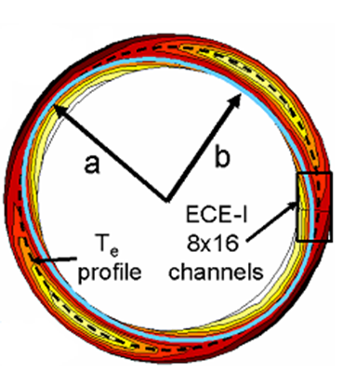
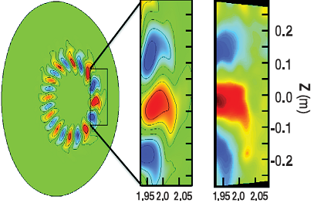
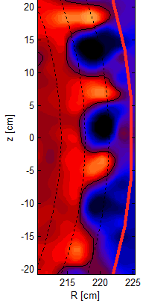
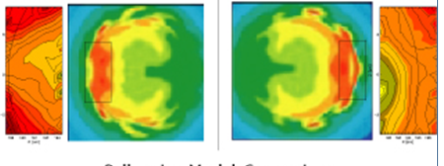
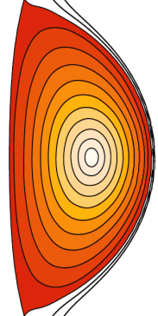

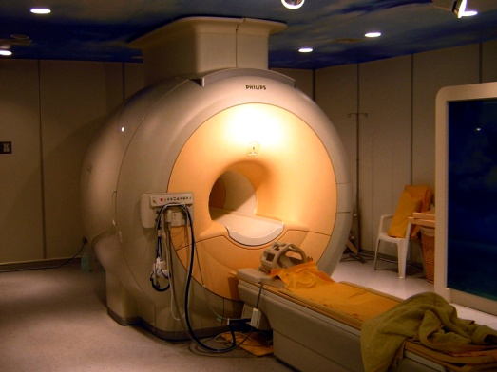
Why 2D/3D visualization (ECEI)?
Improve predictive capability of MHD and wave physics
(e.g. Sawtooth, NTM, Alfvén waves, and ELMs)
Sawtooth crashes (TEXTOR)
H.K. Park et al., PRL (2006)
Tearing modes (TEXTOR)
I. Classen et al., PRL (2007)
Alfvén waves (DIII-D)
B. Tobias et al., PRL (2010)
ELMs (KSTAR)
G.S. Yun et al., PRL (2011)
Test of the Ballooning mode
model
Analogous to evolution of
diagnostic capabilities from
Stethoscope to MRI/CT

Slide 4
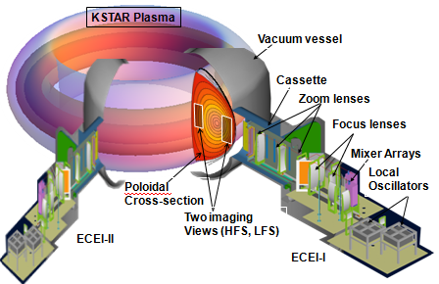
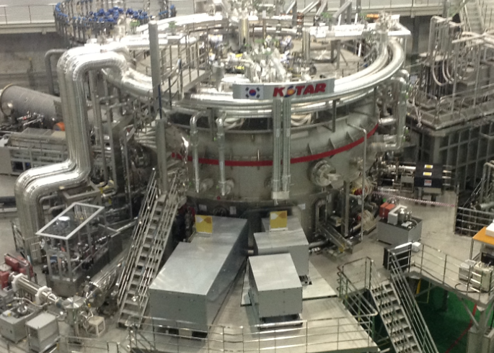
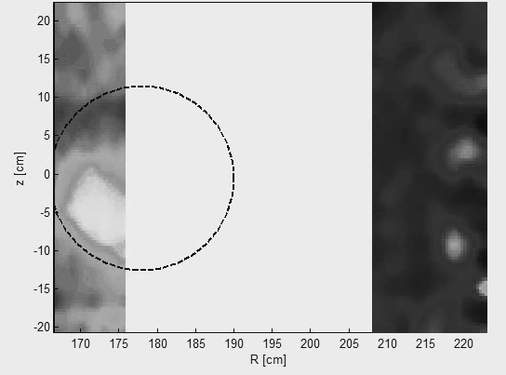
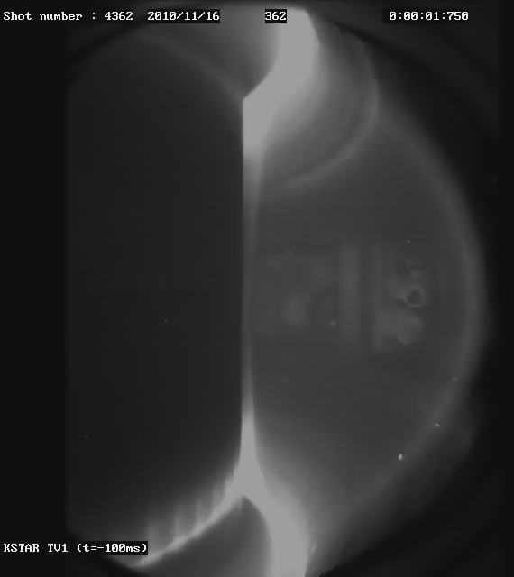

KSTAR 2D/3D ECE imaging systems
H
G
G
H
Comibined
with MIR
KSTAR (2012)
shot 4362
B₀ ~ 2 T
T_{e0} ~ 2 keV
n_{e0} ~ $3×{10}^{19}$ m-³
First simultaneous
2D visualization of the internal kink (m=1)
and
Edge-Localized Modes
(ELMs)
~1m

Slide 5
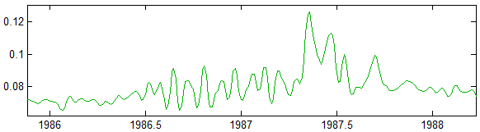
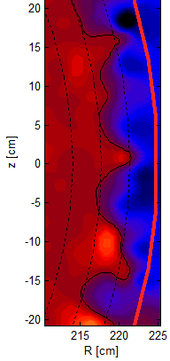
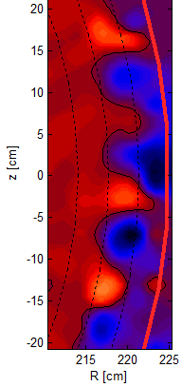
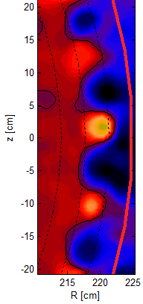
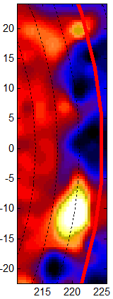

ELM dynamics in KSTAR plasmas
Time evolution of a single ELM
ECEI (V)
4
Shot=4431
2
3
G.S. Yun et al.,
PRL 107 (2011)
1
Initial growth to saturation
Time (ms)
crash phase
1
0 μs
2
100 μs
3
200 μs
4
855 μs

Slide 6
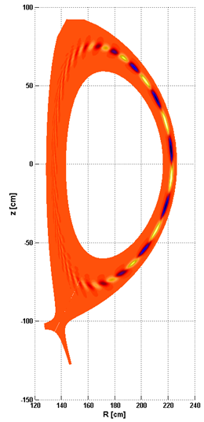
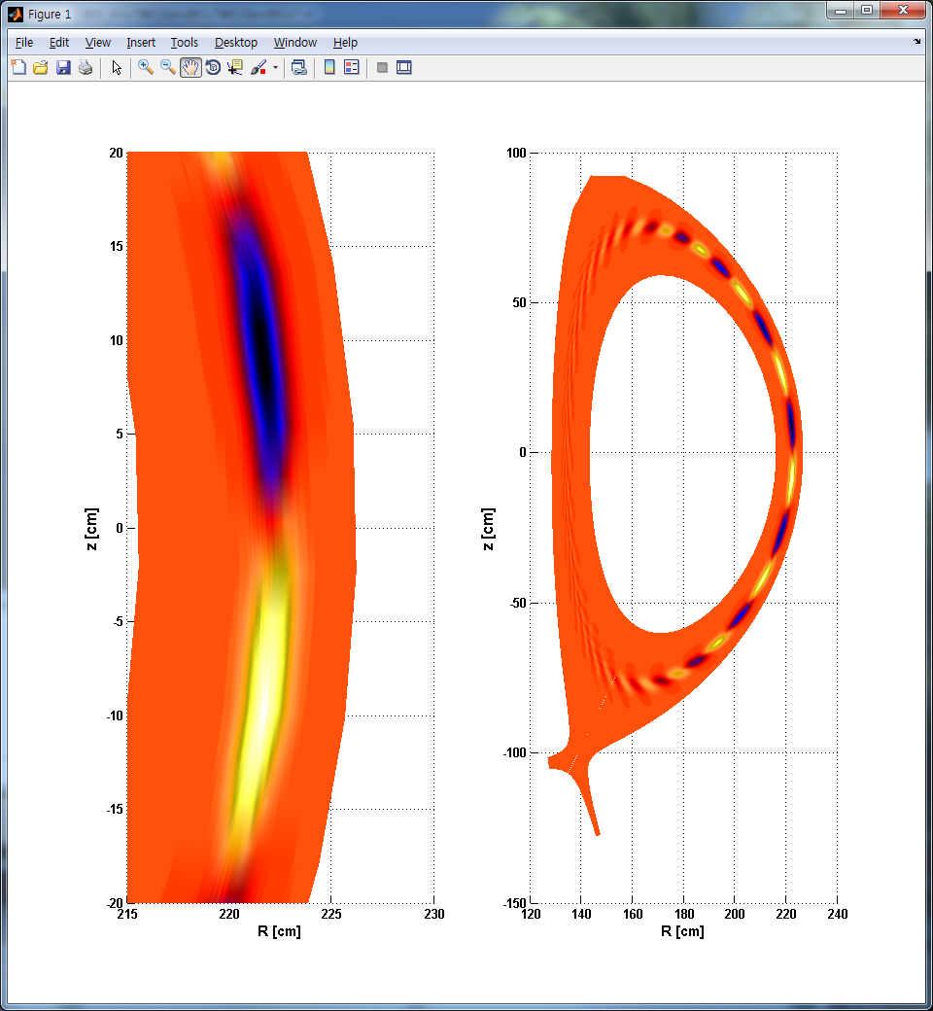
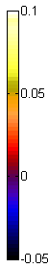
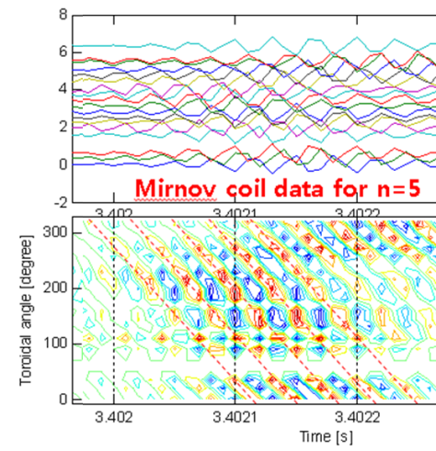

Verification of the stationary ELM
BOUT++ Simulation of the n=5 ELM
2D image of an ELM
Toroidal mode number (n=5) is identified by the magnetics
q- and pressure profiles from EFIT are used to get the 2D image of the n=5 mode w/ the max. growth rate
$$\frac{δT_{ece}}{\left\langle T_{ece}\right\rangle }$$
215
220
225
230
Outcomes
Poloidal mode spacing is
incorrect !
Radial thickness is too thin !
R [cm]
KSTAR shot #6123 @ t~3.6s

Slide 7

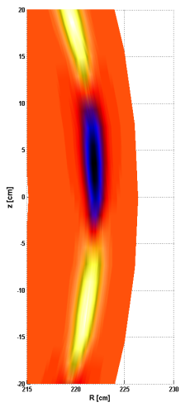
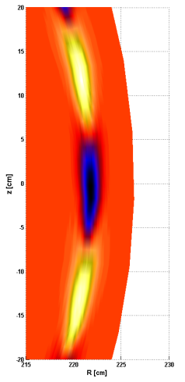
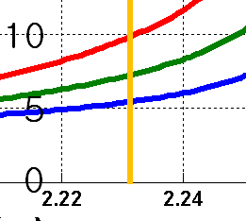

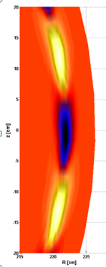
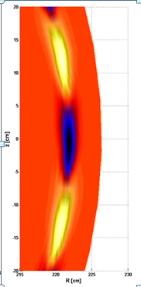
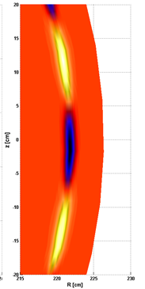

Parametric dependence of the mode structure
A) Poloidal mode spacing is sensitive to the local q-value
#1
#2
#3
Identification of the bootstrap current (J_{b}) due to P’ and ν* changes w/ 3D system !!
B) Radial thickness of the mode and growth rates depends on P’
#1
#2
#4

Slide 8
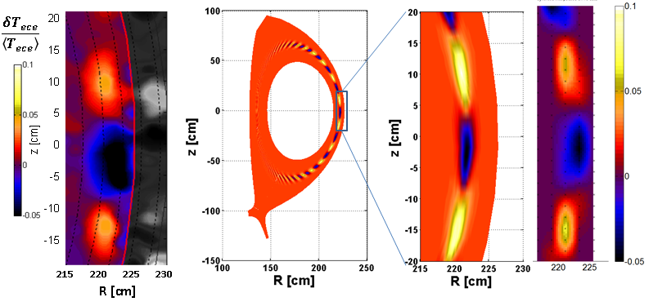
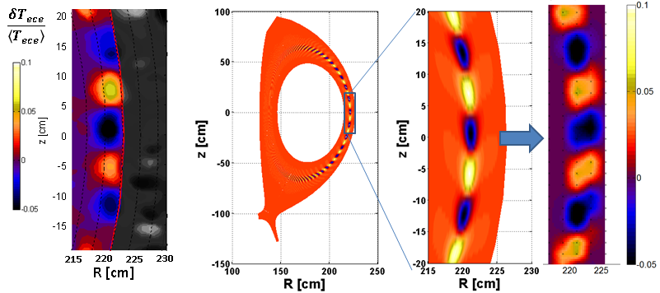
Comparison with the measured 2D images
Measured image
Simulated image
Synthetic image
Synthetic image
Radial resolution of the system (~1 cm) is comparable to the radial thickness of the mode
Broadening of the emissivity
The synthetic 2D images for n=5 and n=10 are in a good agreement with the measured 2D images.
n=5
ELM
n=10
ELM

Slide 9

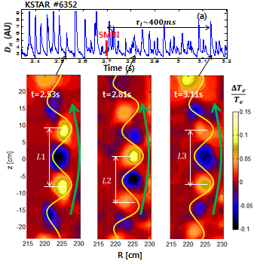
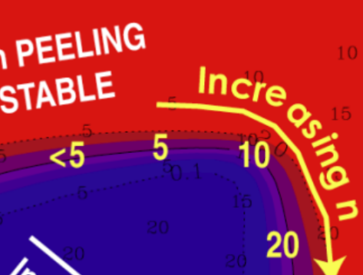





Response of the ELMs to perturbations
Resonant Magnetic Perturbation (n=1)
Supersonic Molecular Beam Injection
A
B
C
A
$$t≈3.12s$$
$$n\sim 10$$
B
$$t≈3.37s$$
$$n\sim 5$$
$$\frac{δT_{ece}}{\left\langle T_{ece}\right\rangle }$$
$$V^{∗}≈1 km/s$$
$$V^{∗}≈12 km/s$$
L1~L3 > L2
RMP case
unstable n~10 to marginally
unstable n~5,10) requires a
reduction of J_{b} & P’ (observed
reductions in P’ & ν*)
No signature of the applied
stochastic magnetic island (i.e.
interference in magnetic
diffusion time scale)
Peeling/Ballooning
mode model (T. Osborne)
SMBI case
L1 – L2 is correlated w/ the [increasedν* (decreased P’)]
L2 – L3 is correlated w/ the [decreased ν* (increased P’)]
No change in n number?
J_{b} change – local q change?
m(q) is in wrong direction !!
Consistent with this model?
Notes:
Low (High) collisionality regimes
n mode change is wrong direction based on P’
m(q) mode change is also in wrong direction

Slide 10

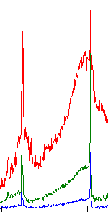
Response of the ELMs from RMP (n=1)
D_{α}(AU)
Pedestal
Te (AU)
RMP
D_{α}(AU)
Unstable n~10 ELM
Marginally stable n~5 and n~10 ELM
Line
density
Te (AU)
3.1 3.2 3.3 3.4 3.5
Time (s)
Transition from stable to marginally stable
Freq.
(KHz))
~35 ms
Te (AU)
Pedestal
ch#5
Time
ELM frequency increases (6 to 8 kHz)
No change in poloidal spacing
of the mode (n~10)
LCFS ch #3
T_{e} gradient increases

Slide 11
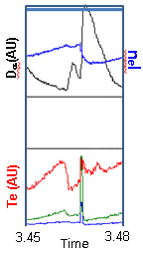
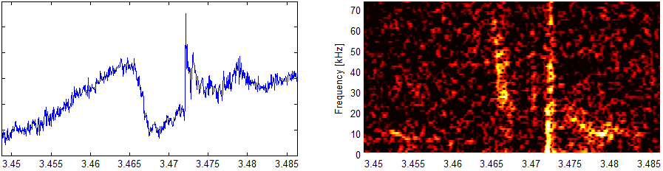
Marginally unstable n~5,10 modes during RMP
Single n=5 ELM
After every crash of the n~5 ELM, small change of p’ & ν*, then the n~10 mode briefly appears.
Peeling dominated regime (low n ) – role of J_{b} is important for marginally unstable n~5 and n~10
Qualitatively consistent with the peeling/ballooning mode model
ELM crash
ELM crash
Te(A.U.)
Freq. (kHz)
Frequency change is due to the change in plasma rotation not toroidal/ poloidal mode number change
Rotation changes from E_{r} ?
E_{r} from charge imbalance ?
Charge imbalance from loss of density (primarily electrons)
n~5
n~5
n~10

Slide 12
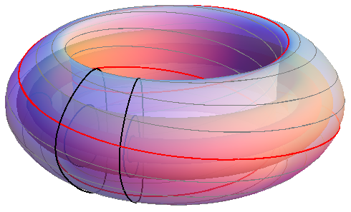
3D imaging in KSTAR
  Equilibrium study (w/ known MHD modes; m=1, m=2, ELM, etc.) (local measurement of q, J_{b}, etc.)
  Toroidal asymmetry and transient bursting
Rotation speeds (toroidal, poloidal, and flow speed)
Heat pulse experiment (short pulse or sharp leading edge)
  Short time scale (t < 10μs) – local pitch angle
  Intermediate time scale (10μs < t < 1ms) - transient asymmetry in “burst” and toroidal mode interference
  longer time scale (10μs < t < 1ms) –
  poloidal, and radial transport
Demonstration of 3D
measurement of the
Tearing Mode with
two ECEI systems
(this week)
Short localized
heat pulse

Slide 13
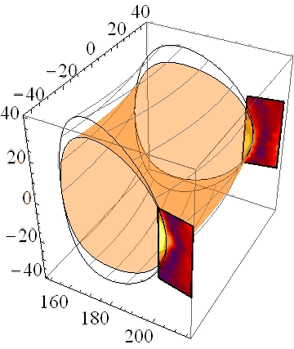
Demonstration of 3D imaging in KSTAR
Raw imaging data are illustrated and 3D analysis is in progress

Slide 14
Summary
Visualization via ECEI is effective for validation of the MHD turbulence and wave physics in tokamak plasmas
Synthetic image from the BOUT++ code verifies the measurement
  Poloidal mode spacing is a sensitive function of the local q value for a fixed toroidal n number [n, m(q)]: P’ is for growth rates.
  Synthetic images (w/ the instrumental and emissivity broadenings) are in good agreement with the measured images
Response of the ELMs to the external perturbations and comparison with stability model
  No continuum of the toroidal mode number in KSTAR configuration
  RMP(n=1) changes the unstable n~10 ELM into marginally unstable n~ 5,10 ELMs and then stabilizes all.
  Mode number changes are qualitatively consistent with the peeling/ballooning mode model
  3D measurement of the local pitch angle change of the ELM is critical (hence the role of J_{b})

